Slide 1
The Technology Value Stream
An Intro

Slide 2
The Techonology Value Stream
What is DevOps?
DevOps integrates developers and operations teams in order to improve collaboration and productivity, by automating infrastructure, automating workflows, and continuously measuring application performance

Slide 3
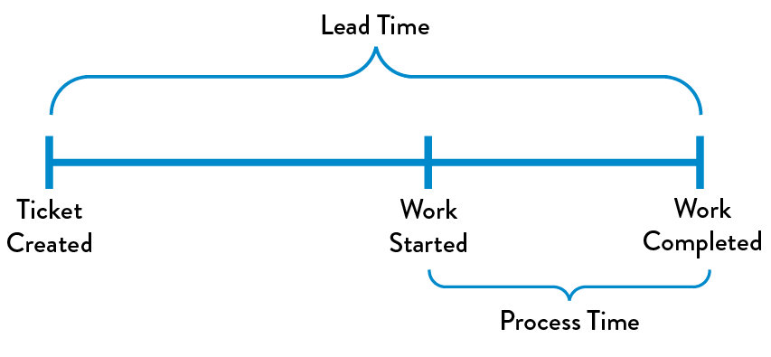
The Techonology Value Stream Cont’d
Defining Lead Time
Lead time is used to measure performance in value streams
Lead time clocking starts when the request is made and ends when it is fulfilled

Slide 4
The Techonology Value Stream Cont’d
Processing Time
Process time starts only when work has began on the customer request
The time between “ticket created” and “work started” is omitted
Lead time is used more often to stay on the perspective that the customer sees

Slide 5
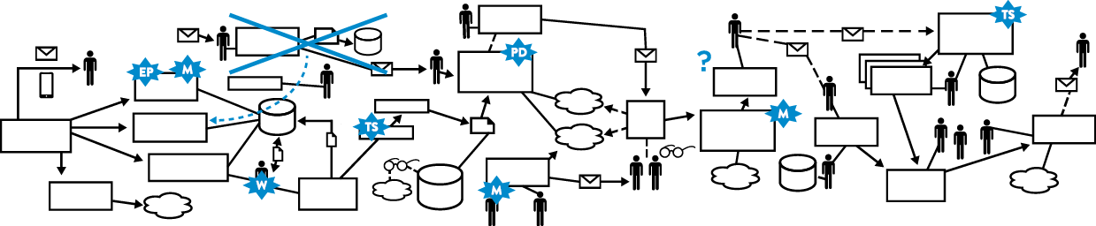
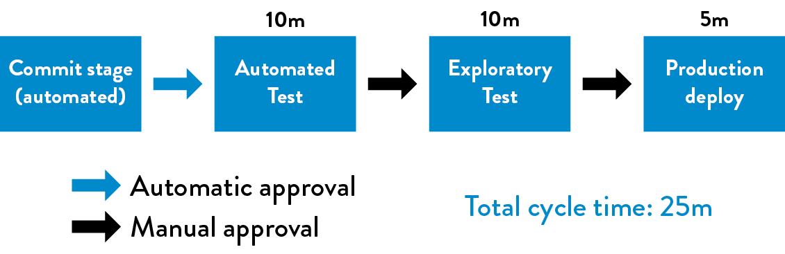
The Techonology Value Stream Cont’d

Slide 6
The Techonology Value Stream Cont’d
The Common Scenario: Deployment Lead Times Requiring Months
All too often projects are developed which may take months then are not tested until the very end
Due to this feedback cannot be provided on fixes until the end of the process
Even worse, if feedback is delayed, it puts the project in a worse off state

Slide 7
The Techonology Value Stream Cont’d
Additionally issues may not be discovered until a merge of all the development team’s code
Sometimes fixing these issues can take days or weeks of investigation putting a severe delay in completion and causing a financial burden
This can cause poor customer communications and take from future business and trust

Slide 8
The Techonology Value Stream Cont’d
Our DevOps Ideal: Deployment Lead Times of Minutes
In an ideal tech development world, developers receive fast & constant feedback on their work
This allows them to quickly & independently implement, integrate, and validate their code
It also helps with quickly deploying the code to the production environment

Slide 9
The Techonology Value Stream Cont’d
When code is continually checked in it is much easier to track, revert, & merge
It is best that code is tracked through some sort of version controlling system like Team Foundation Server, GitHub, Subversion, etc.
If a code problem is found in production, the team can easily roll back the site to a working state

Slide 10
References
Willis, J., Debois, P., Humble, J., & Kim, G. (2016, October). The DevOps Handbook [EPUB]. Retrieved
from https://learning.oreilly.com/library/view/the-devops-handbook/9781457191381/
Micro Focus. (2017, September 12). Understanding the DevOps Transformation [Videoblog post].
Retrieved from https://www.youtube.com/watch?v=Ait2-9NCkpk
Notes:
In Slide Show mode, select the arrows to visit links.

