Slide 1
DevOps Automation Testing
An Intro

Slide 2
DevOps Automation Testing
What is automation testing?
Automation testing is the process of testing the functionality of software in place of a human.
How does it tie in with DevOps?
The idea of DevOps is to keep all processes moving continuously. Testing automation, greatly reduces time delays involved with waiting for human testing.

Slide 3
DevOps Automation Testing
Why use automation testing?
The more proficient the QA specialist or developer can be in assisting the DevOps team in automating their testing for greater delivery efficiency, the more valuable they will make themselves to the organization (Fitzpatrick, 2018).

Slide 4
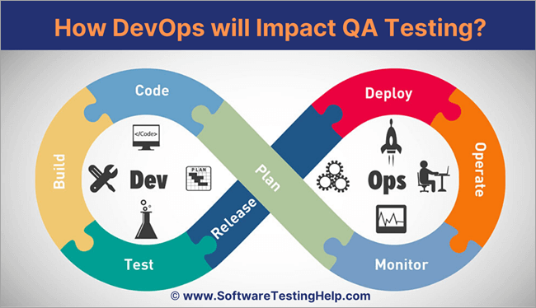
DevOps Automation Testing

Slide 5
DevOps Automation Testing
Continuous delivery (CD) is an approach to application delivery that prioritizes being able to deliver application changes at any point in time (Fitzpatrick, 2018).
When an organization is properly utilizing a strategy of continuous delivery, its applications always exist in a state that can be deployed (Fitzpatrick, 2018).
Through the use of this approach the organization would experience a lower level of risk when releasing changes to an application by doing so incrementally with shorter development cycles (Fitzpatrick, 2018).

Slide 6
DevOps Automation Testing
This process of CD is made possible through the use of continuous testing, which relies heavily on test automation (Fitzpatrick, 2018).
Continuous testing is the process of implementing end-to-end automated testing throughout all possible phases of the delivery lifecycle (Fitzpatrick, 2018).
This process can be utilized with any type of application (mobile, web, etc.) (Fitzpatrick, 2018)
By employing the concept of continuous testing, the DevOps team makes an effort to catch bugs earlier in the development process where they are less expensive to fix (Fitzpatrick, 2018).

Slide 7
DevOps Automation Testing
Application testing is no longer solely the responsibility of the QA specialists associated with the project (Fitzpatrick, 2018).
Developers are responsible for contributing automated test scripts that need to be written and configured to fully test the application, while the Operations side is often responsible for monitoring and smoke testing in environments such as production (Fitzpatrick, 2018).
Automated testing frameworks and data analysis have also opened the door for AI test automation (Fitzpatrick, 2018).

Slide 8
DevOps Automation Testing
As software development organizations make the move to processes that prioritize continuous delivery, the value of implementing continuous testing through test automation continues to rise (Fitzpatrick, 2018).
With the ongoing growth of test automation, it becomes necessary for all involved in software development to maintain a great understanding of the test automation frameworks and tools that make test automation possible (Fitzpatrick, 2018).

Slide 9
DevOps Automation Testing
What are some top DevOps testing tools?
Ranorex
Experitest
Buddy
TestRail
QuerySurge
Jenkins

Slide 10
References
Fitzpatrick, S. (2018, July 19). The Growing Importance of Test Automation Skills in DevOps.
Retrieved January 14, 2020, from saucelabs website: https://saucelabs.com/blog/
the-growing-importance-of-test-automation-skills-in-devops
Guru99. (n.d.). Top 15 DevOps Testing Tools in 2020. Retrieved January 14, 2020, from guru99
website: https://www.guru99.com/devops-testing-tools.html
Notes:
In Slide Show mode, select the arrows to visit links.

