Slide 1
DevOps Continuous Integration
An Intro

Slide 2
DevOps Continuous Integration
What is continuous integration?
Continuous Integration (CI) is the process of automating the build and testing of code every time a team member commits changes to version control (Guckenheimer, 2017).
- CI encourages developers to share their code and unit tests by merging their changes into a shared version control repository after every small task completion (Guckenheimer, 2017).

Slide 3
DevOps Continuous Integration
Why use continuous integration?
CI emerged as a best practice because software developers often work in isolation, and then they need to integrate their changes with the rest of the team’s code base. Waiting days or weeks to integrate code creates many merge conflicts, hard to fix bugs, diverging code strategies, and duplicated efforts. CI requires the development team’s code be merged to a shared version control branch continuously to avoid these problems (Guckenheimer, 2017).

Slide 4
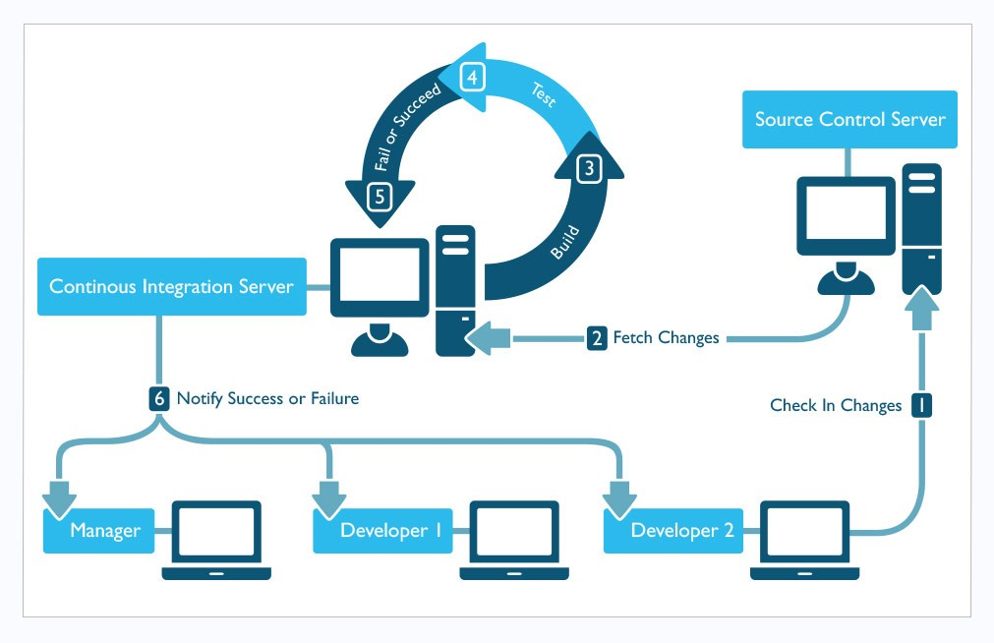
DevOps Continuous Integration
(Cois, 2015)

Slide 5
DevOps Continuous Integration
Pros of continuous integration: (Rasmussen, 2017)
Automation of deployment
Handling different environments & configurations
Integrating smaller increments
Everything is forced to be under source control
Frequent releases
Notification of something being broken

Slide 6
DevOps Continuous Integration
Cons/Troubles with continuous integration: (Rasmussen, 2017)
Everyone has to be on the same page
CI server needs maintenance
Integration becomes one point of failure if something goes wrong
A lot of time is invested in creating & maintaining scripts

Slide 7
DevOps Continuous Integration
A list of some useful tools for continuous integration:
HockeyApp
Jenkins
Apache Gump
BuildBot
Bamboo
CircleCI

Slide 8
DevOps Continuous Integration
- Continuous integration holds a most substantial benefit of risk mitigation (Lee, 2017).
By deferring code integration, teams increasingly compound the number and severity of their merge conflicts (Lee, 2017).
When teams integrate frequently (with an automated build), they reduce the number of potential risks because they always know the current state of their system (Lee, 2017).

Slide 9
DevOps Continuous Integration
Teams that implement continuous integration have greater confidence in their operations (Lee, 2017).
They know the automated build is catching defects immediately, which allows them to promise quality (Lee, 2017).
They aren't guessing the number of bugs in their system either, which allows them to give accurate numbers to their teammates and a better service for their customers (Lee, 2017).

Slide 10
References
Guckenheimer, S. (2017, April 3). What is Continuous Integration? Retrieved January 21, 2020, from
Microsoft website: https://docs.microsoft.com/en-us/azure/devops/learn/
what-is-continuous-integration
Cois, C. A. (2015, January 26). [Continuous Integration]. Retrieved from
https://insights.sei.cmu.edu/devops/2015/01/continuous-integration-in-devops-1.html
Rasmussen, P. D. (2017, December 31). What are the advantages and disadvantages of continuous
integration? Retrieved January 21, 2020, from peterdaugaardrasmussen website:
https://peterdaugaardrasmussen.com/2017/12/31/
what-are-the-benefits-and-disadvantages-of-continuous-integration/
Lee, J. (2017, October 23). The Benefits and Challenges of Continuous Integration. Retrieved January
21, 2020, from DZone website: https://dzone.com/articles/
the-benefits-and-the-drawbacks-of-continuous-integ
Notes:
In Slide Show mode, select the arrows to visit links.

