Slide 1
The Dangers of Change Approval Processes
An Intro

Slide 2
The Dangers of Change Approval Processes
Learn by example:
The Knight Capital failure is one of the most prominent software deployment errors in recent memory. (Willis, Debois, Humble, & Kim, 2016).
A fifteen minute deployment error resulted in a $440 million trading loss, during which the engineering teams were unable to disable the production services. (Willis, Debois, Humble, & Kim, 2016).
Financial losses jeopardized the firm’s operations and forced the company to be sold over the weekend so they could continue operating without jeopardizing the entire financial system (Willis, Debois, Humble, & Kim, 2016).

Slide 3
The Dangers of Change Approval Processes
- John Allspaw stated that when high-profile incidents like such happen, there are typically two counterfactual narratives for why it happened (Willis, Debois, Humble, & Kim, 2016):
1) the accident was due to a change control failure
2) the accident was due to a testing failure

Slide 4
The Dangers of Change Approval Processes
The accident was due to a change control failure
In this case, better change control practices should have taken place
If they had, the risk might have been detected earlier and prevented from a rollout to production
Even if it could not have been prevented, step may have been able to be taken to enable faster detection and recovery

Slide 5
The Dangers of Change Approval Processes
2) The accident was due to a testing failure
With better testing practices the risk could be identified earlier
The risky deployment could have also been canceled
Again maybe steps could have been taken to enable faster detection and recovery

Slide 6
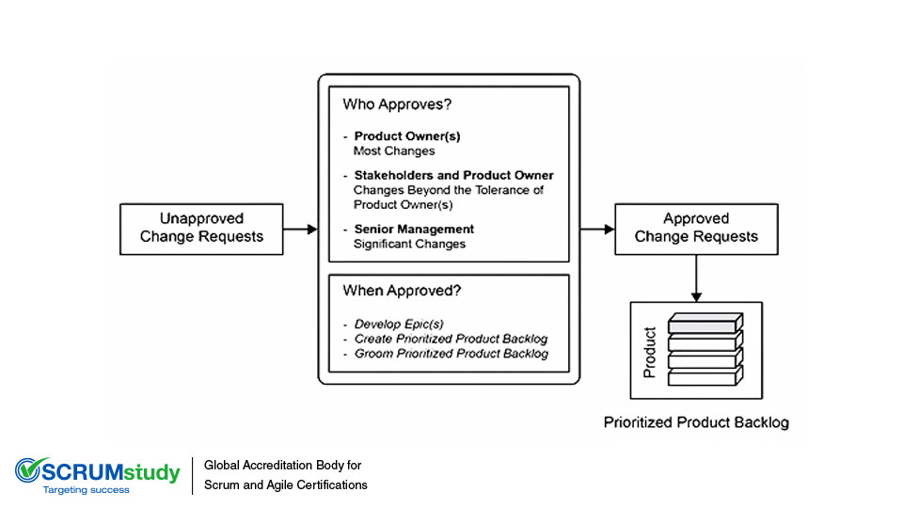
The Dangers of Change Approval Processes
(SCRUMstudy, (n.d))

Slide 7
The Dangers of Change Approval Processes
Environments with low-trust and command-and-control cultures often result in an increased likelihood that problem
Instead, the feature is only done when it is performing as designed in production, without causing excessive escalations or unplanned work for either Development or Operations (Willis, Debois, Humble, & Kim, 2016).

Slide 8
The Dangers of Change Approval Processes
Traditional change controls can lead to unintended outcomes, such as (Willis, Debois, Humble, & Kim, 2016):
contributing to long lead times
reducing the strength
immediacy of feedback from the deployment process.

Slide 9
The Dangers of Change Approval Processes
Often used controls that cause friction listed (Willis, Debois, Humble, & Kim, 2016):
Adding more questions that need to be answered to the change request form
Requiring more authorizations, such as one more level of management approval
Requiring more lead time for change approvals so that change requests can be properly evaluated

Slide 10
References
Willis, J., Debois, P., Humble, J., & Kim, G. (2016, October). The DevOps Handbook [EPUB]. Retrieved
from https://learning.oreilly.com/library/view/the-devops-handbook/9781457191381/
SCRUMstudy. (n.d.). Global Accreditation Body for Scrum and Agile Certifications [Photograph].
Retrieved from http://blog.scrumstudy.com/wp-content/uploads/change-request.jpg
Notes:
In Slide Show mode, select the arrows to visit links.

