Slide 1
Technology vs Business Driven Decisions
An Intro

Slide 2
Technology vs Business Driven Decisions
The eternal fight of business vs technology (Monjo, 2016)
People working on the business side of a company (marketing, finance…) tend to disregard the IT department (Monjo, 2016).
IT members consider too often others as too stupid to understand the basics of technology (Monjo, 2016).

Slide 3
Technology vs Business Driven Decisions
There is only on possible solution to accomplish sophisticated projects: cooperation. Think about the alternatives (Monjo, 2016) :
Projects driven purely by business people, impossible to implement due to technology constraints (Monjo, 2016).
Projects driven purely by technical people, which nobody uses because the business does not find it useful (Monjo, 2016).

Slide 4
Technology vs Business Driven Decisions
Technology Driven Decision Making:
It is great to have a choice and we have never had more choice than we do now, but sometimes it can be overwhelming (Hickey, 2017).
Some decisions are so routine that you won't give them much thought, but difficult and challenging decisions demand much more consideration (Hickey, 2017).

Slide 5
Technology vs Business Driven Decisions
Decision making is increasingly becoming technology driven, while the basic principles might be the same, there are many different techniques and tools that can be used when trying to make a decision (Hickey, 2017).

Slide 6
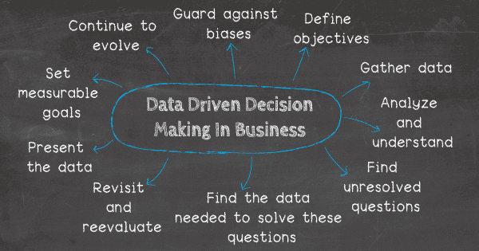
Technology vs Business Driven Decisions
(Durcevic, 2019)

Slide 7
Technology vs Business Driven Decisions
Business Driven Decisions
There is typically more than one approach to resolving a business problem or achieving a business objective (lighthouseis, (n.d)).
a data-supported analysis of the root cause or the real barrier associated with the problem
a process adjustment to permanently eliminate the root cause or barrier
a method for measuring success

Slide 8
Technology vs Business Driven Decisions
A quick resolution that generates short term improvements, for example, might be judged ideal for individuals whose rewards are generated by near-term results, but such an approach may carry with it long term consequences (lighthouseis, (n.d)).

Slide 9
Technology vs Business Driven Decisions
Those stakeholders whose rewards are generated from long-term results will likely select resolutions that generate long-term outcomes (lighthouseis, (n.d)).
If those resolutions take longer to put in place, resolution of short-term difficulties may be delayed, frustrating those who are driven by more immediate rewards (lighthouseis, (n.d)).

Slide 10
References
Monjo, P. (2016, April 12). Business vs Technology. Retrieved February 11, 2020, from pedromonjo
website: https://www.pedromonjo.com/2016/12/business-vs-technology/
Hickey, E. (2017, January 31). Technology Driven Decision Making. Retrieved February 11, 2020, from
dabapps website: https://www.dabapps.com/blog/technology-driven-decision-making/
lighthouseis. (n.d.). Reward Structure: The Source of Subjective Decision Risk. Retrieved February
11, 2020, from lighthouseis website: https://lighthouseis.com/2018/02/20/
business-driven-decisions-maintain-balance-avoid-perilous-subjectivity/
Durcevic, S. (2019, April 16). [Data Driven]. Retrieved from https://www.datapine.com/blog/
wp-content/uploads/2019/04/data-driven-decision-making-in-business.png
Notes:
In Slide Show mode, select the arrows to visit links.

