Slide 1
Change Management as it relates to DevOps
An Intro

Slide 2
Change Management as it relates to DevOps
In DevOps and IT operations, we’re always talking about building incident management plans and speeding up the software delivery lifecycle (Griffith, 2019).
Another common element of IT service management (ITSM) includes change management (Griffith, 2019).
Change management is a tool for preparing people, processes and technology for any kind of organizational change (Griffith, 2019).

Slide 3

Change Management as it relates to DevOps
Change management plans can apply to any industry – but they’re particularly important to the DevOps and IT industry because these are the people maintaining the systems on which everyone works(Griffith, 2019).

Slide 4
Change Management as it relates to DevOps
There are numerous people and processes interacting with technical systems on a day-to-day basis – constantly shipping new code, adjusting network configurations, running automated tests and much, much more. So, defining a change management plan ahead of time can help your team with the identification and installation of required changes to servers, networks and other computer systems (Griffith, 2019).

Slide 5
Change Management as it relates to DevOps
A change management plan allows your team to proactively identify required changes in applications and IT infrastructure and implement those changes. In a DevOps environment, developers and operations teams will collaborate closely, improve workflow visibility and automate much of the configuration, deployment and upkeep process – leading to rapid software delivery that doesn’t hinder reliability or security (Griffith, 2019).

Slide 6
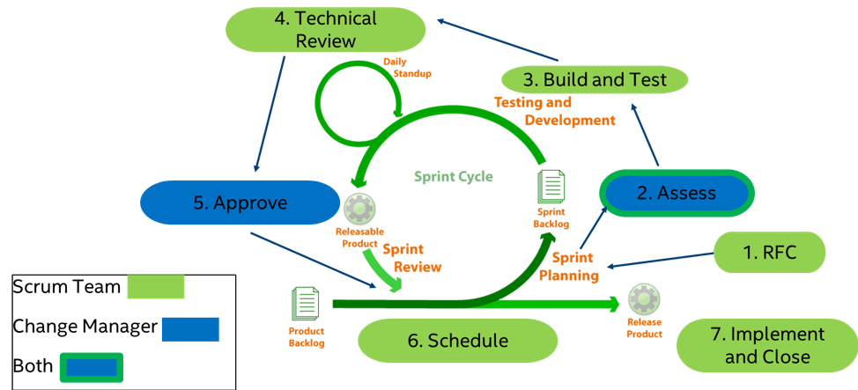
Change Management as it relates to DevOps

Slide 7
Change Management as it relates to DevOps
Crafting your change management plan (Griffith, 2019):
  Why is the change necessary?
  Define the scope of the change
  What benefits do you expect from the change?
  Lay out a schedule and estimated costs of the change
  Build your communication plan
  Establish a monitoring, alerting and incident response strategy
  Track and report on all actions and tasks

Slide 8
Change Management as it relates to DevOps
Change management becomes easier and faster when teams are DevOps-minded (Griffith, 2019).
Through improved collaboration, transparency and automation – DevOps teams are able to make changes faster and more reliably (Griffith, 2019).
Combining the best parts of Agile practices and ITSM lead to software development and IT operations teams who work closely together (Griffith, 2019).
The team will continuously improve on workflow transparency and automation throughout all aspects of engineering and IT (Griffith, 2019).

Slide 9
References
Griffith, B. (2019, June). The Guide to Building a DevOps Change Management Plan. Retrieved February
25, 2020, from VictorOps website: https://victorops.com/blog/
the-guide-to-building-a-devops-change-management-plan
Notes:
In Slide Show mode, select the arrows to visit links.

Slide 10
Thank you
Notes:
In Slide Show mode, select the arrows to visit links.

