Slide 1
OAuth
An Intro

Slide 2

OAuth
What is OAuth?
OAuth is an open-standard authorization protocol or framework that describes how unrelated servers and services can safely allow authenticated access to their assets without actually sharing the initial, related, single logon credential
It is bad practice to give away your password
OAuth solves this by allowing another site to validate you and receives a token verification
OAuth doesn’t share password data
OAuth is an authentication protocol thatallows you to approve one app interacting with another on your behalf

Slide 3
OAuth
History of OAuth
OAuth started around November 2006
Blaine Cook was working on the Twitter OpenID implementation
Chris Messina looking for a way to use OpenID together with the Twitter API to delegate authentication
They met with David Recordon, Larry Halff, and others at a CitizenSpace OpenID meeting to discuss existing solutions
Larry was looking into integrating OpenID for Ma.gnolia Dashboard Widgets
After reviewing existing OpenID functionality, as well as other industry practices, they came to the conclusion that there was no open standard for API access delegation

Slide 4
OAuth
History of Oauth Cont’d
In April 2007, a Google group was created with a small group of implementers to write a proposal for an open protocol
It turned out that this problem wasn’t unique to OpenID
In July 2007 the team drafted an initial specification and the group was opened to anyone interested in contributing
On October 3rd, 2007 the OAuth Core 1.0 final draft was released

Slide 5
OAuth
OAuth 1.0
Transport-independent. Security is not delegated to HTTPS/TLS.
Founded in cryptography, especially digital signatures. Digital signatures are used to prove the integrity and authenticity of a message. Digital signatures can ensure that a certain message was sent from a specific source and that the message and signature were not tampered with in any way. A signed message is tied to its origin. It cannot be tampered with or copied to another source, but client-side implementations can be especially complex
Messages are each individually cryptographically signed. If a single message within the communication is constructed or signed improperly, the entire transaction will be invalidated

Slide 6
OAuth
OAuth 1.0 Flow
Client application registers with provider, such as Twitter
Twitter provides client with a “consumer secret” unique to that application.
Client app signs all OAuth requests to Twitter with its unique “consumer secret.”
If any of the OAuth request is malformed, missing data, or signed improperly, the request will be rejected.

Slide 7
OAuth
OAuth 2.0
Transport-dependent. Most security defenses are delegated to HTTPS/TLS. A typo, an improper TLS configuration, a failure to properly validate a certificate, or vulnerabilities in an underlying library can lead to a man-in-the-middle (MitM) attack, compromising all OAuth communications.
Centered around bearer tokens. These are easy for integration but not great for security. Bearer tokens do not provide internal security mechanisms. They can be copied or stolen but are easier to implement.
Much easier to work with. OAuth 2.0 is much more usable, but much more difficult to build securely.
Much more flexible. OAuth 1.0 only handled web workflows, but OAuth 2.0 considers non-web clients as well.
Better separation of duties. Handling resource requests and handling user authorization can be decoupled in OAuth 2.0.

Slide 8
OAuth
OAuth 2.0 Flow
Client application registers with provider, such as Twitter.
Twitter provides client with a “client secret” unique to that application.
Client application includes “client secret” with every request commonly as http header.
If any of the OAuth request is malformed, missing data, or contains the wrong secret, the request will be rejected.

Slide 9
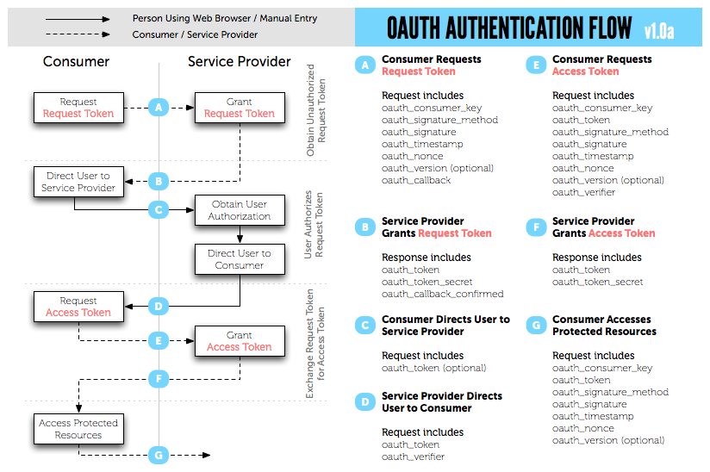
OAuth

Slide 10
References
Grimes, R. A., & Fruhlinger, J. (2019, September 20). What is OAuth? How the open authorization
framework works. Retrieved December 4, 2019, from csoonline website: https://www.csoonline.com/
article/3216404/what-is-oauth-how-the-open-authorization-framework-works.html
SOBERS, R. (2018, August 30). What is OAuth? Definition and How it Works. Retrieved December 4,
2019, from varonis website: https://www.varonis.com/blog/what-is-oauth/
Hammer-Lahav, E. (2007, September 5). Introduction. Retrieved December 4, 2019, from oauth website:
https://oauth.net/about/introduction/
Synopsys Editorial Team. (2016, March 11). What's the difference? OAuth 1.0 vs OAuth 2.0. Retrieved
December 4, 2019, from synopsys website: https://www.synopsys.com/blogs/software-security/
oauth-2-0-vs-oauth-1-0/
nijikokun. (n.d.). The OAuth Bible. Retrieved December 4, 2019, from http://oauthbible.com/
Notes:
In Slide Show mode, select the arrows to visit links.

