Slide 1
Service Oriented Architecture & Enterprise Service Bus
An Intro

Slide 2
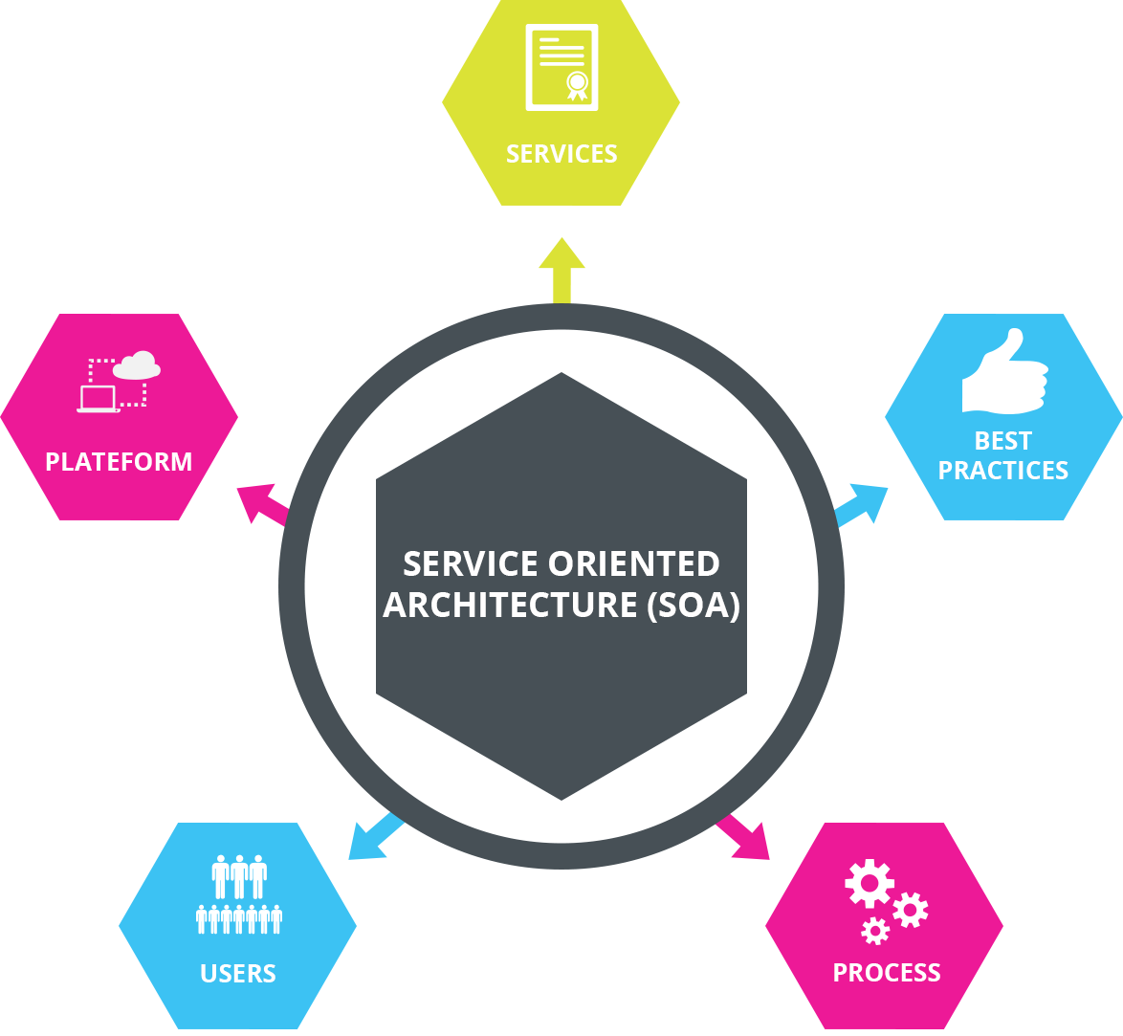
What is Hypermedia Design?
What is Service Oriented Architecture?
Service-Oriented Architecture (SOA) is an architectural approach in which applications make use of services available in the network
In this architecture, services are provided to form applications, through a communication call over the internet
SOA allows users to combine a large number of facilities from existing services to form applications.
SOA encompasses a set of design principles that structure system development and provide means for integrating components into a coherent and decentralized system.
SOA based computing packages functionalities into a set of interoperable services, which can be integrated into different software systems belonging to separate business domains.

Slide 3
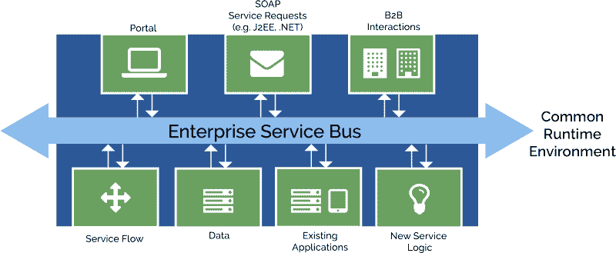
Hypermedia Design Cont’d
What is Enterprise Service Bus?
An Enterprise Service Bus (ESB) is fundamentally an architecture.
It is a set of rules and principles for integrating numerous applications together over a bus-like infrastructure.
ESB products enable users to build this type of architecture, but vary in the way that they do it and the capabilities that they offer.
The core concept of the ESB architecture is that you integrate different applications by putting a communication bus between them and then enable each application to talk to the bus
This decouples systems from each other, allowing them to communicate without dependency on or knowledge of other systems on the bus.

Slide 4
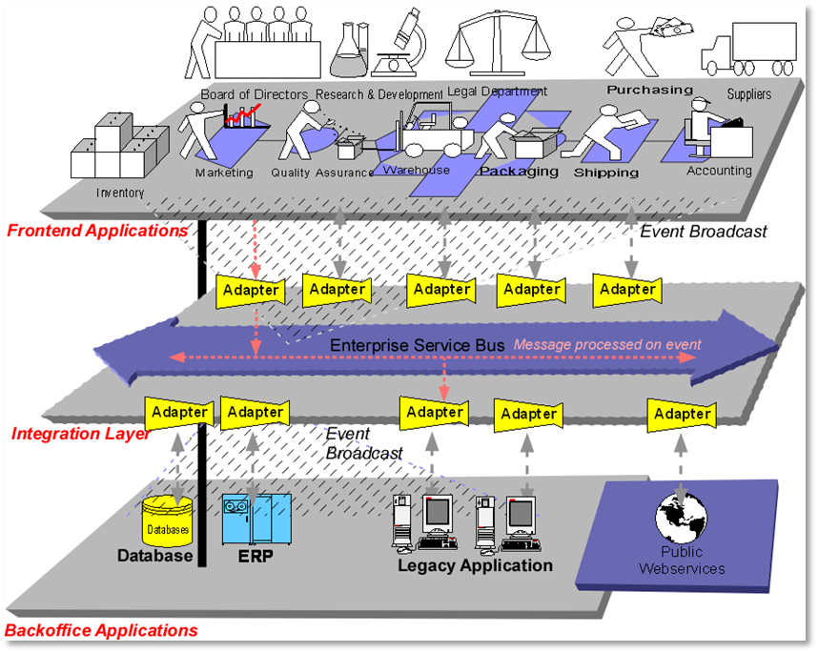
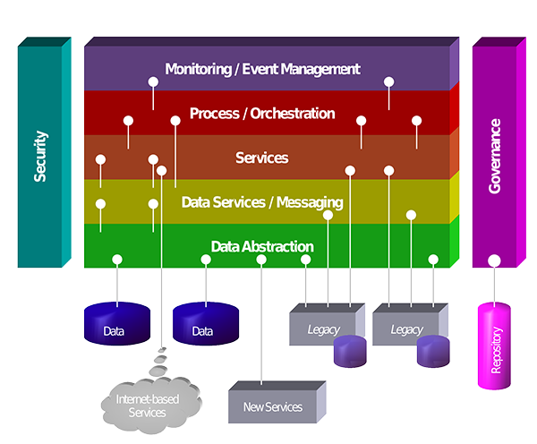
Hypermedia Design Cont’d
Relationship between an ESB and SOA architecture
In SOA services are decoupled and can interact with each other irrespective of the service type.
The key principle of SOA was to design and build enterprise IT architecture around services rather than complete applications.
SOA provides transactional data transfers with no third-party software required
SOA’s primary function is the integration of services and the development of applications.
ESB provides integration of enterprise applications and services for complex architectures
ESB can still follow SOA principles without a consumer
ESB forms the backbone of SOA architecture

Slide 5
Hypermedia Design Cont’d
How data is transmitted through a SOA environment
Service-oriented architecture can be implemented with web services
Data is transferred through
SOAP
REST
Data can be sent through HTTP, FTP, & SMTP protocols
Since a service remains independent of software, the language is platform agnostic

Slide 6
Hypermedia Design Cont’d
The advantages of a SOA architecture
Services are reusable
Maintenance is easy
Reliable
Scalable
Platform independent
Add increased productivity
Same directory structure
Prevent reinventing the wheel

Slide 7
Hypermedia Design Cont’d
The disadvantages of a SOA architecture
Extra overload – all inputs are validated before it is sent to the service
High cost – in terms of human resource, development, and tech
High bandwidth usage
Complex service management – need to ensure that messages have been delivered in a timely manner
High investment cost – requires large up front cost

Slide 8
Hypermedia Design Cont’d
How software in a SOA architecture is deployed and managed in a production environment
Services are deployed
Each software is separately deployed and maintained
The technologies installed facilitate components communications and cooperation over a network
To manage SOA, you should regularly:
Test products by using test scripts for verifying the quality of services
Use management tools to monitor service performance and availability
Use XML appliances to offload SML processing, validation, and tranformation

Slide 9
Hypermedia Design Cont’d
How to scale a SOA environment
As the architecture grows, the need of human resource will as well
Additionally the bandwidth needed on the servers will grow also
If not scaled properly a bottleneck in traffic can happen causing memory to run out or network slow downs
Consider deploying dedicated appliances that take over chores like
XML transformation
Routing
Security

Slide 10
References
SarthakGarg. (n.d.). Service-Oriented Architecture. Retrieved November 26, 2019, from Geeks
For Geeks website: https://www.geeksforgeeks.org/service-oriented-architecture/
Mulesoft. (n.d.). What is an ESB? Retrieved November 26, 2019, from Mulesoft website:
https://www.mulesoft.com/resources/esb/what-esb
Pearlman, S. (2016, October 3). Enterprise Service Bus vs Traditional SOA. Retrieved November 26,
2019, from Mulesoft website: https://blogs.mulesoft.com/dev/connectivity-dev/esb-vs-soa/
innovativearchitects. (n.d.). Key Differences between ESB, EAI and SOA. Retrieved November 26, 2019,
from innovativearchitects website: https://www.innovativearchitects.com/KnowledgeCenter/
business-connectivity/ESB-EAI-SOA.aspx
Hughes, A. (2018, June 5). The Ins and Outs of a Service-Oriented Architecture (SOA). Retrieved
November 26, 2019, from cleo website: https://www.cleo.com/blog/
knowledge-base-soa-service-oriented-architecture
Rehman, J. (n.d.). Advantages and disadvantages of service oriented architecture (SOA). Retrieved
November 26, 2019, from itrelease website: http://www.itrelease.com/2018/10/
advantages-and-disadvantages-of-service-oriented-architecture-soa/
Takale, S. (2018, April 9). Advantages and Disadvantages of Service-oriented Architecture (SOA).
Retrieved November 26, 2019, from techspirited website: https://techspirited.com/
advantages-disadvantages-of-service-oriented-architecture-soa
Bednarz, A. (2006, November 14). The art of managing an SOA. Retrieved November 26, 2019, from
networkworld website: https://www.networkworld.com/article/2301023/
the-art-of-managing-an-soa.html
Notes:
In Slide Show mode, select the arrows to visit links.

