Slide 1
Hypermedia Design
An Intro to Hypermedia Design

Slide 2
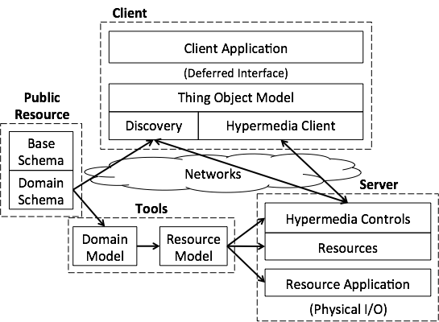
What is Hypermedia Design?
Meeting your business requirements inevitably requires that you extend an existing standard, or design something completely new.
It is best to follow some sort of design pattern to create a sustainable, easy to update, easy to use API
Giving an API the ability to be flexible and easy to use will add to ROI (Return on Investment)
Adding these types of features, will
cut down on development costs
Maintainability
If it is well documented, customer support
To achieve this, a strict step process guideline should be followed and this is where the Seven-Step Design Procedure comes in

Slide 3
Hypermedia Design Cont’d
STEP 1: LIST THE SEMANTIC DESCRIPTORS
List all the pieces of information a client might want to get out of an API
This is comprised of a list of all semantic descriptors or possible requests the client might need to make
Organize into a hierarchal view where applicable
Examples for a game where a penguin can move ice blocks might be:
A container
Left move
Right move
Push block

Slide 4
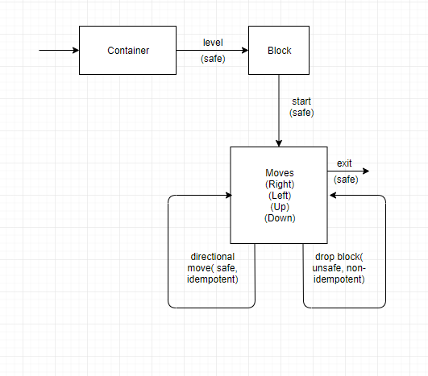
Hypermedia Design Cont’d
STEP 2: DRAW A STATE DIAGRAM
Draw a state diagram for the API
This diagram will show how the semantics are related
Anything important enough to be the topic of a client-server conversation should be a resource with its own URL
Steps one and two sets the way for protocol semantics or which requests the client will be making to send bits of data back and forth

Slide 5
Hypermedia Design Cont’d
STEP 3: RECONCILE NAMES
Reuse existing semantics in API whenever possible, in other words, use useful predefined names where possible
There is a list of registered link relations on the IANA site consisting of simple easy to understand names thought of by many people before for simplicity
The API should use existing features of the HTTP protocol to improve the semantics of input and output such as HTTP Verbs, HTTP Status Codes, and HTTP Authentication
Using name that have already been registered adds ease of use to consumers
There is less of a chance for a misunderstanding
Not to mention, several people have already been through your scenario and came together to decide what the best standards would be
It is highly unlikely that your problem is that unique

Slide 6
Hypermedia Design Cont’d
STEP 4: CHOOSE A MEDIA TYPE
Choose a compatible media type that plays well with both application & protocol semantics
If none do, create a new one
(JSON does not contain hypermedia capabilities)
Use a hypermedia that supports transitions such as adding, editing, deleting items in a collection
In many cases, Collection+JSON, AtomPub, or OData suffices
Using a media type will help to ensure data structures are in correct format

Slide 7
Hypermedia Design Cont’d
STEP 5: WRITE A PROFILE
Write a profile that documents your application semantics
The document should explain all strings, registered link relations, and strings explained by the media type
Add a link to that profile in the HTML portion of your page with rel set to profile so the user knows it is a profile
Add additional links to more profiles to explain the representation’s application semantics
For my penguin block game, I might have links like so
<link rel="profile" href="http://erniephillips/penguingame"/>
<link rel="profile" href="/penguingame.json"/>

Slide 8
Hypermedia Design Cont’d
STEP 6: IMPLEMENTATION
Follow closely the diagram from step 3 and write out the code to handle request and appropriate responses
The responses will consist of the formatting specified in step 4
This is where the other steps really start to show
Program your API in what ever language you have chosen
Spot check and unit test API frequently

Slide 9
Hypermedia Design Cont’d
STEP 7: PUBLICATION
The API needs to be published and have a URL to reference it
The URL is arguably the most important, because it is the gateway to the API
Once published, this is the URL you will send to clientele
The clientele will then be able to consume your API
They most likely will use them in their own custom applications
But may also use your API for misc other reasons

Slide 10
References
Ruby, S., Amundsen, M., & Richardson, L. (2013). RESTful Web APIs [PDF]. Retrieved from
https://learning.oreilly.com/library/view/restful-web-apis/9781449359713/ch08.html
Notes:
In Slide Show mode, select the arrows to visit links.

