Slide 1
Microservices
An Intro

Slide 2
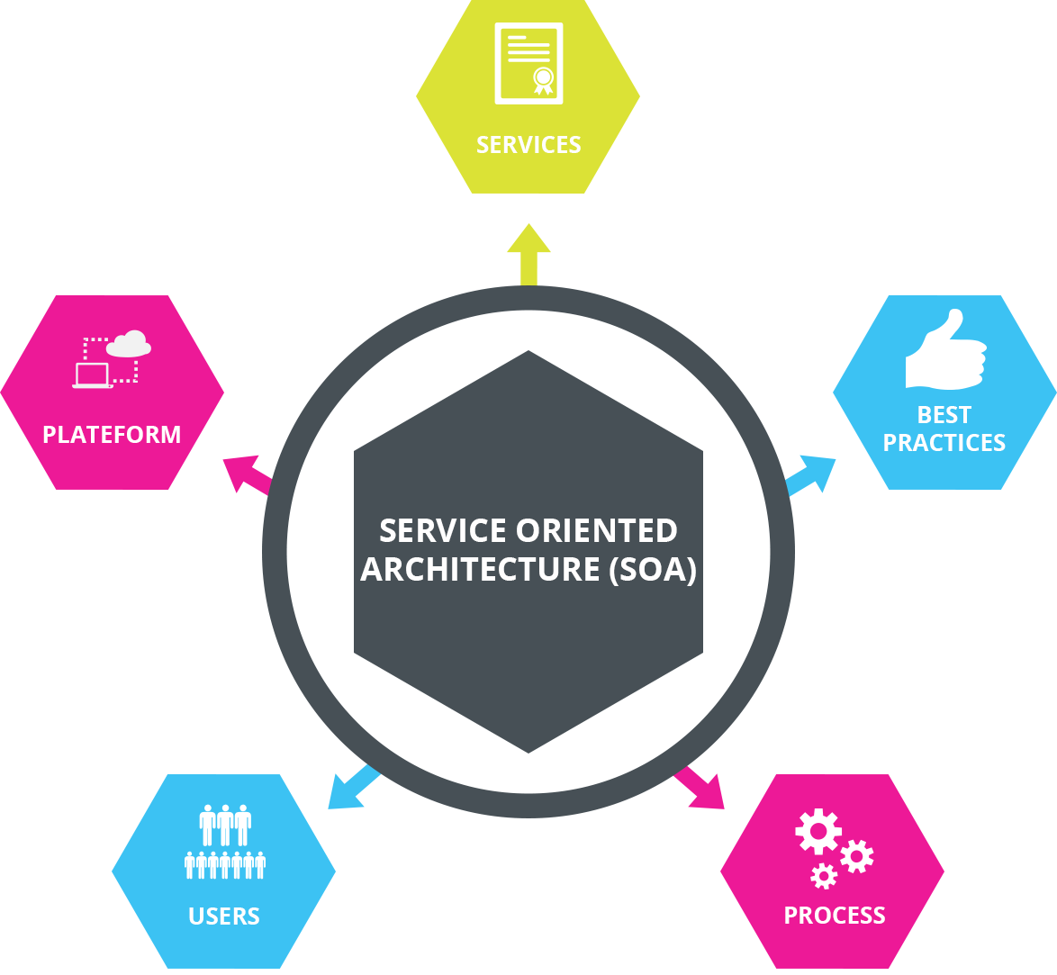
Microservices
What are microservices?

Slide 3
Microservices
What is an API gateway?

Slide 4
Microservices
What are the advantages of Microservices?

Slide 5
Microservices
What are the disadvantages of Microservices?

Slide 6
Microservices
How are Microservices deployed and managed in a production environment

Slide 7
Microservices
How are Microservices scaled?

Slide 8
Microservices

Slide 9
Microservices

Slide 10
References
SarthakGarg. (n.d.). Service-Oriented Architecture. Retrieved November 26, 2019, from Geeks
For Geeks website: https://www.geeksforgeeks.org/service-oriented-architecture/
Mulesoft. (n.d.). What is an ESB? Retrieved November 26, 2019, from Mulesoft website:
https://www.mulesoft.com/resources/esb/what-esb
Pearlman, S. (2016, October 3). Enterprise Service Bus vs Traditional SOA. Retrieved November 26,
2019, from Mulesoft website: https://blogs.mulesoft.com/dev/connectivity-dev/esb-vs-soa/
innovativearchitects. (n.d.). Key Differences between ESB, EAI and SOA. Retrieved November 26, 2019,
from innovativearchitects website: https://www.innovativearchitects.com/KnowledgeCenter/
business-connectivity/ESB-EAI-SOA.aspx
Hughes, A. (2018, June 5). The Ins and Outs of a Service-Oriented Architecture (SOA). Retrieved
November 26, 2019, from cleo website: https://www.cleo.com/blog/
knowledge-base-soa-service-oriented-architecture
Rehman, J. (n.d.). Advantages and disadvantages of service oriented architecture (SOA). Retrieved
November 26, 2019, from itrelease website: http://www.itrelease.com/2018/10/
advantages-and-disadvantages-of-service-oriented-architecture-soa/
Takale, S. (2018, April 9). Advantages and Disadvantages of Service-oriented Architecture (SOA).
Retrieved November 26, 2019, from techspirited website: https://techspirited.com/
advantages-disadvantages-of-service-oriented-architecture-soa
Bednarz, A. (2006, November 14). The art of managing an SOA. Retrieved November 26, 2019, from
networkworld website: https://www.networkworld.com/article/2301023/
the-art-of-managing-an-soa.html
Notes:
In Slide Show mode, select the arrows to visit links.

