Slide 1
CryptoBot
Authors: Sam McKay, Samuel White, Ernest Duckworth

Slide 2
Introduction
Many people in today’s society dream of the ability to make passive income, but in reality many avenues that earn a little extra pocket change require a large initial investment or the undivided attention of the user. These barriers to entry are what our team has made an effort to remedy. Through the use of a Raspberry Pi, the user now has the ability to trade Cryptocurrency without being directly involved. This will give them an opportunity to generate passive income. Once the Pi is up and running, it can be a hands-off experience, the bot will do the hard work. However, the user will still be able to interact with a GUI to input what Coins to buy or sell and determine how much money to put in. Once the bot has begun, multiple threads will be created to scan coins, analyze the data of those coins, and decide whether to buy, sell, or wait.

Slide 3
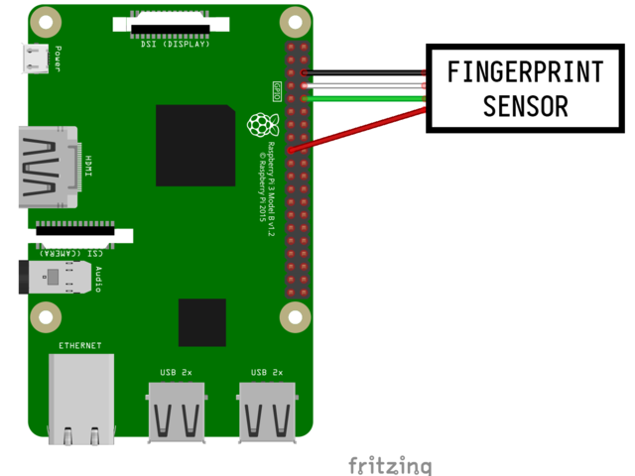
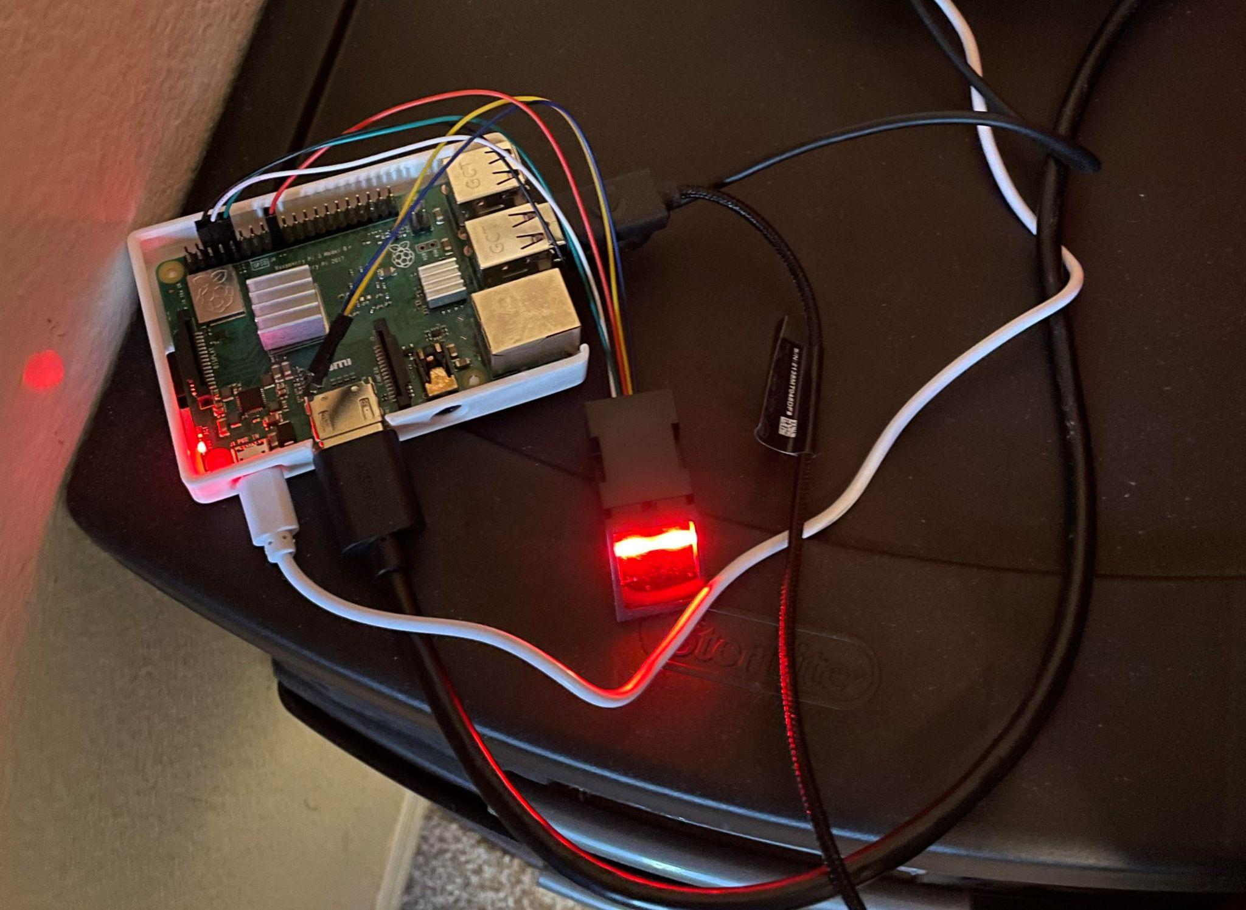
Fingerprint Sensor
The external sensor used for this project is a DiyMall adafruit-compatible fingerprint sensor. Initially we designed the sensor to be inserted through the USB ports on the Raspberry Pi, but due to a mysterious problem that rendered our ttyUSB0 port unusable we decided to use the pins of the raspberry pi to manually mount the fingerprint sensor to the ttyS0 serial port. The fingerprint data is stored on the sensor itself, so moving the fingerprint sensor to a different computer shouldn’t impede the ability to use it.
Fig.1a. Pins for Fingerprint Scanner
Fig.1b. Raspberry Pi with Fingerprint Scanner

Slide 4
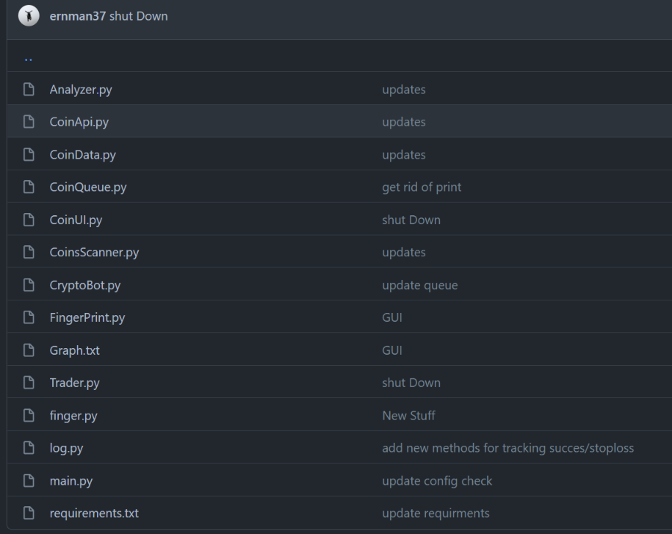
Cryptobot Code
The Cryptobot will have 4 threads. Each thread will be allocated to the:
GUI
Coin Scanner
Coin Analyzer
Coin Trader
This will ensure maximum performance and efficiency for each stage of the trading process.
Fig.2. File Hierarchy for Cryptobot

Slide 5
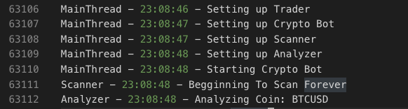
Starting of Threads
Shown below is the start of the bot
It can be seen that the threads are starting up
The scanner threads starts scanning forever since there will always be new data to grab
Fig.3. Terminal Output of the Raspberry Pi Starting

Slide 6
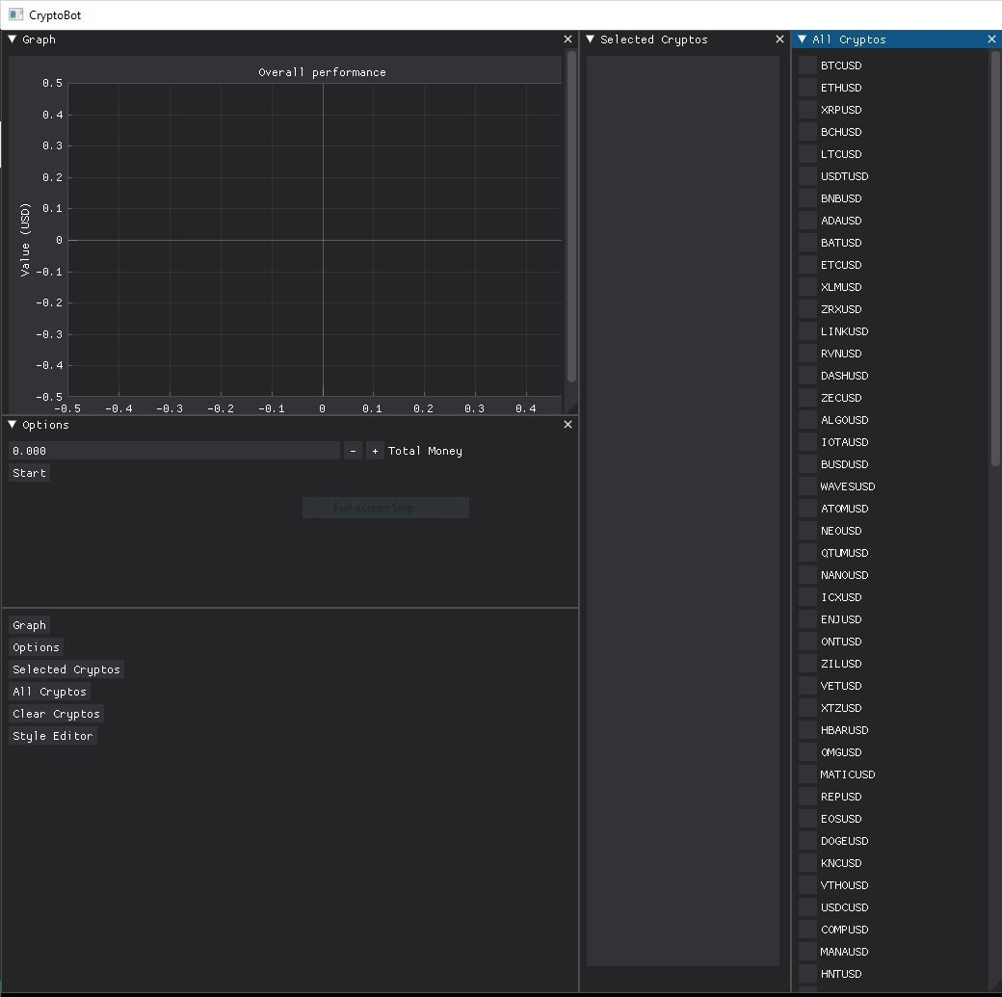
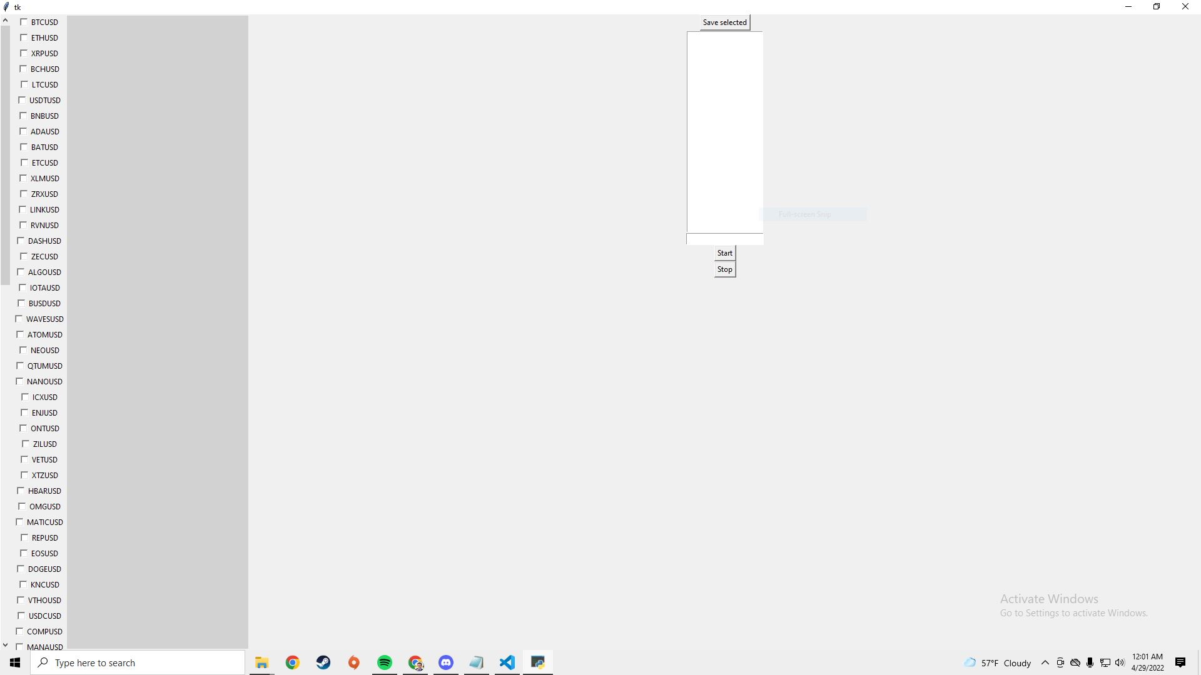
Graphical User Interface
Initially the goal was to use DearpPyGui for the graphical user interface, but upon implementation of the original GUI, we realized that DearPyGUI requires OpenGL to render frames, but can’t initialize itself in the Raspbian environment unless the Raspbian is running in “Legacy” mode, which is devoid of OpenGL. Due to this, a new, extremely lightweight GUI was created in Tkinter to give users the ability to select their own cryptos, insert their initial investment, then start or stop the bot when they desire. When the user stops the bot a “Graph.txt” file will be created, and the user can run “Grapher.py” to see a plot of their investment over time.
Fig.4. Current GUI Crypto Selection

Slide 7
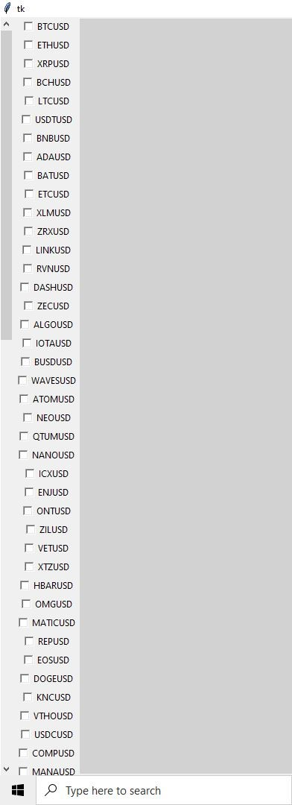
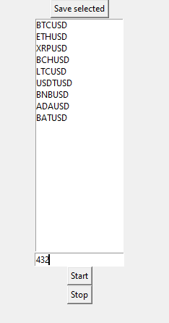
Selection
When the UI is created, the user is prompted to select from a list of cryptos. When they select a crypto currency from the checklist and click “Save selected” or “Start”, an array of the selected cryptos is created and can be used to start the threads that are responsible for buying and selling the coins.
Fig.5a. Selection List of Cryptocurrencies
Fig.5b. List of Currently Selected Currencies

Slide 8
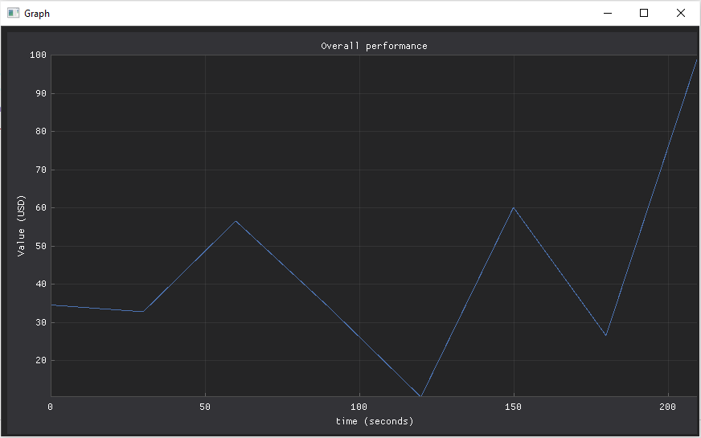
Graph
Initially the desire was to have a graph that would update every 30 seconds with new information regarding the user’s investment, but because of the hardware limitations of the Raspberry Pi we decided that for the longevity of the bot we would simply create a “Graph.txt” file that contains an x axis (time in 30 second increments) and a y axis (growth or decay of initial investment in USD), then afterward give the user the option to graph their data and zoom into it with a stable Dearpygui renderer.
Fig.6. Dearpygui Graph With Coin Value Overtime

Slide 9
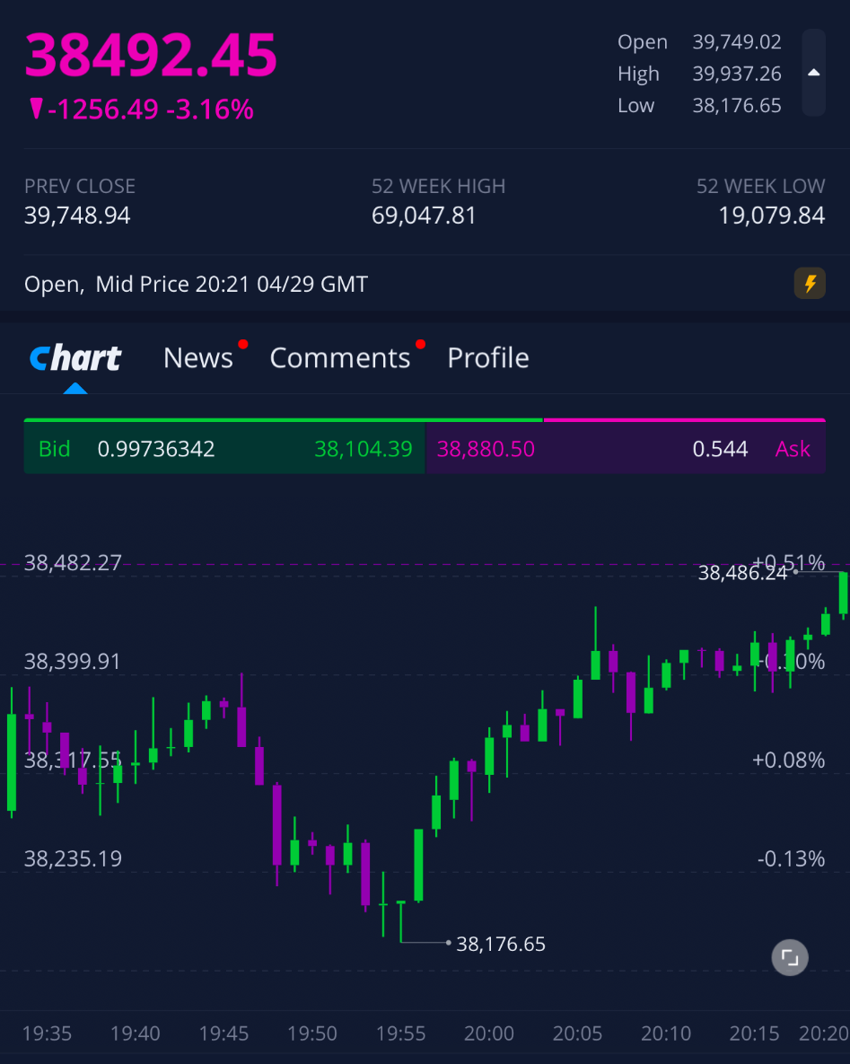
Coin Scanner
The purpose of the coin scanner is to periodically gather coin data. These intervals could range anywhere from every minute to every fifteen minutes.
The data that is gathered from these Coins are candles. These candles show the high, low, open and close prices for a coin over a specified time interval.
Fig.7. Bitcoin Candles -> 4/29

Slide 10
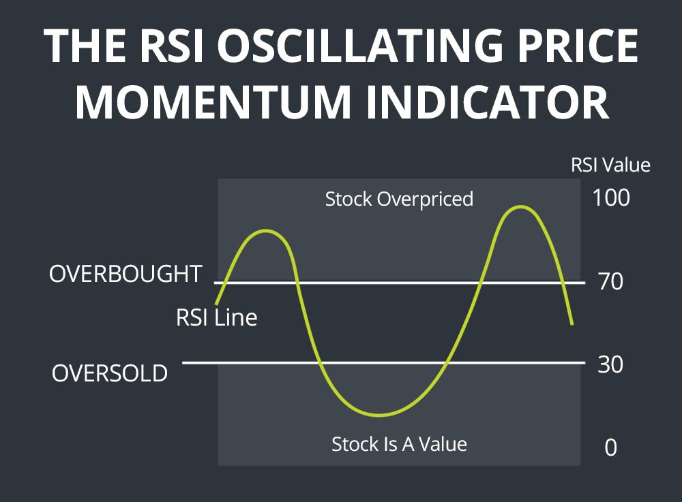
Coin Analyzer
The sole purpose of the Analyzer is to take in data from the Scanner and determine if the bot needs to buy or sell the coin.
The two ways this is accomplished is through weighted values and Relative Strength Index (RSI).
Following the graph, if the RSI is high, the bot will sell. If the RSI value is low, the stock is oversold and the bot will buy.
Fig.8. How RSI Works

Slide 11
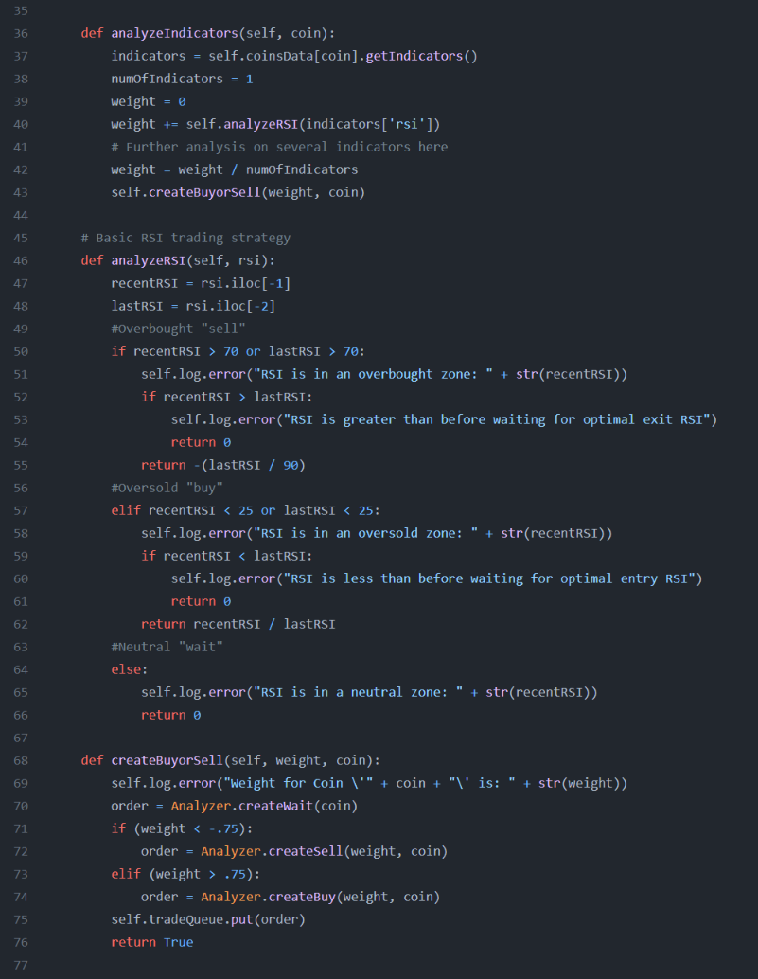
Analyzer Code
The analyzer takes in an indicator for a specific coin that is then passes onto a function that will determine the weight.
The functions checks to see if RSI > 70, and if so, returns a small weight value.
Otherwise, it is oversold and produces a larger weight value.
This weight value is then passed on to determine if the bot needs to buy or sell.
Fig.9. Code that Runs Analyzer

Slide 12
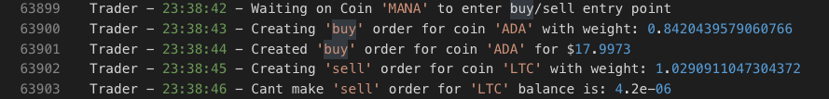
Trader
From the outside, the Trader has the simplest job. Based on the weight, determine if we need to buy, sell, or hold the coin and then execute that trade if necessary.
Trader also has to determine how much to buy or sell. Check if there are funds in the account and determine if the trade was a success or failure.
Based on these actions the Trader also gives this data to the GUI to show the user what has happened.
Fig.10. Terminal Output of Bot Creating Trades

Slide 13
Conclusion
We set out to create an alternative way to generate passive income. With a cheap, small, efficient Raspberry Pi 4, we have successfully developed a way for others to create money on the side while never having to intervene. There is no guarantee this will generate money 100% of the time, but we have generated a solution that will, hopefully, alleviate some people’s financial troubles.
Fig.11. Repeat of Fig.1b.

