Slide 1
How to view full-stack chromatin state annotations data on the genome browser
Ha Vu
02/26/2023

Slide 2
1. Visit the UCSC genome browser website
Note, for us, using Google Chrome as the browser hid away multiple panels of the browser, so we used Safari

Slide 3
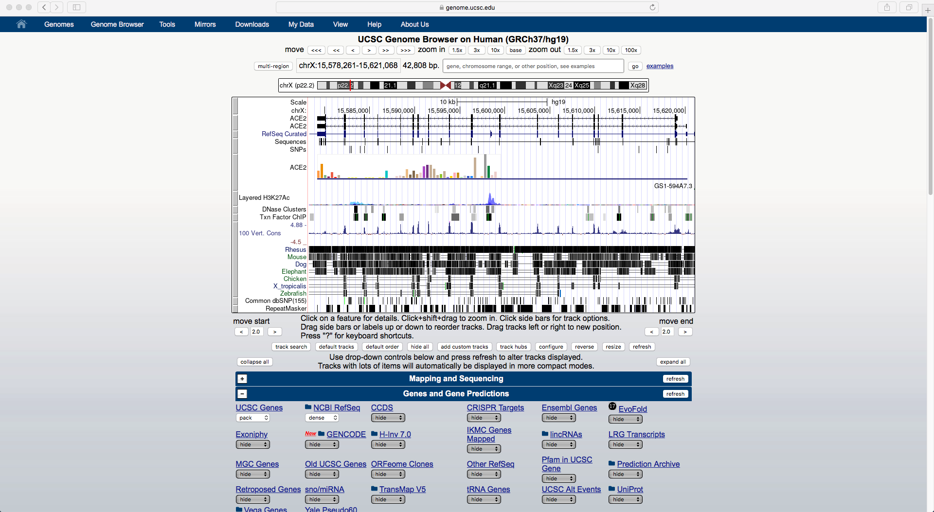
Select ‘Track hubs’
OR if you don’t see ‘Track hubs’, do … (next slide)

Slide 4
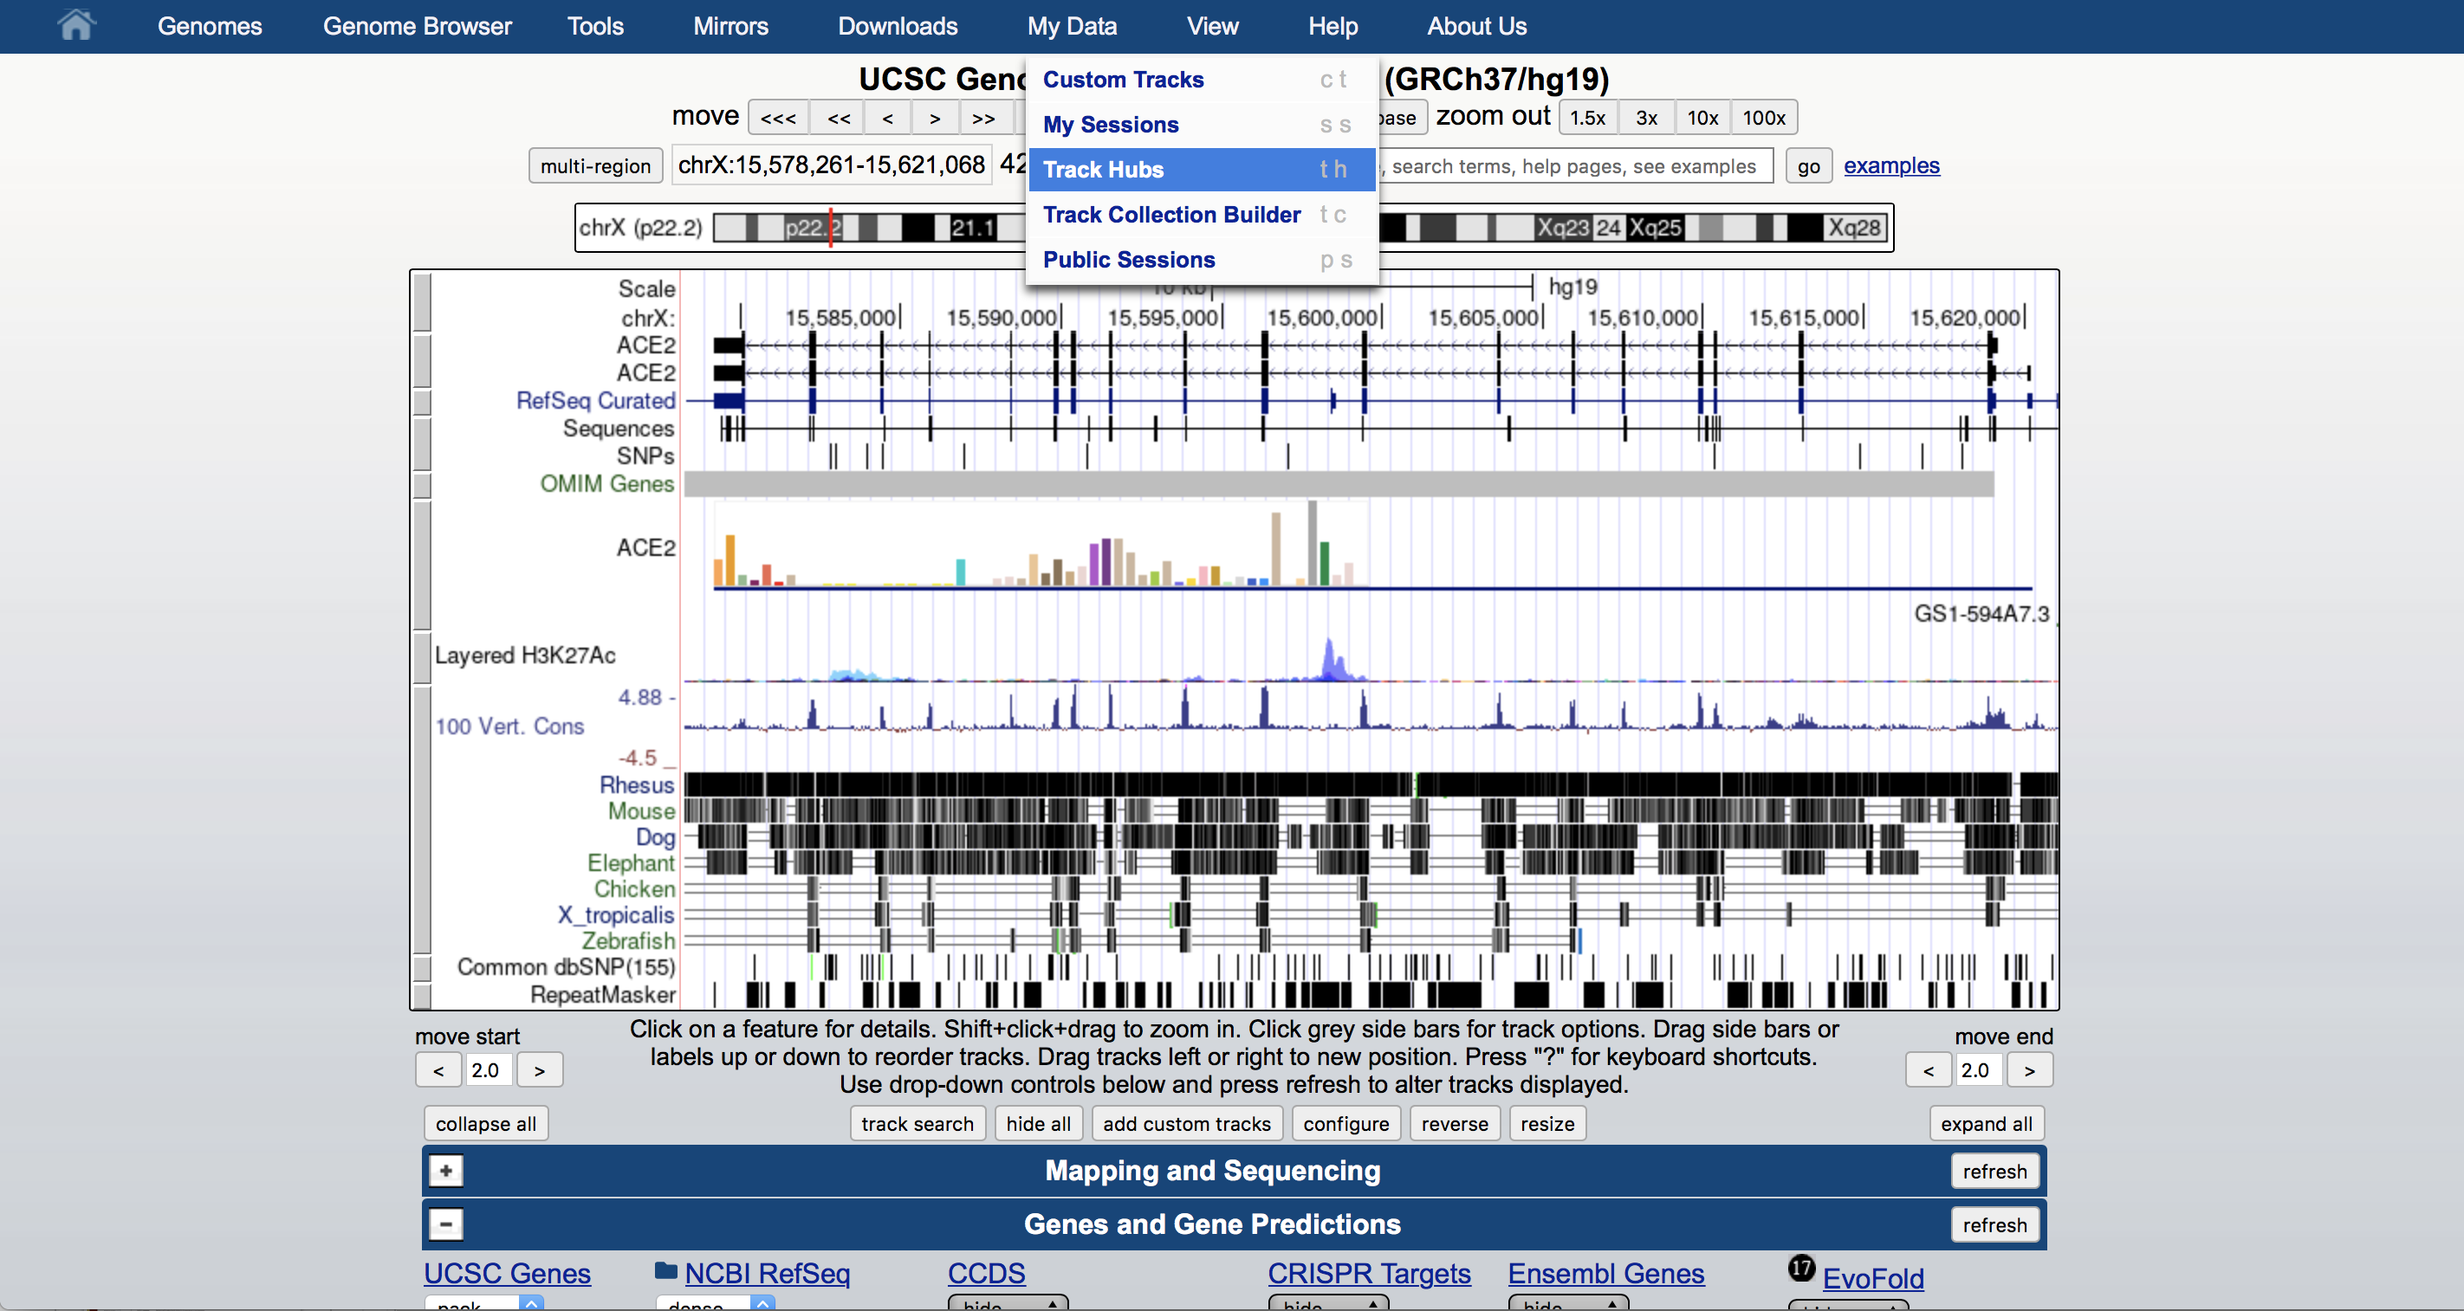
Click ‘Track hubs’ from ‘My Data’ menu

Slide 5
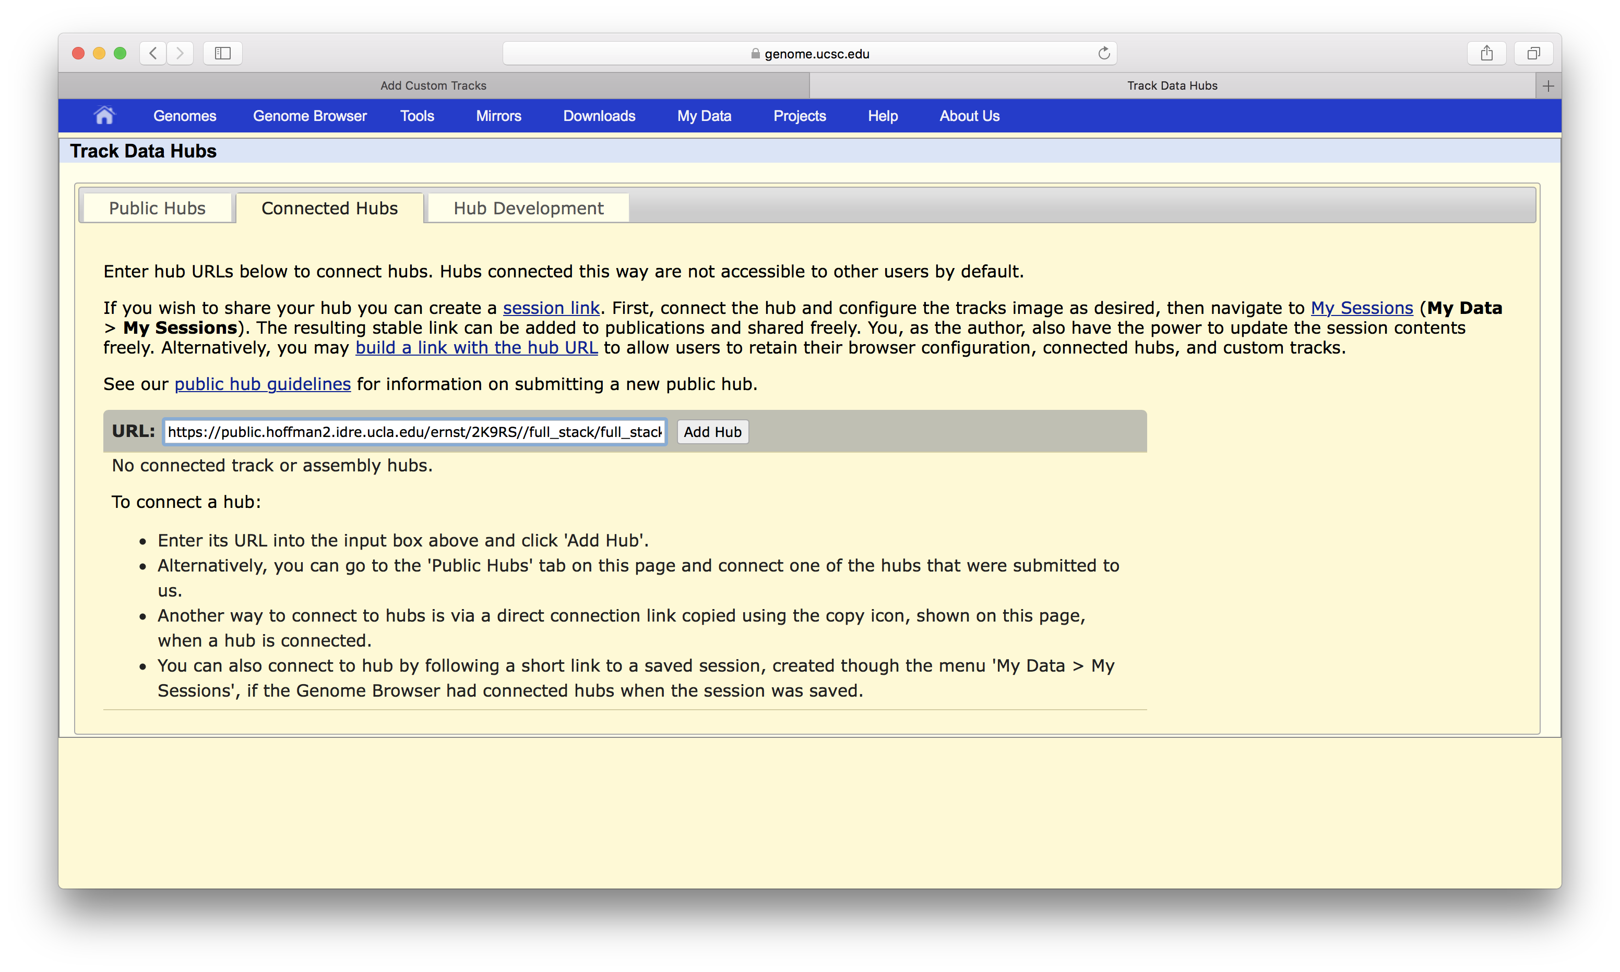
On the ‘Connected Hubs’ tab, paste the link to full-stack track hub
The link to full-stack track hub is most updated in our Github for human or Github for mouse, then ‘Add Hub’
On Github, find the trackhub link:

Slide 6
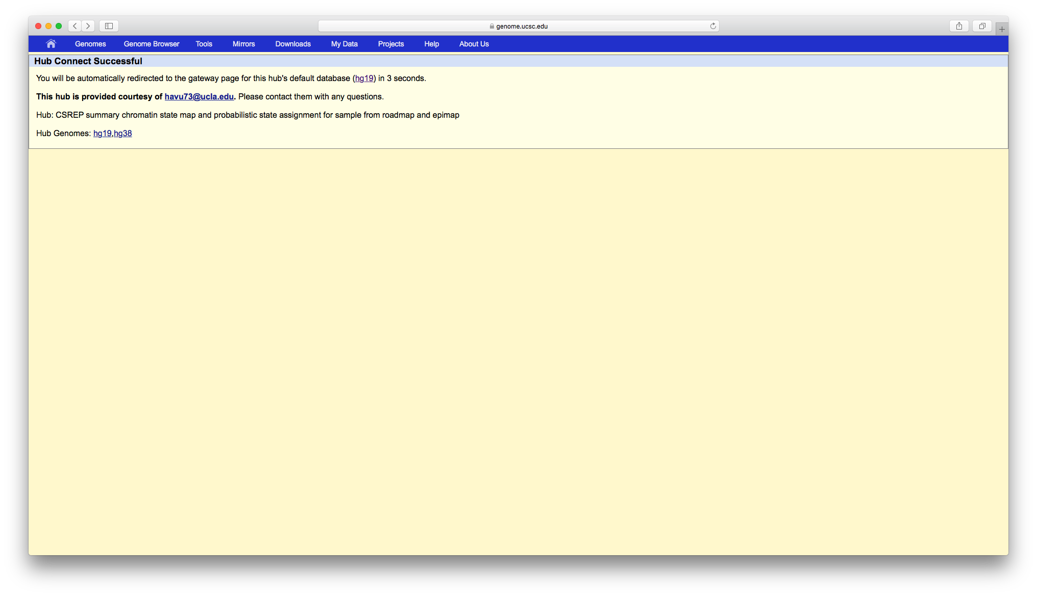
Wait a few seconds

Slide 7
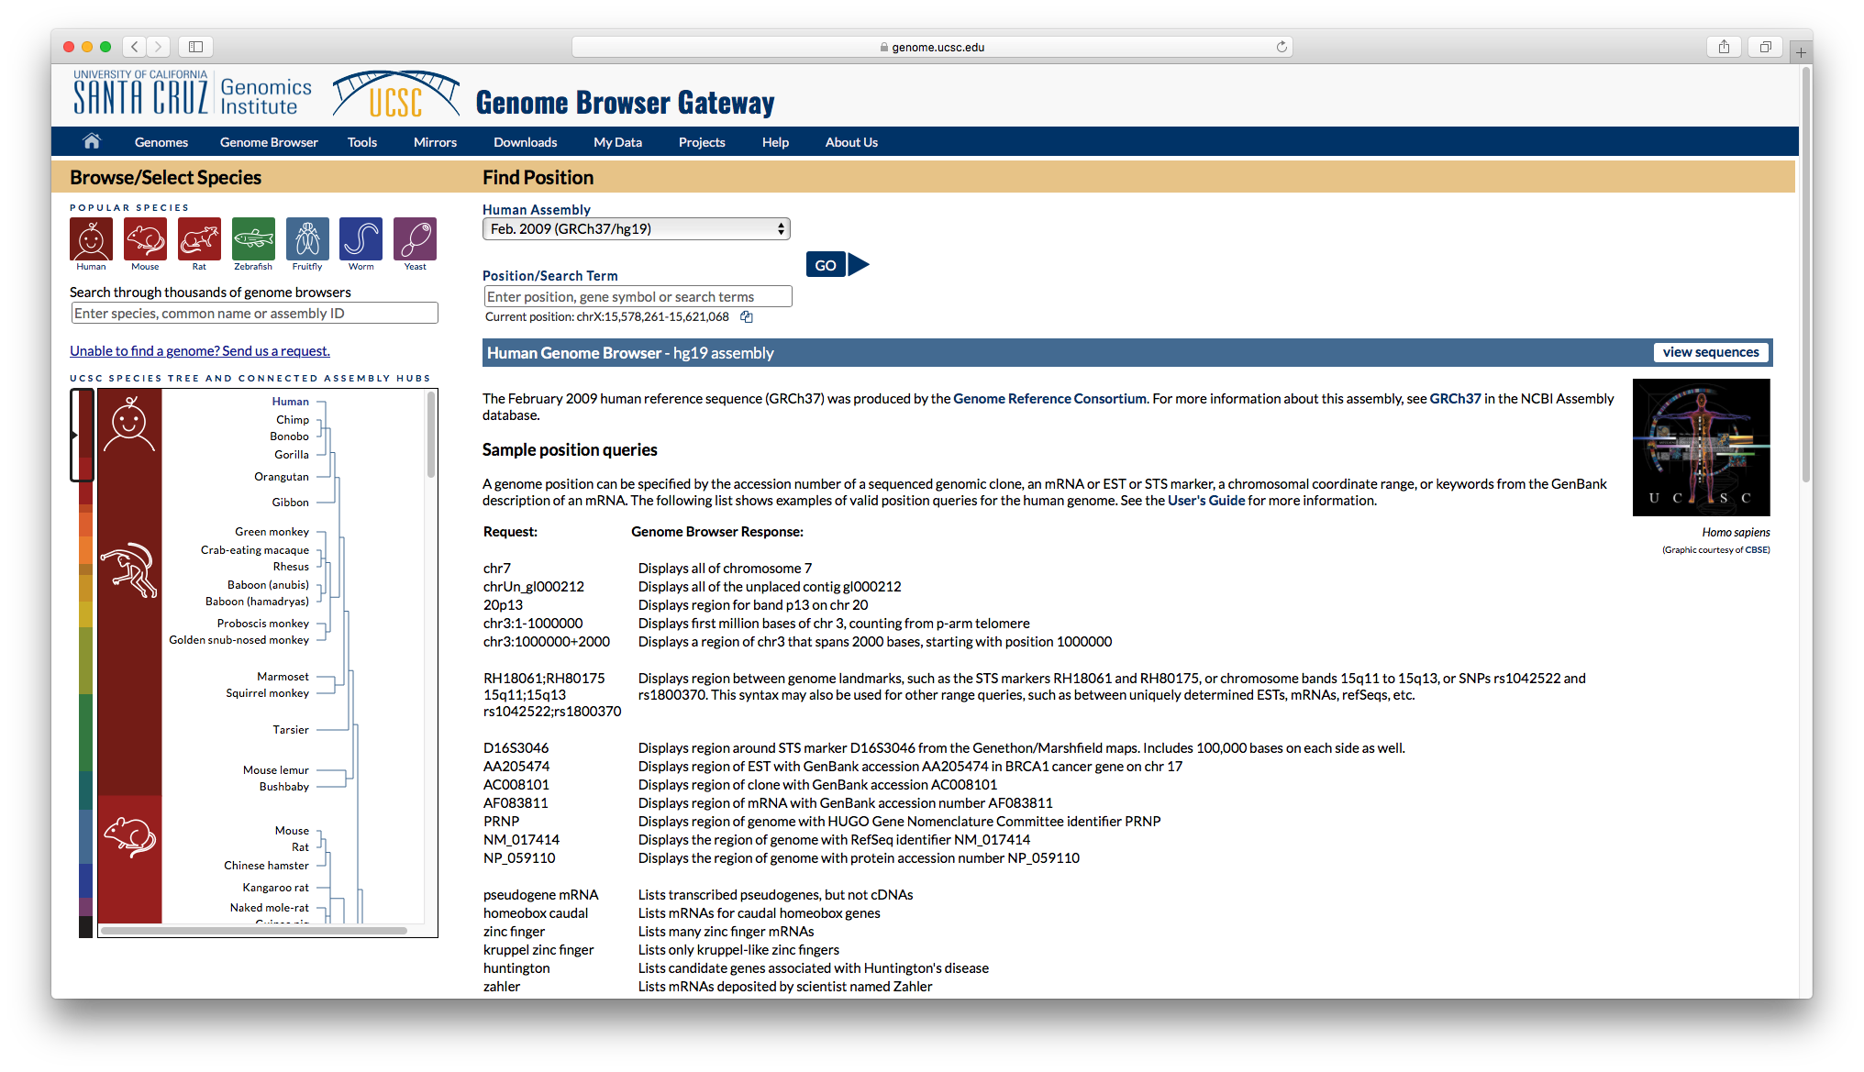
Select a genomic region and ‘Go’

Slide 8
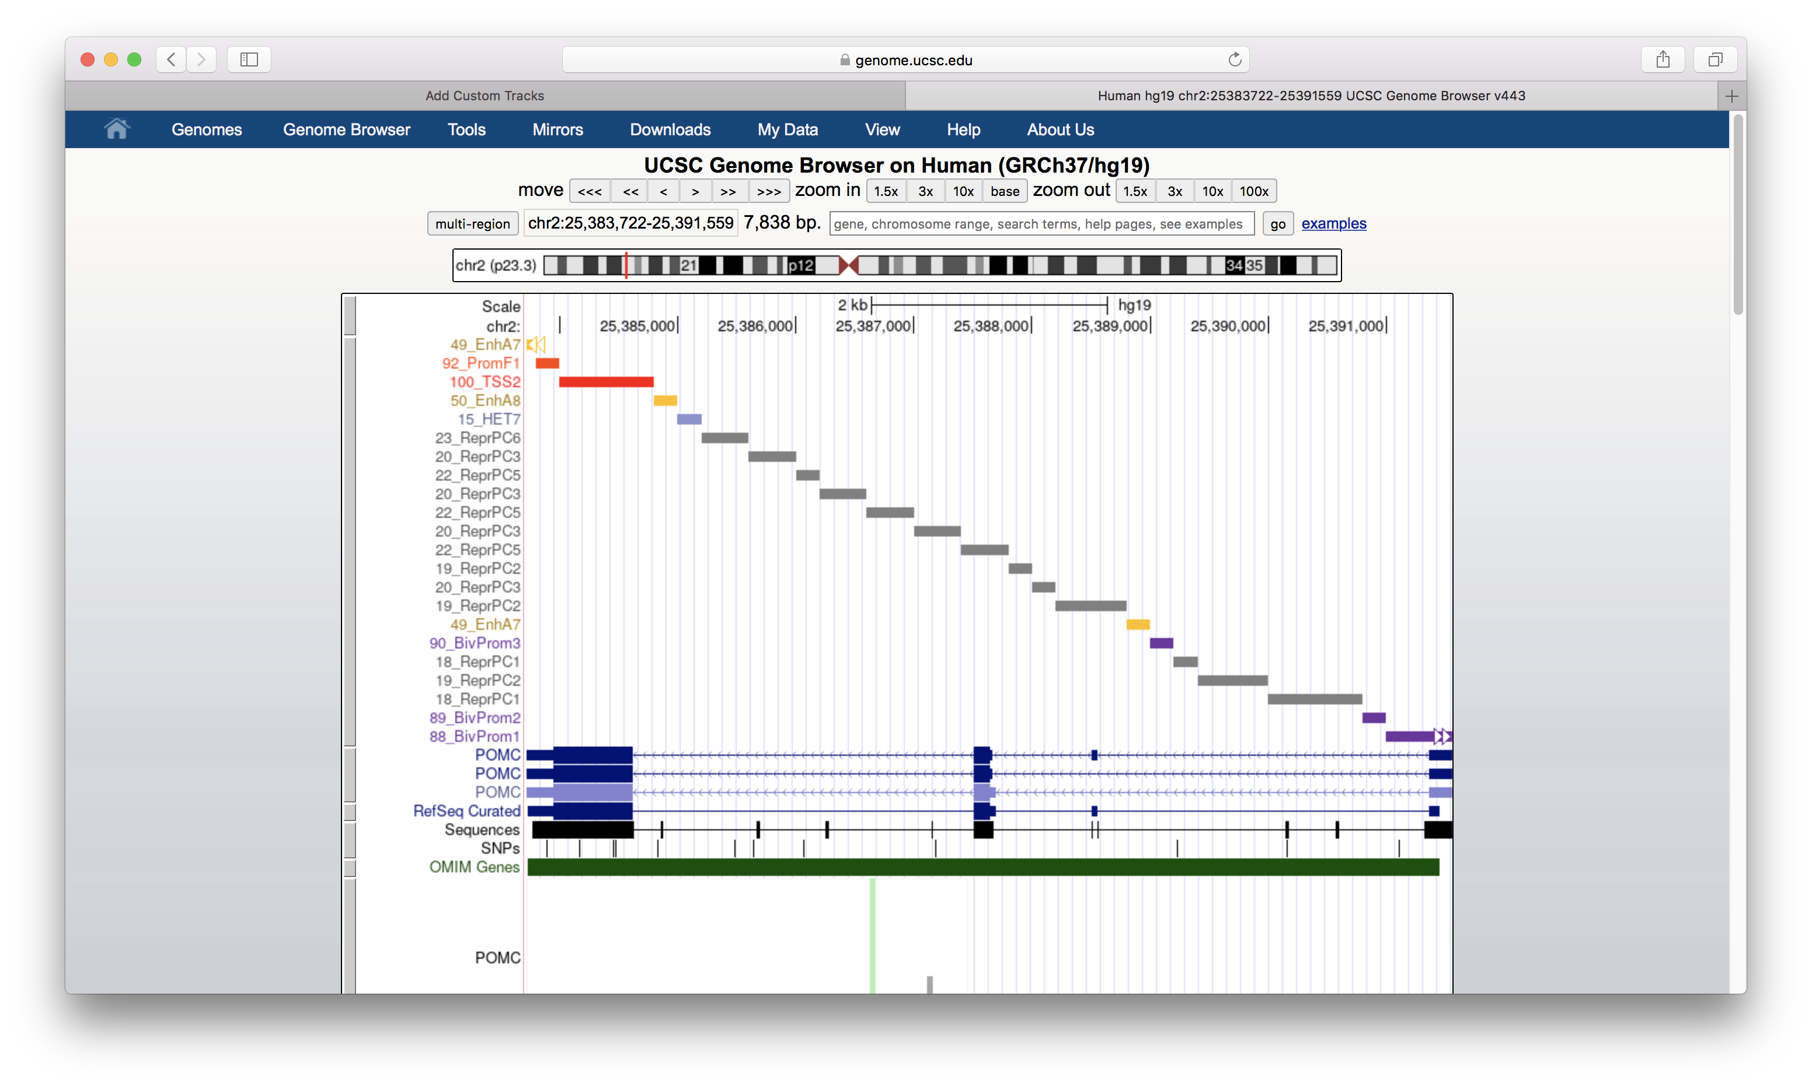
Full-stack chromatin state maps the chosen assembly (hg19 in this case) is displayed
To view the full-stack annotation in different modes, right click on the track and then create the. desired view mode. Here, we show the full-stack annotation in ‘full’ mode

Slide 9
Feedbacks and questions
If you have any feedbacks or questions, please contact Prof. Jason Ernst (jason.ernst@ucla.edu) or graduate student Ha Vu (havu73@ucla.edu). We are happy to help you.

