Slide 1
The STEM Academy Data Solution
Shannon Ernst, Kyle Nichols, Javier Franco
CS 463 Spring 2017
Group 48

Slide 2
Original Goals
Problem: the STEM Academy was doing data analysis by hand
Solution: provide them with a way to collect and analyze data digitally

Slide 3
Survey Generation: Requirements
Made from scratch and saved
Editable
Three types of questions: matrix, multiple choice, text
Add/Delete questions from survey
Deletable
Printable
Reorder questions
Display logic

Slide 4
Survey Generation Demo and Code Walk through

Slide 5
Requirements Not Met and Add Ons
Deletable
Reorder questions
Display logic
Frequently Used Questions
Preview the Survey

Slide 6
Database: Requirements and walk through
Store information in a database to allow for:
Creation and retrieval of camp information
Creation and retrieval of surveys, including camp and question association
Storing students enrolled in camps
Generation and retrieval of responses from survey questions tied to students
Storing and retrieving reports based on survey responses
Hosting on Central Web Services

Slide 7
Requirements Not Met and Add Ons
Demographic information on students (partial)

Slide 8
Report Generation: Requirements
Query data without knowledge of SQL
Save results of queries to report
Printable
Title and caption data
Summary results (averages, counts, etc.)

Slide 9
Report Generation Code Discussion

Slide 10
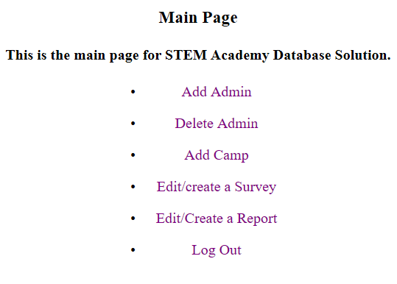
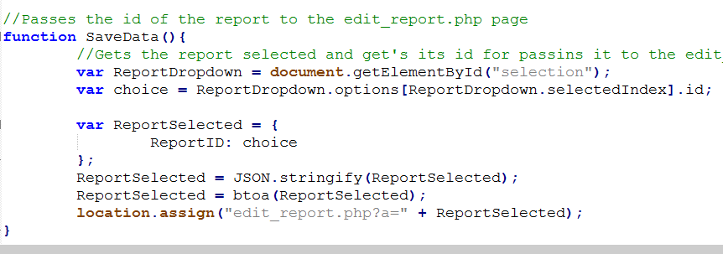
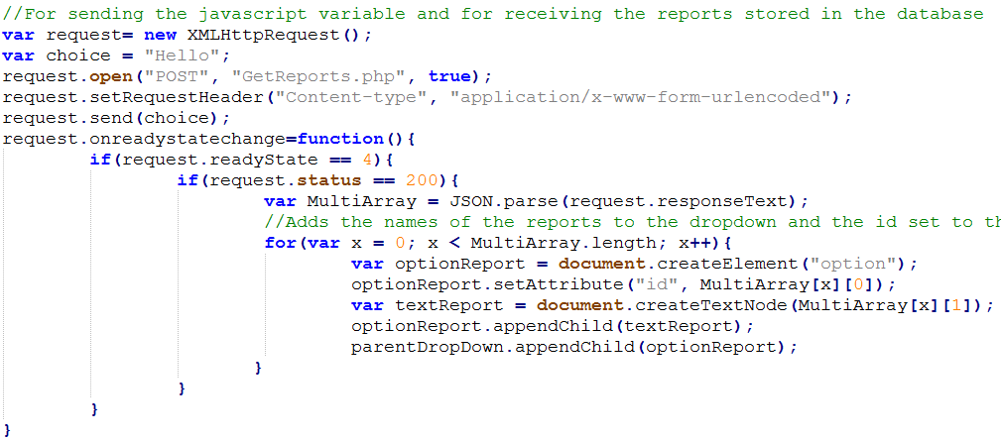
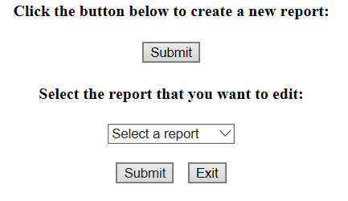
Edit Report/Create New Report Page
GetReports()

Slide 11
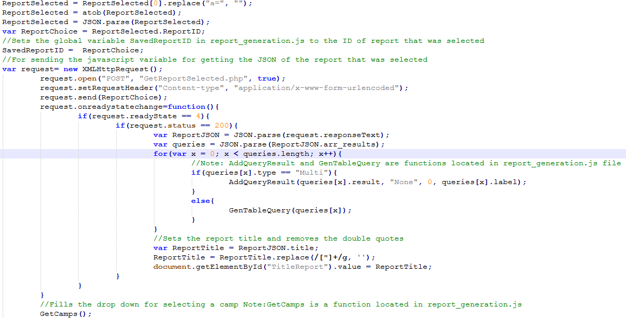
Generating a Report for the Edit Report Page
GenSavedReport()

Slide 12
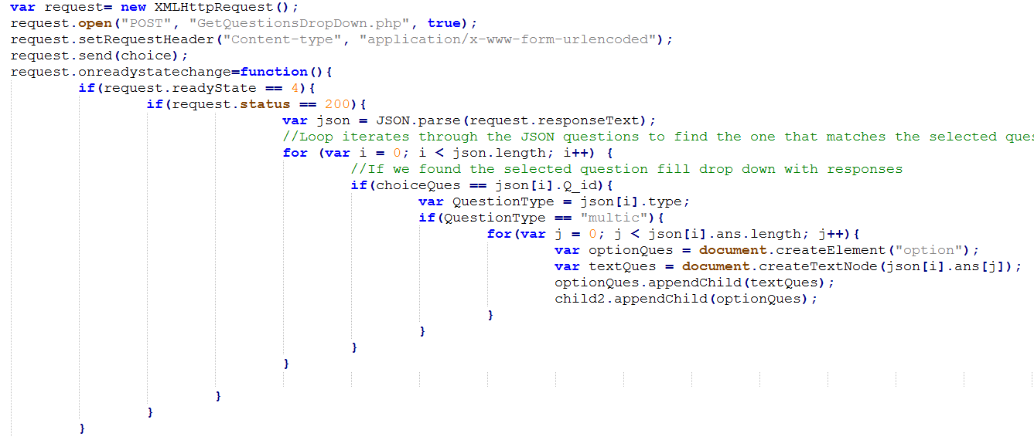
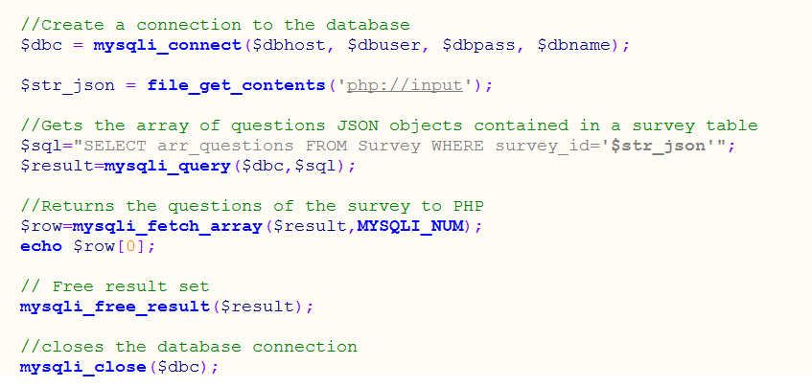
Populating Question and Responses

Slide 13
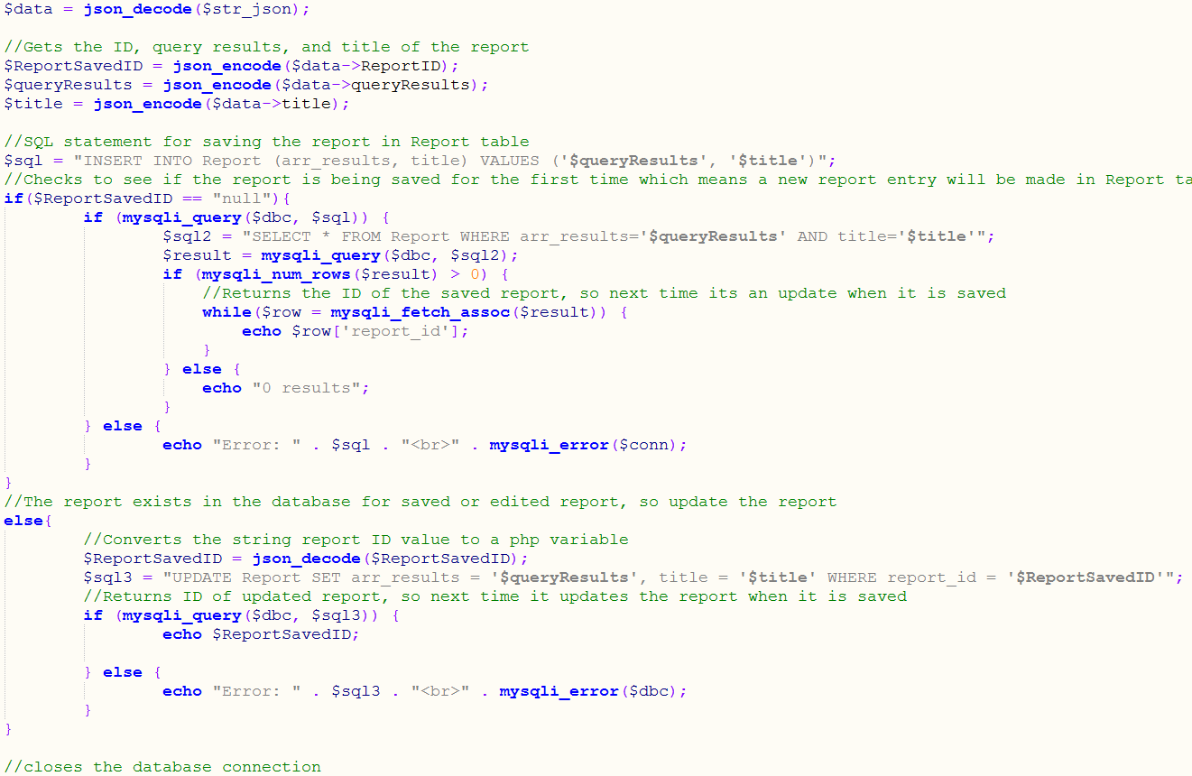
Saving a New/Edit Report

Slide 14
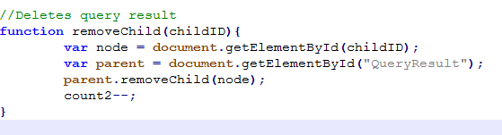
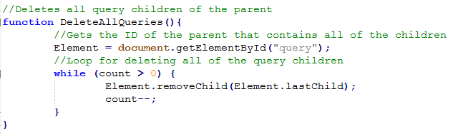
Deleting a Query Result and All Queries
Deletes a selected query result:
Deletes all the query templates displayed on the page:

Slide 15
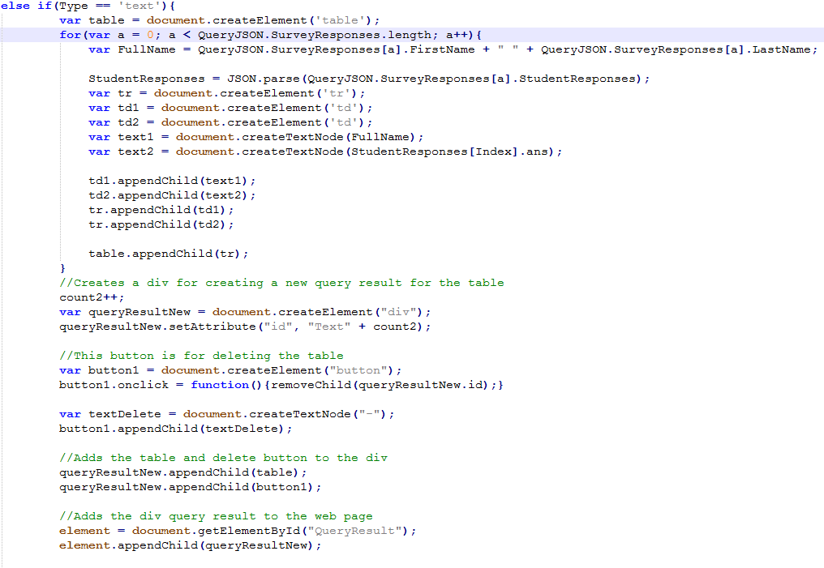
Generating a Query Result for a Text and Matrix Questions

Slide 16
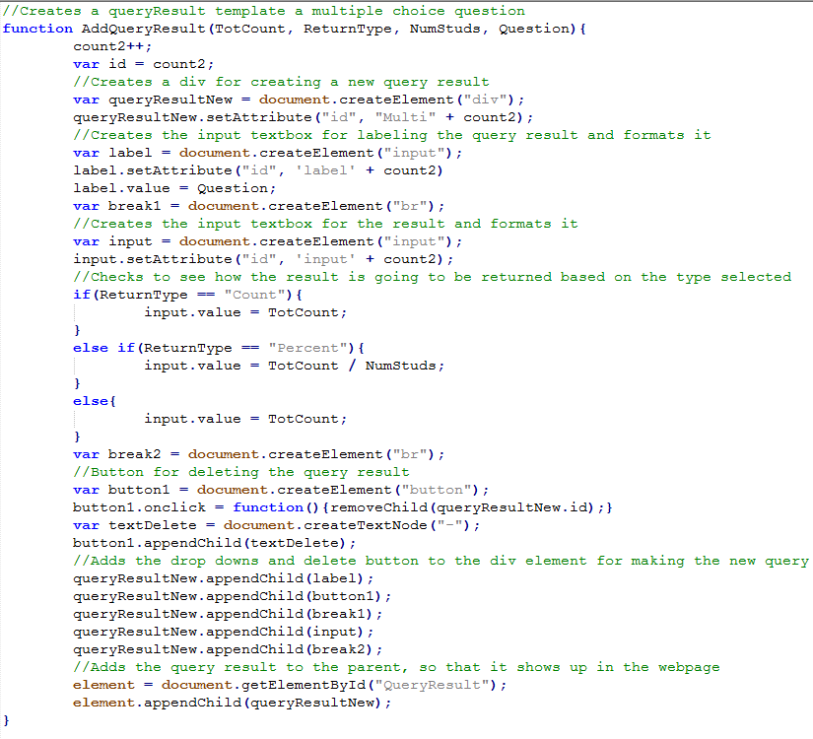
Generating a Query Result for a Multiple Choice Question

Slide 17
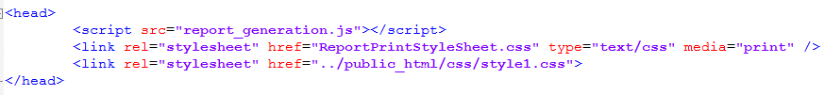
Printing a Report
Style sheet:
Button for displaying printing options:

Slide 18
Report Generation: Demo walk through

Slide 19
Requirements Not Met and Add Ons
Summary results (averages, counts, etc.)
Demographic Info
Pre and Post comparison
Captioning query result(partial)

Slide 20
Expo Pitch and Strategy

