Slide 1
The STEM Academy Data Solution
Winter Mid Term Progress Report
Shannon Ernst, Kyle Nichols, Javier Franco
Group 48
CS 462 Winter 2017

Slide 2
Problem
STEM Academy is a self funded organization that relies on donations and other funding that requires results based on data on STEM Academy
Data is collected through surveys that are given to students that attend the program
Surveys are administered on paper and tabulated by hand by volunteers
Inefficient method for collecting data for obtain more funding
STEM Academy needs:
System for electronically distributing surveys and being able to print them
Database for storing all of their survey information
Report generation for viewing most recent data in a meaningful way
Notes:
<number>
<number>
<number>

Slide 3
Solution Overview
Web app for
Survey Generation and Distribution: STEM Academy will now be able to create digital surveys
Database: store and own all data
Report Generation: STEM Academy will now be able to query their data quickly and generate printable reports
Alternatives
Qualtrics
Survey Monkey
Notes:
<number>
<number>
<number>

Slide 4
Solution Survey Generation
Requirements
Create and edit surveys
Add, delete, reorder questions in survey
Three question types
Text Entry
Matrix (Likert Scale)
Multiple Choice (Both single and many answer)
Preview, save and distribute survey
Notes:
<number>
<number>
<number>

Slide 5
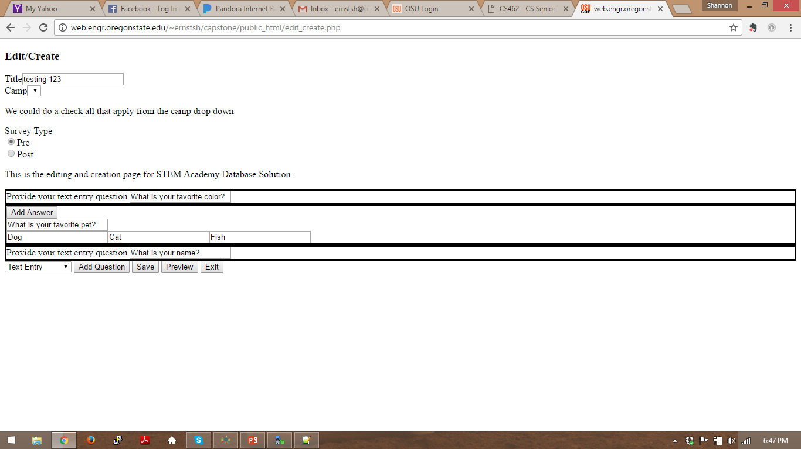
Survey generation
Notes:
Live demo the survey generation page
<number>

Slide 6
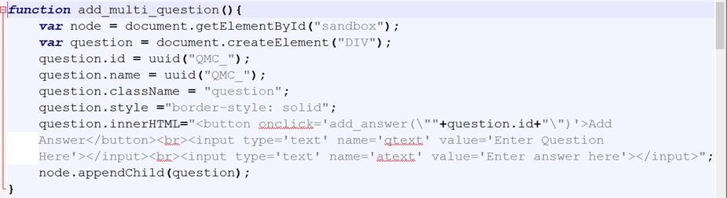
Question Generation

Slide 7
Survey Generation
Survey Json
{
title: alphanumeric string,
type: pre or post
camp: which camp it is associated with
questions: [
{
qText: alphanumeric string
type: text
},
{
qText: alphanumeric string
type: multic
answers: [“a”, “b”, “c”]
}
]
}

Slide 8
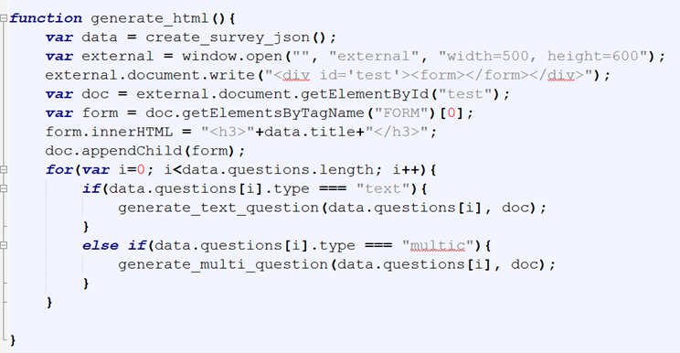
HTML Generation

Slide 9
Future of Survey Creation
Fix the save -> the PHP is receiving the post and the JSON correctly but we are unable to parse the JSON to put it in our database
Implement matrix questions
Make it look nicer
Find a way to keep the DOM Manipulation simple and not generating too much HTML
Add delete and reorder buttons/functionality

Slide 10
Database

Slide 11
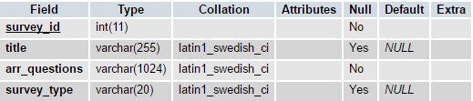
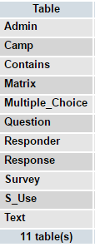
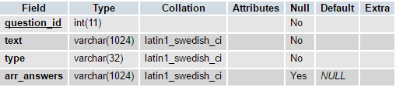
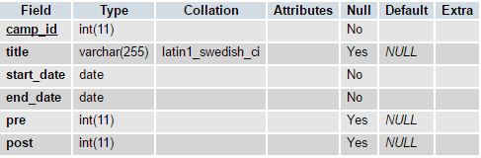
Database Organization
Survey table
Question table
Camp table

Slide 12


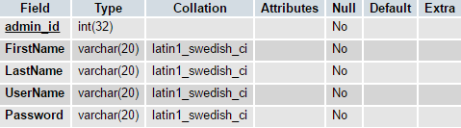
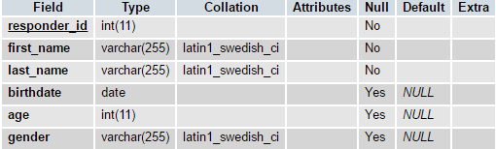
Database Organization
Contains table
S_Use table
Admin table
Responder table

Slide 13




Database Organization
Response table
Matrix table
Multiple_Choice table
Text table

Slide 14
Database interaction
Database interaction still minimal
Example data can be inserted/selected from database
But not through saving surveys or generating reports components
Example data can be read from a .json file

Slide 15
Future of the Database
Implement more complete interaction
Resolve POST issue
Organization fixes

Slide 16
Report Generation

Slide 17
Where we are going

