Slide 1
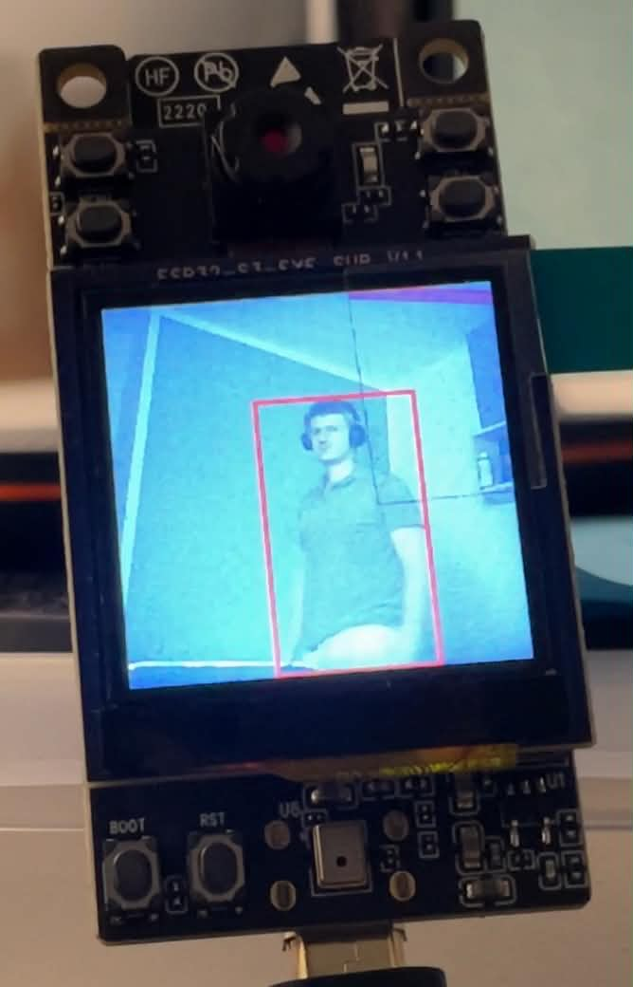
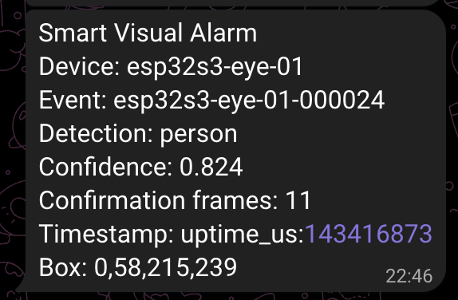
Smart Visual Alarm System
Ernyei Zoltán | MAT. 265056
Frames stay on the board. Only alarm metadata leaves the device.
Telegram alarm from MQTT metadata
ESP32-S3-EYE local detection
ESP-DL
MQTT
Telegram
embedded inference
event transport
notification
PedestrianDetect on ESP32-S3
JSON topic payload
Bot API sendMessage
Smart Visual Alarm System | 01
Notes:
Open by saying that this project is a complete visual alarm prototype built around the ESP32-S3-EYE board. The board runs the people detector locally, so the camera image is not sent to a cloud model. The alarm is converted into a small MQTT JSON event, and a Python script forwards that event to the Telegram bot. Point to the two images: the board display proves the local detection, and the Telegram screenshot proves the notification path.

Slide 2
Requirements drive the runtime design
Embedded vision
On-device AI
ESP32-S3-EYE camera frame acquisition
ESP-WHO / ESP-DL pedestrian detector
LCD preview with detection overlay
confidence threshold for valid candidates
camera frames stay on the device
bounding-box output for visual feedback
Event control
Notification bridge
confirmation frames before an alarm
MQTT topic transport
cooldown to avoid repeated alerts
Python validation and formatting
compact JSON metadata payload
Telegram Bot API user notification
Core flow: detect locally -> confirm event -> publish MQTT -> notify Telegram
Smart Visual Alarm System | 02
Notes:
Explain this slide as the requirement baseline for the system. The project is not just a camera demo: it needs embedded vision, a clear alarm policy, a network event format, and a user notification bridge. Each block maps to a real component in the implementation, which keeps the architecture easy to explain and easy to verify.

Slide 3
Six-stage alarm path
01
02
03
04
05
06
Camera
Inference
Policy
MQTT
Backend
Telegram
ESP32-S3-EYE onboard camera captures RGB565 frames.
ESP-WHO task runs PedestrianDetect locally.
Threshold + repeated frames confirm an alarm.
Firmware publishes compact JSON event metadata.
Python subscriber validates and formats the alert.
Bot message reaches the configured chat.
ESP-IDF v5.5.2
ESP-WHO / ESP-DL
Mosquitto broker
paho-mqtt + requests
Telegram Bot API
Boundary rule: raw camera frames stay on the ESP32-S3-EYE. The network event contains label, confidence, count, time, and box coordinates.
Smart Visual Alarm System | 03
Notes:
Walk left to right. The ESP32-S3-EYE captures frames, the detector runs on-device, the policy waits for repeated positive frames, and only then the firmware publishes MQTT JSON. The backend is a separate Python process on the laptop. It subscribes to the topic and sends a Telegram message. The slide also lists the real technologies used: ESP-IDF, ESP-WHO/ESP-DL, Mosquitto, paho-mqtt, requests, and Telegram Bot API.

Slide 4
ESP32-S3-EYE runtime loop
1
Boot
Initialize LEDs, LCD preview, Wi-Fi/MQTT client
Tunable Kconfig controls
Frame capture
score threshold
2
ESP-WHO camera pipeline acquires RGB565 frames
confirmation frame count
alert cooldown seconds
device ID, broker URI, topic
3
Detect
PedestrianDetect returns boxes and confidence scores
Defensive networking
4
Preview
If Wi-Fi or MQTT is not configured, detections still run and alarm JSON is logged over serial.
LCD overlays the strongest person candidate
5
Confirm
Threshold + consecutive frames + cooldown
Core files: app_main.cpp, alarm_mqtt.cpp, lcd_preview.cpp, frame_cap_pipeline.cpp
6
Publish
MQTT JSON alarm event, or serial log fallback
Smart Visual Alarm System | 04
Notes:
This slide explains what happens inside the firmware. The firmware starts the board hardware, begins capture, runs the detector, draws a visual bounding box on the LCD, and then applies the alarm policy. The policy is important because it prevents a single noisy frame from creating a Telegram message. Also mention that the firmware can keep running without network setup and log JSON over serial, which helps debugging.

Slide 5
The pedestrian model runs fully on the ESP32-S3
PICO_S8_V1
435,328 B
224x224x3
118.3 ms
model variant
parameter storage
input tensor
reported model step
Espressif pedestrian_detect v0.3.0
compiled .espdl blob in flash
RGB image resized before inference
Espressif ESP32-S3 timing
1
2
3
4
Frame
Preprocess
Infer
Result
RGB565 camera frame from ESP32-S3-EYE
resize and format for 224x224x3 input
PedestrianDetect calls ESP-DL model locally
person box and confidence score returned
Model artifact: pedestrian_detect_pico_s8_v1.espdl | Runtime: ESP-WHO + ESP-DL on ESP32-S3
Smart Visual Alarm System | 05
Notes:
Explain that the AI model is not running on a laptop or cloud API. The firmware embeds Espressif's PICO_S8_V1 pedestrian detector as an ESP-DL model artifact. The compiled model blob is 435,328 bytes in flash, the input is 224 by 224 by 3, and the reported model inference step on ESP32-S3 is around 118.3 ms. The detector produces a bounding box and confidence score, and the alarm policy decides whether that result becomes an alert.

Slide 6
Confirmed detections become MQTT events
{
"device_id": "esp32s3-eye-01",
"label": "person",
"confidence": 0.824,
"confirmation_frames": 11,
"box": {"x_min":0, "y_min":58}
}
1
2
N
!
30s
candidate seen
threshold passed
repeated frames
publish event
cooldown
6+
0..1
box
required fields
alarm quality
debug evidence
event, device, time, label, confidence, frames
confidence score kept in payload
x_min, y_min, x_max, y_max
Design reason: the backend receives enough context for an alert, while the camera frame stays local.
Smart Visual Alarm System | 06
Notes:
Explain that detections are not forwarded immediately. The firmware first checks the confidence threshold, then counts positive frames. Once the configured confirmation count is reached and cooldown is not active, it creates a JSON event. The event includes the device ID, event ID, timestamp, label, confidence, confirmation frames, and box coordinates. This is why the Telegram message is informative but still lightweight.

Slide 7
Python bridge sends Telegram alerts
01
02
03
04
Mosquitto
paho-mqtt
validator
sendMessage
LAN broker receives smart-visual-alarm/events
Python subscriber receives the JSON payload
Rejects missing fields and invalid confidence
requests posts to Telegram Bot API
Backend checks
User sees: device, event ID, person label, confidence, confirmation frames, timestamp, and box.
required fields exist and have correct types
confidence is numeric and between 0 and 1
cooldown prevents repeated Telegram spam
Smart Visual Alarm System | 07
Notes:
This is the backend side. The Python bridge is intentionally small because it should be easy to test, audit, and run during a live demo. The script loads environment variables, connects to the MQTT broker, subscribes to the topic, validates the event, formats it into readable lines, and sends it to Telegram. The validation and cooldown are there so malformed messages or repeated events do not create confusing output.

Slide 8
The bounding box is visible on the device
What this proves
The camera image is processed on the embedded board, and the detection result is rendered immediately as a bounding box on the device display.
ESP32-S3-EYE LCD preview with red person bounding box
Smart Visual Alarm System | 08
Notes:
Use this slide as the device-side proof. The important point is that the red bounding box is visible directly on the ESP32-S3-EYE screen. That means the camera frame is captured and processed locally, and the detector result is available before MQTT or Telegram are involved.

Slide 9
Telegram alert metadata
1
Device
which ESP32-S3-EYE produced the alarm
2
Event
unique event ID for logs and debugging
3
Detection
detected class label, here: person
4
Confidence
model score used to understand alert quality
5
Confirmation frames
how many positive frames supported the alert
6
Timestamp
device uptime when the alert was created
Telegram alert generated by the Python backend
7
Box
bounding-box coordinates from the detector output
The backend forwards readable metadata, not raw camera frames.
Smart Visual Alarm System | 09
Notes:
Walk through the rows of the Telegram message. Device identifies the board, Event is a unique alarm ID, Detection is the class label, Confidence is the model score, Confirmation frames shows that this was not a single noisy frame, Timestamp is the device uptime, and Box is the detector bounding box. The main design point is that the user receives enough detail to understand the alert without sending the camera image.

Slide 10
Possible next steps
Reliability testing
Latency metrics
test empty scenes, motion, low light, backlight
measure camera-to-MQTT timing
record false positives and missed detections
measure MQTT-to-Telegram timing
compare thresholds and confirmation-frame settings
separate model latency from network latency
Deployment hardening
Product features
broker authentication or TLS
web dashboard for event history
watchdog and reconnect handling
configurable zones or schedules
token rotation and cleaner secret handling
optional image snapshot with privacy controls
Smart Visual Alarm System | 10
Notes:
This slide shows that the prototype has clear directions for improvement. The most useful next step would be structured testing: different lighting, empty scenes, moving objects, and repeated timing measurements. After that, I would improve security and reliability around MQTT and credentials, and then add product features like event history or configurable detection zones.

Slide 11
Summary
Implemented capabilities
Runtime path
ESP32 camera -> on-device AI -> MQTT event -> Python backend -> Telegram alert
ESP32-S3-EYE camera, LCD, and detector pipeline
on-device pedestrian model with confidence output
confirmation and cooldown alarm policy
MQTT JSON event publishing
Repository
Python Telegram notification bridge
ernyei13/iot-project-pedestrian-detector
Key idea: useful alarm metadata leaves the device; raw camera frames do not need to.
Smart Visual Alarm System | 11
Notes:
Close with the complete system path. The project combines embedded camera capture, on-device pedestrian detection, an alarm policy, MQTT event publishing, and a Python Telegram bridge. The strongest design decision is that the device sends useful event metadata rather than raw camera frames, which keeps the pipeline lightweight and privacy-aware.

Slide 12
End-to-end system flow
ESP32-S3-EYE local processing: raw frames stay on the board
1
Camera + LCD
Captures RGB565 frames locally and draws the person box on the LCD.
2
On-device AI
Resizes to 224x224x3 and runs ESP-DL PICO_S8_V1 on the board.
3
Alarm decision
Checks confidence, confirmed frames, and cooldown before publishing.
metadata only leaves the device
4
MQTT JSON event
Publishes device, event, label, confidence, count, time, and box.
5
Mosquitto broker
Transports the compact alarm event on the local LAN.
6
Python backend
Validates JSON, formats text, and calls the Telegram API.
7
Telegram alert
Sends a readable alarm message to the user.
Smart Visual Alarm System | 12
Notes:
Use this final slide as the complete walkthrough. First, the ESP32-S3-EYE captures the frame and displays the local preview. The AI inference also runs on the board, then the firmware checks the confidence, confirmation-frame count, and cooldown rule. Only after that does compact metadata leave the device. MQTT carries the JSON event to Mosquitto, the Python backend validates and formats it, and Telegram delivers the readable alert to the user.

