Slide 1
Wildfire Prevalence and Severity
Justin Lawrence, Dustin Malandra, Emilia Roberts, Christ Tanner

Slide 2

Wildfires by fire code
The USDA categorizes all fires by size in acres (A-G):
A = 0 – 0.25
B = 0.26 – 9.99
C = 10 – 99.9
D = 100 – 299
E = 300 – 999
F = 1000 – 4999
G = 5000+

Slide 3
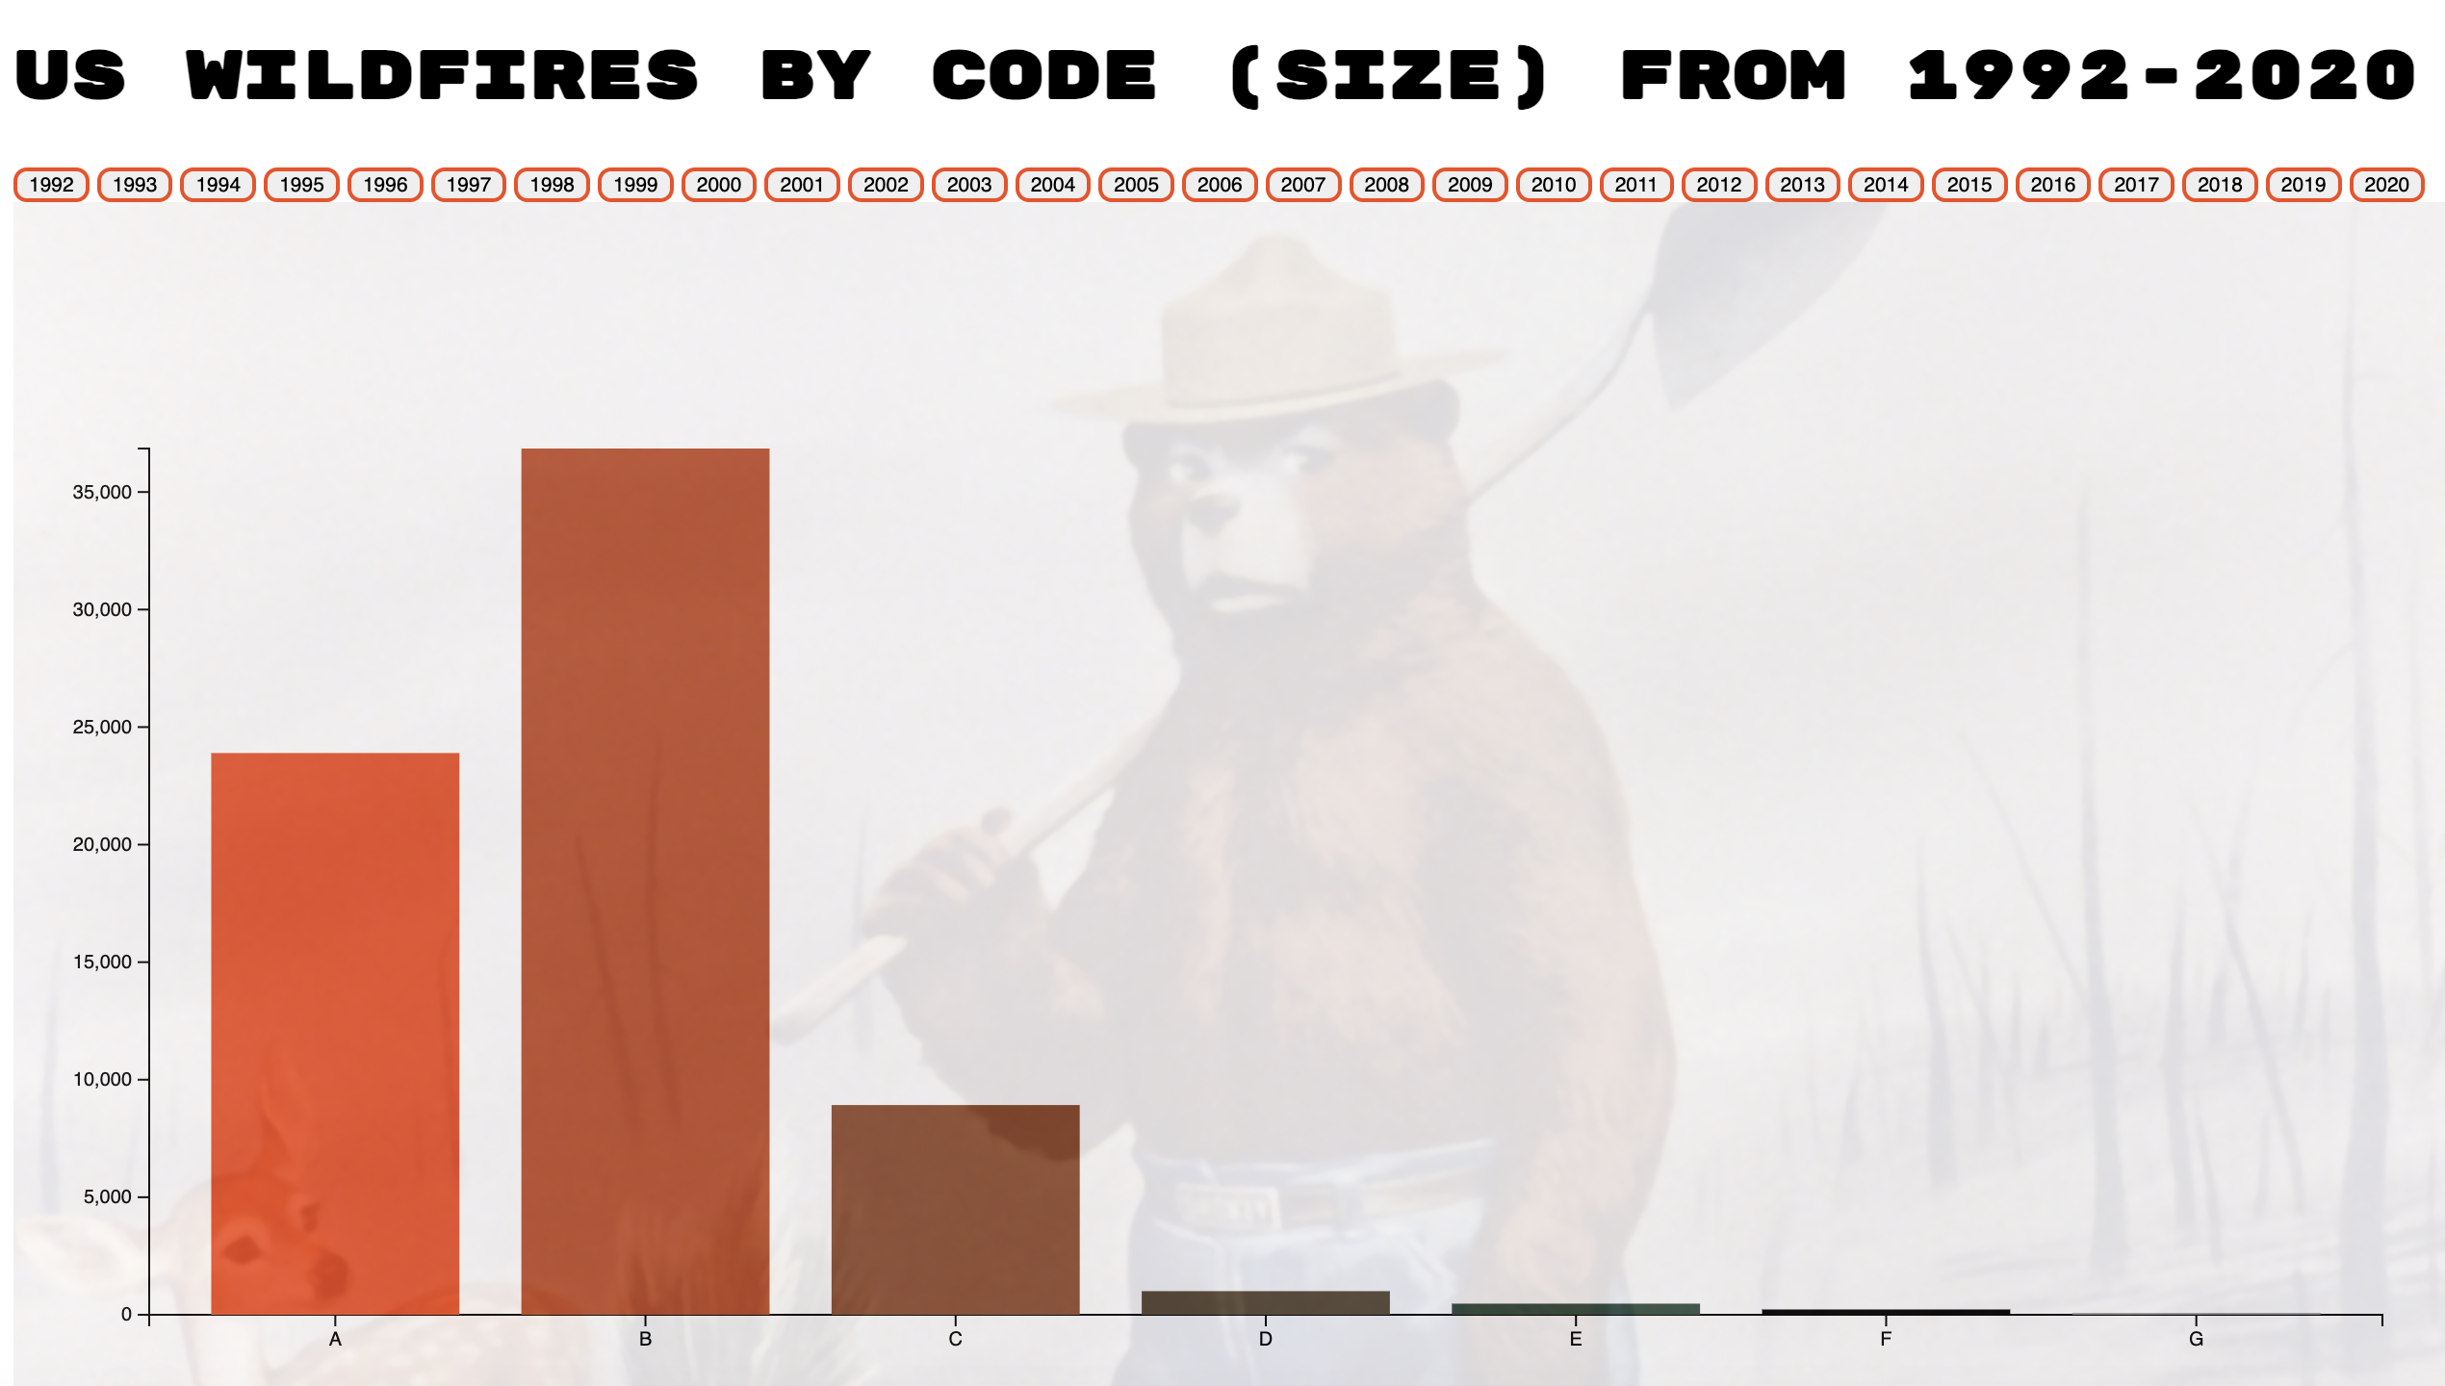
Wildfires by code
The following bar chart represents the total fires in the US by fire size code for a given year.
We can infer from the data some reasons why certain codes dwarf others
Also suggests the vast number of resources allotted towards fire care and prevention every year
https://dmalandra.github.io/animatedchart/

