Slide 1
Cream
Advanced ORM for CakePHP

Slide 2
Options
CakePHP 2: Uses simple arrays with no inherent connection to underlying data models. No inheritance model.
CakePHP 3: Offers limited Entity functionality; Support for association browsing is very limited. No inheritance model.
We need another way out!

Slide 3
Why we need inheritance?
Model is-a like a has-a relation is like having a “manual motorized saw, basically a chainsaw with a crankshaft” . It is not a replacement functionality, it is a lack of functionality!
In this case it is a lack of functionality that cost us a lot of extra wasteful time!
Traversing a complex data structure, at the same time as we traverse the various roles (id/model) for the is-a / has-a replacements, just becomes ultra-confusing! (see next example)

Slide 4
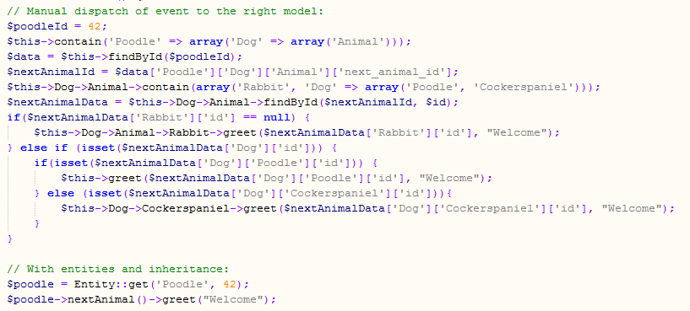
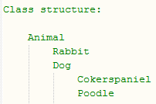
Why we need inheritance. Example

Slide 5
Solution
Build a new ORM on top of Cake 2 (or cake 3) that is easy to deploy/use and that introduces the desired features.
Find a suitable acronym:
CakePHP Relation/Entity Advanced Modeler =
CREAM

Slide 6


Because cake tastes better with cream!
Basic entity functionality
Data structure browsing.
Data structure modification.
An optional custom made entity class per model.
Simple deployment
One single file with code.
Basic functionality works with zero modification of models.
Advanced Features:
Single Table Inheritance. (Several entity classes per model)
Multi Table Inheritance. (Several models per entity class)
Non redundant serialization.
Ready but configurable copy interface.
Future: Change tracking on the client side. Single save controller.

Slide 7
Basic functionality
Data structure browsing and modification:
No special preparation of models needed!
No Entity duplicates. For every combination of Model/Id there is exactly one entity object.

Slide 8
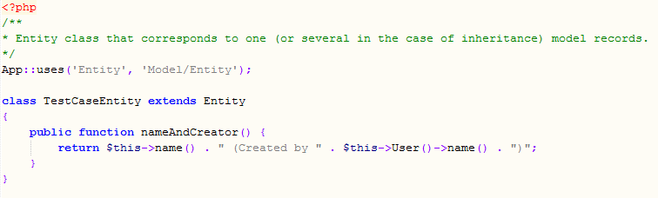
Basic functionality
Custom entity class (with your own functions)

Slide 9
Single table inheritance
Add a column called “class” to your model.
Note: Values of the class column uses column syntax, so “activation_sequence” translates to “ActivationSequence”.
Different entities from the same model/table, will now have different entity classes!
Entity
Model/Table Fie
FooEntity
extends
id
class
foo_col
extends
1
foo
FieEntity
2
foo
BarEntity
extends
3
foo
4
bar
5
bar

Slide 10
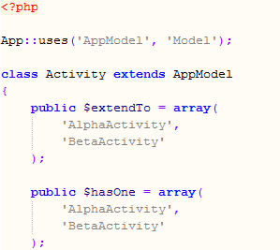
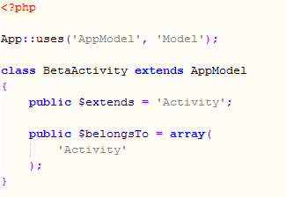
Multi table inheritance
If a model want to inherit data and behavior from another model, set the “extends” member variable of the model.
However, the model that is extended by another model, needs to list those that directly extend it in the “extendsTo” member variable. (this can be used but has very poor performance. )
The inheriting model needs two columns “entity_model_name” and “entity_model_id”. The values of these will be set by cream, linking the models together.
Note: This will not influence normal model functionality! (should we prefix those fields with “cream” to clarify this?)

Slide 11
Multi table inheritance
The Entity class hierarchy will typically match the Model extension graph (but it need not be a direct match).
Model/Table A
extends
extends
Model/Table B
Model/Table F
Entity A
extends
extends
extends
extends
Entity B
Model/Table D
Model/Table C
extends
Entity C
Entity E
It can even be combined with single table inheritance.
extends
Entity D1
extends
Entity D
Entity D2

Slide 12
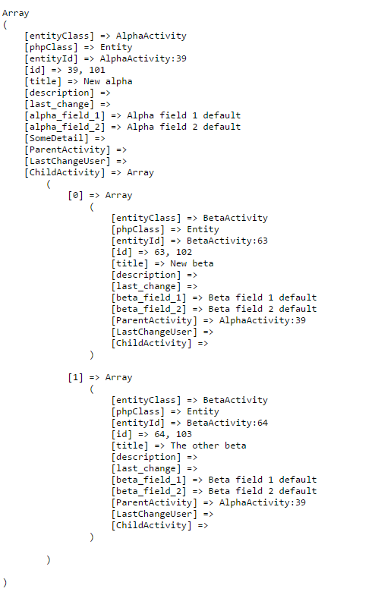
Multi table inheritance …

Slide 13
Multi table inheritance …
The polymorphism works as follows, because in Cream, an Entity is a chain of roles (role = Model + id). A relation to and from any of those roles will be a relation to the entity.
Another entity can have a relation to either of these roles, it does not matter on the entity level.
Model = A / Id = 12
Entity
Roles
Model = B / Id = 25
Model = C / Id = 33
Model = D / Id = 23

Slide 14
Multi table inheritance …
For example, if you create a relation to a base model. Then you have a relation to any entity that extends that model.
Hence, no polymorphic associations are needed on the model level! (with a foreignKey and foreignModel columns etc.)

Slide 15
