Slide 1

Fundamentals of
Computer Graphics
Lengths and areas
Emanuele Rodolà
rodola@di.uniroma1.it
1st semester a.y. 2018/2019 – November 19, 2018

Slide 2
Measuring lengths and areas
How to compute these?
Length of a curve
Area of a region
Integral of a function

Slide 3
First fundamental form
The quadratic form given by
is called the first fundamental form of the regular surface S at p.
It is the key ingredient for computing lengths and areas on surfaces

Slide 4
First fundamental form
Let us denote by the basis spanning the tangent plane
Any vector is the tangent vector to a curve
which lies on the surface, with
Then we can write:
chain rule

Slide 5
Metric tensor
also called metric tensor
E(u,v), F(u,v), and G(u,v) are the components of the first fundamental form
These play important roles in many intrinsic quantities of the surface
If E(u,v), F(u,v), G(u,v) are smooth, we have a Riemannian manifold

Slide 6
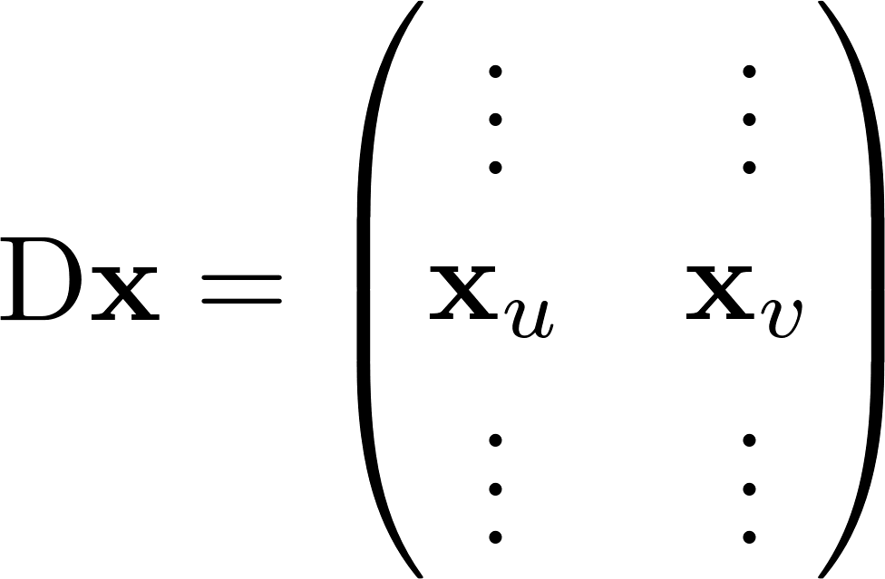
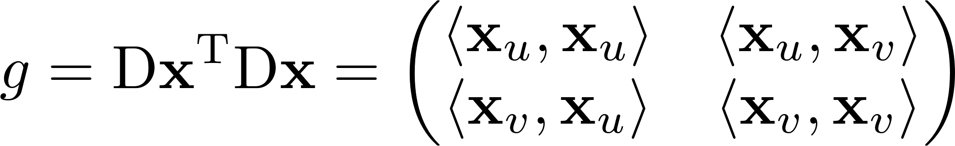
Metric tensor and Jacobian
often called just g
We have seen the Jacobian matrix:
Then, it is easy to see that:

Slide 7

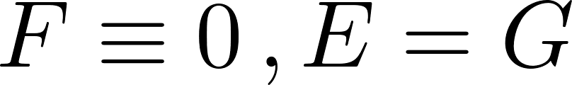
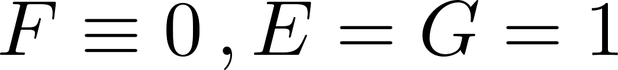
Parametrizations
generic parametrization
orthogonal
conformal
isometric

Slide 8
Example: The plane (1/3)
Consider a plane passing through and containing the orthonormal vectors and
We want to compute the first fundamental form for an arbitrary point q in S.
Thus, the first fundamental form of w at p is

Slide 9
Example: The plane (2/3)
This time let and
We are changing the parametrization x, but still we expect that the lengths of vectors in do not change (as they are a property of the surface).
As before, we have and then
previous example:
this example:
The two bases, and thus the coefficients for w are different in the two examples.
We can now compute

Slide 10
Example: The plane (3/3)
Now let and
We have and now
Again we expect the first fundamental form to be the same as before.
So we get

Slide 11
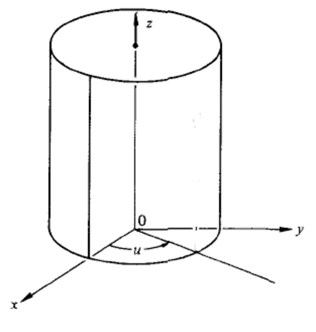
Example: The cylinder
Plane and the cylinder behave locally in the same way, since their first fundamental forms are equal
We say that plane and cylinder are locally isometric

Slide 12
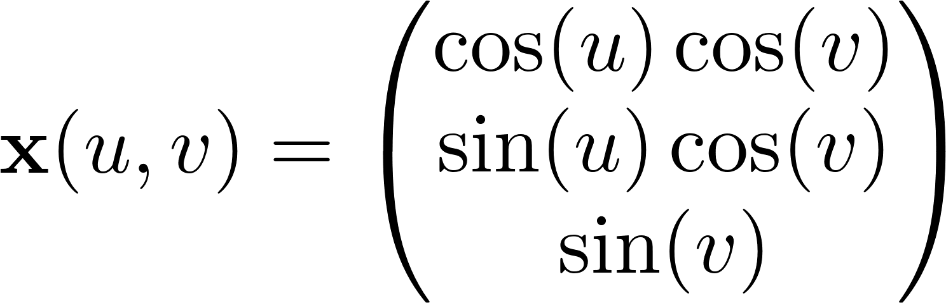
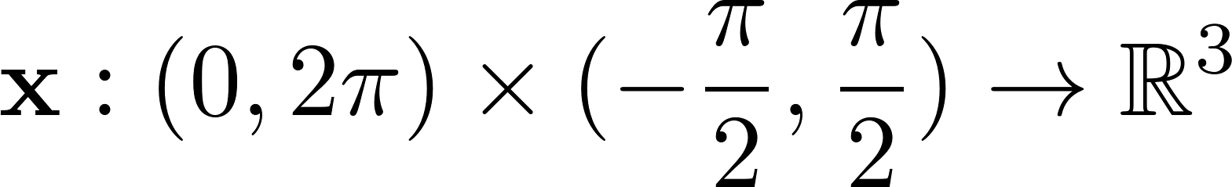
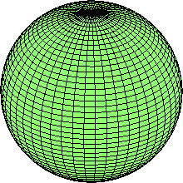
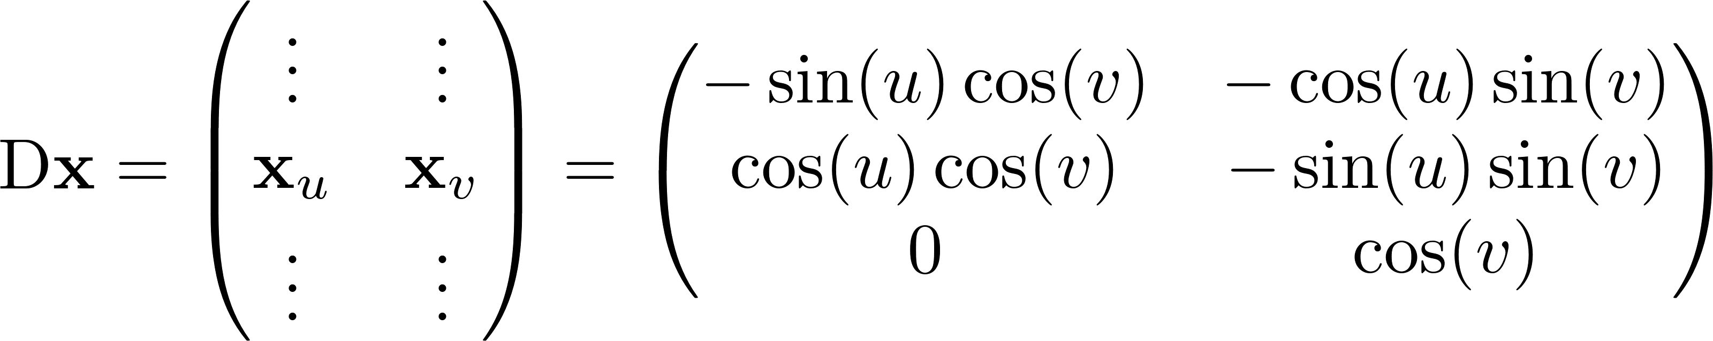
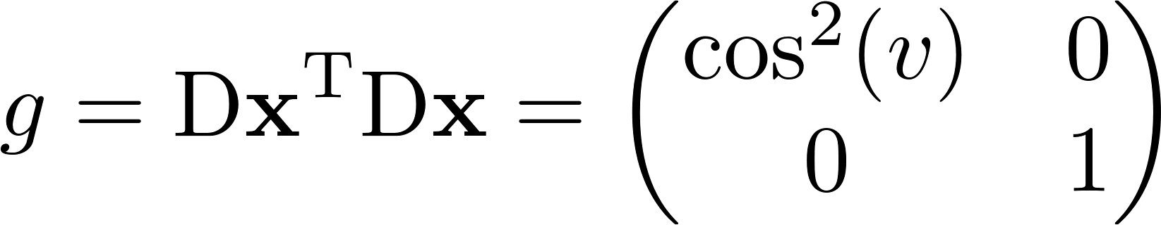
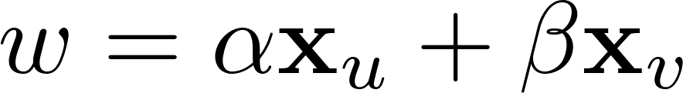
Example: The sphere
Here it is evident that E, F, G are indeed differentiable functions E(u,v), F(u,v), G(u,v).
Thus, if is the tangent vector to the sphere at point x(u,v), then its squared length is given by

Slide 13
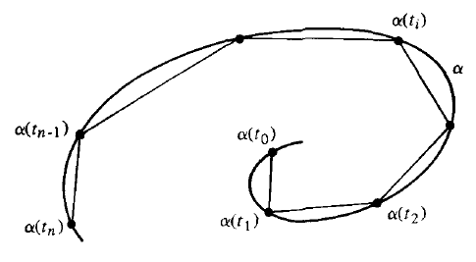
Length of a curve
With the first fundamental form, we can treat metric questions on a regular surface without further references to the ambient space
arc-length of a curve
Remember that E, F, G are actually functions of (u,v), so in general they are changing along the curve.
Thus, if is contained in a surface element parametrized by x(u,v), we can compute the length as:

Slide 14
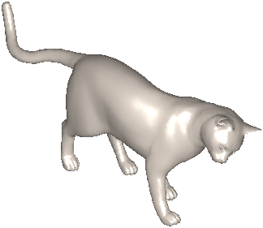
Length of a curve
length

Slide 15
Arc length element
Length
The first fundamental theorem of calculus gives us:
We get to the compact notation:
In terms of the metric tensor, the arc length element ds is given by:

Slide 16
Area of a region
If is contained in the image of the parametrization , the area of R is defined by

Slide 17
Area of a region
The area of a region on the surface is defined as the sum of the areas of parallelograms tangent to that surface region.

Slide 18
Area of a region
Observe that:
We can then rewrite:
We get the compact expression:

Slide 19
Area element
We define the area element da as:
Leading to:
The area element is also called (Riemannian) volume form
In the case of 2-dimensional manifolds (our case), volume corresponds to area

Slide 20
Wrap-up
We have two alternative expressions for measuring lengths and areas
One in parameter space, the other directly on the surface
Parameter space
Surface
Parameter space
Surface

Slide 21

Integral of a function
We have the definition:
Generalizes the substitution rule in classical multivariate calculus

Slide 22

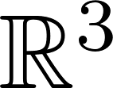

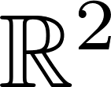
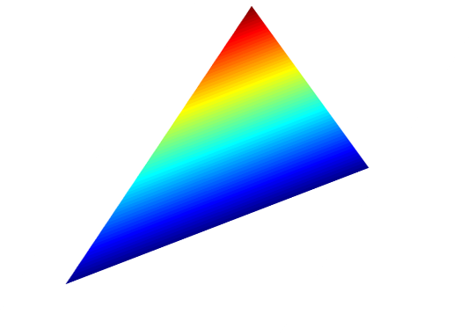

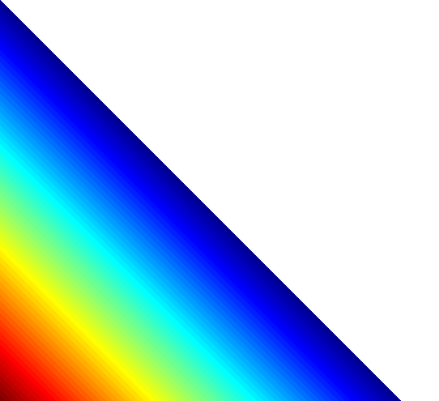



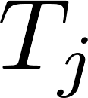



Discretization: Metric tensor
We simply have:
The coefficients for the metric tensor are thus given by:

Slide 23
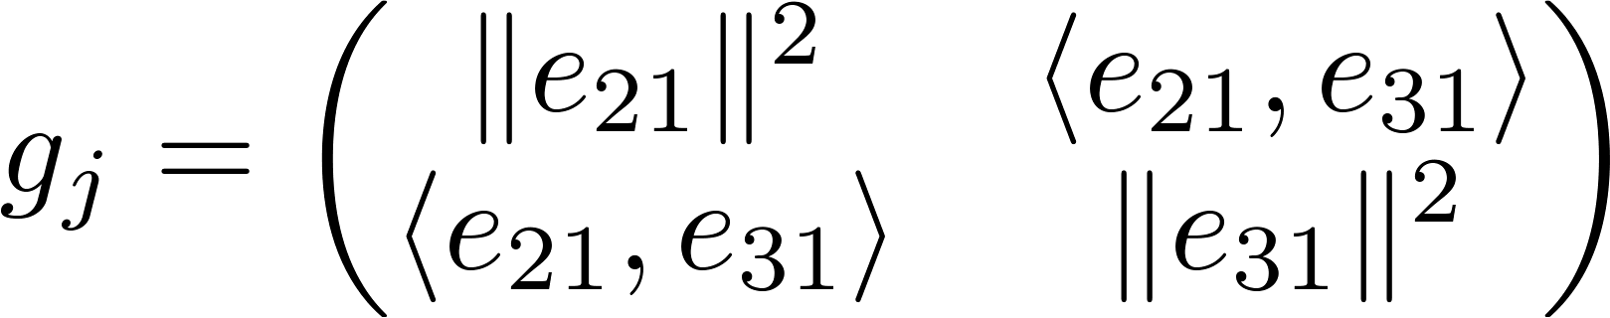
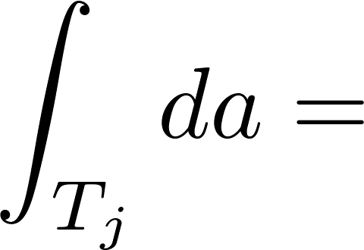
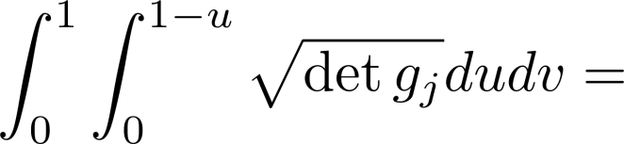
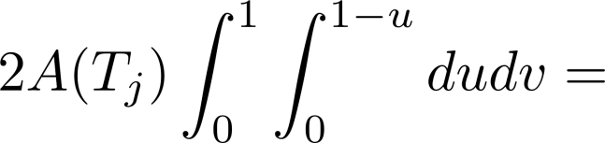
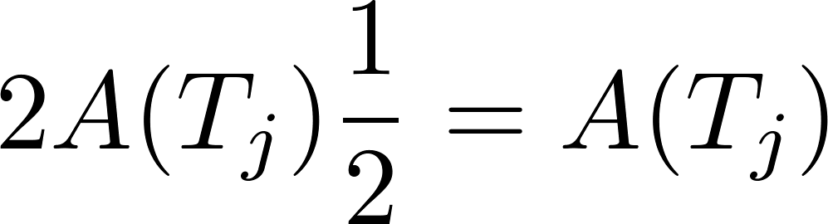
Discretization: Area element
The area of the triangle is the area of a region:

Slide 24
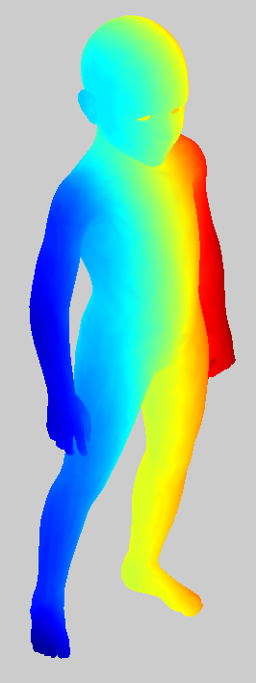
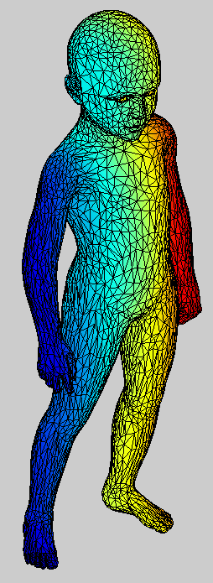
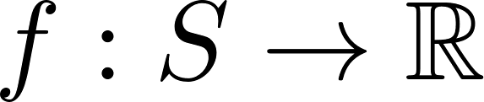



Discretization: Integral of a function
behaves linearly within each triangle and it is uniquely determined by its values at the vertices of the triangle.

Slide 25
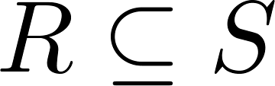
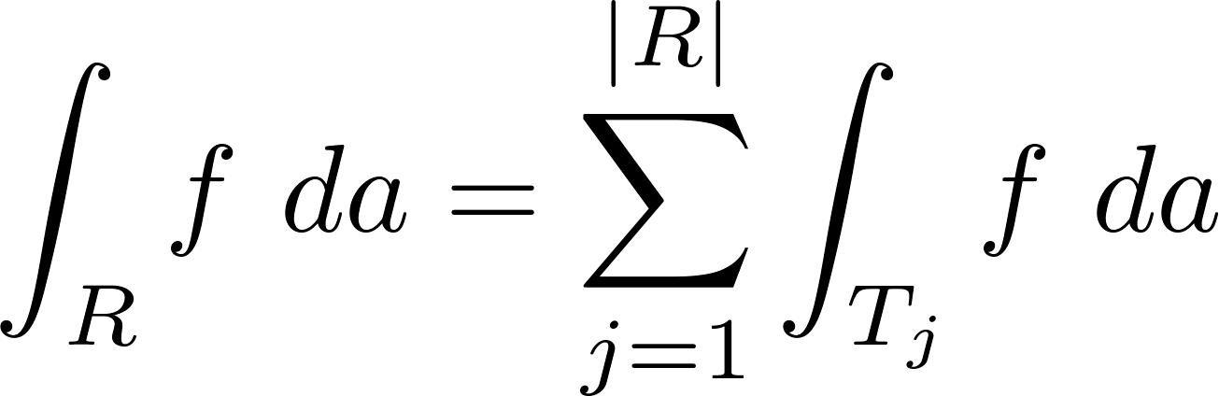
Discretization: Integral of a function
behaves linearly within each triangle and it is uniquely determined by its values at the vertices of the triangle.
The integral of f over a region is just the sum:

Slide 26
Exercise: Integral of a function
Write the code to compute the integral of a function on a triangle mesh
Test it by computing the integral of the constant function f(x)=1, and check if it returns the total surface area

Slide 27
Suggested reading
Differential geometry of curves and surfaces. Do Carmo – Chapters 2.5, Appendix 2.B

