Slide 1

Fundamentals of
Computer Graphics
The gradient
Emanuele Rodolà
rodola@di.uniroma1.it
1st semester a.y. 2018/2019 – November 22, 2018

Slide 2

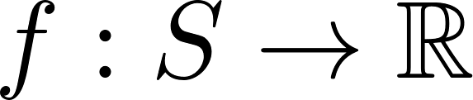
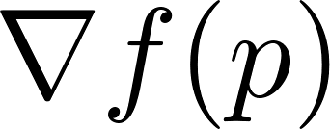
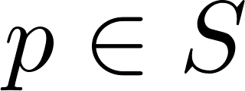
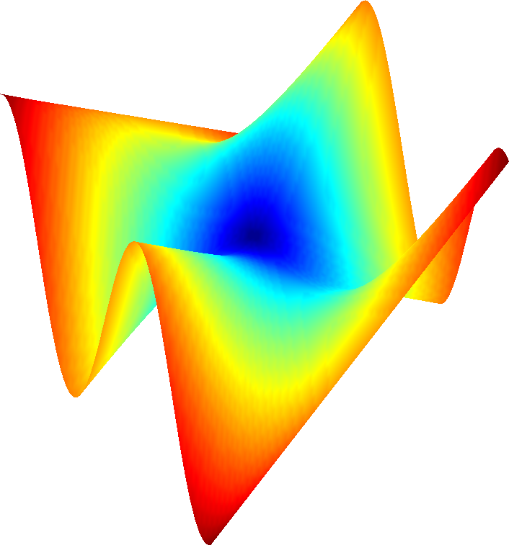
Gradient of a function
Consider a surface S with parametrization and a differentiable function
We want to define the gradient at a point
p

Slide 3
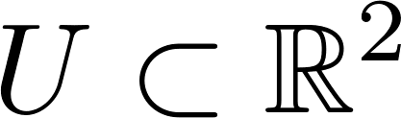
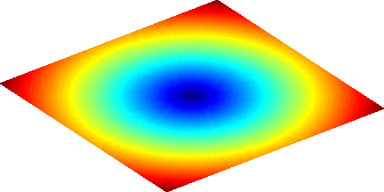
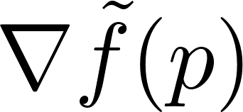
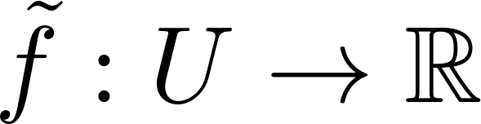
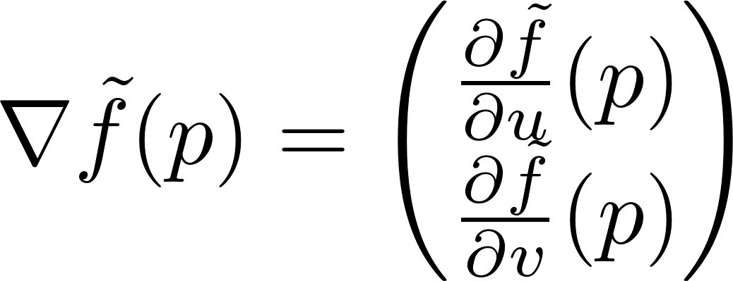
The gradient in R²
v
p
u
The gradient of a differentiable function is the vector field

Slide 4
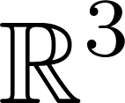


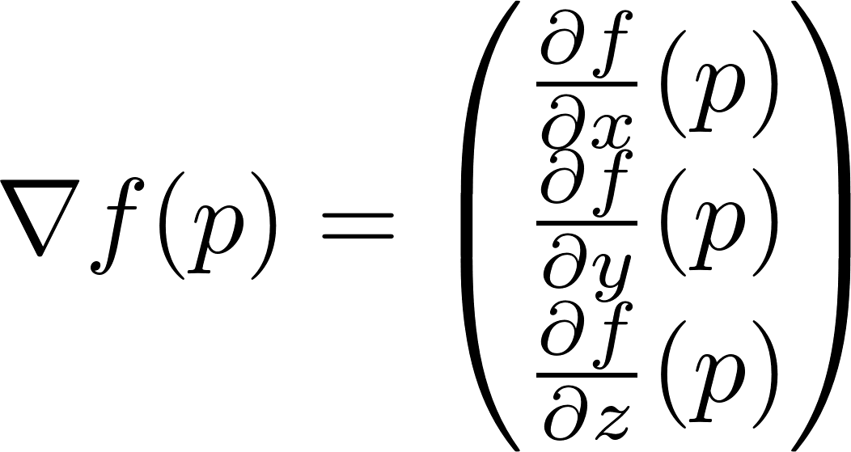


The gradient on a surface
Ideas how to define :
Use the same formula as before, but in terms of x, y, z:
p
Not a good choice, because we have
no information about f outside of S!

Slide 5
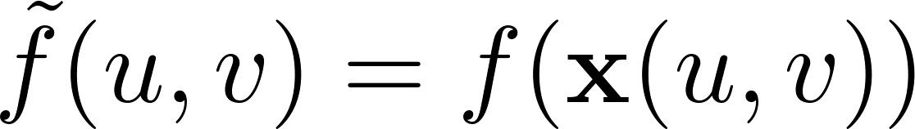
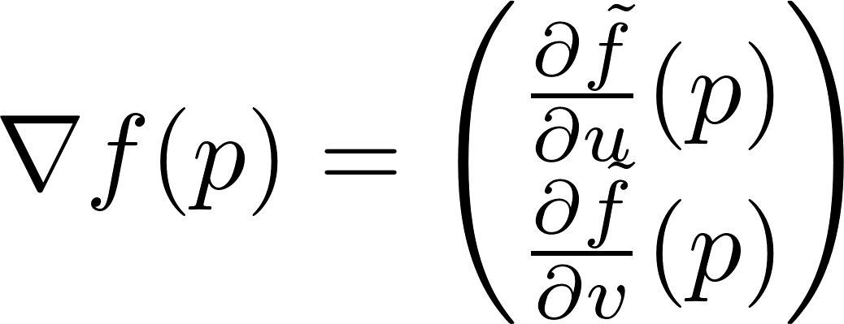

The gradient on a surface
Another possibility is to express our differentiable function f in terms of a parametrization x:
and then set:
Depends on the choice of the parametrization!
v
p
p
u

Slide 6
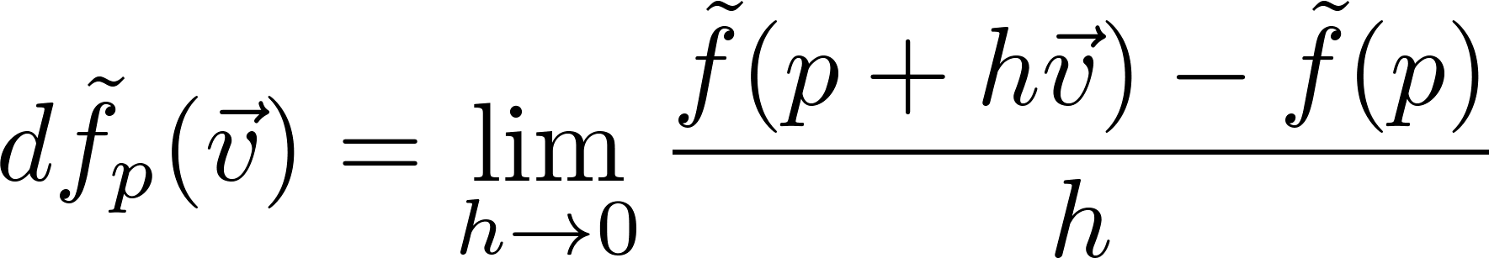
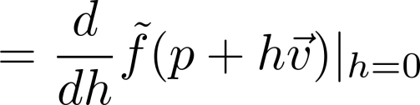

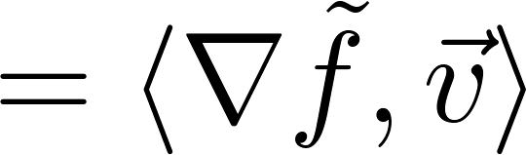
The gradient on a surface
Instead, let us try to interpret the geometric meaning of the gradient:
The vector that points in the direction of steepest increase of f
Its length measures the strength of increase
We have a relationship with the directional derivative:
v
p
u
directional derivative of f at p, along direction v

Slide 7
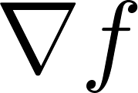
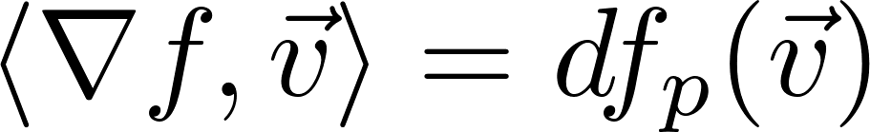



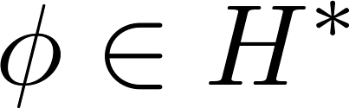
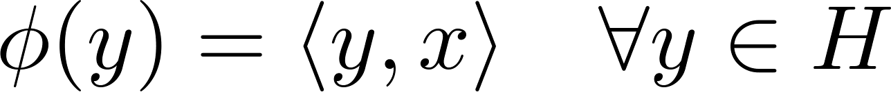
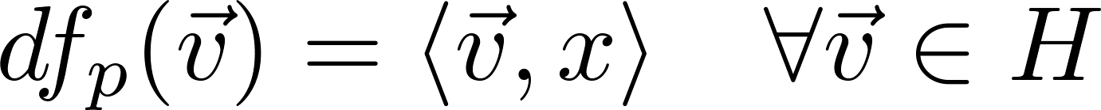
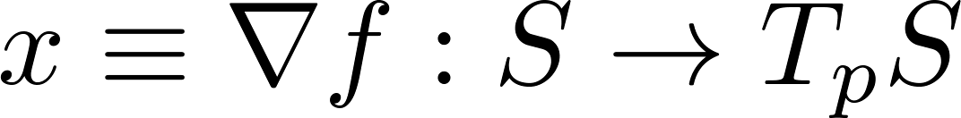
Representation theorem
The gradient of any differentiable function can be defined as the unique vector field such that the relationship holds:
This is an application of the Riesz representation theorem:
Inner product space
dual space of H
Then, every can be written uniquely as an inner product:
And one can then define the gradient as the unique

Slide 8
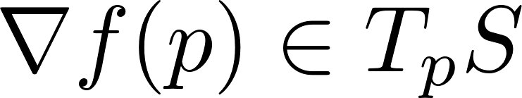

The gradient on a surface
We define the gradient by means of the inner product:
Thus, if we are able to write down , we can “solve for” .
p

Slide 9
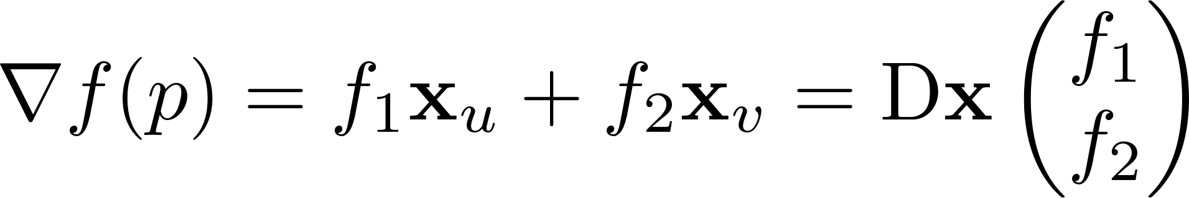


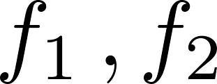

The gradient in local coordinates
Since the gradient is a member of T_{p}S , we can express it in the local basis:
Hence, knowledge of the coefficients corresponds to knowledge of .

Slide 10
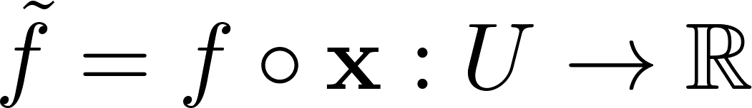
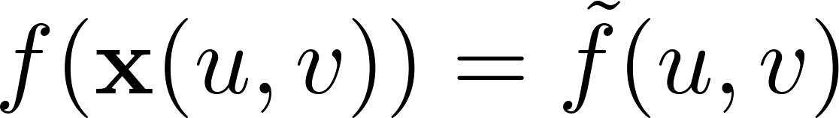
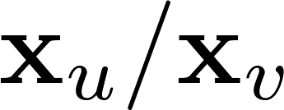

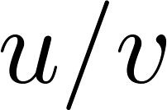
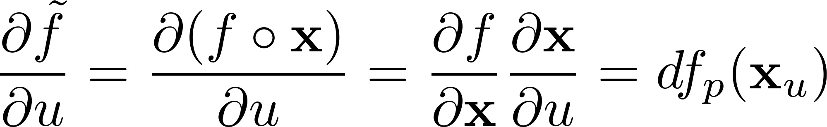

The gradient in local coordinates
It turns out that the coefficients can be obtained by considering the gradient of , which is defined on the parameter domain.
v
p
u
Since we have , we also have that the change of in the direction corresponds to the change of in the direction :
Hence, we can compute the directional derivative directly in parameter space
chain rule
Riesz

Slide 11
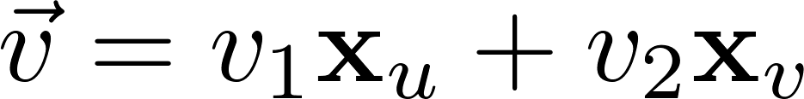
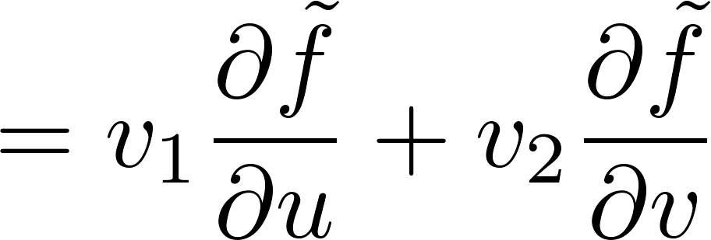
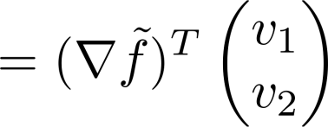
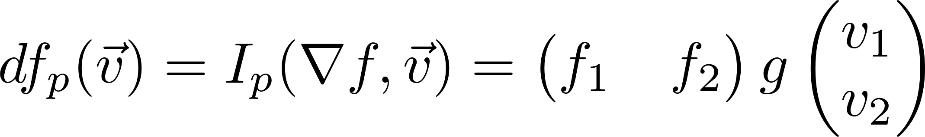
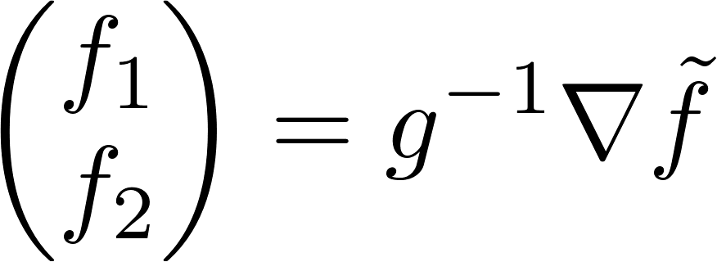
The gradient in local coordinates
Now let , and apply on both sides (note that is linear):
p
On the other hand, we can also write:
This means

Slide 12
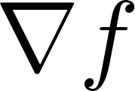
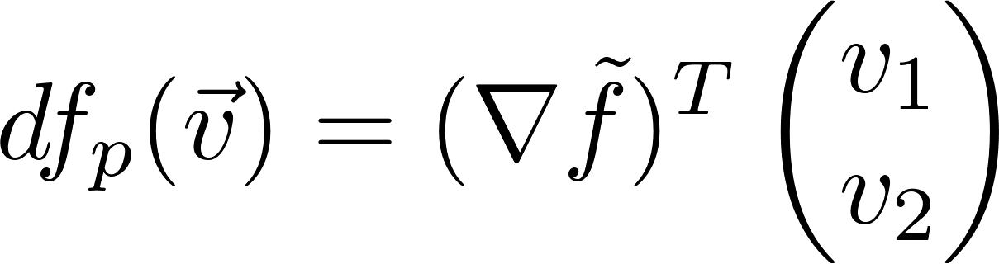
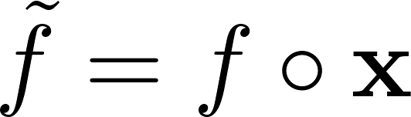
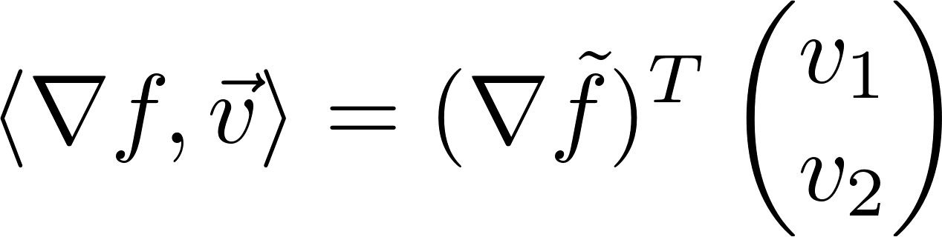
Wrap-up
Thus, according to our definition of the gradient, we have to find the unique such that:
We can compute the directional derivative directly in U, as:
where
defined on the surface S
defined on the parameter domain U
We can thus write

Slide 13
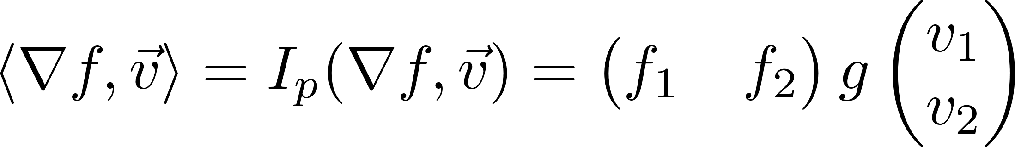
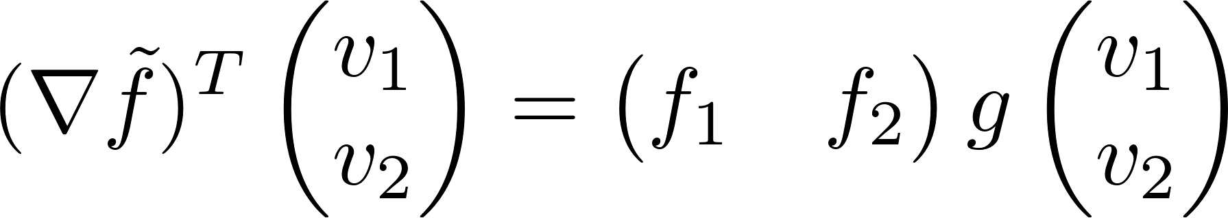
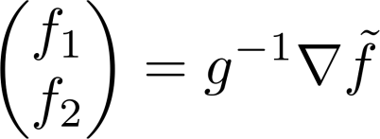
Wrap-up
Using the bilinear definition of first fundamental form, we can also write
Together with the last equation from the previous slide, we have
And thus we finally obtain:

Slide 14
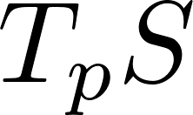
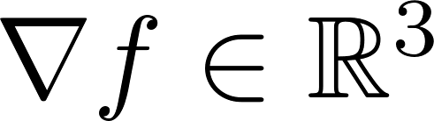
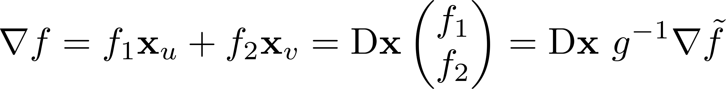
Expression in local coordinates
The expression
is giving the gradient coefficients w.r.t. a basis in , hence it is said to be given in local coordinates.
To obtain a vector (i.e. in global coordinates), we simply have to write:

Slide 15
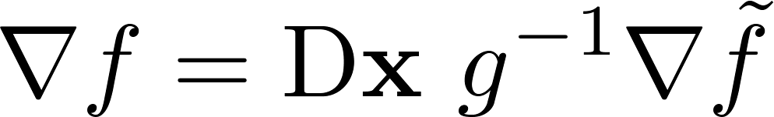
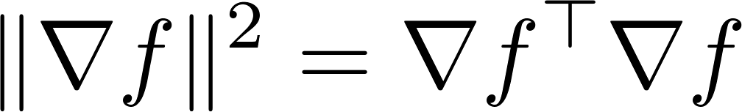
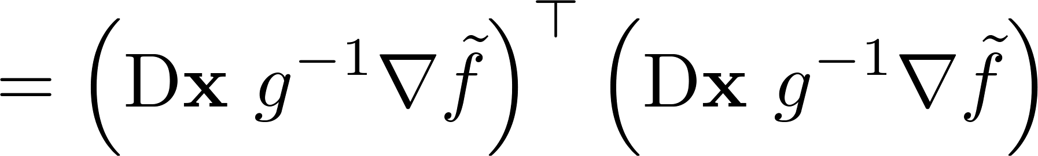

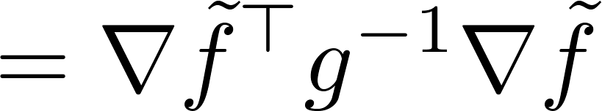
Gradient norm
In some applications we need the norm of the gradient. Our final expression for the gradient is given by:
Computing its (squared) norm is straightforward:

Slide 16
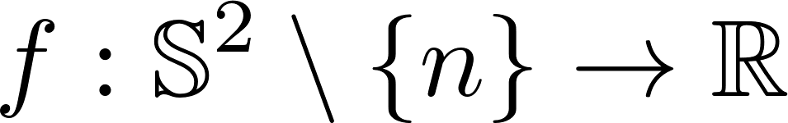






Example: The sphere
Consider the function that assigns to each point its distance to the north pole n:
We want to compute its gradient:
We consider the parametrization:

Slide 17






Example: The sphere
u
v

Slide 18



Example: gradients in R²
u
v

Slide 19






u
v

Slide 20
















Discretization: The gradient
Recall that we are assuming functions to be linear within each triangle.
Our partial derivatives on the reference triangle can be simply approximated by the finite differences:

Slide 21


Discretization: The gradient
The discrete gradient is then given by:
Also observe that:

Slide 22



Discretization: Gradient norm
We simply obtain:
Note that, since we take f to be linear, the gradient is constant within each triangle.

Slide 23






Discretization: Total variation
The total variation of a function is:
We know how to compute integrals of functions on triangulated meshes. We simply get, for each triangle:

Slide 24


