Slide 1
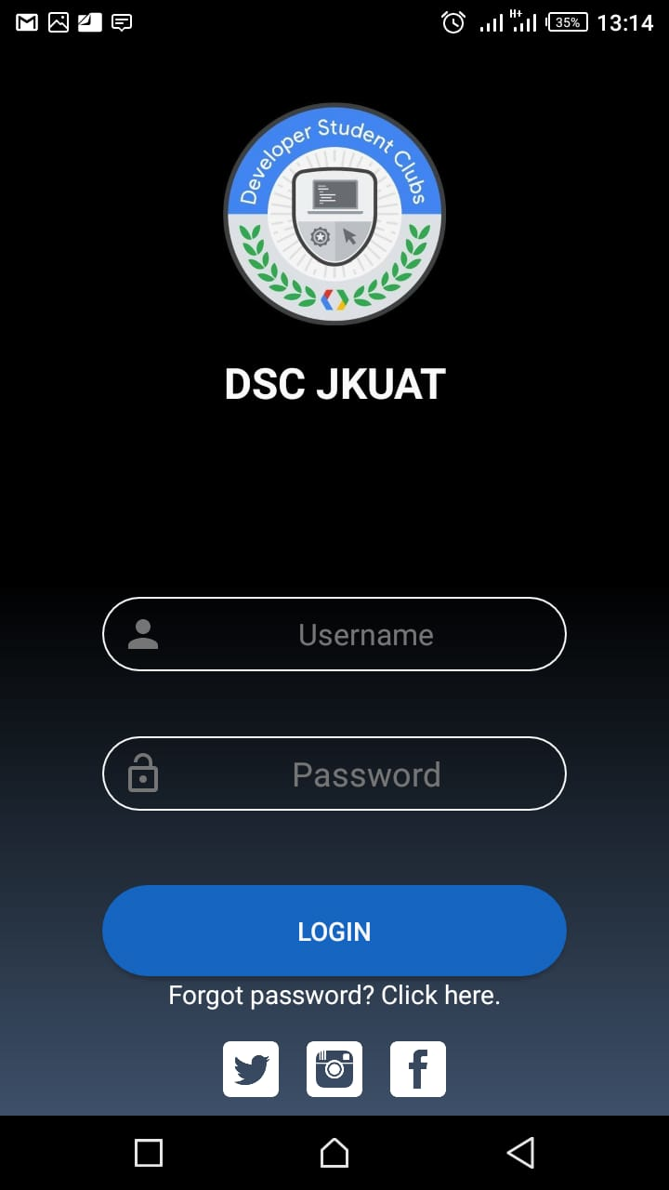
LOGIN UI DESIGN
Instructor: Eric Ndirangu
GITHUB: https://github.com/erodrago/LoginUI-design
TWITTER:@eric_ero

Slide 2
WHAT WE WANT TO ACHIEVE
We will create this basic login UI which implements the basic concepts weve been learning like:
Layouts: Linear, Vertical….
Views: TextVies, Button….
We will work with the following components:
Linear layout
Image Views
Text Views
Buttons

Slide 3
JUST A LAYOUT WITH BASIC COMPONENTS
LINEAR LAYOUT
Image View
Text View
EditText

Slide 4
LETS START CODING
STEPS:
Create Vertical Linearlayout
Add Image View
Add 2 Textviews
Add a button
Another Text View
A horizontal linear layout
NEW- Add scroll layout
Lets style our Views lets make it look AWESOME

Slide 5
FIND RESOURCE HERE
https://github.com/erodrago/LoginUI-design

Slide 6
THE END
CODE ON…..

