Slide 1

Automated Temperature Control System with Visual and Auditory Feedback
Project No: 9
Project Name: Temperature-Controlled Fan
Students: Ata Deniz, Ece Akdeniz, Egemen Eroğlu

Slide 2
Objective
The objective of this project is to create a temperature control system using an Arduino microcontroller that regulates a fan motor's speed based on the ambient temperature. Additionally, the system provides visual feedback using an RGB LED and auditory feedback using a buzzer.
Components:
1 x Arduino Uno R3
1 x Temperature Sensor (TMP36)
1 x LCD 16x2 (I2C)
1 x DC Motor
1 x NPN Transistor (BJT)
1 x Piezo
1 x RGB LED
1 x Push Button
12 x Jumper Cable
3 x 150Ω Resistor + 1 x 10kΩ Resistor

Slide 3
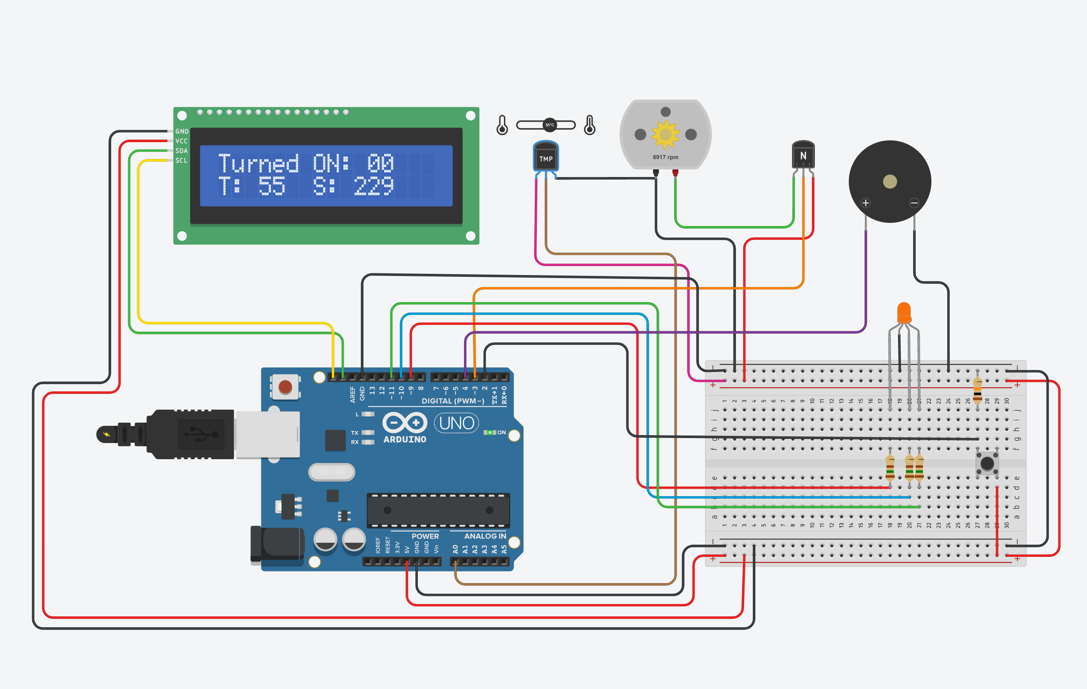
Circuit Design

Slide 4
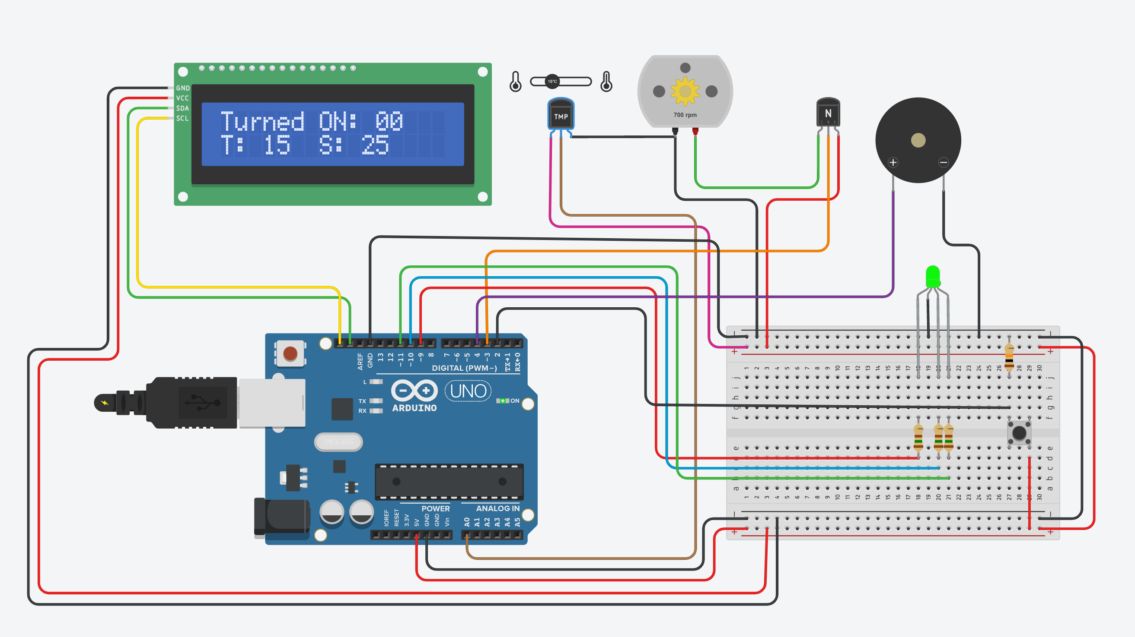
State 1: Safe Zone (tmp < 30: green light)

Slide 5
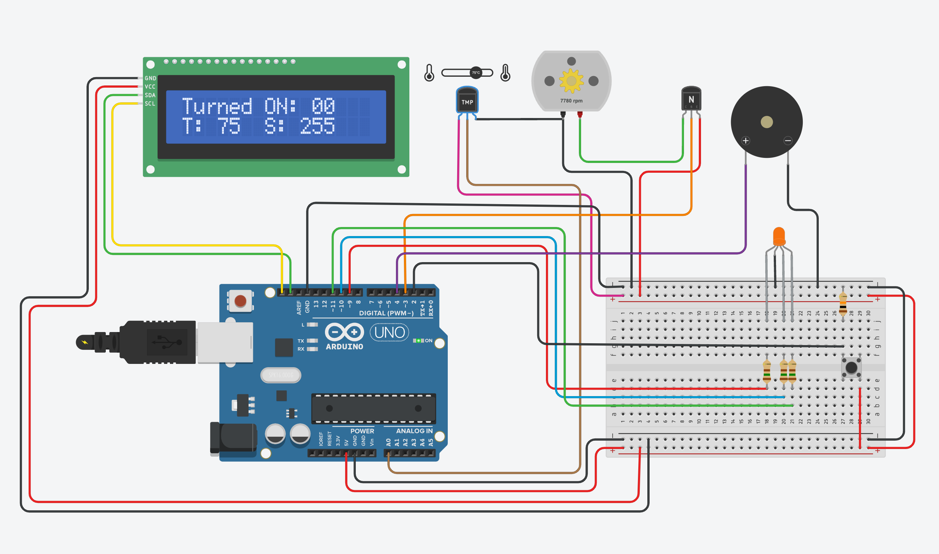
State 2: Warning Zone (tmp > 30 & tmp < 80: orange light)

Slide 6
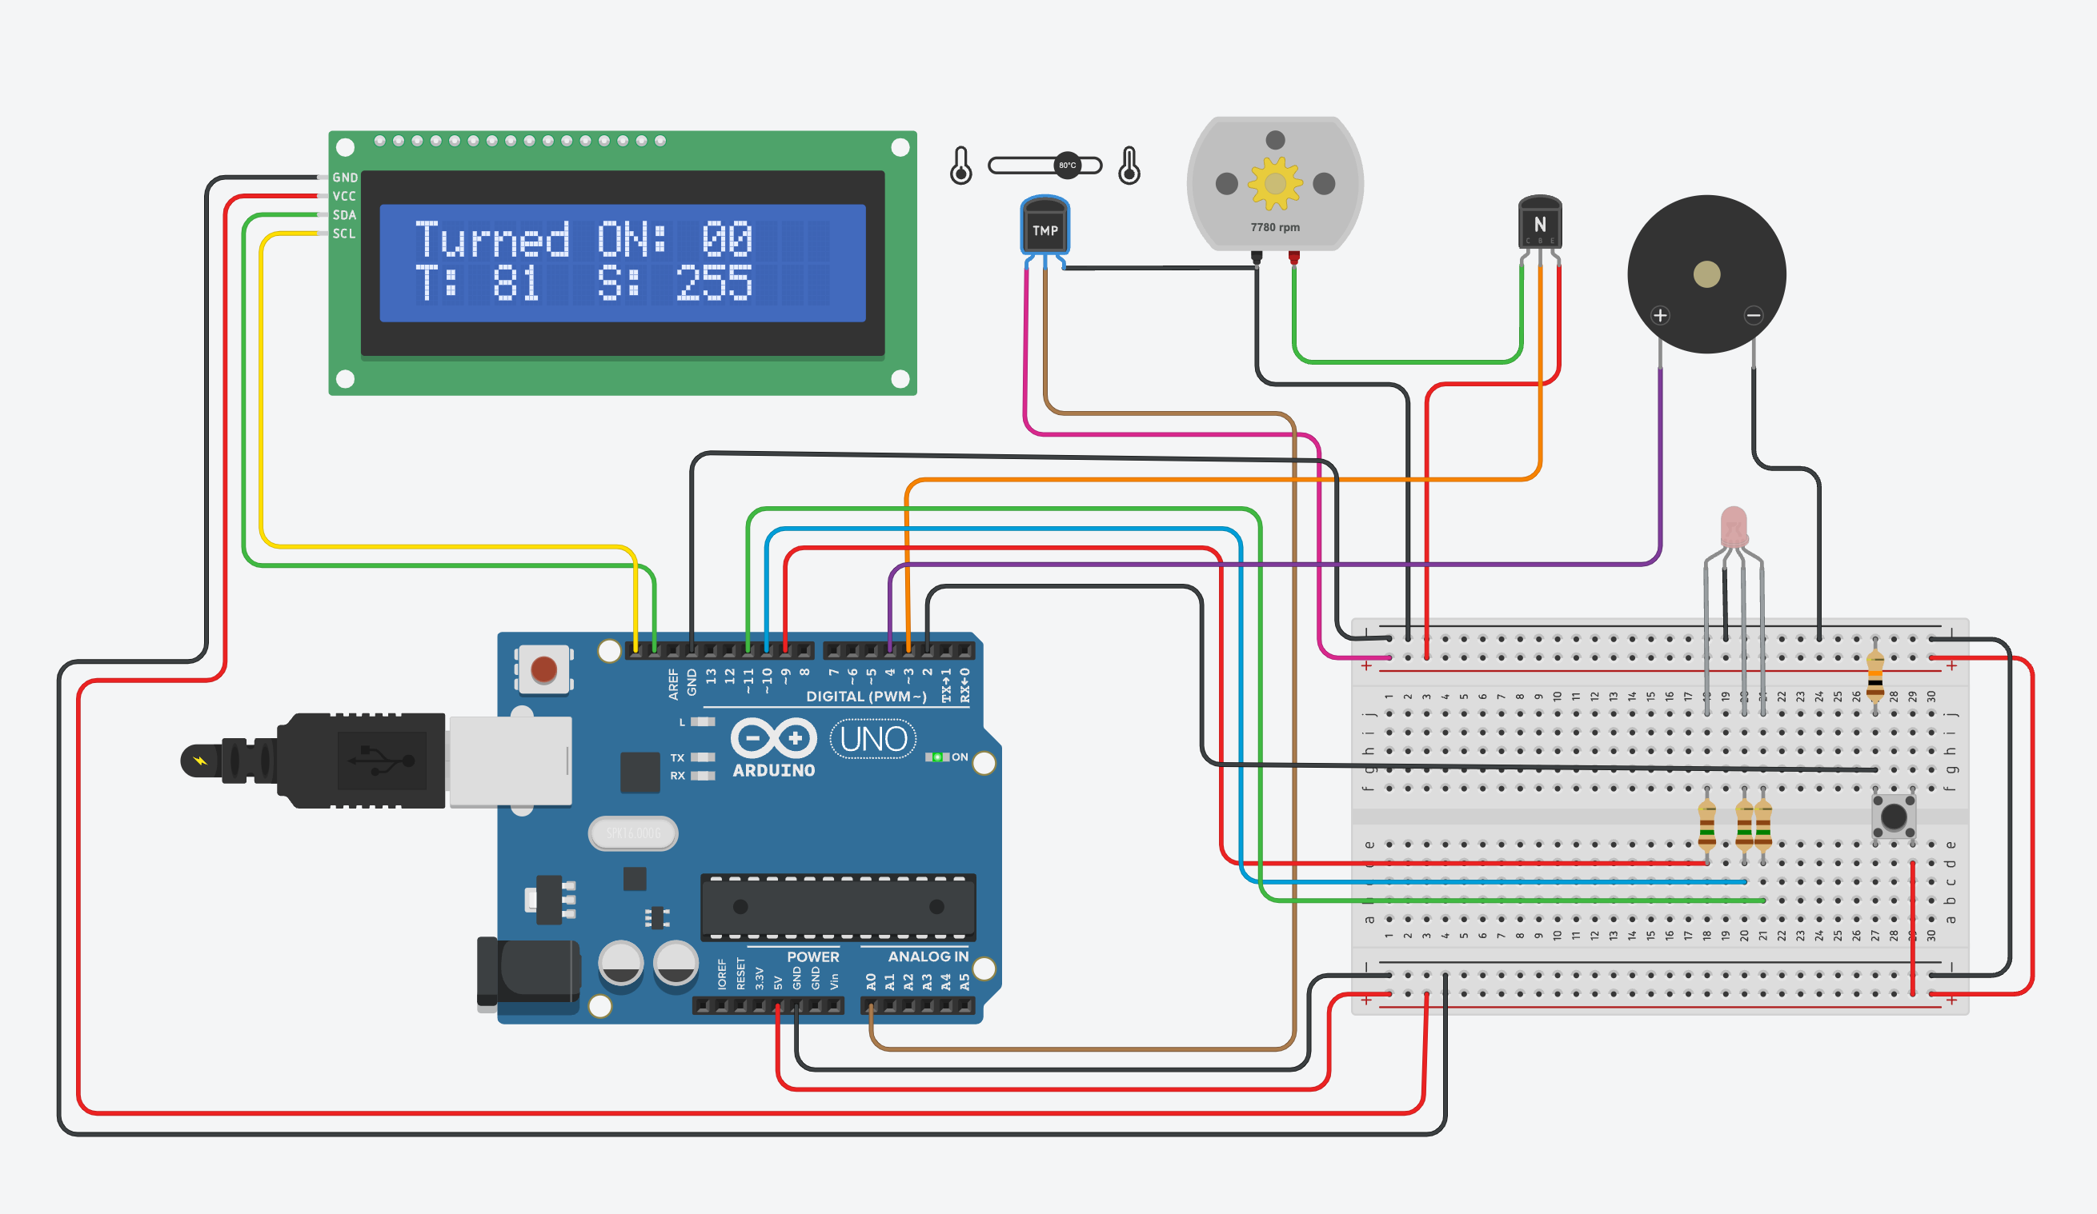

State 1: Danger Zone (tmp > 80: red light(blink) + buzzer)
time = 0
time = 1

