Slide 1
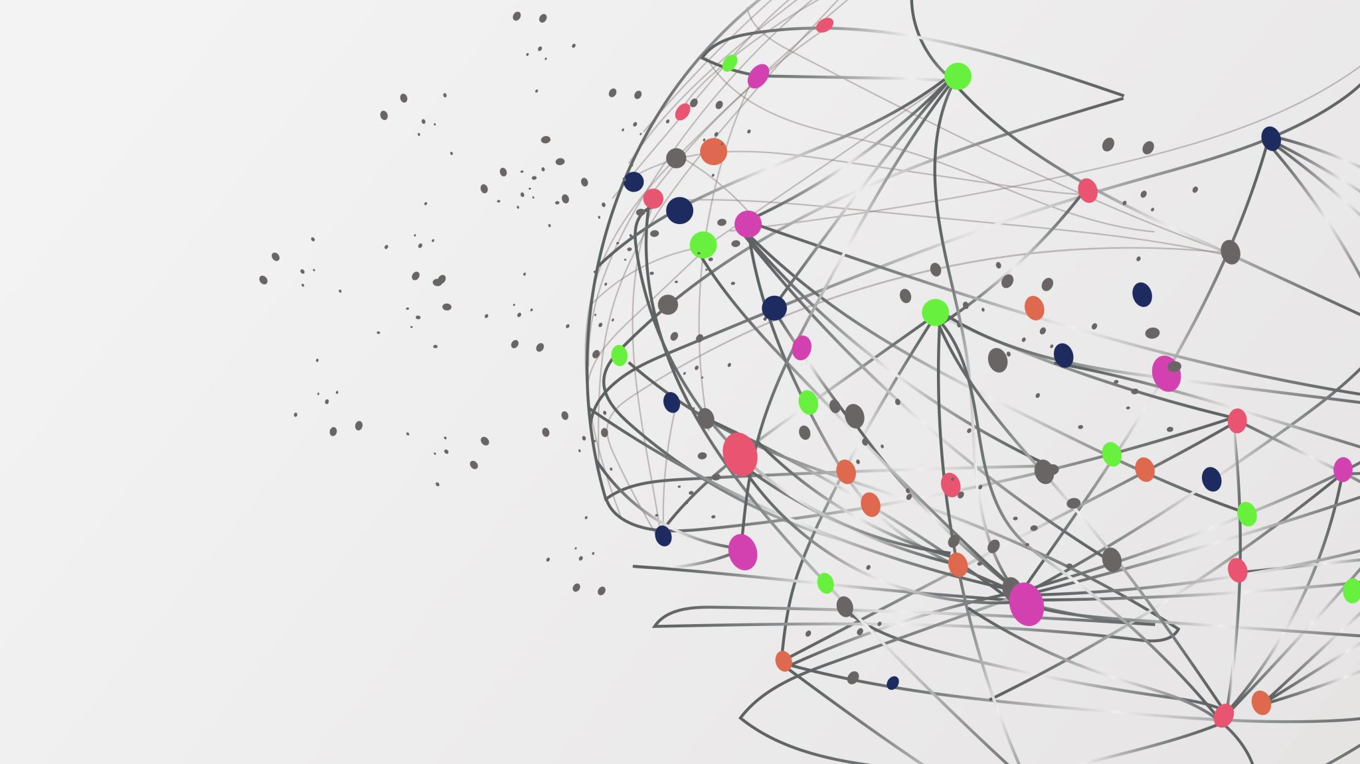
Graph Partitioning
Egemen Eroglu - 2203252

Slide 2
Algorithms that we are gonna dive into
Kernighan-Lin (KL):
The agile explorer, KL swiftly navigates the graph, swapping vertices like seasoned travelers to find better partitions.
Complexity: O(n^2 * log n)
Fiduccia-Mattheyses (FM):
FM analyzes each vertex, calculating its impact on the cut size before strategically shifting it to a new node.
Complexity: O(n * m)
Multi-Level Graph Partitioning (MLGP):
MLGP conquers sprawling networks by shrinking the playing field. It repeatedly merges vertices, tackles the simplified version, and then carefully projects the solution back onto the original graph.
Complexity: O(n log n).

Slide 3
Kernighan-Lin (KL) Algorithm:
Steps:
Assign vertices to initial partitions randomly.
Iteratively swap pairs of vertices between partitions to improve the cut size.
Accept a swap only if it decreases the cut size.
Terminate when no more beneficial swaps can be found.
Key Points:
Efficient heuristic for finding good partitions.
Often used as a refinement step in other algorithms.
Doesn't guarantee finding the optimal solution.

Slide 4
Preview Kernighan-Lin Algorithm
k: Number of subset/cluster
3
frames: Number of iteration
10
(Each color represent one cluster!)
You can find the source code in my github!

Slide 5
Fiduccia-Mattheyses (FM) Algorithm:
Steps:
Assign vertices to initial partitions randomly.
Move single vertices between partitions to improve the cut size.
Prioritize moving vertices with high gain scores.
Update gain scores after each move.
Terminate when no more beneficial moves can be found.
Key Points:
Often faster than KL in practice.
Can produce high-quality partitions in a reasonable amount of time.
Also doesn't guarantee finding the optimal solution.

Slide 6
Preview Fiduccia-Mattheyses Algorithm
k: Number of subset/cluster
3
frames: Number of iteration
10
(Each color represent one cluster!)
You can find the source code in my github!

Slide 7
Multi-Level Graph Partitioning (MLGP) Algorithm:
Steps:
Coarsen the graph repeatedly by merging vertices and edges.
Partition the coarsest graph (often using KL or FM).
(Uncoarsen) Project the partition back to the original graph, refining it at each level.
Key Points:
Effective for large graphs.
Can produce high-quality partitions for complex graph structures.
Commonly used in practice for large-scale partitioning tasks.

Slide 8
Complexity Showdown:
Algorithm | Complexity | Strengths
Kernighan-Lin (KL) | O(n^2 * log n) | Efficient, good refinement tool
Fiduccia-Mattheyses (FM) | O(n * m) | Fast, high-quality partitions
Multi-Level Graph Partitioning (MLGP) | O(n log n) (typically) | Effective for large graphs, good quality

Slide 9
Which one should we use?
Small graphs: KL or FM might be sufficient.
Large graphs: MLGP is often more efficient.
Performance critical: FM might be faster than KL.
High-quality partitions: MLGP often produces better results.

Slide 10
Resources & References
(ENG) Fiduccia-Mattheyses Algorithm
(TR) EN KISA YOL PROBLEMİNDE ÇİZGE PARÇALAMA YÖNTEMİ KULLANILARAK YENİ BİR YAKLAŞIM
(ENG) Carnegie Mellon University (CMU) - Kernighan-Lin Graph Partitioning
(ENG) Massachusetts Institute of Technology (MIT) - Multilevel Graph Partitioning
GitHub Repository:
https://github.com/erogluegemen/CMP3005-Term-Project

