Slide 1





DeepMind
Lamija Hadzic

Slide 2
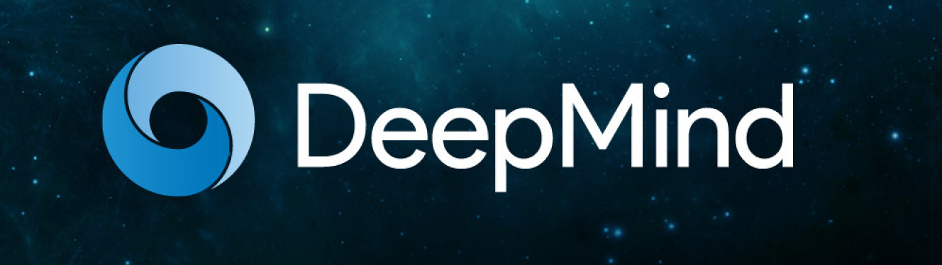
What’s DeepMind?
DeepMind is a company that specialises in artificial intelligence programming

Slide 3

Founded in September of 2010
Acquired by Google in 2014
Demis Hassabis, Shane Legg und Mustafa Suleyman

Slide 4

WHAT’S THEIR GOAL?

Slide 5
To solve intelligence, and then use it to solve everything else.

Slide 6
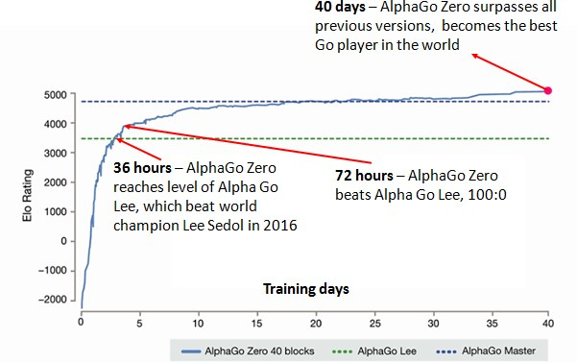
AlphaGo & AlphaZero
AlphaGo beat a professional go player, a world champion
AlphaZero beat the most powerful programs playing go, chess and shogi

Slide 7






APPLICATIONS
saving energy, identifying eye disease, accelerating science, and improving Google products used across the world

Slide 8
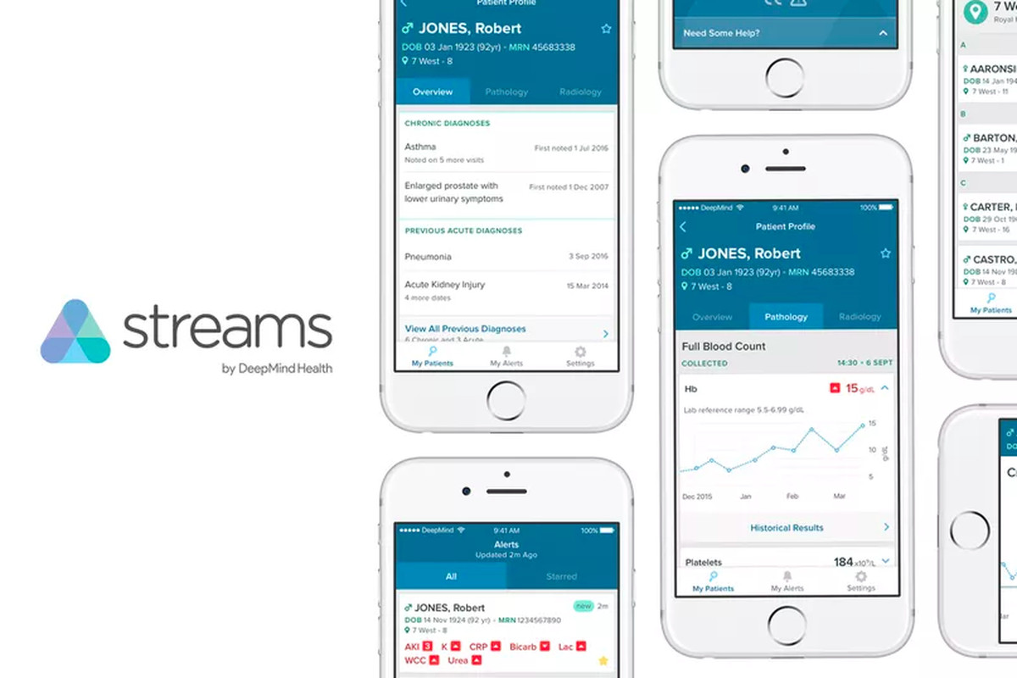

Slide 9

STREAMS
a patient safety app
reviews test results for signs of sickness and sends staff instant alerts
Breached the Data Protection Act

Slide 10
However…

Slide 11
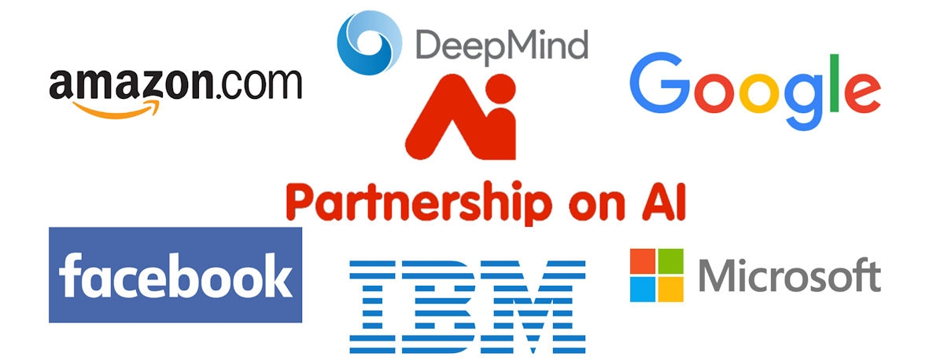
Tackling ethical issues
Partnership on AI
DeepMind Ethics and Society

