Slide 1

FACULTY OF MECHANICAL ENGINEERING AND INFORMATICS

Slide 2
OPTIMIZATION OF OBJECTS AND SYSTEMS
Author: Sumeyra Erol
Lecturer: Dr. Karoly Jarmai

Slide 3
DEFINITION
The term optimize: “to make perfect”
An act, process or methodology of making something as fully perfect
Finding an alternative solution for problems

Slide 4
INTRODUCTION
Everyday, people always make optimization in their life on a conscious or subconscious way.
Optimization can be to reach the best, which is possible with the resources available. Because of that, the conscious makes the act more efficient.
The birth of optimization methods can be dated back to the days of 100 years. The further development in optimization was possible of differential calculus.

Slide 5
FLOW CHART FOR OPTIMIZATION
INPUTS
REAL SYSTEM
OUTPUT
INPUT FACTOR LEVELS
MATHEMATICAL MODEL OF SYSTEM
RESPONSE
OPTIMIZATION PROCEDURE

Slide 6
ADVANTAGES
The first and most obvious benefit is how it can improve your problem’s efficiency.
Require fewer experiments to achieve an optimum formulation.
It can trace and rectify problem in a remarkably.

Slide 7
Continuous
Use derivatives
Multilevel
Discrete
Without derivatives
Single level
Multiobjective
Optimization
Model
Constrained
Single objective
Unconstrained
Linear
Inequality constraints
Analytical
Nonlinear
Equality constraints
Numerical

Slide 8
Analytical and Numerical
Analytical methods use the mathematical theory of differential calculus and calculus of variations.
Numerical methods usually employ mathematical programming.Numerical methods use past information to generate better solutions.

Slide 9
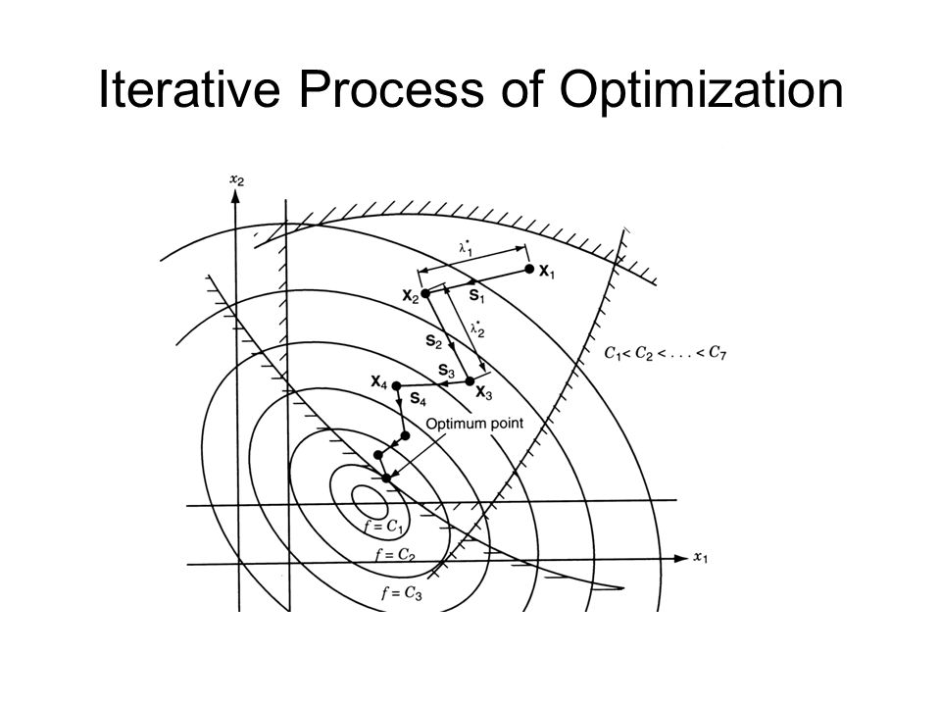
Numerical methods can be used to solve problems that cannot be solved analytically, because of this efficiency in problems, we deal with numerical methods of nonlinear programming. Best solution is shown in the middle of the figure. Constraints don’t changed but unknowns can change.

Slide 10
Unconstrained and Constrained
In early generation of the optimization techniques, the aim was only the function minimization without any constraints. Some techniques transform the constrained problem into an unconstrained one.

Slide 11
Single- and Multivariable
Most of the constrained multivariable optimization techniques are efficient, if the number of unknowns variables is not too much.

Slide 12
Single- and Multiobjective
The basis of the multi objective optimization methods is the transformation of the vector optimization problem into a sequence of single objective optimization problems.

Slide 13
Discrete and Nondiscrete
Most optimization techniques use non discrete. So, discrete optimization is a smaller stream in this field. The main advantage of discrete optimization is, that the result is closer to the realistic solution.

Slide 14
Methods Without Derivatives
Complex Method
Flexible Tolerance Method
Hillclimb Method

Slide 15

Complex Method
Complex method is a constrained minimization technique which uses random search. So it doesn’t require derivatives. It usually use the random search directions. Because of that, its nonlinear programming problems solve with inequality constraints. M is the number of implicit constants and x the limit for the variables.
The explicit constraints(i=1,2,…N):
The implicit constraints(i=N+1,N+2,…N+M):

Slide 16
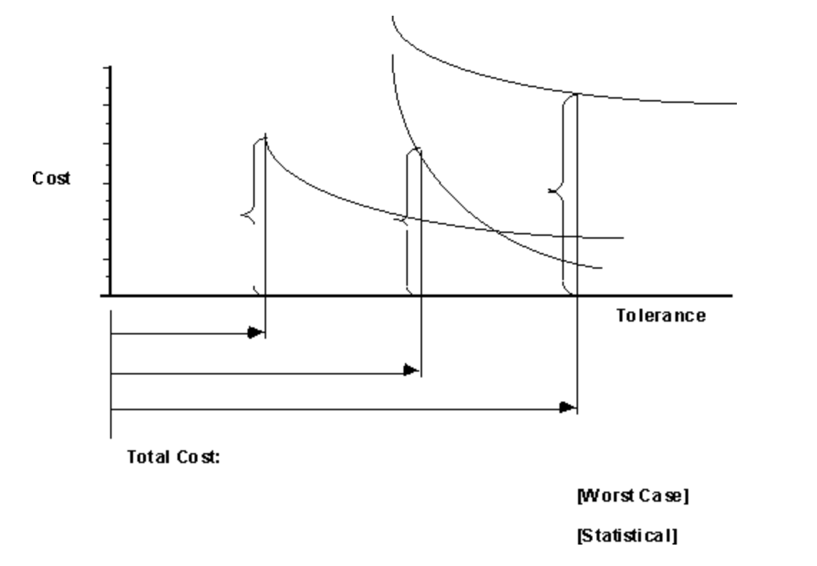
Flexible Tolerance Method
Flexible method is a constrained random search technique. It uses the complex method. It allows to go outside of the feasible region, but if it doesn’t go far. This method improves the value of the objective function. It uses information provided by feasible points.
Also there is a figure about optimal tolerance allocation for minimum cost. In this figure, the optimization tries to increase the tolerances to reduce cost, however, the specified assembly tolerance limits the tolerance size.

Slide 17
Hillclimb Method
This method is a direct search one without derivatives and a mathematical optimization technique.
It is an iterative algorithm that tries to find a sufficiently good solution by making an incremental change to the solution. Then another incremental change is made to the new solution.
Also, it finds optimal solutions for convex problems.

Slide 18
Methods With First Derivatives
Penalty Method:
It solves the constrained optimization problems satisfactorily. The main idea is to construct some unconstrained optimization problems. Then it solves them by any minimization method.
These type of optimization methods are named as Sequential Unconstrained Minimization Techniques (SUMT).
These methods use inequality and equality constraints.

Slide 19
Methods With Second Derivatives
Newton’s Method:
Newton’s Method uses second derivatives and indeed performs better.
It constructs a quadratic approximation to the objective function with a starting point. And objective function is a function that matches the first and second derivative values at that point. The minimizer of the approximate function is used as the starting point in the next step and repeat it iteratively.
Sequential Quadratic Programming Methods:
SQP methods are the standard general purpose algorithms that solve problems under the following assumptions:
-The problem is well-scaled and smooth,
-The problem is not too big.

Slide 20
TRAVELING SALESMAN PROBLEM

Slide 21
Introduction
The famous Traveling Salesman Problem is an important category of optimization problems that is mostly encountered in many areas of engineering and science. It has been studied for decades and many of solutions have been theorized.
Rather than focus on finding the most effective route, TSP is often concerned with finding the best solution.

Slide 22
Description
TSP is one such Np hard problem which is used for comparing different methods and algorithms in combinational optimization.
The Traveling Salesman Problem describes a salesman who must travel between N cities. Given a set of locations, each with an x-y coordinate and aim is that all cities once only is visited, and returns to the starting city. Find this tour such that distance travelled is a minimum. The best solution should be the shortest way. Because of that each city is connected to other close by cities or nodes.
In addition to finding solutions to the classical TSP, including the asymmetric cost problems: the distance from point A to point B equals the distance from point B to point A.

Slide 23
What Is The Problem?
The problem is: when given a set of cities, you could make to visit costly tour the least the cost of traveling from one city to another one .

Slide 24
History of TSP
The traveling salesman problem was defined in the 1800s by the British mathematician Thomas Kirkman and by the Irish mathematician W. R. Hamilton.
The picture on the right is a photograph of Hamilton's Icosian Game that requires players to complete tours through the 20 points using only the specified connections.

Slide 25
EXAMPLE OF TSP
A
15
45
40
B
40
20
40
C
D
The TSP is a lot more complicated than it may appear!
If you start at an arbitrary city and keep going to the city nearest to it, you can not get the best solution.

Slide 26
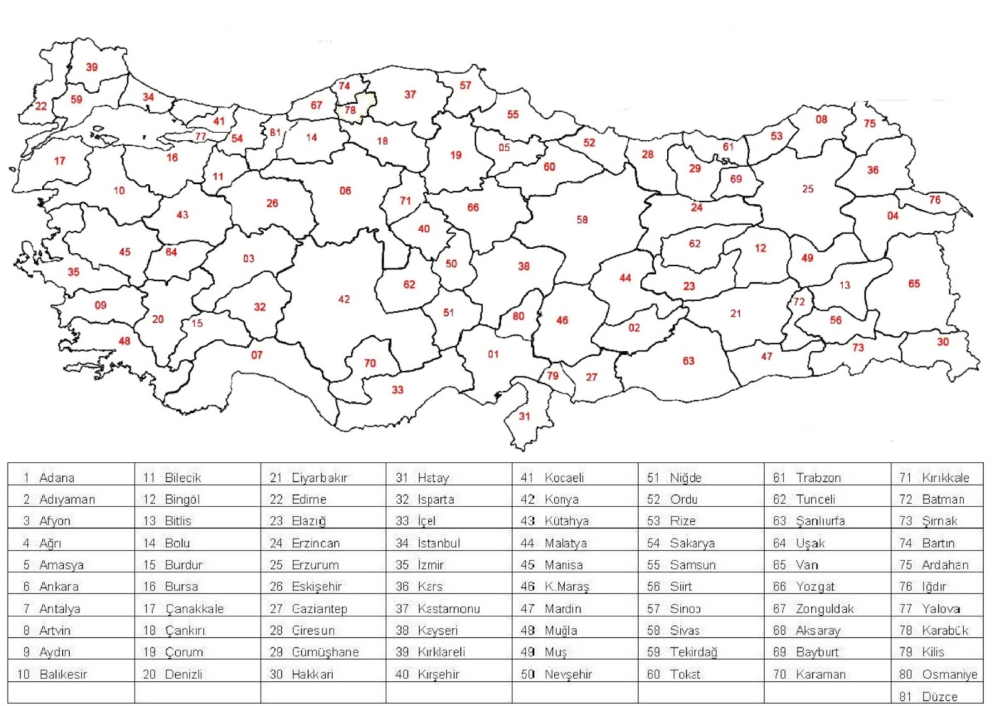
In this example, we consider a salesman traveling in Turkey. The salesman starts in Istanbul and has to visit a set of cities on a business trip before returning home. The problem then consists of finding the shortest tour which visits every city.
In this example the objective is the same as total travel distance, but this is not always the case. Because of that, it is a good idea to compute the quantity you want to minimize, rather than simply printing the objective.

Slide 27
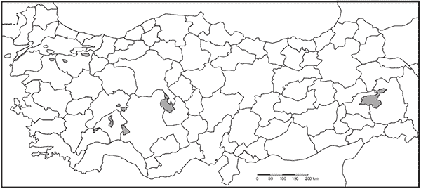
Istanbul
Kocaeli
Bursa
Ankara
Izmir
Konya
Antalya
Adana
Gaziantep
Şanlıurfa

Slide 28
REFERENCES
[1] http://adcats.et.byu.edu/Publication/87-5/WAM2.html
[2] József Farkas, Károly Jármai, Analysis and Optimum Design of Metal Structures
[3] https://complexmethod.readthedocs.io/en/latest/Description.html
[4] https://www.brightstorm.com/math/calculus/applications-of-the-derivative
[5] https://arxiv.org/abs/1805.10928
[6] http://www.math.uwaterloo.ca/tsp/history/index.html

Slide 29
“Thank you for your attention!”
–Sümeyra EROL
Computer Engineering / University of Miskolc

