Slide 1
Agreement and Adherence of Salivary Sampling Times and Diurnal Hormone Patterns
Eduardo Romo
February 4, 2026

Slide 2
Research Question
Investigators evaluated a novel saliva collection booklet with electronic cap timing to inform future research in endocrine system
Three aims
Agreement between booklet vs electronic cap sampling times
Test intercept = 0 and slope =1 in LMM
Adherence to required sampling times (30 min and 10 hr)
Descriptive comparison of % within ±7.5min and ±15min
Diurnal patterns of cortisol and DHEA
LMM with knot at 30 min to quantify hormone fluctuations over time

Slide 3
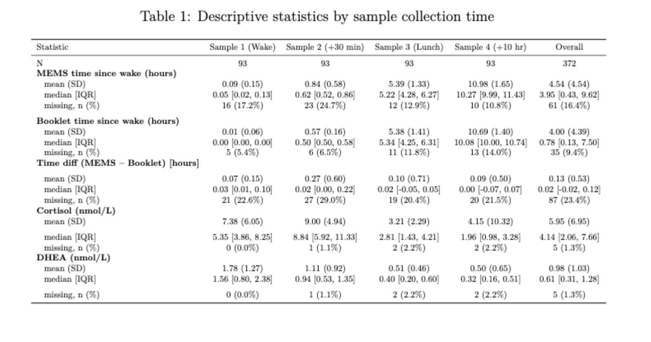
Date Overview
31 subjects with 4 samples/day over 3 days
Exclusions (Q3 analysis)
Removed subject 3037 (DHEA detection limit)
Removed cortisol >80
Removed DHEA = detection limit

Slide 4
Analysis
Q1
Scatterplot of booklet vs MEMs time
Linear mixed model with random intercepts for subjects
Outcome: MEMs interval
Predictor: Booklet interval
Test intercept ≠ 0 (constant bias) and slope ≠ 1 (proportional bias)
Q2
Descriptive proportions within ±7.5min and ±15min for MEMs and booklet
Q3
Piecewise linear mixed model with knot at 30
Outcome: log(Cortisol) and log(DHEA)
Predictor: booklet time since wake

Slide 5
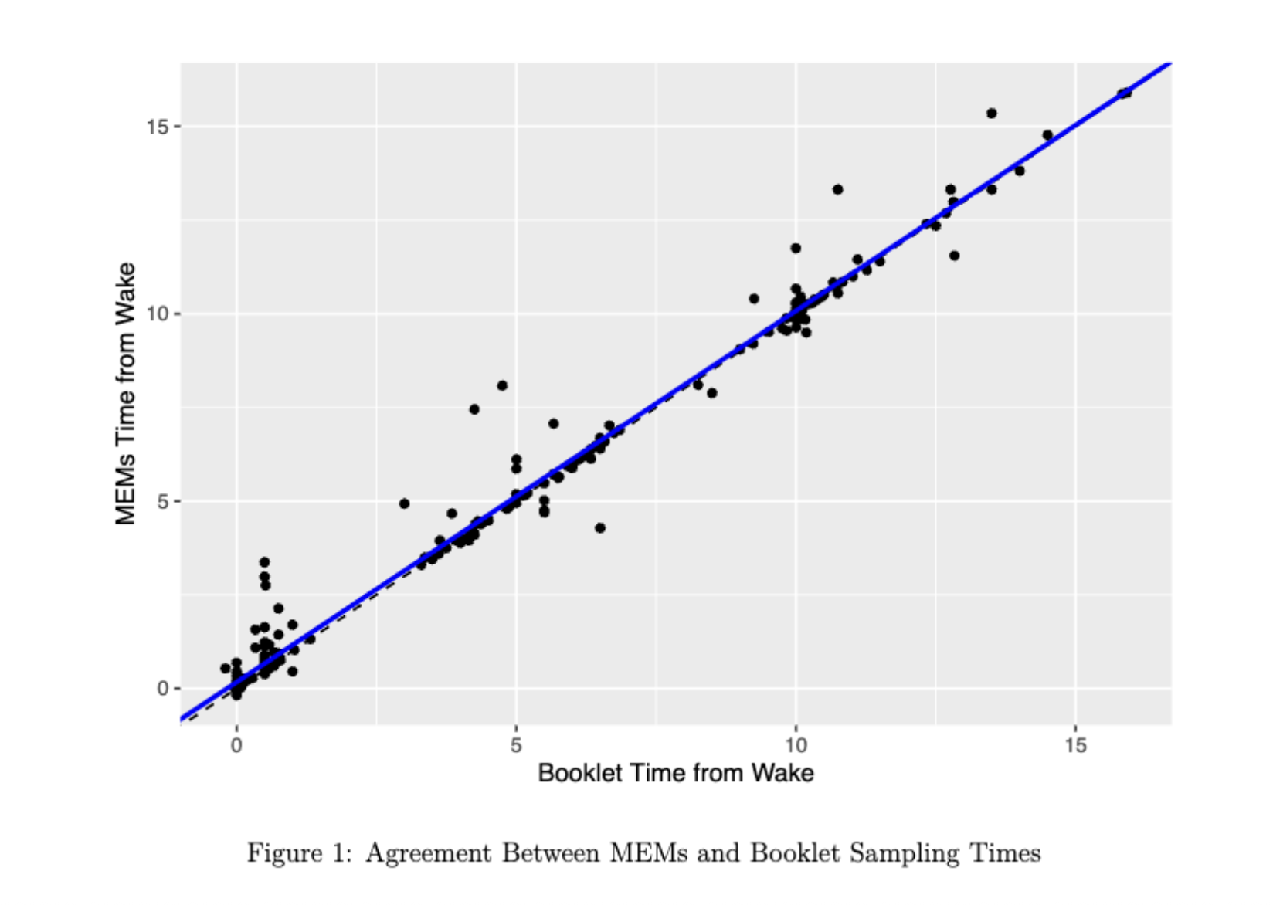
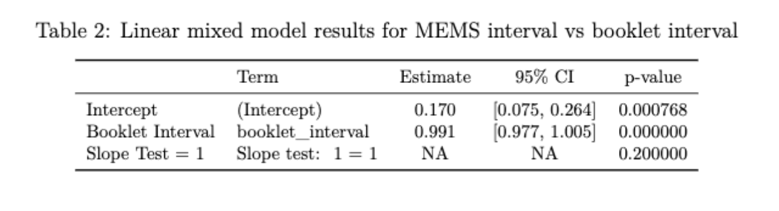
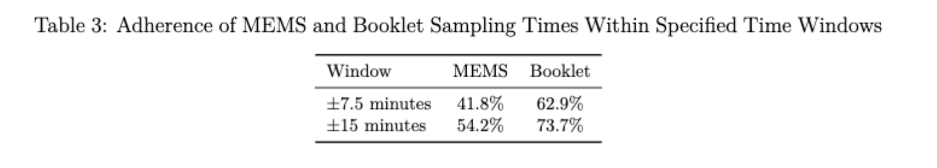
Results (Adherence + Agreement)

Slide 6
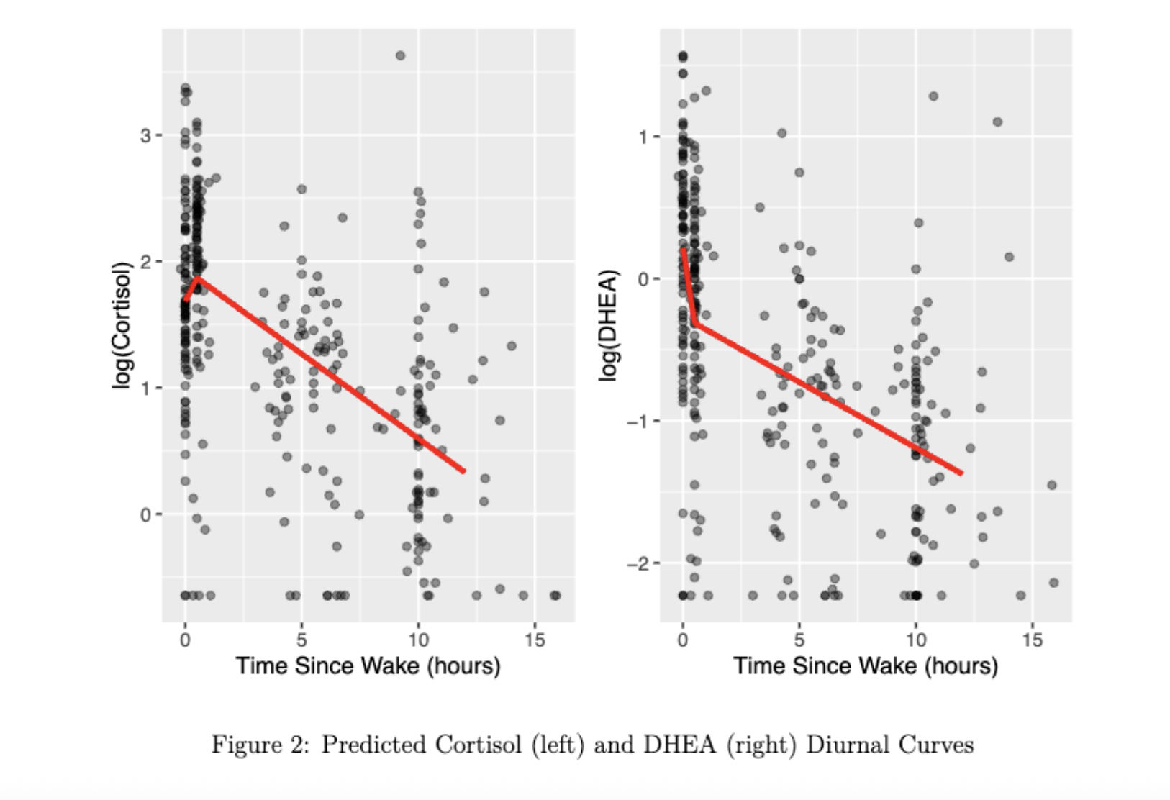
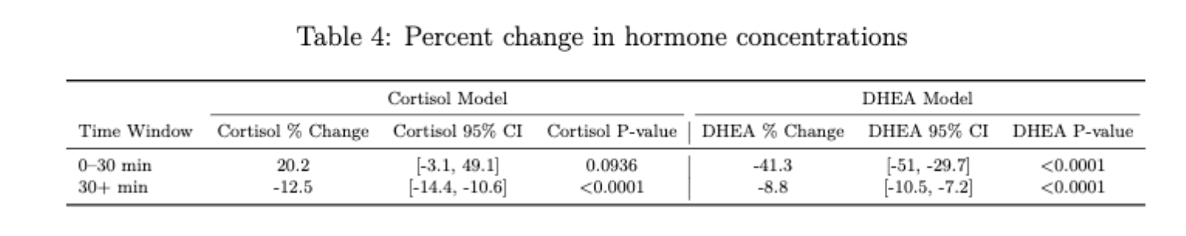
Results (Diurnal Pattern)

Slide 7
Discussion
Good agreement between sampling methods
Booklet times more complete + more adherent
Hormone patterns consistent with expected biology
Limitations
Small sample size
Missing MEMs data
Only healthy subjects

