Slide 1
Effect of baseline hard drug use on haart treatment response
Eduardo Romo
BIOS 6624
March 2, 2026
Notes:
Hi everyone, today I’ll be presenting my final analysis examining whether baseline hard drug use is associated with treatment response two years after initiating HAART therapy in HIV patients.
I’ll walk through the research question, data, analysis approach, key results, and then finish with the main conclusions and limitations.

Slide 2
Research Question & Statistical Hypotheses
Does baseline hard drug use affect treatment response 2 years after HAART initiation?
Four outcomes:
Mental QoL change
Physical QoL change
CD4+ T-cell change
Log viral load ratio
Primary Exposure: baseline hard drug use
Adjusted for age, BMI, smoking, education, race/ethnicity
Statistical hypotheses:
H₀ : Mean treatment response is equal between groups
H₁ : Mean treatment response differs
Notes:
The primary goal of this analysis was to evaluate whether reporting hard drug use at baseline is associated with poorer treatment response two years after initiating HAART.
Treatment response was measured using four outcomes that capture different aspects of health:
change in mental quality of life,
change in physical quality of life,
change in CD4+ T-cell count, which reflects immune recovery,
and change in viral load measured as a log ratio.
The primary exposure was baseline hard drug use, coded as yes versus no.
In all analyses, I adjusted for potential confounders including age, BMI, smoking status, education, and race or ethnicity.
Statistically, the hypothesis tested for each outcome was whether the mean treatment response differed between participants who reported hard drug use and those who did not.

Slide 3
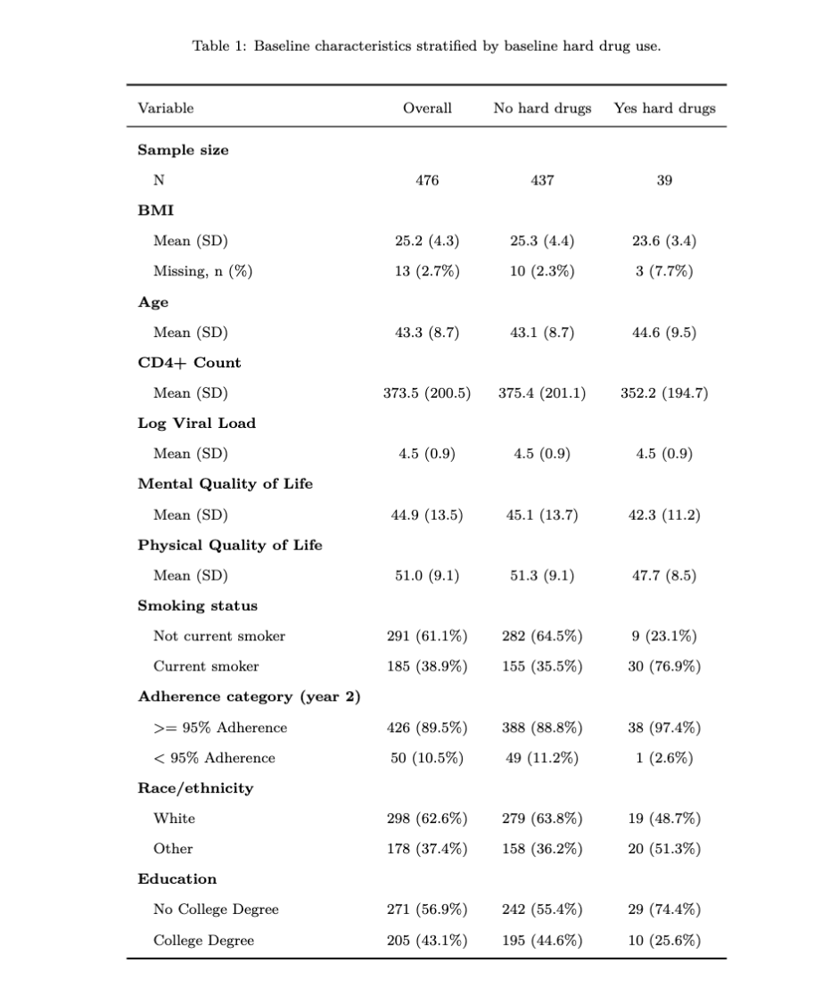
Data Overview
Source: Multicenter AIDS Cohort Study
Final analysis sample: 476 subjs
Collapsed categorical vars:
Race -> White vs Other
Smoking -> Current vs Not
Education -> College vs No college
Implausible BMI values set to NA (≤0 or ≥250)
8.2% reported hard drug use
Hard drug users:
More likely current smokers
Less likely college educated
Notes:
The data come from the Multicenter AIDS Cohort Study, which follows HIV-infected men longitudinally after HAART initiation.
The original dataset contained 715 participants. For this analysis, I focused specifically on baseline and two-year follow-up measurements because the goal was to evaluate short-term treatment response.
After restructuring the data and restricting to complete cases, the final analytic sample included 476 participants.
Several variables were recoded to improve interpretability and avoid sparse categories — for example, race and education were collapsed into binary groups.
BMI values outside plausible physiological ranges were coded as missing.
Outcomes were defined as change from baseline to year two.
A complete-case approach was used, assuming missingness was at random conditional on observed covariates.
I performed a brief exploration of missingness by stratifying proportion of missing for each outcome by hard drug use. I found that hard drug users had higher proportions of missingness.

Slide 4
Statistical Analysis
Models
Linear regression for each outcome
Bayesian models (primary)
Frequentist models (validation)
Adjustment covariates: baseline outcome value, age, BMI, smoking status, education, and race/ethnicity
Secondary analysis
Added 2 year adherence to assess mediation between hard drug use and treatment response
Inference
Point estimate + 95% intervals
Bayesian posterior probabilities of clinically meaningful effects
Notes:
For each outcome, I fit linear regression models using both Bayesian and frequentist approaches.
The Bayesian models were considered primary, while frequentist models were used mainly to verify consistency of results.
Each model included the baseline value of the outcome along with demographic and clinical covariates shown here.
I also performed a secondary analysis where adherence at year two was added to the model. This was intended as a naive mediation analysis to see whether adherence might explain part of the association between hard drug use and treatment response.
Inference focused on estimated effects and 95% uncertainty intervals, along with posterior probabilities of clinically meaningful effects in the Bayesian framework.

Slide 5
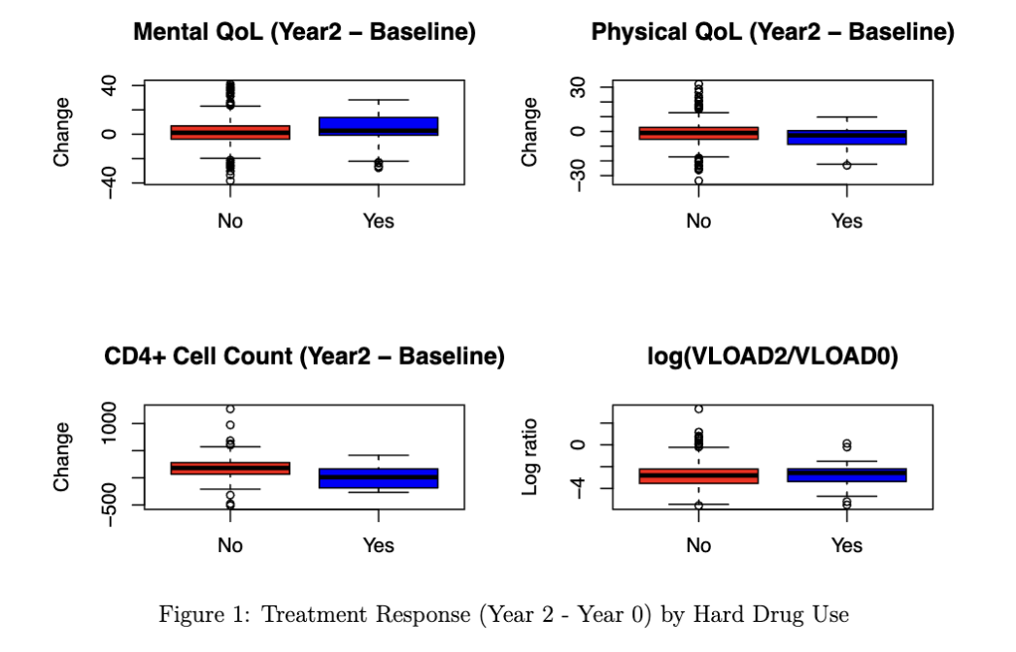
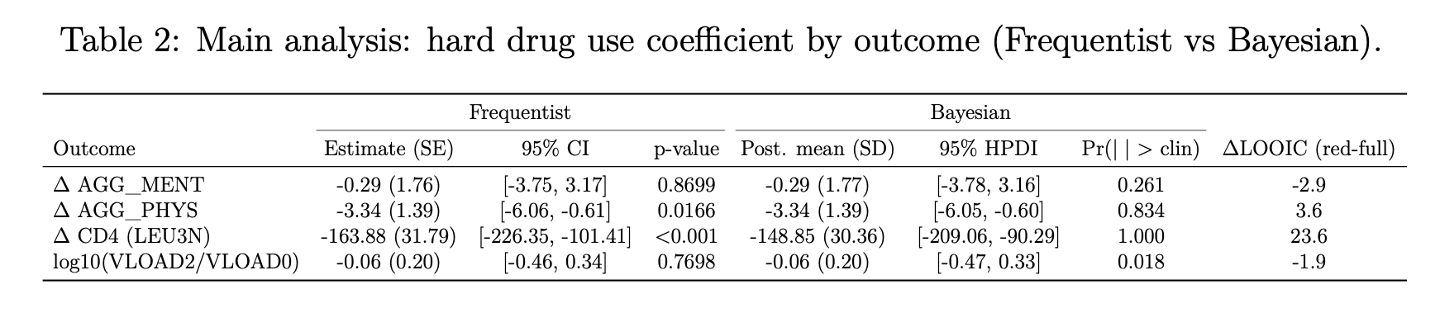
Main Results: Hard Drug Use & Treatment Response
Little evidence for mental QoL or viral load effects
Hard drug use associated with:
↓ Physical QoL improvement
↓ CD4+ recovery
Bayesian and frequentist results consistent
Notes:
This slide summarizes the main regression results, focusing only on the hard drug use coefficient since that directly addresses the research question.
Starting with mental quality of life, the estimated effect was close to zero and the uncertainty interval crossed zero, suggesting little evidence of an association.
For physical quality of life, however, hard drug use was associated with poorer improvement over time. The estimated difference was negative and the interval excluded zero, indicating moderate evidence of an effect.
The strongest result was for CD4+ T-cell count. Participants reporting hard drug use showed substantially poorer immunologic recovery, with a large negative estimated effect and strong statistical evidence.
For viral load change, the estimate was again near zero with wide uncertainty, suggesting little evidence of an association.
Importantly, Bayesian and frequentist estimates were highly consistent across outcomes, which increases confidence that the results are driven by the data rather than modeling choices.
Overall, the strongest evidence suggests that hard drug use is associated with worse physical quality of life improvement and poorer immune recovery.

Slide 6
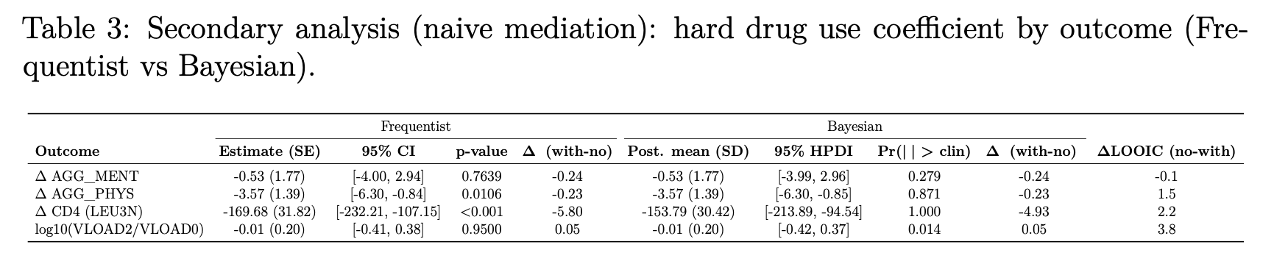
Secondary Analysis: Adjustment for Adherence (naïve mediation)
Goal: assess how hard drug coefficient changes after adjusting for adherence
Estimates changed minimally across outcomes
Suggests adherence does not strongly explain observed associations
Exploratory analysis, not a formal mediation analysis
Notes:
This slide shows results from the secondary analysis where adherence at year two was added to the models.
The goal here was not formal mediation, but rather to examine whether the hard drug use coefficient changed meaningfully after accounting for adherence.
If adherence were a strong mediator, we would expect the hard drug use effect to shrink substantially after adjustment.
Instead, the estimates changed very little across outcomes.
For mental and physical quality of life, the coefficients were nearly unchanged.
For CD4+ count, the effect actually became slightly larger in magnitude.
And for viral load, the estimate moved slightly closer to zero, but remained very small and uncertain.
Overall, this suggests that adherence does not strongly explain the relationship between baseline hard drug use and treatment response — at least within this exploratory framework.
I want to emphasize that this was a naive mediation analysis and does not estimate causal mediation effects.

Slide 7
Discussion & Limitations
Baseline hard drug use associated with:
Worse physical QoL improvement
Poorer CD4+ recovery
Little evidence for mental QoL or viral load effects
Adherence did not substantially explain associations
Limitations
Complete case analysis
Collapsed covariates
Naïve mediation approach (not causal mediation)
Notes:
To summarize, this analysis found that baseline hard drug use was associated with poorer treatment response for two key outcomes: physical quality of life improvement and CD4+ immune recovery.
In contrast, there was little evidence for associations with mental quality of life or viral load change.
The secondary analysis suggested that treatment adherence did not substantially explain these associations.
There are several limitations to consider.
First, this was a complete-case analysis, which may introduce bias if missingness depended on unobserved factors.
Second, some variables were collapsed into binary categories, which may reduce sensitivity to more nuanced effects.
Third, the mediation analysis was exploratory and not a formal causal mediation framework.
Overall, these results suggest that baseline hard drug use may be an important predictor of poorer physical and immunologic response after HAART initiation, and future work could extend this using longitudinal modeling and more formal mediation methods.
Thank you — I’m happy to take any questions.

