Slide 1
Test Automation using RASTA/CXTA
ACI Test Auto Generator (ATAG)
Morten Skriver
Solutions Architect
June 2019

Slide 2
Let’s start with some of the surrounding tools

Slide 3
DAFE (Deploy ACI From Excel)
Deployments / Configuration of ACI fabrics have for a while been automated using the DAFE tool (https://wwwin-gitlab-sjc.cisco.com/fadallar/DAFE)
DAFE consists of a few parts
Configuration templates written as Jinja2 XML templates
YAML Data Model used for data validation
Excel based configuration “database”
Python script that renders the configuration templates based on the configuration database.
The output of the script can either be online configuration of an ACI fabric or offline XML files that then subsequently can be applied using the ACI API

Slide 4
DAFE Excel Sheet
The DAFE excel sheet consists of a number of worksheets – each addressing the configuration parameters related to a specific object type within the ACI object model.
The excel sheet provides a human friendly way to capture the desired configuration and can be filled out with minimal knowledge to the ACI object model.
A number of tools are available to generate a DAFE excel sheet from an ACI configuration export
As Built Doc Generator (https://wwwin-gitlab-sjc.cisco.com/fadallar/ACI_ASBuilt_Doc_Generator

Slide 5
RASTA / CXTA
RASTA is a Test Automation Framework that is used to perform system, integration, and acceptance testing in AS projects (https://wwwin-github.cisco.com/AS-Community/RASTA)
The initial motive for creating RASTA where to provide a common way to automatically execute system and acceptance testing for NSO projects.
However, RASTA’s use cases have since been extended to other use-cases and components.
RASTA will soon be replaced with CXTA, which is a merge of the RASTA tool with a similar tool from SVS (https://wwwin-github.cisco.com/AS-Community/CXTA)
CXTA are designed to be backwards compatible with RASTA, so any test suite written for RASTA should work using CXTA without modifications
RASTA / CXTA is based on Robot Framework and enhance it through keywords and python libraries targeted for use-cases we are involved in.
These keywords are developed by AS and SVS engineers and added to the RASTA distribution.

Slide 6
RASTA / CXTA Installation
RASTA installation guide can be found at: https://wwwin-github.cisco.com/pages/AS-Community/RASTA/Installing-RASTA/
CXTA installation guide can be found at: https://wwwin-github.cisco.com/pages/AS-Community/CXTA/

Slide 7
RASTA / CXTA Test cases
Test case are in RASTA / CXTA written using a keyword-driven approach, that makes it easier for someone to understand the test cases.
A test suite in RASTA / CXTA consists of two parts
Testbed file, which contains all device data (IP addresses, username, password, etc.)
Robot file(s), which contains the test cases
A test suite may consist of one or more robot files

Slide 8
RASTA / CXTA Keywords
RASTA / CXTA supports a wide range of keywords – some coming from Robot Frameworks and some specific to RASTA
List and documentation of RASTA keywords can be found at: https://wwwin-github.cisco.com/pages/AS-Community/RASTA/libdoc/keyword-index/
List and documentation of CXTA keywords can be found at: https://wwwin-github.cisco.com/pages/AS-Community/CXTA/libdoc/keyword-index/

Slide 9
RASTA / CXTA Test Execution and Results
RASTA / CXTA test suites are exacted using the command “robot <robot-file>”
The output of test execution are in RASTA / CXTA provided in three formats
report.html – high level result
log.html – detailed log output all output retrieved during test execution
output.xml – same as log.html just in XML format

Slide 10
ACI and RASTA / CXTA

Slide 11
ACI Support in RASTA / CXTA
ACI support in RASTA utilizes the ACI REST API
CLI (SSH) access to Leaf/Spine have been tested and can be used for retrieving information not available in the ACI Object Model
CLI (SSH) access to APIC initially failed due prompt recognition issues, which may have been fixed in the mean time
CLI (SSH) access to APIC CIME have been tested and can be used for retrieving information not available in the ACI Object Model
Two “flavours” of ACI keywords are available in RASTA & CXTA
High Level keyworks that can retrieve or configure objects within the ACI object model
Simplifies test case creation as session handling, etc. are taken care of by these keywords
Allows retrieved information to be returned as objects in addition to JSON or XML strings
Low Level keywords that are the fundamental building blocks for high level keywords
Used by the high level keywords
Can be used by test cases directly, but increases complexity

Slide 12
ACI keywords in RASTA / CXTA High Level Keywords
The following ACI high level keywords are available in RASTA / CXTA
via ACI REST API retrieve "${uri}" from "${dev}" as "${encoding}”
via filtered ACI REST API retrieve "${uri}" using filter "${filter}" from "${dev}" as "${encoding}"
via ACI REST API configure device "${dev}" at URI "${uri}" using "${encoding}" payload "${payload}”
Where
${uri} – Path to the object in the object model – example: /api/mo/uni/tn-tenant1
${dev} – Name of the device under test - device credentials, etc. are in the testbed file
${encoding} – Encoding format: xml, json, or object. Object encoding only supported for the keywords retrieving information
${payload} – XML or JSON payload that will be posted to the APIC
Login session handling is automatically taken care of when using the high level keywords

Slide 13
Example - RASTA / CXTA testbed file for ACI
testbed:
devices:
apic1:
connections:
rest:
ip: x.x.x.x
username: admin
password: my_secret_password
protocol: https
port: 443
os: apic
type: aci
leaf1:
connections:
cli:
ip: x.x.x.x
protocol: ssh
port: 22
os: linux
type: linux
passwords:
linux: my_secret_password
tacacs:
username: admin

Slide 14
Example - RASTA / CXTA test suite for ACI
*** Settings ***
Resource rasta.robot
Library XML
Library String
Library Collections
Suite Setup setup-test
Force Tags aci
*** Variables ***
${testbed} dafe2rasta_testbed.yaml
${apic} apic1
*** Keywords ***
setup-test
use testbed "${testbed}"
*** Test Cases ***
Checking ACI VLAN Pool for Faults - VLAN Pool baremetal
[Documentation] Verifies that no ACI faults exist for VLAN Pool 'baremetal’
... - VLAN Pool Name:
... - Critical fault count <= 0
... - Major fault count <= 0
... - Minor fault count <= 0
[Tags] aci-faults aci-fabric aci-fabric-vlan-pool
# Retrieve Faults
${uri} = Set Variable /api/node/mo/uni/infra/vlanns-[baremetal]-static/fltCnts
${return}= via ACI REST API retrieve "${uri}" from "${apic}" as "object"
Should Be Equal as Integers ${return.status} 200 Failure executing API call values=False
# Verify Fault Count
Should Be Equal as Integers ${return.totalCount} 1 Failure retreiving faults values=False
${critical_count} = Set Variable ${return.payload[0].faultCounts.attributes.crit}
${major_count} = Set Variable ${return.payload[0].faultCounts.attributes.maj}
${minor_count} = Set Variable ${return.payload[0].faultCounts.attributes.minor}
run keyword if not ${critical_count} <= 0 run keyword
... Fail "Fail, more than ${critical_count} critical faults - ${critical_count} faults present."
run keyword if not ${major_count} <= 0 run keyword
... Fail "Fail, more than ${critical_count} major faults - ${major_count} faults present."
run keyword if not ${minor_count} <= 0 run keyword
... Fail "Fail, more than ${critical_count} minor faults - ${minor_count} faults present."

Slide 15
So, what’s next
✓
ACI support added to RASTA / CXTA
RASTA installed on laptop / linux host
ACI fabric configured and APICs reachable via HTTPs
Creation of test cases
Time consuming
Often requires configuration specific parameters (object names, parameters, etc.)
What if we had test case templates that could be rendered based deployment specific configuration?
✓
✓
😴

Slide 16
ACI Test Auto Generator (ATAG)

Slide 17
Idea behind ATAG
What are the time consuming part of writing test cases
Coming up with the test cases ?
Adapting existing test cases to the specific customer environment ?
What if we could create a repository of pre-canned test cases to pick from AND automate the required customer specific customization of these
Customization of test cases to a customer environment requires a configuration “database”
We already have this configuration ”database” in the form of the DAFE excel
And we have tools to create the DAFE excel from a configuration export if DAFE where not used to configure the ACI fabric

Slide 18
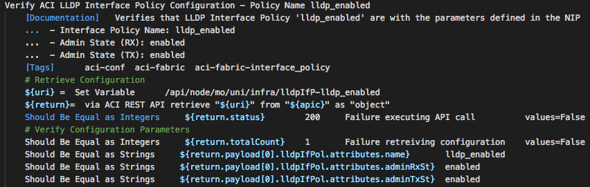
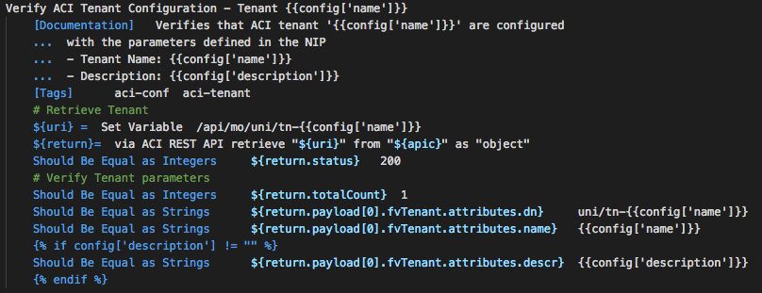
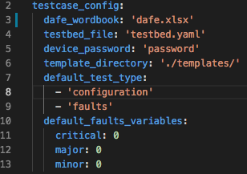
What is ATAG ?
ACI RASTA / CXTA test suite and testbed file
ACI Test Templates (robot files)
ATAG python script
ATAG Configuration File
ACI Configuration “database” (DAFE excel sheet)

Slide 19
Which type of tests can be created with ATAG ?
It is up to the you and/or the community
Anyone can contribute
No need to code python or have extensive RASTA knowledge
You just have to
Knowledge about the ACI object model in order to know which objects to retrieve/modify/configure
Create or update test templates
Modify the ATAG configuration file
Launch the script
AND commit your changes/additions to the repository for the community to reuse

Slide 20
Do it your self? Are you kidding?
No need to panic, ATAG already have a set of test templates
Current templates covers the following type of tests
Configuration Verification
Fault Verification
Operational State Verification
BUT this does not mean at there is a test template for everything needed in a typical project ….
Yet at least – community support needed

Slide 21
ATAG Test Templates
A list of the available test templates can be found at: https://wwwin-github.cisco.com/pages/AS-Community/ATAG/Template-Coverage/
Documentation of each test template can be found at
Configuration Verification Tests (https://wwwin-github.cisco.com/pages/AS-Community/ATAG/Templates-configuration/)
Fault Verification Tests (https://wwwin-github.cisco.com/pages/AS-Community/ATAG/Templates-faults/)
Operational State Verification Tests (https://wwwin-github.cisco.com/pages/AS-Community/ATAG/Templates-faults/)

Slide 22
What is a ATAG test template ?
Written in the RASTA / Robot Framework language mixed with Jinja2 templating techniques
A test template consists of the following building blocks
One or more test cases that operates on the same input worksheet in the DAFE excel
Each test case must include description of the parameters that are being validated
Jinja2 variables used as placeholders for parameters that will be replaced with customer specific data when rendered by the test generation script – Example: tenant or VRF name, IP addresses, etc.
Documentation of each test case in YAML format in order facilitate automatically generation of test case documentation (embedded as Jinja2 comments encapsulated within a {# #} section

Slide 23
How to use ATAG

Slide 24
How to use ATAG as an end-user
Take you DAFE excel sheet containing the customer specific configuration
If you didn’t use DAFE to deploy the ACI fabric, then use the As Built Doc Generator tools to generate the excel from a json configuration export

Slide 25
How to use ATAG as an end-user
Edit the ATAG configuration file to fit your needs
The configuration file consists of three parts
testcase_config – Will typically require modification by the user
Used to define global parameters like
Location of templates
Location of DAFE excel
Login credentials on ACI fabric – admin user’s password (optionally)
Default test types to be executed
Default passing criteria for faults
tests_to_generate – May require modifications by the user
Used to control which test cases to be included in test suite
Used to provide additional parameters needed in test case creation than the ones available in DAFE excel (non-default passing criteria for faults, etc.)
testcase_templates – Will typically not require modifications by the user
Used to link test template to sheet in DAFE excel

Slide 26
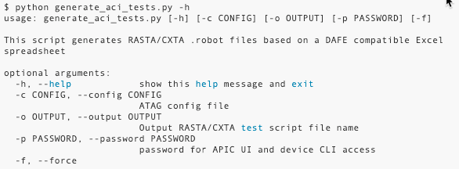
How to use ATAG as an end-user
Launch the script
Default configuration file: atag_config.yaml
Default output files: aci_tests.robot aci_tests_testbed.yaml
APIC username are ”hardcoded” as admin
By default, APIC username/password are taken from configuration file

Slide 27
Output of ATAG – testbed file
When ATAG are executed, is a test suite specific testbed file created which contains
All entries present in the input testbed file – hardcoded filename: testbed.yaml
A device entry for each APIC controller and leaf/spine switch found in the DAFE Excel file
The default name of the testbed file is aci_tests_testbed.yaml
If desired can the name be changed through the “-o” parameter when executing the script

Slide 28
Output of ATAG – robot file
When ATAG are executed, is a RASTA robot file created which contains
Test cases that has been rendered based on the configuration file and the content of the DAFE excel
Each test case includes description of the parameters that are being validated in case of configuration verification, the passing number of faults, etc.
Each test case contains tags that enables useful test execution statistics based on test type
The default name of the robot file is aci_tests.robot
If desired can the name be changed through the “-o” parameter when executing the script

Slide 29
Time to execute test suite

Slide 30
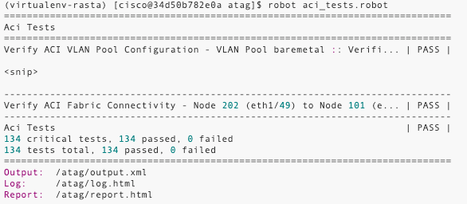
Test Execution
With the ACI test suite generated using ATAG is it now time to execute the tests
The test suite is executed from within the python virtual environment created as part of RASTA installation
Test suite is executed using the command

Slide 31
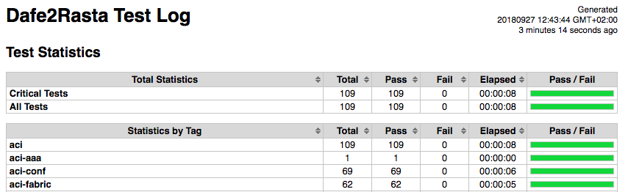
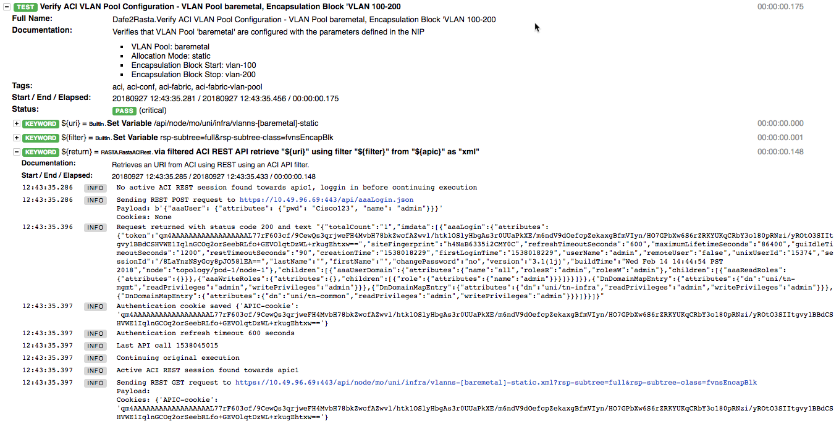
Test Results
The PASS / FAILED criteria of each individual test case are available on the terminal – including reason in case of failure
Detailed log output are provided in both HTML and XML format

Slide 32
Want to know more or get involved ?

Slide 33
How to get help
In case of questions, please use the ATAG Users Webex Teams space that can be found at https://eurl.io/#SJJfoqILV or send an email to atag-cx-tool@cisco.com

Slide 34
How to get involved
Use the tool in your projects !
In case of issues, make sure to report these
Preferably through opening issues directly on the repository
Provide suggestions on additional test cases and comments/suggestions on how to increase usability of the tool
Preferably through opening issues directly on the
Contribute by writing test cases your self
Reach out if you need guidance on how to write test cases and how to commit them to the repository

Slide 35
More information
ATAG GIT Repository: https://wwwin-github.cisco.com/AS-Community/ATAG
ATAG Documentation: https://wwwin-github.cisco.com/pages/AS-Community/ATAG/
RASTA GIT Repository: https://wwwin-github.cisco.com/AS-Community/RASTA
RASTA Documentation: https://wwwin-github.cisco.com/pages/AS-Community/RASTA/
CXTA Git Repository: https://wwwin-github.cisco.com/AS-Community/CXTA
CXTA Documentation: https://wwwin-github.cisco.com/pages/AS-Community/CXTA
DAFE GIT Repository: https://wwwin-gitlab-sjc.cisco.com/fadallar/DAFE
DAFE Documentation: https://wwwin-github.cisco.com/pages/fadallar/DAFEDOC

