Slide 1
Terrain-interaction control of a hexapod robot
A measured comparison of three controllers on a shared simulation plant
Eros Cribello · Andrea Russo
Field and Service Robotics — A.Y. 2025/2026
University of Naples Federico II
Notes:
[0:20] Introduce ourselves and the course. The work compares three controllers for the PhantomX hexapod on the same Simscape plant.

Slide 2
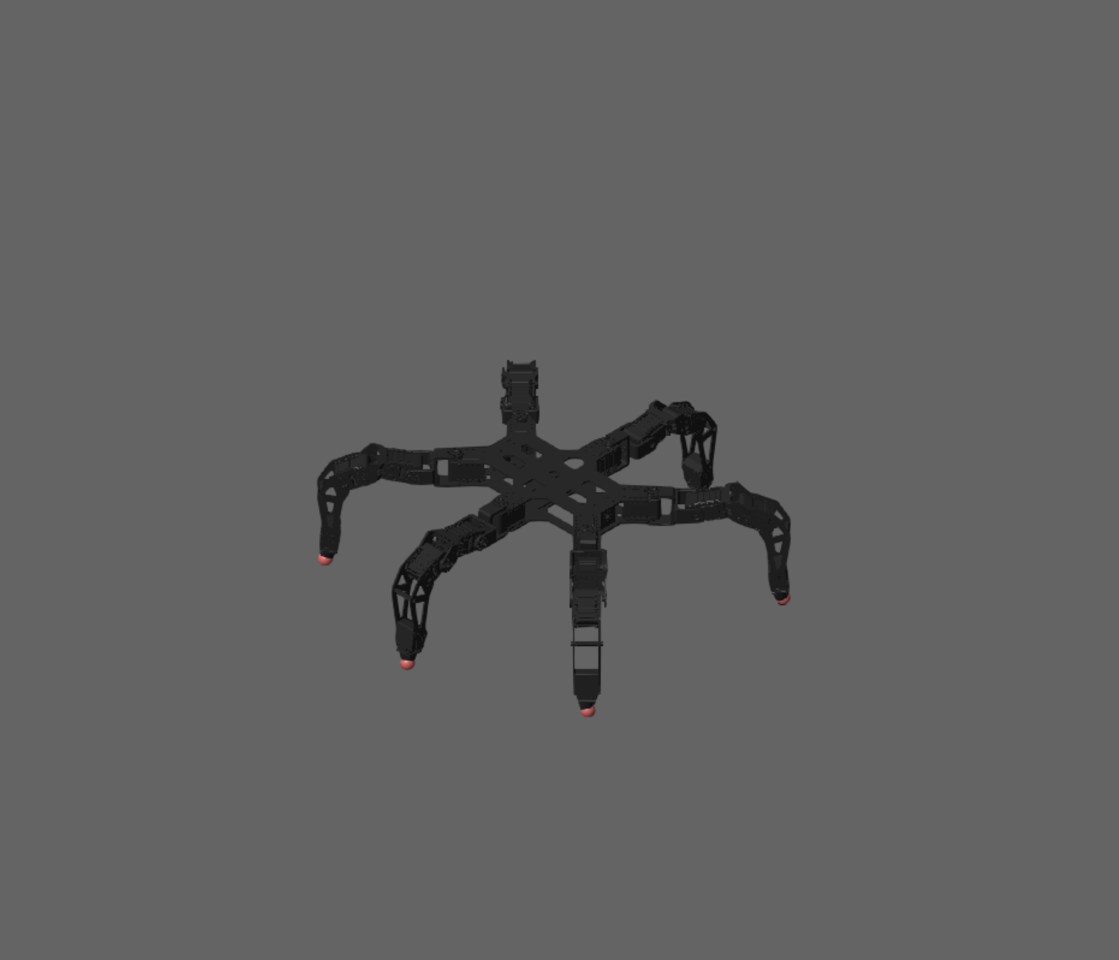
The robot that we used
PhantomX AX Metal Hexapod Mark II
25 rigid bodies: 1 trunk + 24 leg links
18 position-commanded revolute joints
6 spherical contacts at the feet
Notes:
[0:30] The model comes from the public URDF. Joints are position-commanded, so torque is a reaction. Penalty contact with Coulomb friction, static penetration 4.3 mm.

Slide 3
The reference work
No force sensors at the feet, no IMU
Only feedback: position, load estimate of each servo
S. Arrigoni et al. “Control of a Hexapod Robot Considering Terrain Interaction,” Robotics, vol. 13, no. 10, art. 142, 2024.
Foot–ground contact is detected from torque alone: measured versus predicted by inverse dynamics. The detection adapts the commanded foot height.
Our questions:
How much does the mechanism cost where there is no terrain to discover?
Will an attitude control improve the performances?
How would the robot behave with a payload?
Notes:
[0:50] Hardware without force sensors: everything goes through servo torque. The paper shows that terrain search helps on unmodelled terrain, but does not say how much it costs where the terrain is already known. That is our starting question.

Slide 4
The controllers we implemented
C1
Open-loop tripod
sim_zero
Foot trajectories from the gait parameters, per-leg inverse kinematics, position-commanded joints. No feedback.
C2
C1 + terrain search
sim_zero
If the foot has reached the stance height but the flag is low, it keeps descending until the torque residual exceeds the threshold. At the same time the foot can stop whenever it detects a contact with the terrain even before its complete descent.
C3
C2 + attitude loop
sim_attitude
Two discrete PIs; outputs distributed over the six feet as an additive Δz.
Notes:
[0:50] Each controller adds a single mechanism to the previous one, on the same model, terrain and gait generator. So every comparison between adjacent controllers has a single cause. In C3 the foot height is the sum of terrain search and attitude correction.

Slide 5
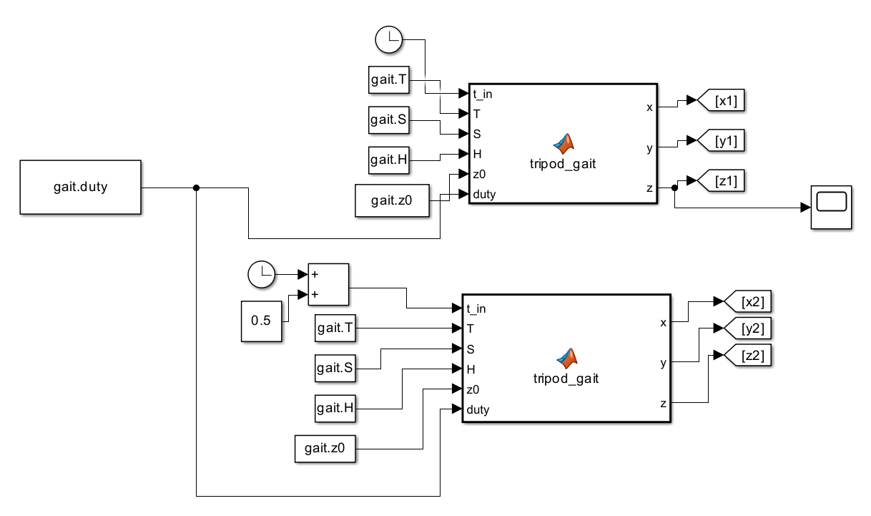
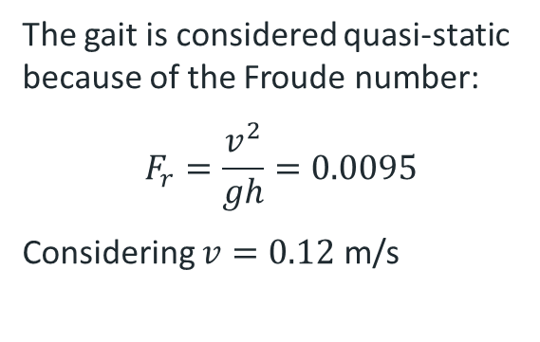
C1: The gait
Gait parameters
S = 0.06 m
step
T = 1.0 s
period
H = 0.05 m
height
The gait is considered quasi-static because of the Froude number:
$$F_{r}=\frac{v^{2}}{gh}=0.0095$$
Considering $v=0.12$ m/s
β = 0.50
duty factor

Slide 6
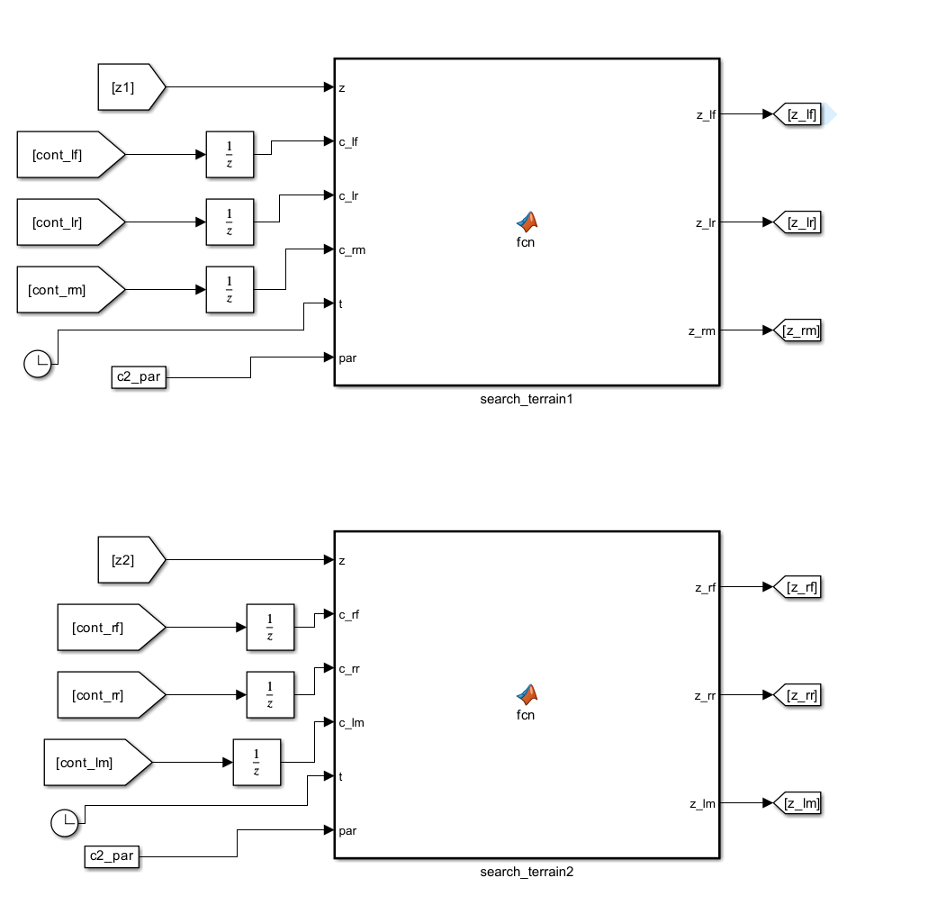

C2: Adaptive gait
The core of the C2 controller is the contact detection which is estimated using the torques measured at the legs joints and their estimations:
$$OR_{j}\left(\left|τ_{j}^{meas}−τ_{j}^{exp}\right|>σ_{j} \right)$$
Once the flag is up the foot is considered to be touching the ground and the leg stops moving.
If the nominal descent of the foot is completed but no contact is detected yet the foot will start moving down searching for the ground until it finds it.

Slide 7
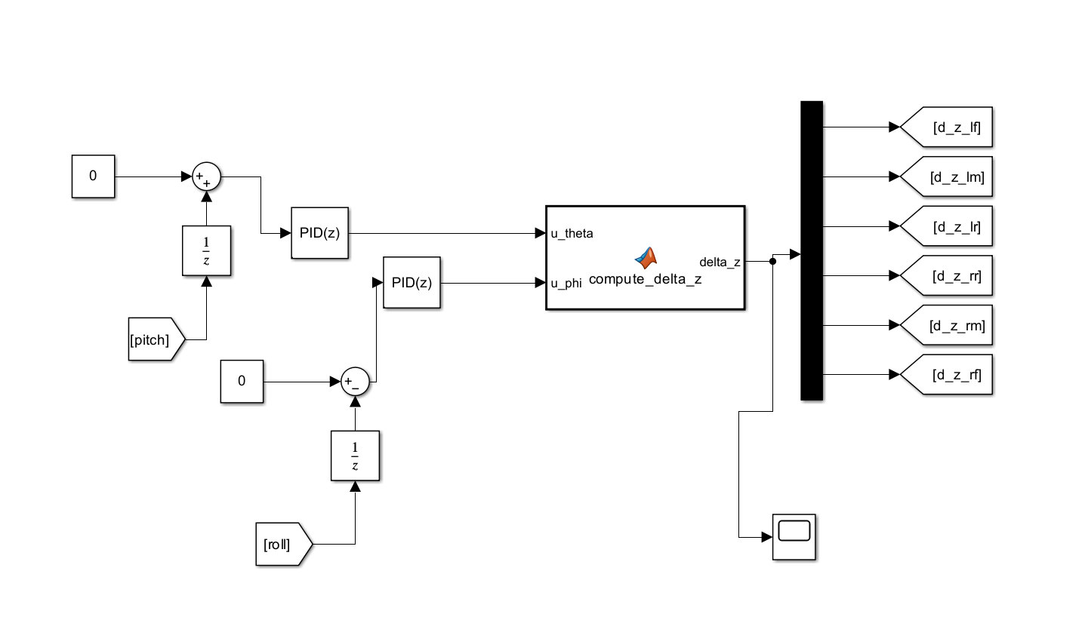
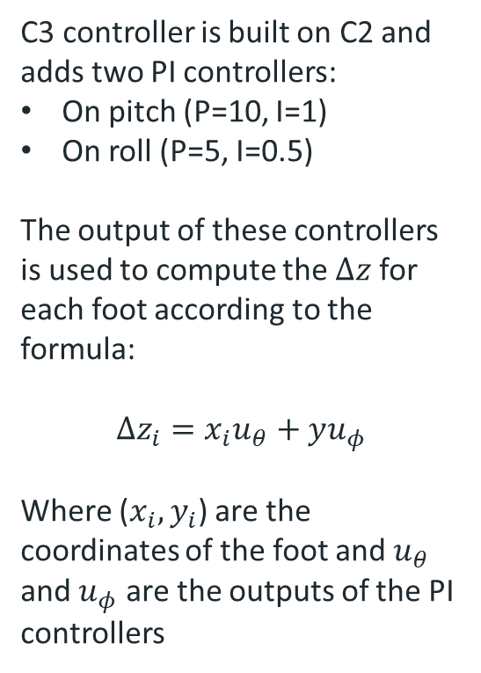
C3: Attitude control
C3 controller is built on C2 and adds two PI controllers:
On pitch (P=10, I=1)
On roll (P=5, I=0.5)
The output of these controllers is used to compute the $Δz$ for each foot according to the formula:
$$Δz_{i}=x_{i}u_{θ}+yu_{φ}$$
Where ($x_{i},y_{i}$) are the coordinates of the foot and $u_{θ}$ and $u_{φ}$ are the outputs of the PI controllers

Slide 8
The seven tasks
ID | Task | What it stresses
T2 | flat, speed sweep | reference and speed envelope
T3 | curved path | yaw 0.1 rad/s
T4 | 8° ramp | body attitude versus terrain
T4D | 8°/8° bump | ascent and descent
T5 | single obstacle | unmodelled step, 32.8 mm
T6 | seven obstacles | four full-width, three lateral
T7 | lateral impulse | from 1% to 1600% of nominal
Notes:
[0:40] Three of the five parameters are fixed by measured constraints; the period follows from step and speed. Froude 0.0095: the gait is quasi-static, which justifies the static stability assumption of the tripod. The seven tasks range from flat ground to obstacles to a lateral impulse.

Slide 9
When a difference is a result
1
Three runs per controller
2
Variability band
3
The 3× rule
nominal z0 ±0.2 mm, on four tasks
max − min of the metric across the three runs
difference ≥ 3 × the worse of the two bands
$$|M_{A} − M_{B}| ≥ 3 · max⁡( band_{A} , band_{B} )$$
Above the threshold: valid difference, bold in the tables
Below: not conclusive (n.c.), not attributed to the controller
Notes:
[0:50] In simulation everything is deterministic, but a lucky combination of impact instants can favour one controller. We perturb the stance depth by 0.2 mm, measure how much each metric oscillates, and declare a difference only if it is at least three times that oscillation.

Slide 10
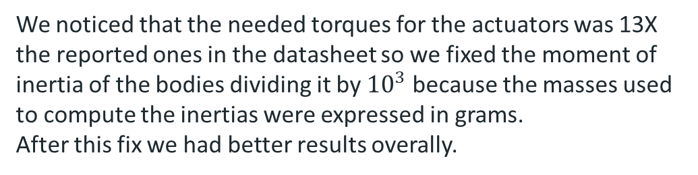
Fixed issues 1: the URDF inertias
We noticed that the needed torques for the actuators was 13X the reported ones in the datasheet so we fixed the moment of inertia of the bodies dividing it by ${10}^{3}$ because the masses used to compute the inertias were expressed in grams.
After this fix we had better results overally.
r = 1.79 m
declared radius of gyration for a 25 cm wide trunk
24 / 24
links with identical inertia, to the same decimal
Notes:
[0:40] The declared inertias place the trunk mass 1.79 m from its centre, for a 25 cm wide trunk. All 24 links have the same inertia. Dividing by a thousand makes everything plausible: a CAD export in grams. Effect on pitch: from 45 to 15 degrees.

Slide 11
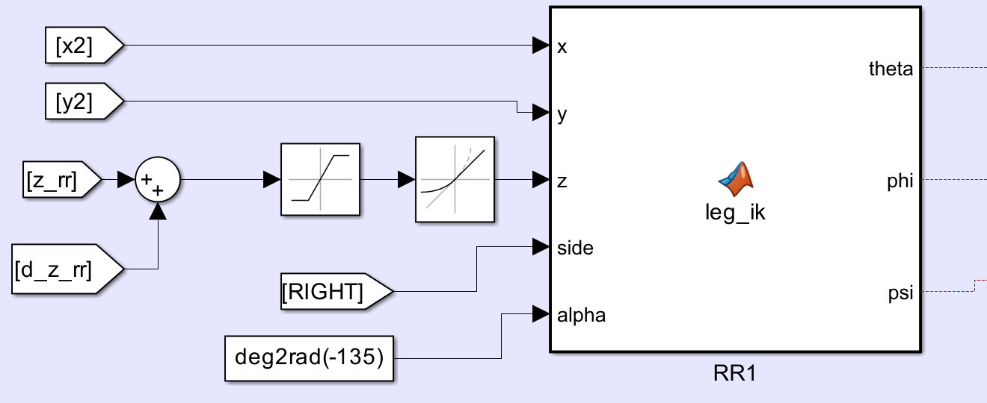
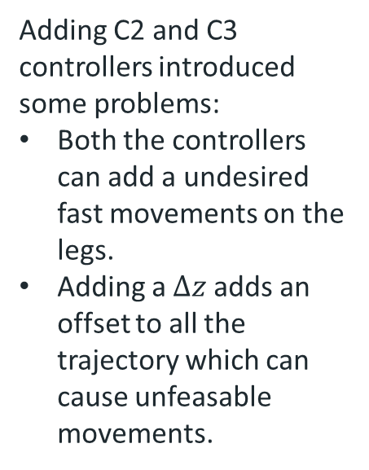
Fixed issues 2: slew limiter and saturator
Adding C2 and C3 controllers introduced some problems:
Both the controllers can add a undesired fast movements on the legs.
Adding a $Δz$adds an offset to all the trajectory which can cause unfeasable movements.
To fixed this we added a saturator and a slew rate that improved the gait a lot
Notes:
[0:50] We had corrected the inertias only in the simulated robot: the torque estimator still described the other one. An always-high flag was wrong as often as ours, so ours carried no information. After alignment the error drops to 0.6%. We then disabled the coxa threshold.

Slide 12

Flat ground (T2): terrain search has a cost
 | C1 | C2 | C3 | C1→C2 | C2→C3
max pitch [deg] | 0.514 | 1.95 | 0.356 | +279% (16.3) | −82% (18.1)
max roll [deg] | 0.206 | 0.280 | 0.205 | +36% (n.c.) | −27% (n.c.)
cost of transport * | 0.888 | 0.865 | 1.11 | −3% (n.c.) | +28% (27.7)
energy [J] | 18.6 | 18.2 | 23.3 | −2% (n.c.) | +28% (28.4)
RMS torque [N·m] | 0.400 | 0.403 | 0.372 | +1% (n.c.) | −8% (8.0)
peak torque [N·m] | 1.87 | 2.02 | 2.23 | +8% (n.c.) | +11% (n.c.)
mean speed [m/s] | 0.135 | 0.136 | 0.135 | +1% (6.9) | −0% (n.c.)
In parentheses the ratio to the variability band; valid verdicts (≥ 3×) in bold, not conclusive ones in grey.
The mechanism keeps working where there is nothing to find, and the body pays for it.
*
$$CoT=\frac{E}{mgd}$$
Notes:
[0:50] On terrain identical to what the generator expects, search worsens pitch almost fourfold, with no energy gain. The attitude loop cuts it by 82%, but uses 28% more energy.

Slide 13
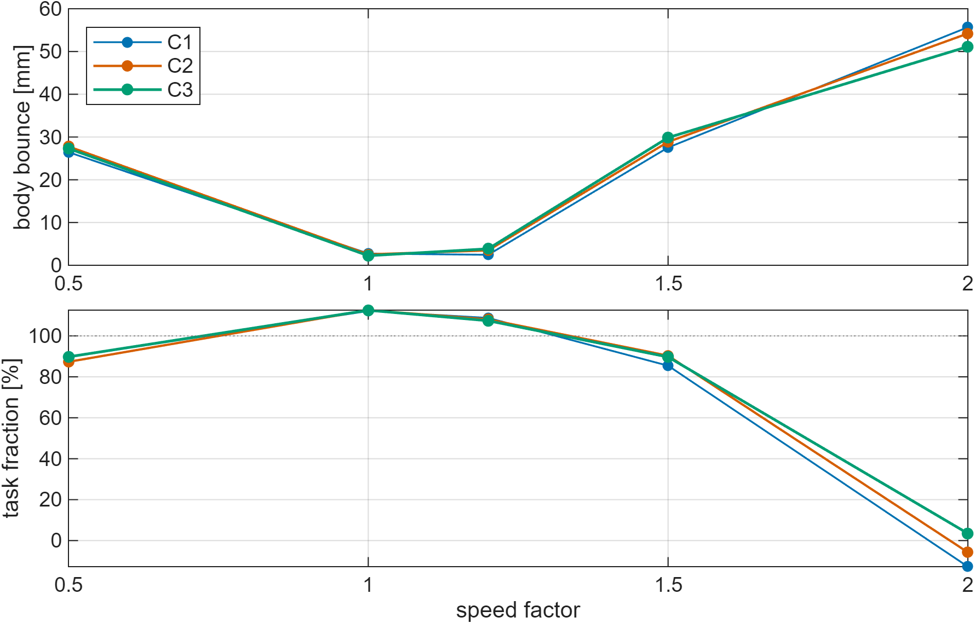
Speed envelope (T2)
factor | bounce [mm]
0.50 | 28.5 | fails
1.00 | 2.9 | nominal
1.20 | 3.0 | last stable
1.50 | 32.4 | fails
2.00 | 58.9 | moves back
C1, 10 mm threshold declared before the sweep
Notes:
[0:40] Sweep of five factors, judged on body bounce with a 10 mm threshold set beforehand. The open-loop gait is stable between 1 and 1.2 times nominal speed; at 2 times the robot moves backwards.

Slide 14
Curve (T3)
 | C1 | C2 | C3 | C1→C2 | C2→C3
max pitch [deg] | 0.579 | 1.85 | 0.392 | +219% (40.0) | −79% (45.9)
max roll [deg] | 0.224 | 0.351 | 0.210 | +57% (4.6) | −40% (5.1)
cost of transport | 0.970 | 0.951 | 1.22 | −2% (3.6) | +28% (24.3)
energy [J] | 30.3 | 29.5 | 37.8 | −3% (6.4) | +28% (22.5)
RMS torque [N·m] | 0.398 | 0.389 | 0.376 | −2% (7.0) | −3% (7.3)
peak torque [N·m] | 1.91 | 2.11 | 2.43 | +10% (n.c.) | +15% (n.c.)
In parentheses the ratio to the variability band; valid verdicts (≥ 3×) in bold, not conclusive ones in grey.
Notes:
[0:40] On the curve almost all differences pass the threshold. Search worsens attitude but saves 2-3% energy; the attitude loop brings attitude back down and costs 28%.

Slide 15
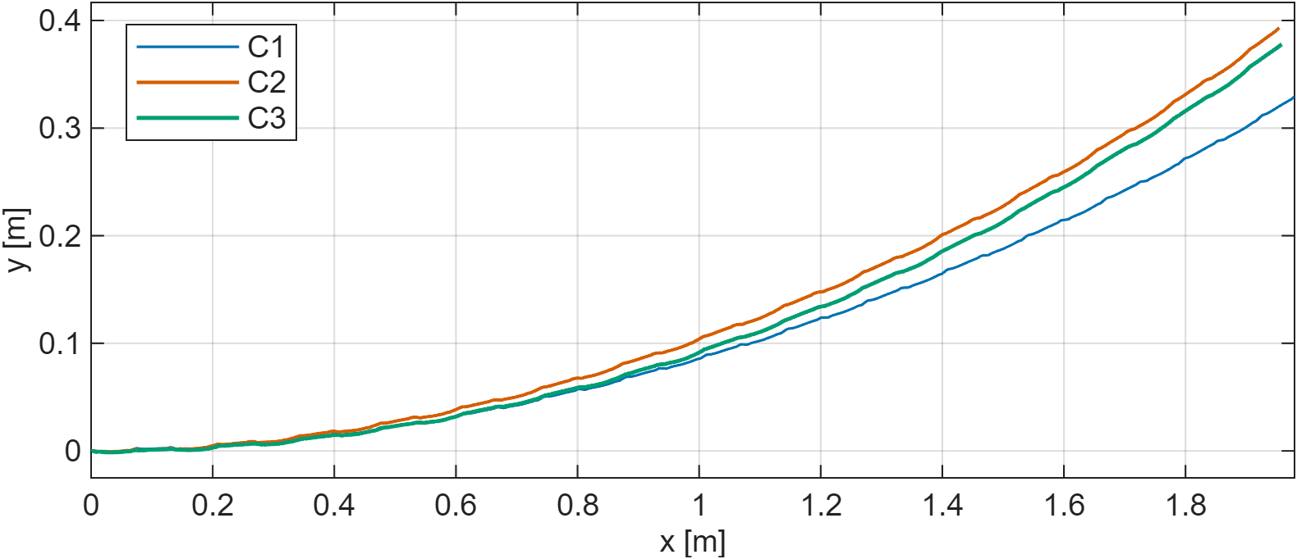
Curve (T3): same path for the three controllers
The differences concern attitude, not the path. Note: axes at different scales.
Notes:
[0:25] The three trajectories overlap: the yaw command is followed in the same way. The axes have different scales, so the lateral deviation looks larger than it is.

Slide 16
Discontinuities (T4D, T5)
 | C1 | C2 | C3 | C1→C2 | C2→C3
T4D — 8°/8° bump
max pitch [deg] | 8.65 | 10.4 | 1.98 | +21% (19.8) | −81% (93.8)
max roll [deg] | 2.12 | 1.49 | 0.611 | −30% (6.4) | −59% (7.6)
cost of transport | 1.12 | 1.04 | 1.45 | −7% (5.1) | +40% (16.8)
energy [J] | 64.1 | 59.9 | 83.6 | −7% (3.5) | +40% (18.8)
T5 — single obstacle
max pitch [deg] | 7.56 | 6.41 | 1.73 | −15% (16.4) | −73% (19.8)
max roll [deg] | 4.49 | 2.31 | 1.13 | −49% (n.c.) | −51% (n.c.)
cost of transport | 1.20 | 1.08 | 1.40 | −10% (5.2) | +30% (17.1)
energy [J] | 48.1 | 44.3 | 57.5 | −8% (3.6) | +30% (17.2)
In parentheses the ratio to the variability band; valid verdicts (≥ 3×) in bold, not conclusive ones in grey. Full rows in the report (T4D/T5 table).
Notes:
[0:50] On bump and obstacle search reduces energy and cost of transport, and roll on the bump. This is the paper's result. Exception: on the bump C2 pitch worsens by 21%, because the body follows the gradient. The attitude loop cuts pitch by 81% and 73%.

Slide 17
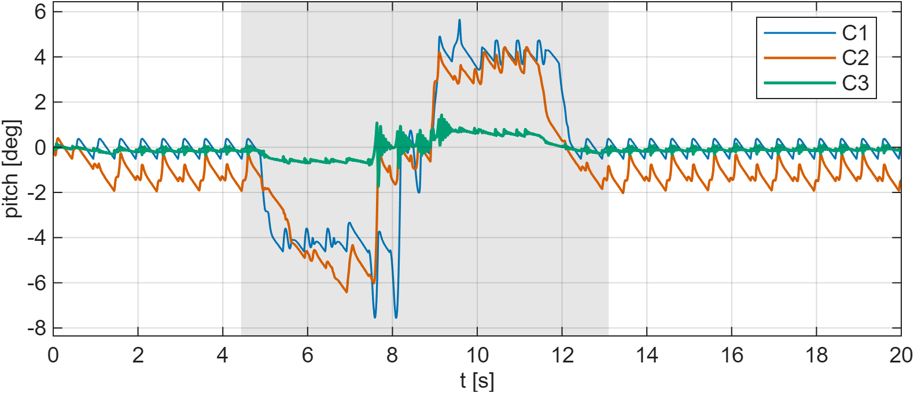
Single obstacle (T5): pitch
C1 and C2 swing several degrees over the step; C3 stays within about one degree (−73%).
Notes:
[0:30] Outside the grey window the curves oscillate with the step. Inside, C1 and C2 pitch nose-up as the front legs climb and nose-down with the rear ones. C3 stays flat.

Slide 18
Ramp (T4): two different behaviours
 | C1 | C2 | C3
body attitude − ramp angle [deg] | 0.106 | 0.259 | −7.54
peak-to-peak pitch on the ramp [deg] | 0.994 | 1.97 | 0.839
roll on the ramp [deg] | 0.662 | 0.563 | 0.314
cost of transport | 1.15 | 1.09 | 1.58
successful climb | yes | yes | yes
C1 and C2
Align the trunk with the ramp, within a few tenths of a degree
C3
Keeps the trunk horizontal, within 0.5°
Price: C3 shows +45% cost of transport with respect to C2
Notes:
[0:40] On the ramp the band is not measured, so no verdicts, but the difference is qualitative. C1 and C2 stay parallel to the ramp; C3 keeps the trunk horizontal, its objective. It costs 45% in cost of transport.

Slide 19
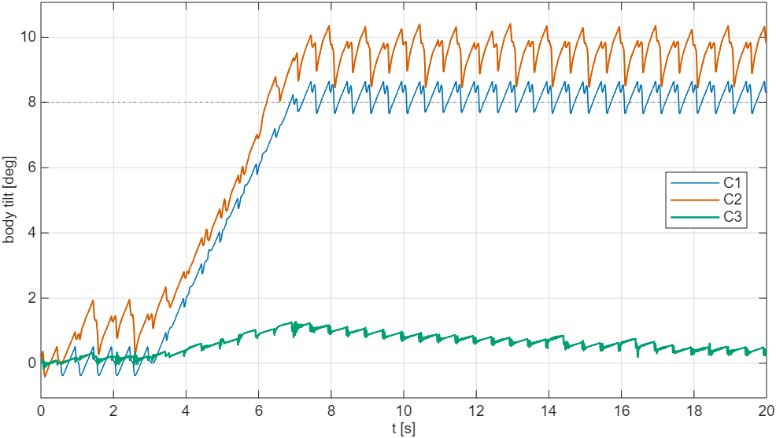
Ramp (T4): body inclination
C1 and C2 rise to 8° and stay parallel to the ground; C3 stops below 1.5°.
Notes:
[0:25] The first 4.5 s are on flat ground. Then C1 and C2 lie along the slope, C3 keeps the trunk horizontal. The sawtooth is the step oscillation.

Slide 20
Ramp (T4) in simulation
▶ VIDEO
T4: C2 and C3 side by side, side view
Notes:
[0:25] Video: C2 parallel to the ramp, C3 horizontal.

Slide 21
Obstacles(T6)
 | C1 | C2 | C3
obstacles crossed (out of 7) | 7 | 7 | 7
advance [m] | 3.65 | 3.68 | 3.72
max lateral drift [m] | 0.067 | 0.104 | 0.058
max roll [deg] | 9.44 | 10.0 | 2.78
max pitch [deg] | 14.7 | 13.6 | 4.44
peak torque [N·m] | 7.51 | 7.97 | 4.18
rollovers | 0 | 0 | 0
course completed with margin | no | no | yes
−72% / −67%
C3 roll / pitch with respect to C2
−48%
C3 peak torque with respect to C2
Drift below the 0.183 m threshold for all: the three meet the same obstacles.
All three cross the seven obstacles; only C3 finishes with one cycle of margin.
Notes:
[0:50] All three cross the seven obstacles without rolling over, and drift stays below the threshold beyond which an obstacle would be bypassed. C3 cuts roll and pitch by about 70% and almost halves peak torque. Only C3 completes the course with a gait cycle of margin.

Slide 22
Obstacle course (T6) in simulation
▶ VIDEO
T6 obstacle course, 30 s: C1, C2 and C3
Notes:
[0:35] Video of the full course: note C1 and C2 roll on the lateral obstacles and the steadiness of C3's trunk.

Slide 23
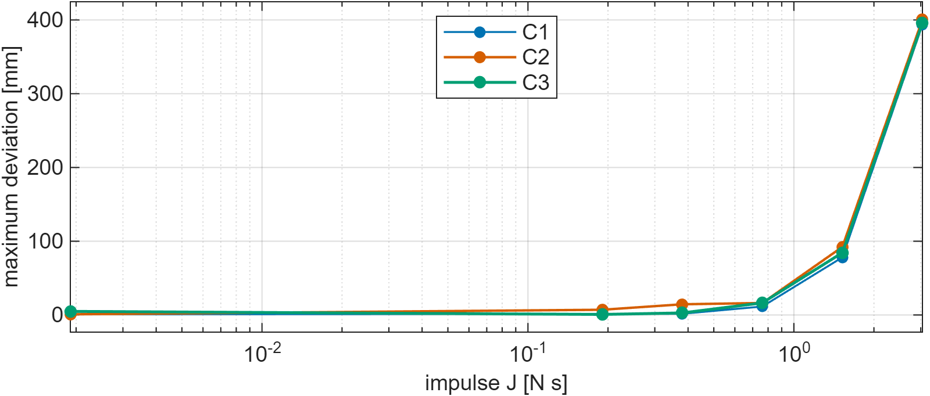
Lateral impulse (T7)
 | C1 | C2 | C3
residual deviation, 1× [mm] | 1.34 | 6.04 | 0.164
residual deviation, 16× [mm] | 393 | 400 | 392
recovers at 16× | no | no | no
At 16× none of the three recovers: the curves coincide within 2%. Neither search nor attitude acts on this disturbance.
Notes:
[0:40] At large impulse none of the three recovers: the curves coincide within 2%. Neither search nor attitude acts on this disturbance: it is the clearest gap for a future controller.

Slide 24
Feasibility on real AX-12A servos
 | RMS / stall |  |  | peak / stall |  |  | samples over stall
task | C1 | C2 | C3 | C1 | C2 | C3 | C1 | C2 | C3
T2 | 46% | 44% | 39% | 1.2 | 1.3 | 1.5 | 0.40% | 0.45% | 0.38%
T3 | 46% | 42% | 39% | 1.3 | 1.4 | 1.6 | 0.50% | 0.40% | 0.43%
T4 | 44% | 44% | 45% | 1.4 | 2.3 | 1.8 | 0.39% | 0.49% | 0.48%
T4D | 42% | 42% | 39% | 1.7 | 2.7 | 2.1 | 0.45% | 0.41% | 0.49%
T5 | 45% | 44% | 40% | 3.0 | 5.6 | 2.7 | 0.61% | 0.50% | 0.51%
T6 | 42% | 43% | 42% | 5.0 | 4.9 | 2.8 | 0.91% | 0.67% | 0.81%
T7 | 46% | 44% | 39% | 1.2 | 1.3 | 1.5 | 0.41% | 0.45% | 0.38%
Stall 1.5 N·m, one fifth recommended: walking runs at 2.3× the recommended load, impact peaks up to 5× stall.
Notes:
[0:45] The simulator grants any torque; here we measure what each controller demands. Walking sits at 39-46% of stall, 2.3 times the one fifth recommended by the manufacturer. Impact peaks exceed stall, up to 5 times, but on less than 1% of samples.

Slide 25
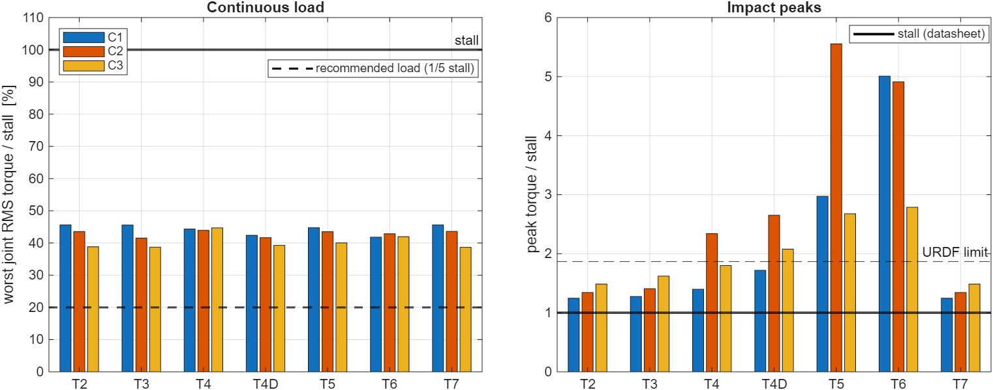
Demanded torque versus AX-12A limits
Two regimes: walking below stall but above the recommended load; peaks beyond stall at impacts.
Notes:
[0:25] Same information as the table, graphically: RMS bars stay below stall, peaks exceed it only at impacts.

Slide 26
Load transport: C2P versus C3P
1 kg cube free on a 0.1 kg tray: +69% mass
C3P = C3 with the load;
C2P = C3P with the PI gains set to zero
The package must stay within 50 mm, the tray clearance
Criterion, declared before the runs
1. Task completed: no rollover, drift within threshold, path crossed in full
2. Package on the tray: max displacement < 50 mm (clearance); below 20 mm it is still
Notes:
[0:40] So far attitude was just a number to minimise. With a free load on the robot it becomes a requirement. To see whether the load needs the attitude loop we compare C3P with C2P: same model, same package, loop off.

Slide 27
C2P versus C3P
 | T4 — ramp |  | T4D — bump |  | T6 — obstacles
 | C2P | C3P | C2P | C3P | C2P | C3P
distance travelled [m] | 2.39 | 2.35 | 3.70 | 3.71 | 3.67 | 3.72
max pitch [deg] | 12.60 | 1.33 | 12.15 | 1.68 | 12.77 | 3.53
max roll [deg] | 1.00 | 0.44 | 1.47 | 0.45 | 11.13 | 2.07
RMS torque, worst joint [N·m] | 0.963 | 1.004 | 1.028 | 0.956 | 0.999 | 0.989
max package displacement [mm] | — | 19 | — | 14 | — | 20
package outcome | fallen | stays | at the limit | stays | at the limit | stays
Same locomotion (distance within 2%, same torque): only the fate of the package changes.
Notes:
[0:50] So far attitude was just a number to minimise. With a free load it becomes a requirement. With the loop off the robot still completes the paths with the same torque, but the package exceeds the clearance within the first nine seconds.

Slide 28
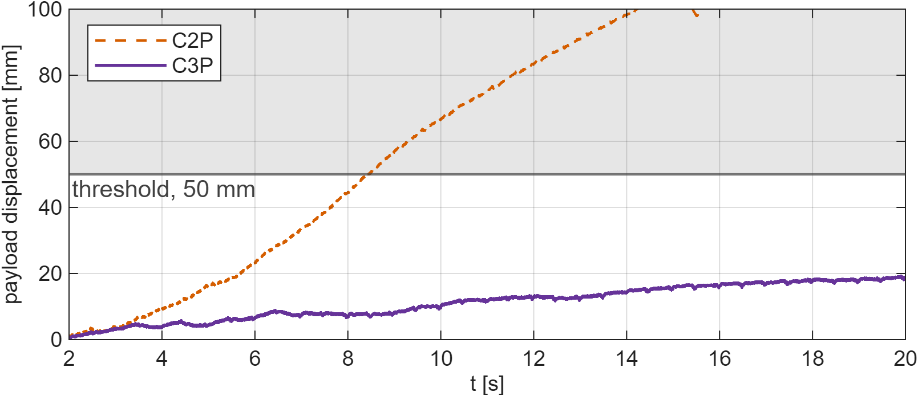
The package on the ramp (T4)
C2P exceeds the clearance at 8.4 s and never returns: the cube falls. C3P stays below 20 mm.
Notes:
[0:30] On the ramp the fall is clean: past the threshold, the cube leaves the robot. With the loop on it stays still on the tray.

Slide 29
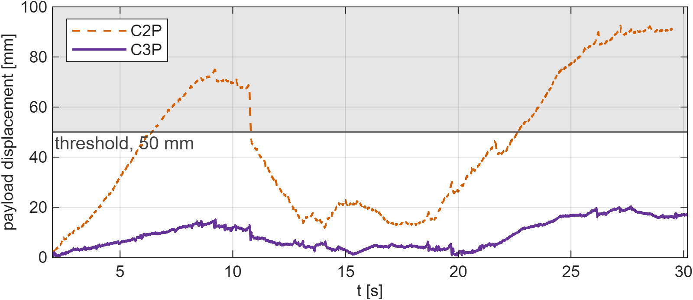
The package on the obstacle course (T6)
C2P goes out and back a few times and ends at 91 mm: not delivered. C3P never reaches the threshold.
Notes:
[0:30] Here there is no clean fall: the cube bangs back and forth well beyond the tray limits. By the criterion it is still not delivered.

Slide 30
Transport in simulation
▶ VIDEO
T4 with package: C2P and C3P side by side
Twelve degrees of pitch are enough to make the cube walk to the edge.
Notes:
[0:35] Video: same path, same package. On the left without the attitude loop the cube slides and falls, on the right it stays on the tray. The attitude loop does not improve transport, it makes it possible.

Slide 31
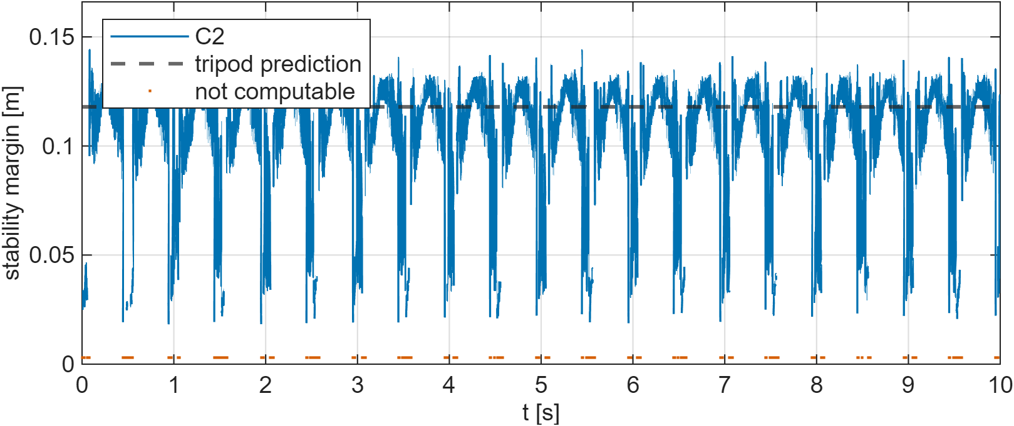
Stability: the ZMP confirms the static assumption
0
samples with negative margin
0.115 m
median margin, versus 0.118 m predicted by geometry
90%
of the time with a computable margin
Not computable = fewer than three feet above Fmin = 2 N, only at the tripod switch: a limit of the measurement, not a loss of support.
Notes:
[0:55] The tripod is built on a static assumption. With Froude 0.0095 the ZMP coincides with the projection of the centre of mass, so measuring it verifies the assumption with the robot in motion. Margin never negative, median on the geometric prediction. The gaps are instants with fewer than three feet above 2 N, only at the tripod switch. The noise comes from unfiltered contact forces.

Slide 32
Conclusions
Terrain search
Attitude loop
Limits
Cost on known terrain (pitch +219–279%), benefit on discontinuities (cost of transport −7/−10%).
Pitch −73/−82% on every task, +28–40% energy. With a load, it makes transport possible.
Lateral impulse recovered by none; on real servos, torques above the recommended load.
Notes:
[0:40] Three messages: terrain search has a measurable cost where it is not needed; the attitude loop is what makes the robot useful for transport; recovery from lateral disturbances remains open.

