Slide 1
Microphysical properties of ESCAPE clouds as measured by HOLODEC
Nithin Allwayin, Elise Rosky, Raymond Shaw
Michigan Technological University

Slide 2
Example Flight Segments
C-RF 06 – Warm Cloud
21:23:45-21:24:25 UTC
C-RF 12 – Mixed Phase cloud
23:18:40-23:19:25 UTC

Slide 3
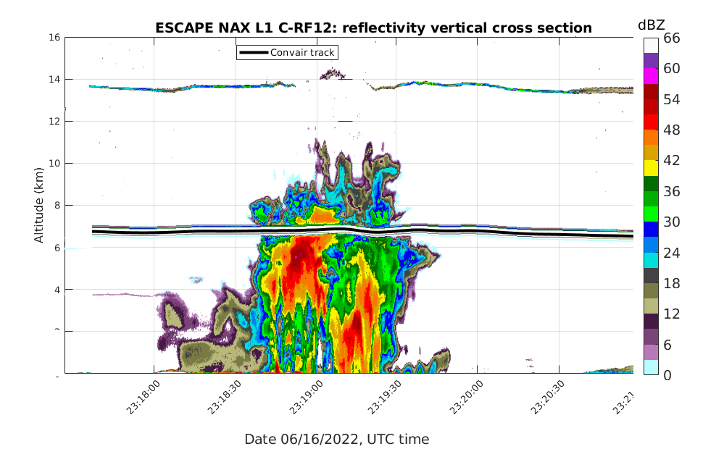
C- RF12

Slide 4
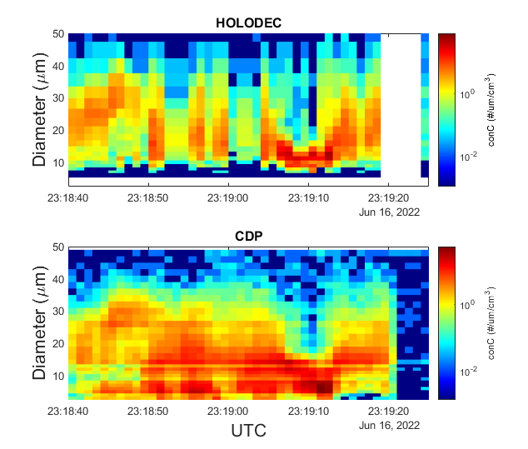
C-RF12- HOLODEC vs CDP
Reasonable agreement between CDP and HOLODEC number concentrations.
Some holograms are corrupted by water on the instrument windows

Slide 5
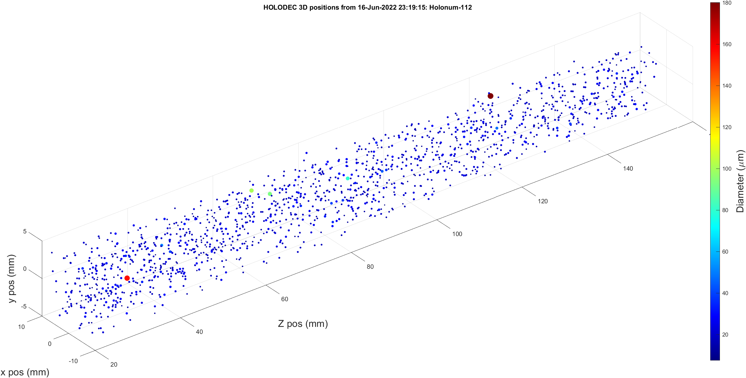
C-RF- HOLODEC sample volume

Slide 6
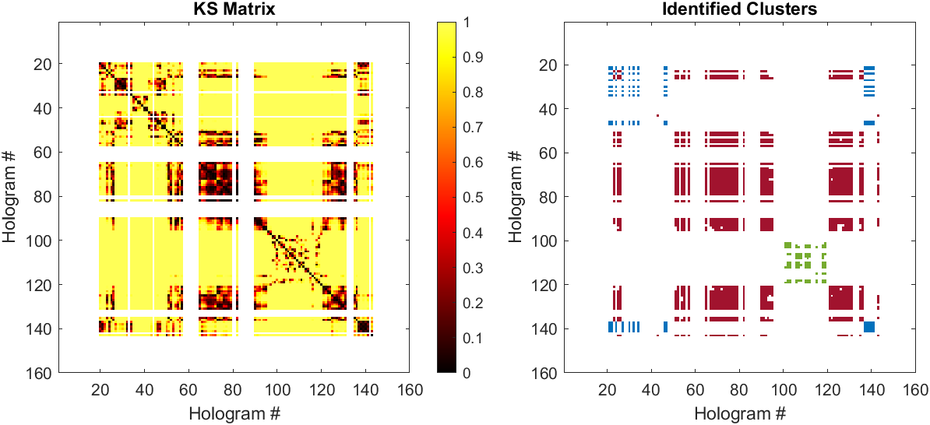
C-RF12: Clusters of similar droplet size distribution
3 clusters of holograms having similar droplet size distributions are identified
Allwayin, N., Larsen, M. L., Shaw, A. G., & Shaw, R. A. (2022). Automated Identification of Characteristic Droplet Size Distributions in Stratocumulus Clouds Utilizing a Data Clustering Algorithm, Artificial Intelligence for the Earth Systems, 1(3), e220003. Retrieved Nov 10, 2022, from https://journals.ametsoc.org/view/journals/aies/1/3/AIES-D-22-0003.1.xml

Slide 7
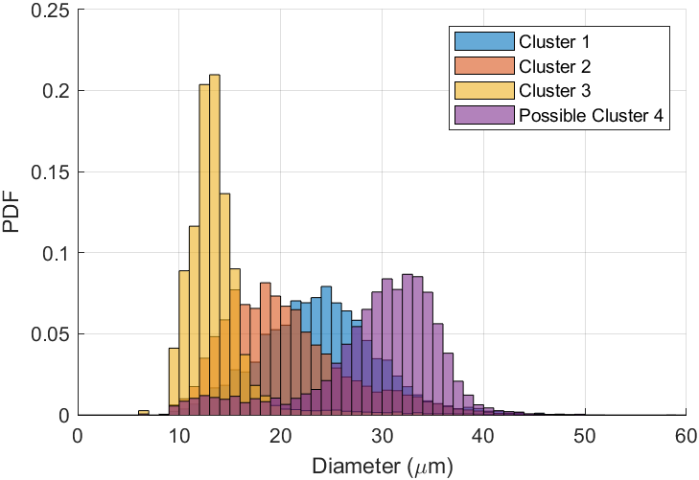
C-RF12: Clusters of similar droplet size distribution
Each cluster correspond to distinct distribution shapes.
There might be a possible fourth cluster not identified by the algorithm (possibly due to threshold of minimum number of holograms needed to form a cluster).

Slide 8
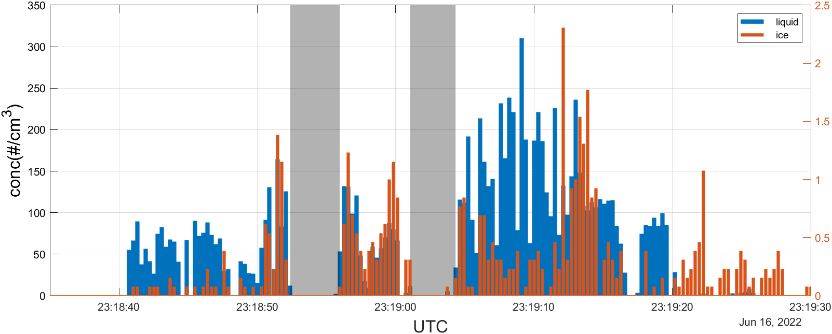
RF12- number concentration time series

Slide 9
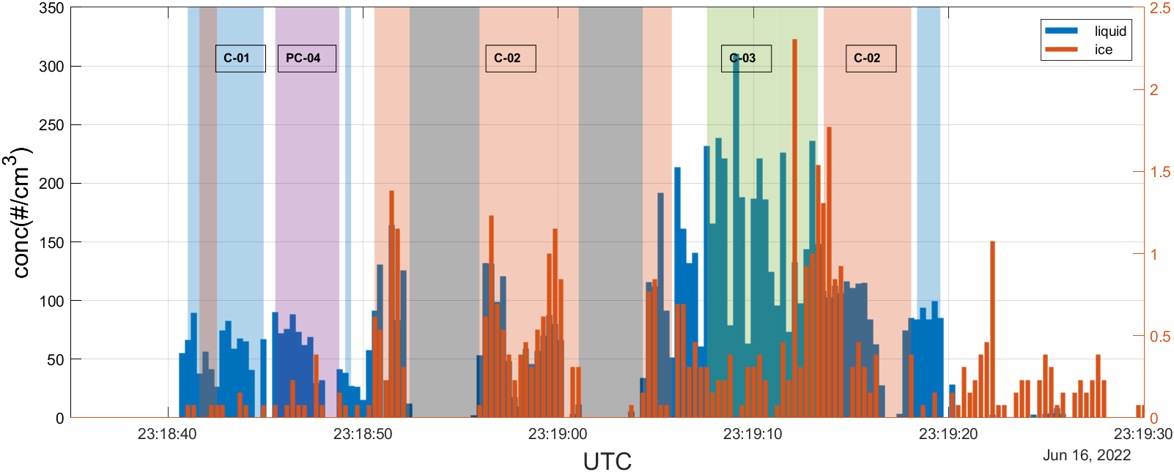
RF12- number concentration with clusters

Slide 10
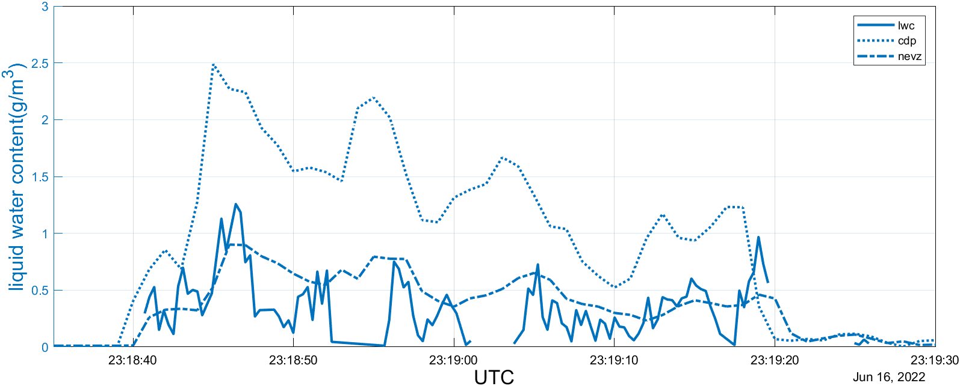
C-RF12 – Liquid Water Content Comparison

Slide 11
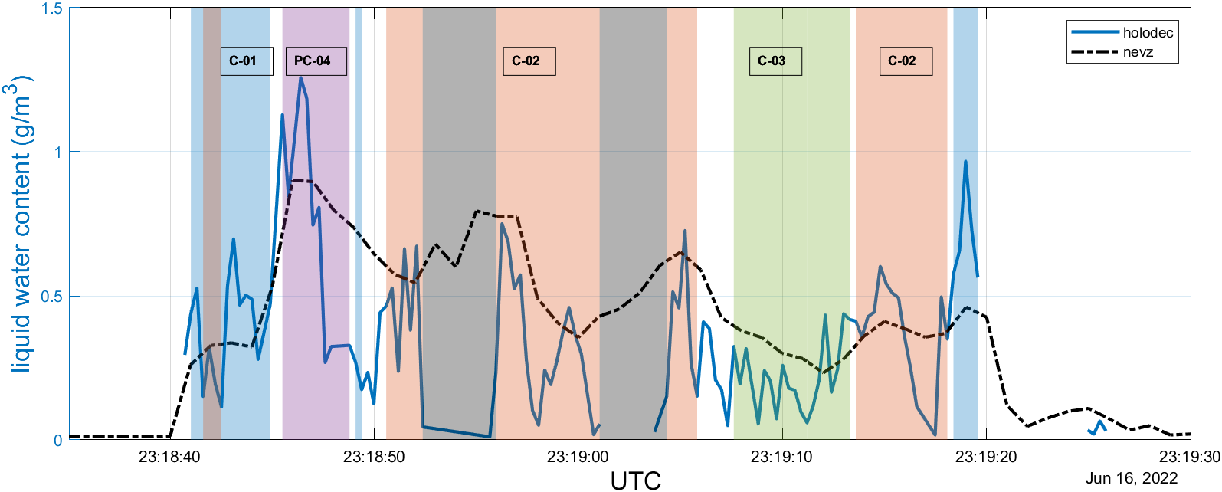
C-RF12 – Liquid Water Content with Clusters

Slide 12
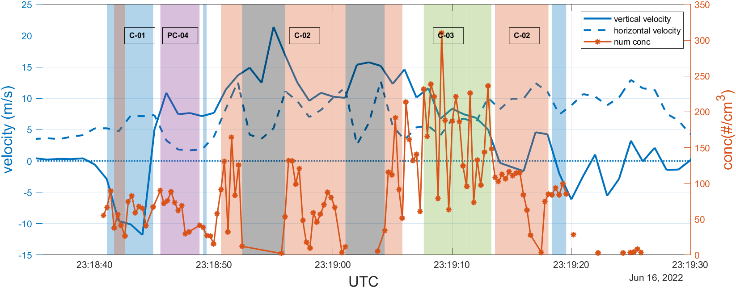
C-RF12 –Vertical velocity with Clusters

Slide 13
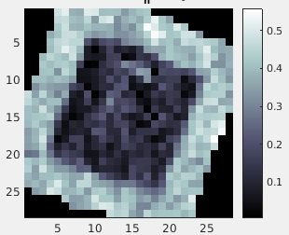
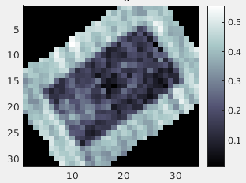
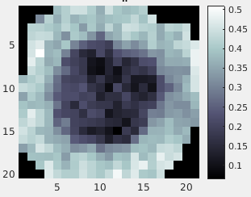
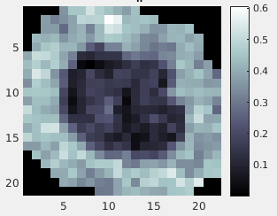
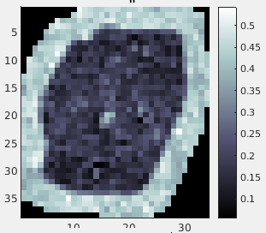
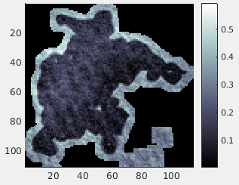
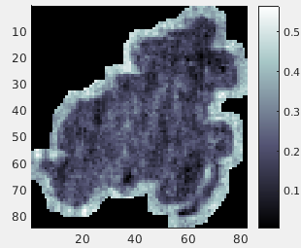
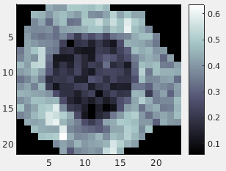
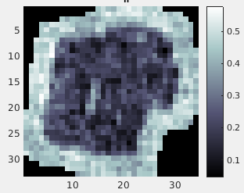
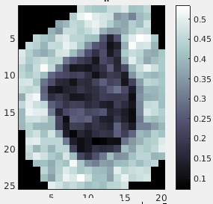
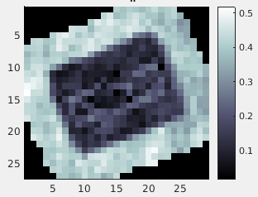
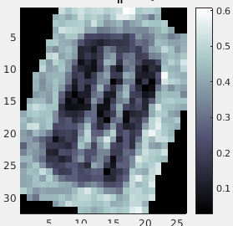
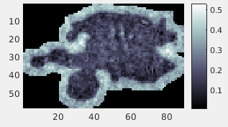
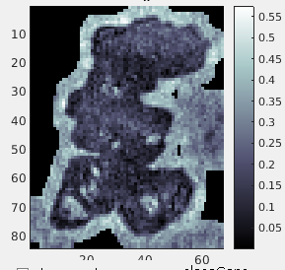
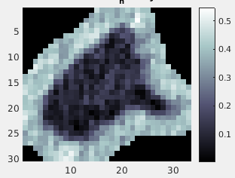
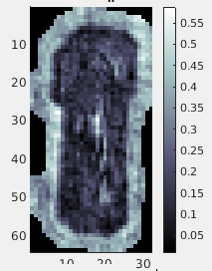
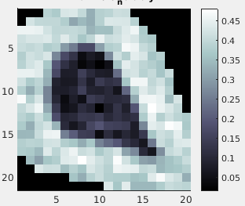
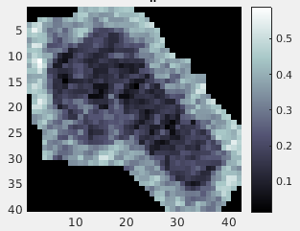
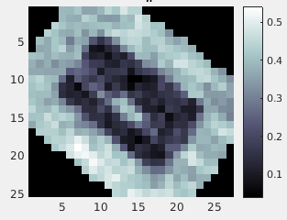
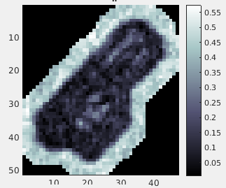
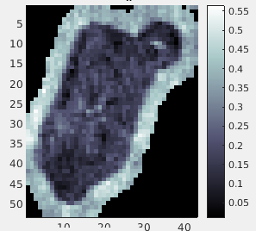
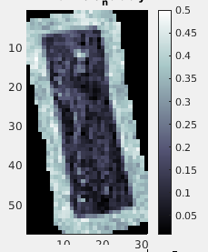
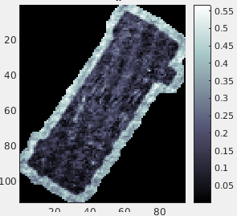
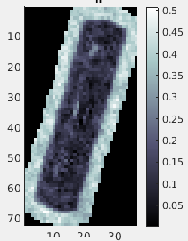
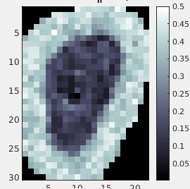
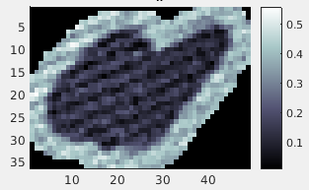
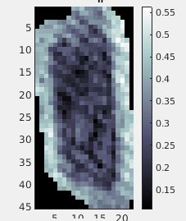
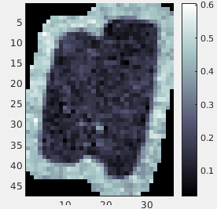
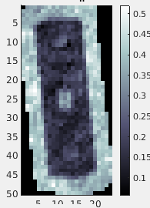
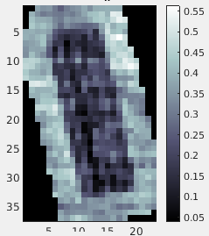
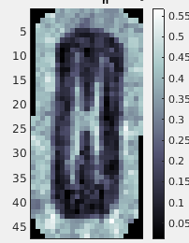
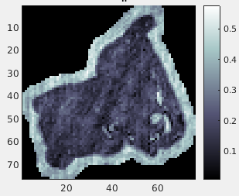
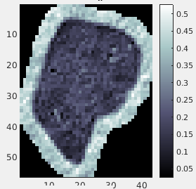
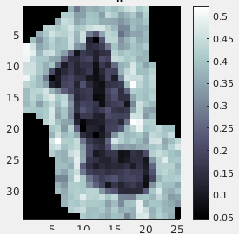
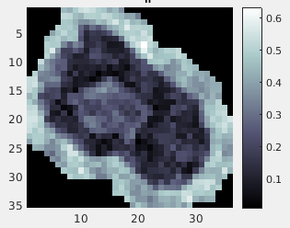
Short Columns
Frozen Droplets
Plate Assemblages
Long Columns
Irregular
Small Ice
<20um

Slide 14
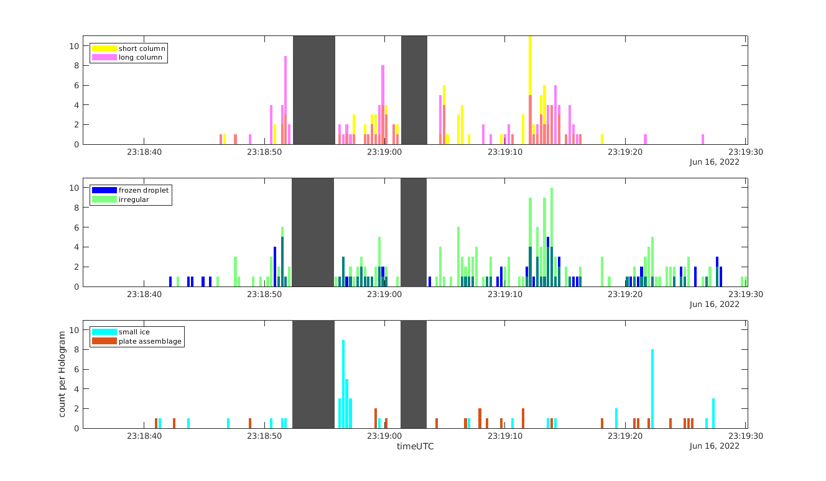
Time series of crystal habits

Slide 15
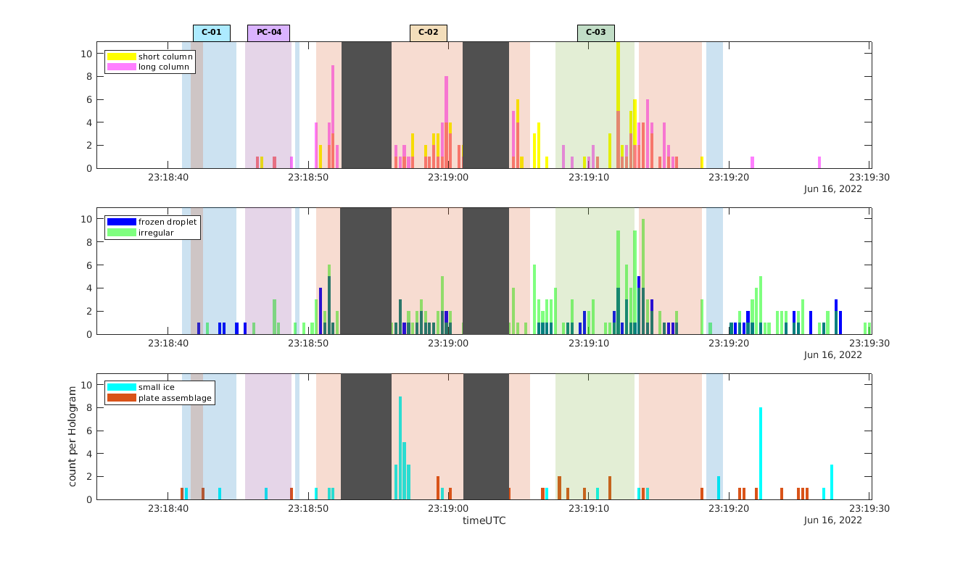
Time series of crystal habits

Slide 16


Slide 17
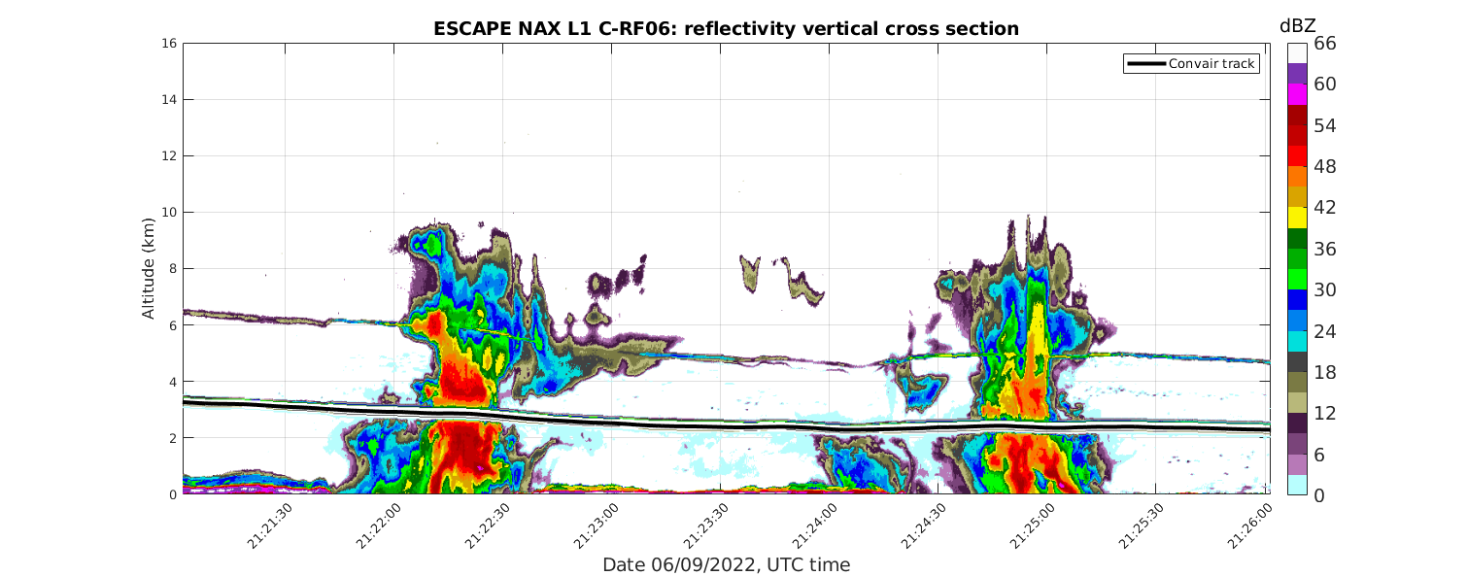
C- RF06

Slide 18
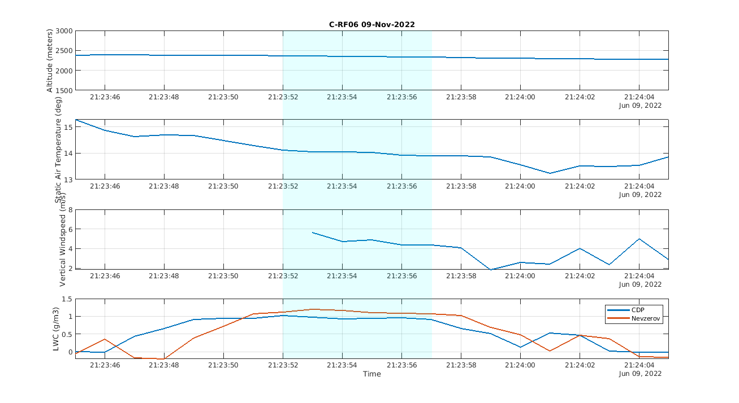
Updraft Core (~4.7 m/s)

Slide 19
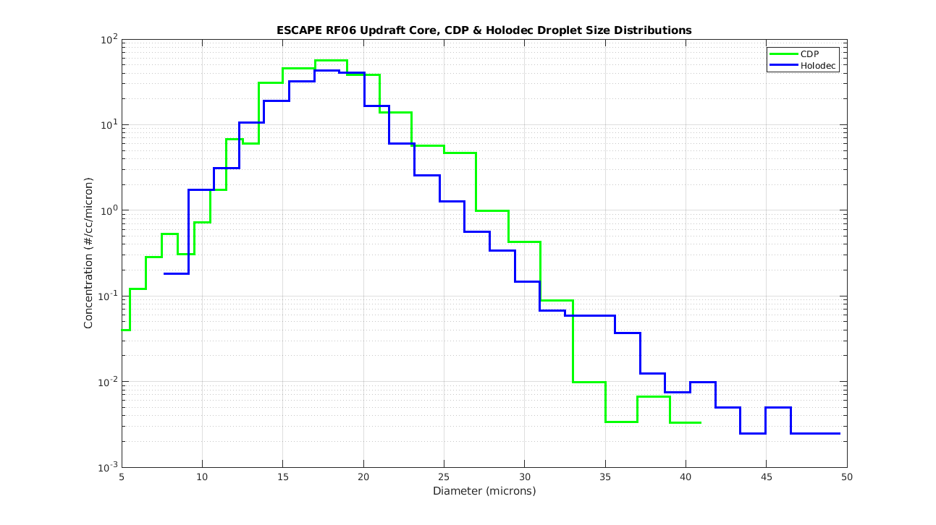
C-RF06- HOLODEC number concentration using Major Axis diameter (Good agreement with CDP)
Major Axis diameter = major axis of elipse enclosing the particle.
Holodec Number Conc
= 277 #/cc
Holodec LWC = 0.7 g/m3
CDP LWC = 1 g/m3

Slide 20

C-RF06- HOLODEC number concentration using Equivalent Diameter (Biased towards low LWC)
Equivalent Diameter = particle pixel area converted to diameter
Holodec Number Conc
= 277 #/cc
Holodec LWC = 0.5 g/m3
CDP LWC = 1 g/m3

Slide 21

C-RF06- HOLODEC number concentration

Slide 22

C-RF06- HOLODEC – Mixing Diagram
Indication of Inhomogeneous mixing

Slide 23
HOLODEC preliminary results C-RF06
Holodec and CDP droplet distributions have similar shape, but peak is shifted depending on how Holodec diameter is selected.
The mixing signatures indicate inhomogeneous mixing

Slide 24
HOLODEC preliminary results C-RF12
LIQUID
There are regions with different droplet size distributions within a single cell
The clusters align well with different vertical velocity regions
ICE
The ice concentrations tend to change at the cluster transition points.
The liquid droplet size distribution prior to ice formation seems to have an influence on the ice habits that arise.

