Slide 1
Excel for Data Analysis
Samson Eromonsei​

Slide 2

Introduction
What is Excel ?
Why is excel essential tool for businesses and why do I need to learn it

Slide 3
About the Course
Empower you to help business to automate and optimize business process
The Course will help you know how to collect data
Perform in-depth analysis , Drive effective and impactful business decision

Slide 4
Primary focus of the course
How to use Pivot tables, Charts, Histogram
Data cleaning and prep
Basic statistical functions

Slide 5
Course Outcomes
Understand business problem and datasets
Perform calculations using statistical techniques
Present and interpret the result of statistical analysis
Design dynamic reports and dashboard for the business consumption

Slide 6
Areas of Analytics
Customer Analytics
Data entry /Data management
Accounting/Auditing
Budgeting Planning
Data analysis
Risk analytics (Quantitative/ Qualitative)
Programming/Performance Analytics
Financial modelling and Analytics

Slide 7
What is Analytics ?
Is really about analyze historical data for descriptive, diagnostic , predictive and prescriptive purposes . In order to understand trends and patterns to make important decision. Or to evaluate performance of the business base on past decision.

Slide 8
Business Scenario
Your Business and manager has you to take sales data, cost expenses data and create an analysis on it. Your business/manager want to know the sales to cost relationship. In order to decide if they should push in money into certain areas of the business or they should should quit
Tyre Manufacturing Company collecting data on production line for good and defective product.

Slide 9
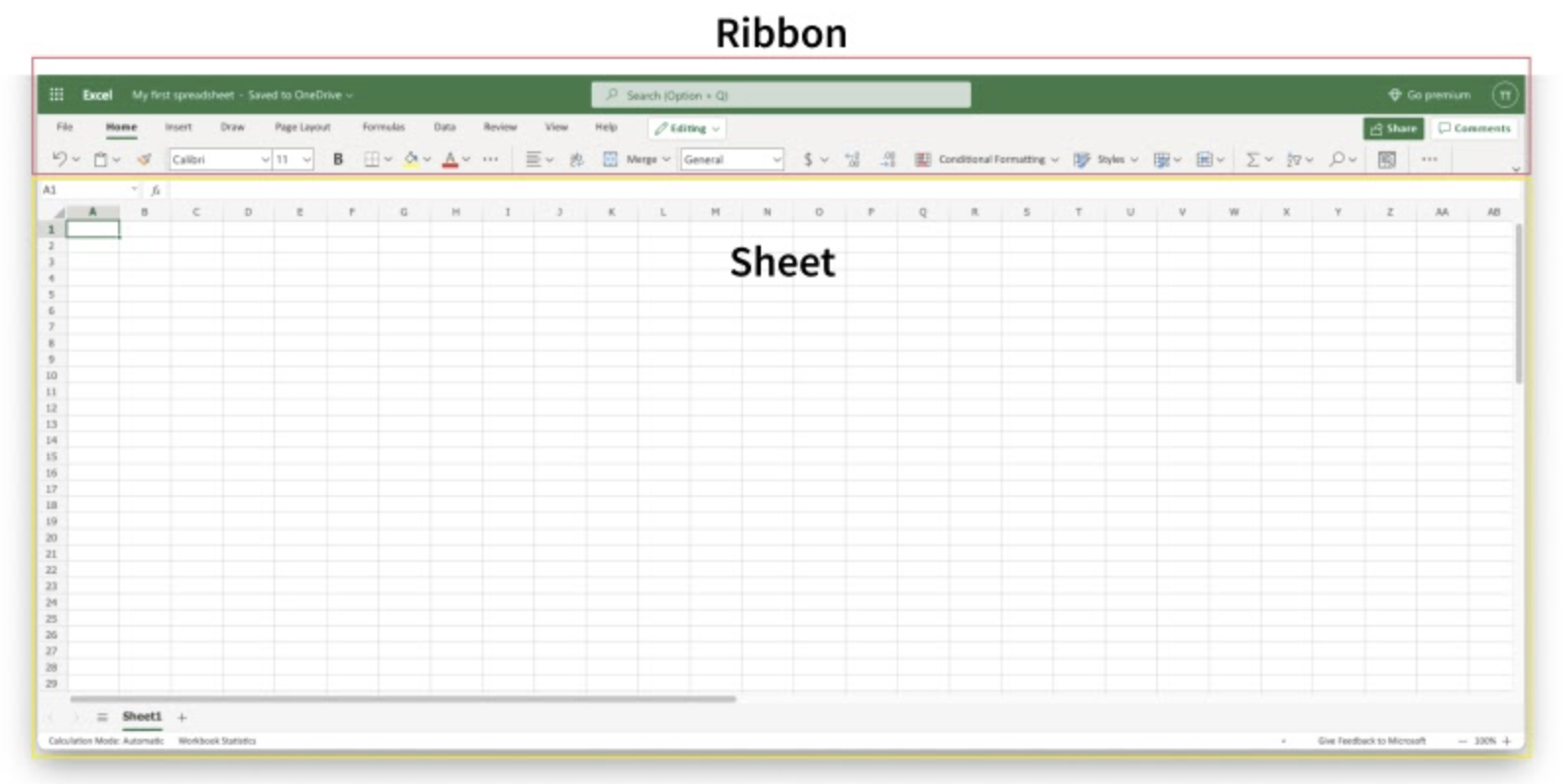
Understanding Excel Interface

Slide 10
Files Types, Structures and Data Types
Understanding Files Types
Understanding Files Structures
Data types

