Slide 1

Handwritten Digit Recognition System
An intelligent, automated platform powered by Convolutional Neural Networks and deep learning — accurately classifying handwritten digits from 0 to 9 in real time.
DEEP LEARNING
COMPUTER VISION
IMAGE CLASSIFICATION
E.MANASA
REG NO : 323129510012

Slide 2

The Challenge of Manual Digit Processing
Handwritten digits appear across postal codes, bank checks, medical forms, and academic records — yet manual processing is slow, error-prone, and costly. Organizations need an intelligent, automated solution that bridges the gap between human handwriting and machine-readable data.
High Error Rates
Slow Throughput
Human operators make frequent transcription errors under fatigue and volume pressure.
Manual processing bottlenecks delay critical workflows in banking, logistics, and healthcare.
Scalability Gap
Traditional rule-based systems fail to generalize across diverse handwriting styles and image conditions.

Slide 3
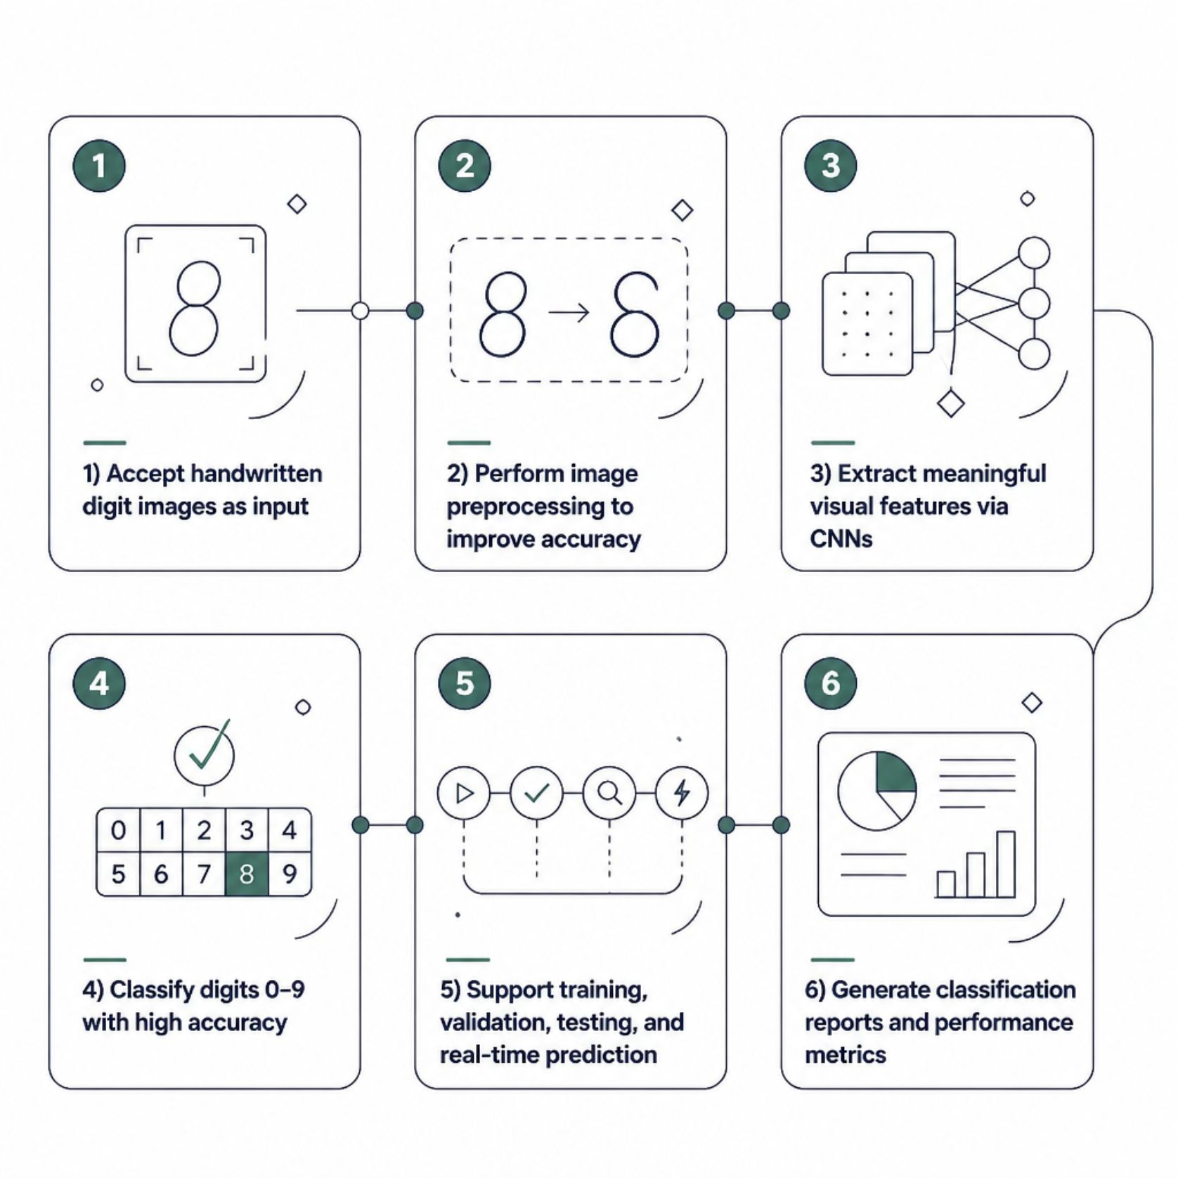
Project Objectives
This system delivers an end-to-end deep learning pipeline for handwritten digit recognition — from raw image input to real-time classification output.
What We Set Out to Build
A secure, scalable, and user-friendly platform that automates digit recognition across real-world document processing workflows — reducing manual effort and improving accuracy at every stage.
The system is designed for deployment in postal automation, banking, education, and intelligent document analysis.

Slide 4
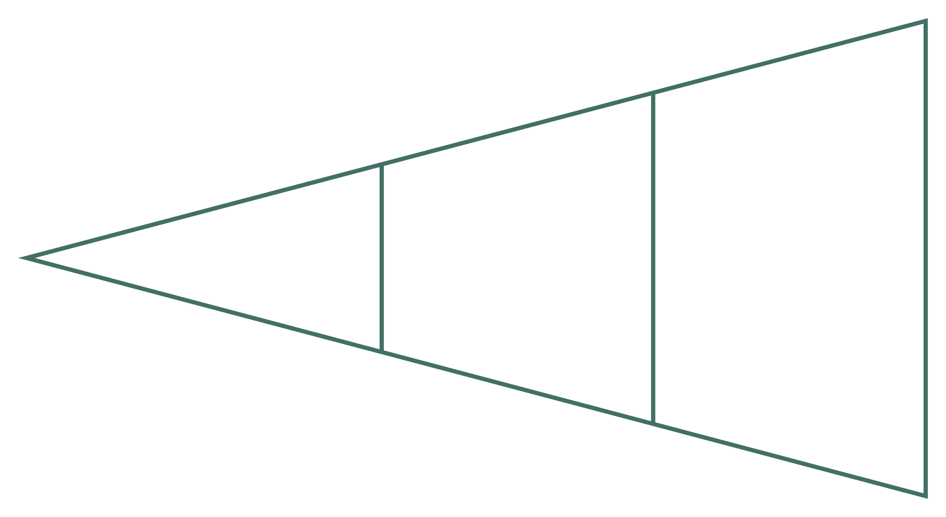
System Architecture & Workflow
Input Image
Feature Extraction
Preprocessing
The end-to-end pipeline transforms a raw handwritten digit image into a classified label through sequential, optimized stages — each designed to maximize recognition accuracy and minimize computational overhead.

Slide 5
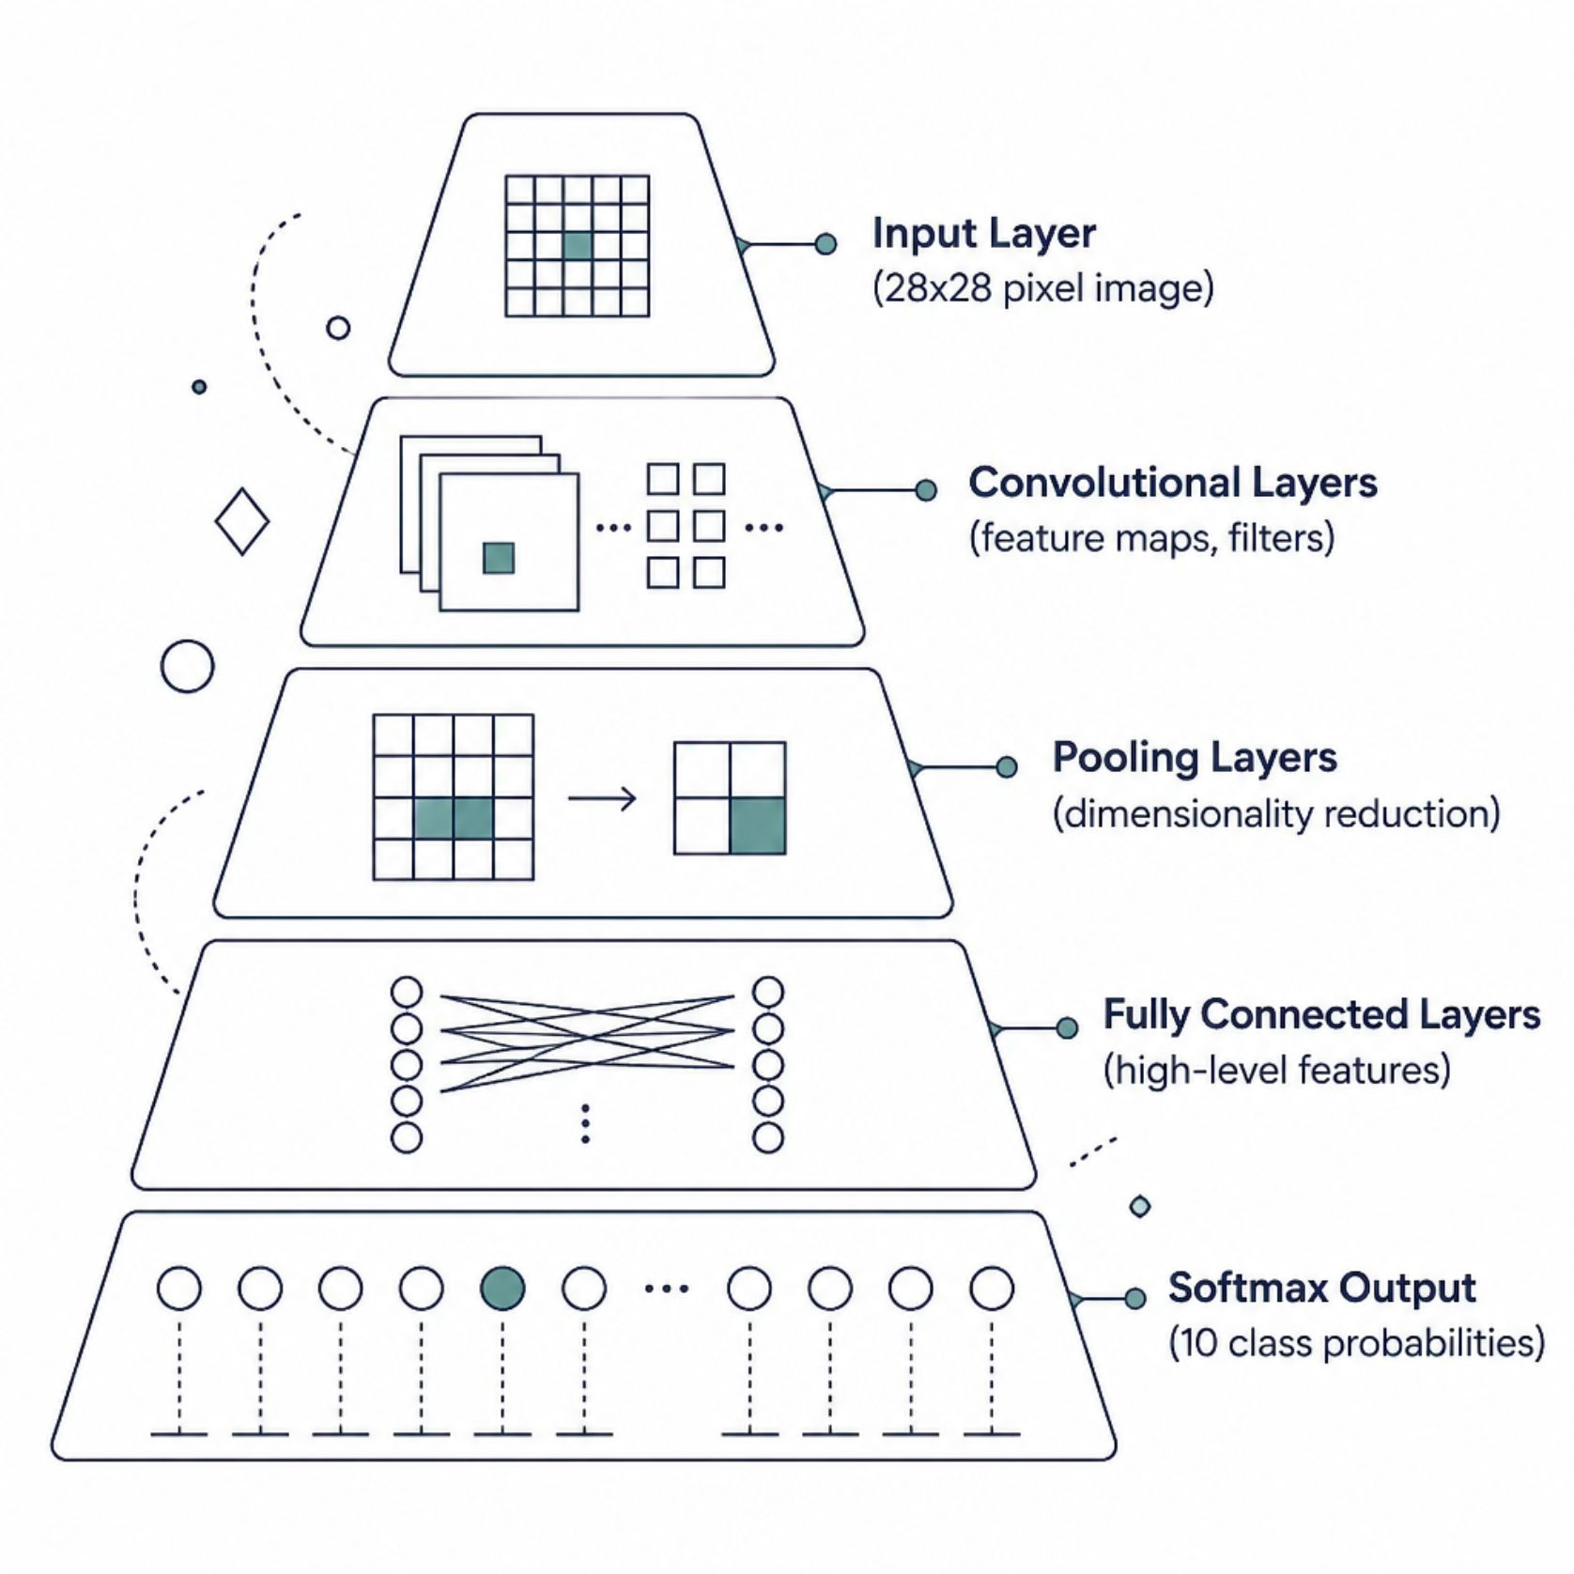
Core Deep Learning Concepts
Why CNNs?
Convolutional Neural Networks are uniquely suited for image data. They automatically learn spatial hierarchies of features — edges, shapes, and patterns — without manual feature engineering.
Convolution: Sliding filters detect local patterns
Pooling: Reduces dimensionality, retains key features
Softmax: Converts outputs to class probabilities

Slide 6
Dataset & Preprocessing Pipeline
The MNIST Benchmark
Preprocessing Steps
The system is trained on the MNIST dataset — the gold standard for handwritten digit recognition research.
01
Resize & Normalize: Scale to 28×28, normalize pixel values to [0, 1]
02
Denoise: Apply Gaussian blur to reduce image noise
03
Binarize: Threshold to enhance digit-background contrast
04
Data Augmentation: Rotate, zoom, and shift to improve generalization
60,000
10,000
28×28
10
Training samples
Test samples
Grayscale pixels
Digit classes

Slide 7
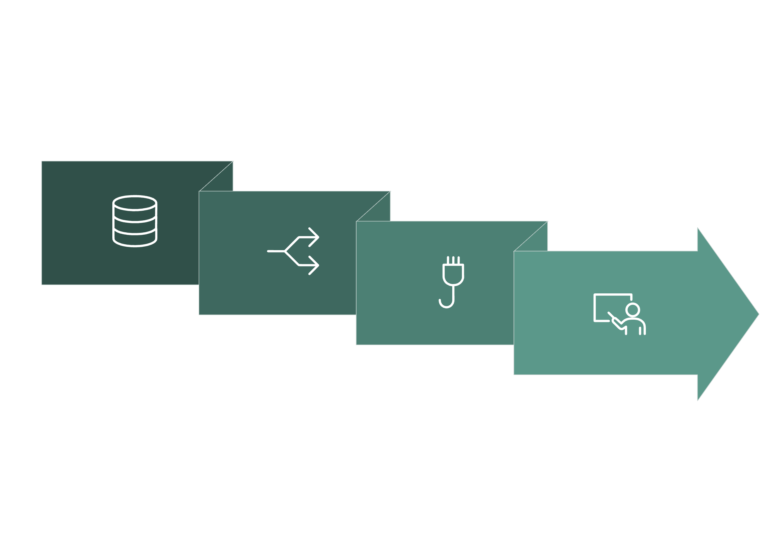
Model Training & Feature Extraction
Split Sets
Train & Tune
Load Data
Build CNN
The training workflow follows a rigorous methodology to ensure model generalization and prevent overfitting at every stage.
Training Configuration
Feature Extraction
Optimizer: Adam (adaptive learning rate)
Loss Function: Categorical Cross-Entropy
Epochs: 10–20 with early stopping
Batch Size: 128 samples per iteration
Regularization: Dropout (0.5) + L2 penalty
CNN layers automatically learn hierarchical representations — from low-level edges to high-level digit structures — eliminating the need for hand-crafted features.

Slide 8
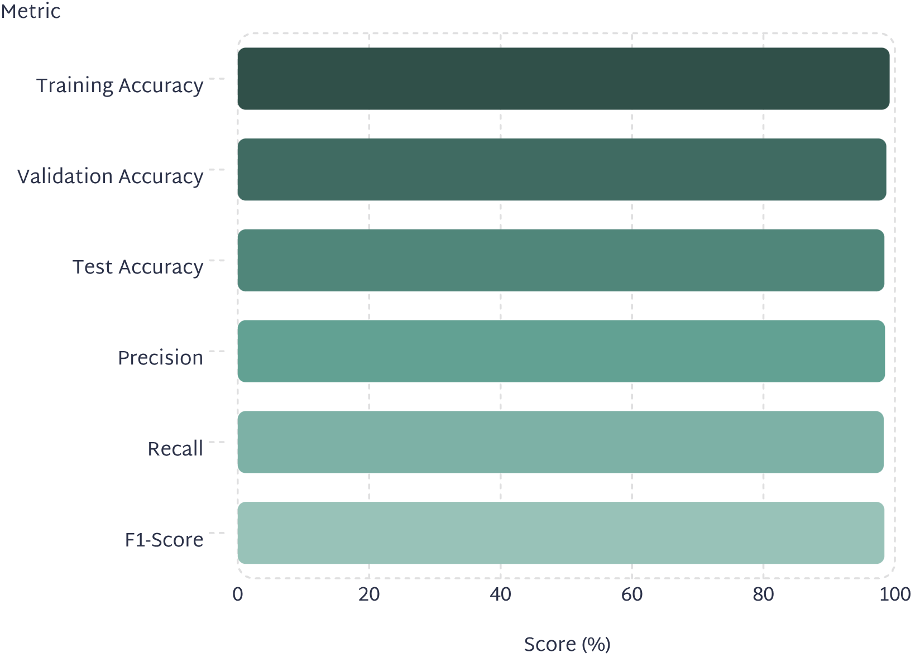
Model Evaluation & Performance
Classification Report Highlights
The model achieves state-of-the-art performance on the MNIST benchmark, with near-perfect accuracy across all 10 digit classes.
Confusion Matrix: Minimal off-diagonal errors, strongest confusion between 4/9 and 3/8
Loss Curve: Smooth convergence with no overfitting — validation loss tracks training loss closely
Inference Speed: Under 10ms per image on standard CPU hardware

Slide 9
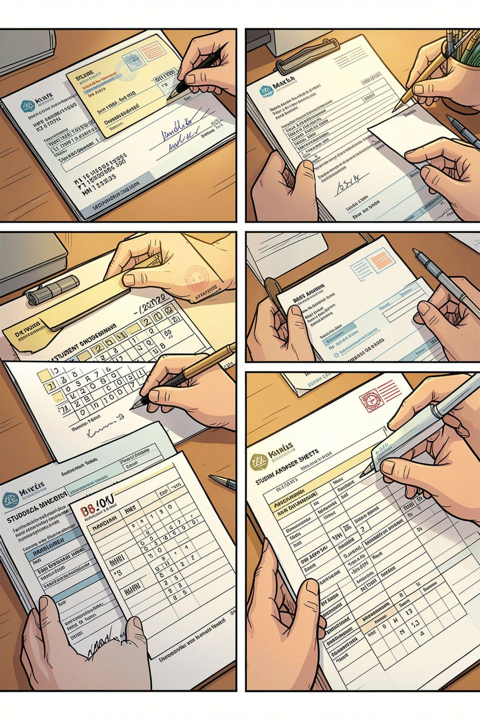
Real-World Applications
Postal Automation
Automated ZIP code and address digit recognition for high-speed mail sorting systems.
Bank Check Processing
Extract account numbers and amounts from handwritten checks with high reliability.
Document Digitization
Convert paper-based forms and records into structured digital data at scale.
Education & Exams
Automate grading of handwritten answer sheets and standardized test forms.

Slide 10

Security, Scalability & Future Roadmap
Security & Scalability
Future Enhancements
Phase 1: Extend to full handwritten text (HTR) and multi-language support
1
Input Validation: Sanitize all image uploads to prevent injection attacks
2
Phase 2: Deploy mobile inference with TensorFlow Lite for edge devices
Access Control: Role-based authentication for API and admin interfaces
Phase 3: Integrate attention mechanisms and transformer architectures for improved accuracy
3
Cloud-Ready: Containerized deployment via Docker/Kubernetes for horizontal scaling
This system demonstrates that deep learning can reliably automate handwritten digit recognition — reducing manual effort, improving accuracy, and enabling intelligent document processing at scale.

