Slide 1
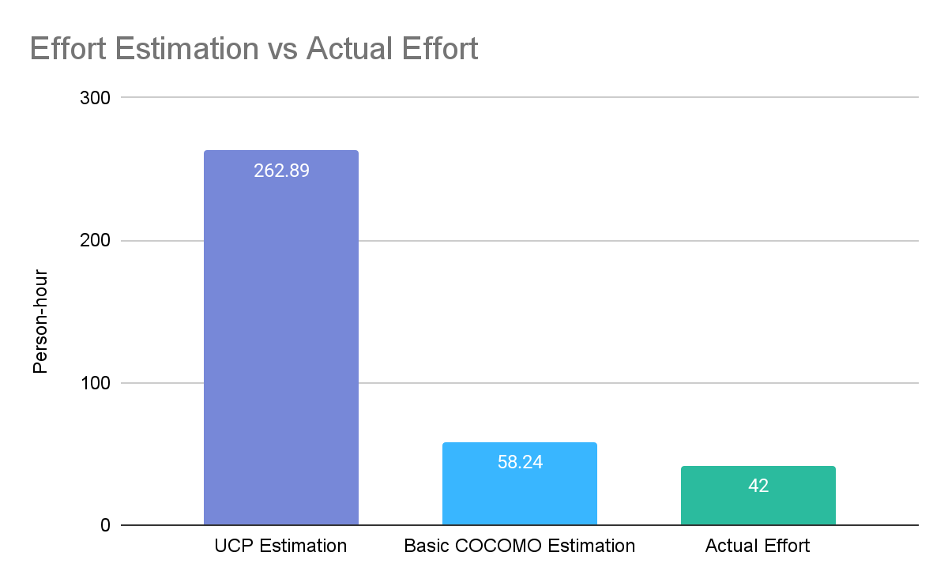
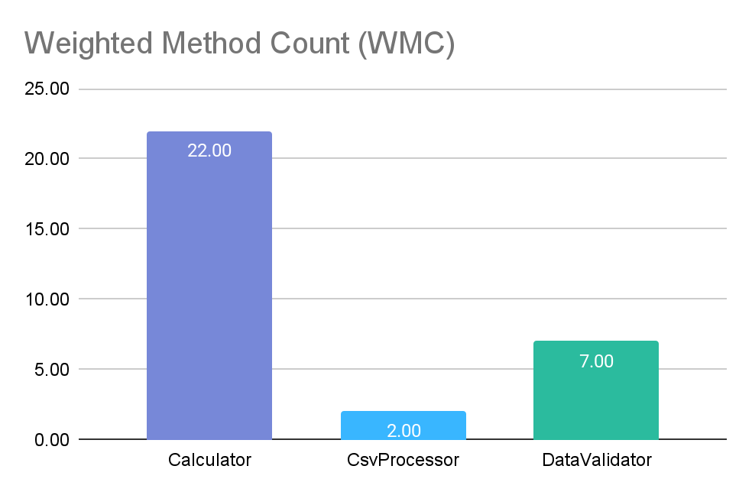
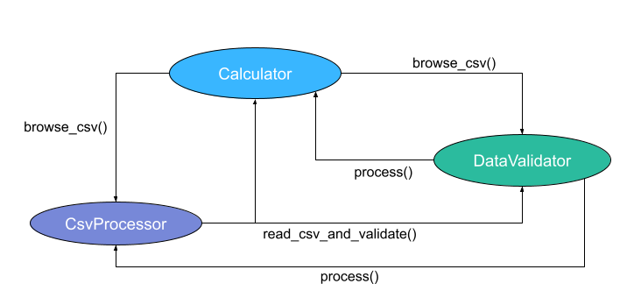
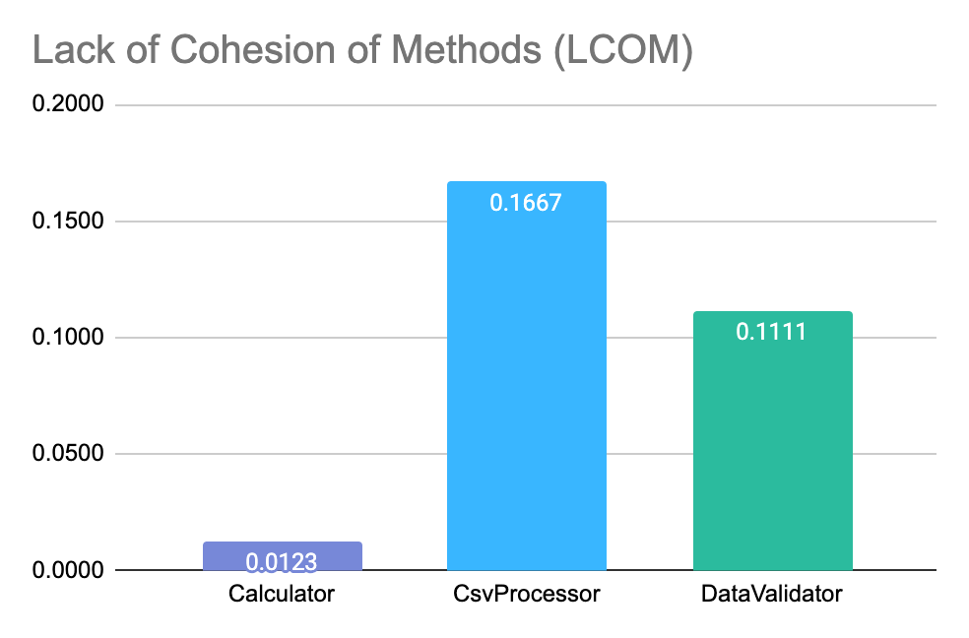
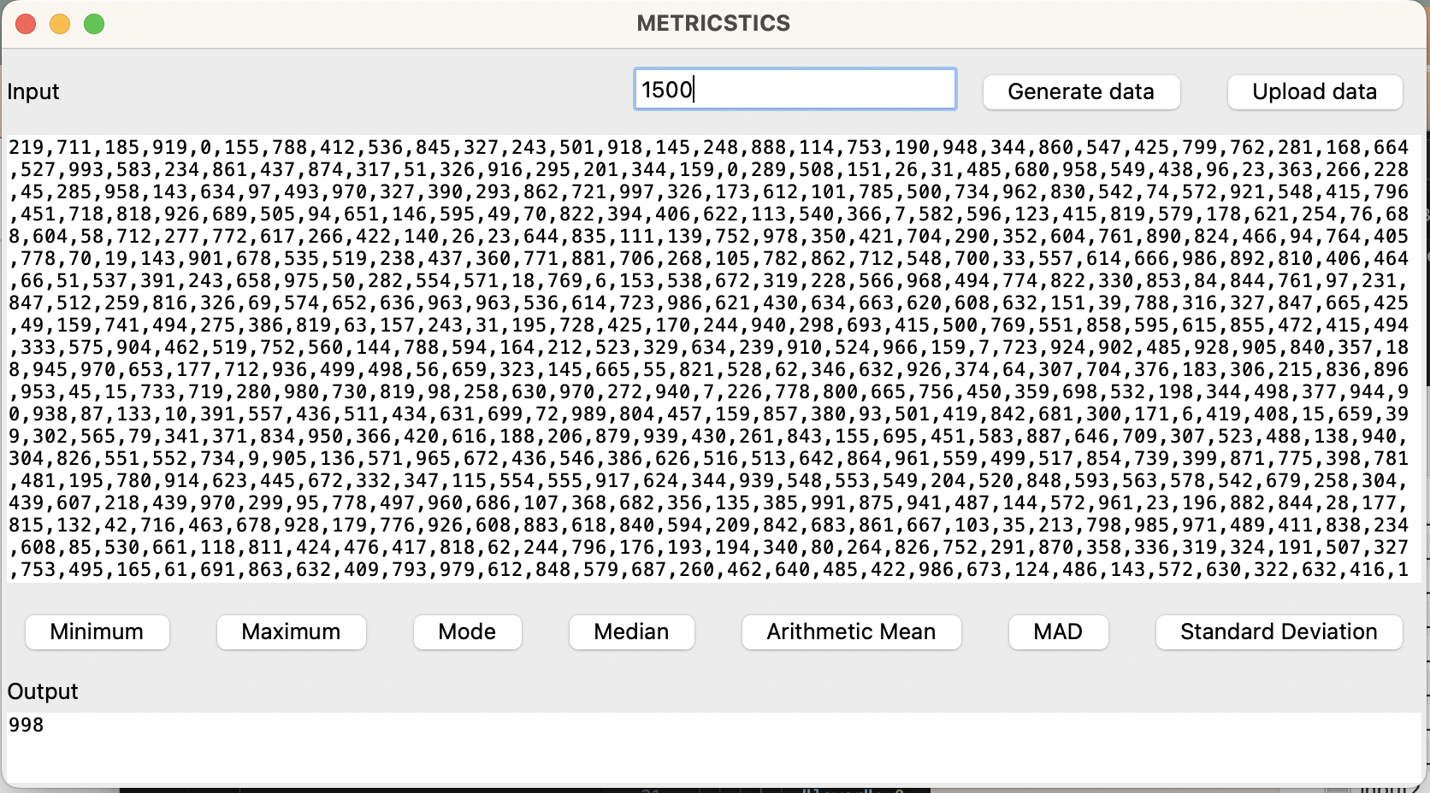
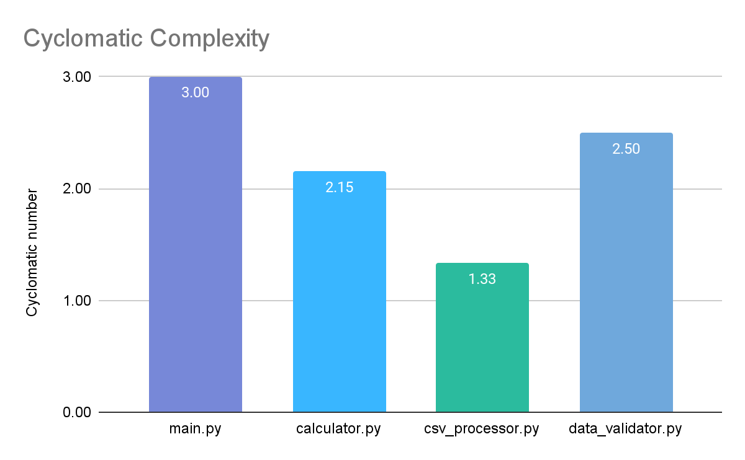
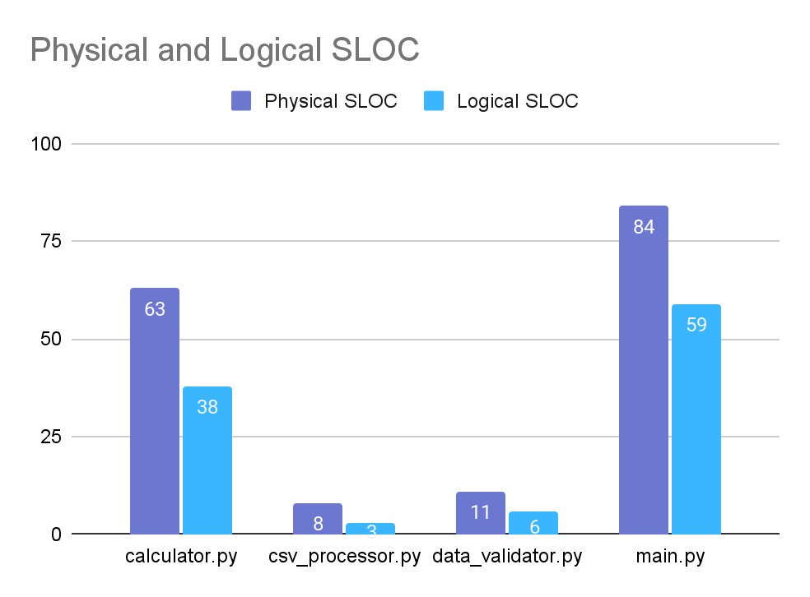
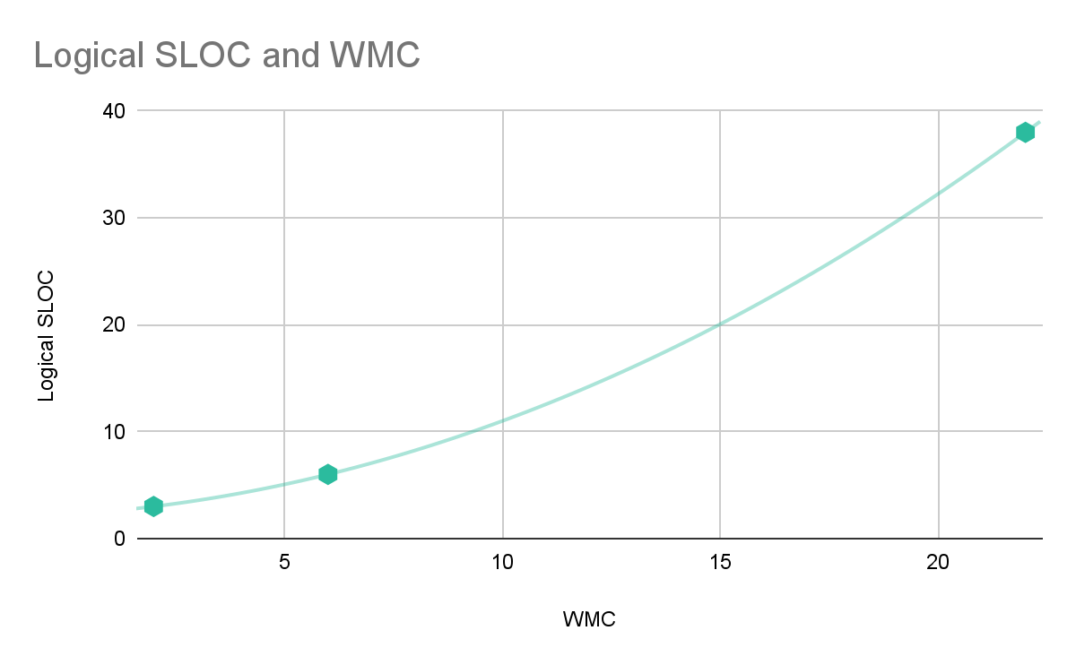
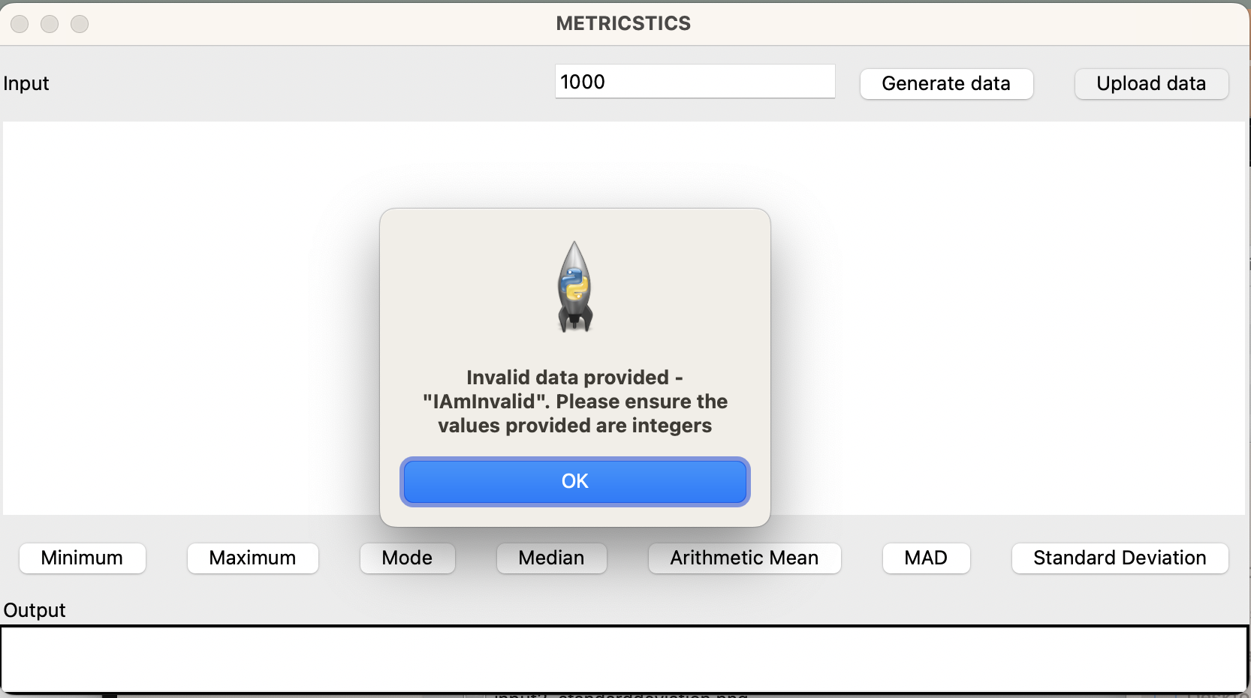
METRICSTICS SYSTEM
SOEN 6611 (Software Measurement)
Team H: Naman Kumar, Yvonne Chooi Mei Lee, Yang Liu, Jothi Basu Lkv, Nasrin Maarefi
INTRODUCTION
EFFORT ESTIMATION
OBJECT-ORIENTED METRICS
METRICSTICS is a statistical calculator which takes in a random number of at least 1000 data values, randomly distributed between 0 and 1000 and outputs its descriptive statistics. Its main objective is to create interconnected artifacts that assist in these measurements, using the GQM Approach. This ensures that our goals are SMART – Specific, Measurable, Achievable, Relevant and Time-bound, enabling data-driven and objective decision making throughout the project.
UCP – subjective, unpredictable abilities of team members, assumes traditional development approach
COCOMO – simple model (only lines of code are considered)
Actual – Agile methodology, effectiveness of project management
Weighted Method Count:
- Calculator (22): comparatively high
- CsvProcessor (2): fewer methods and simpler
- DataValidator(7): process method contributes to complexity
Coupling Factor (CF): 7/6
- Moderate level coupling
Lack of Cohesion of Methods (LCOM)
-Calculator (0.0123): Weak cohesiveness, approaches are tangentially connected
- CsvProcessor (0.1667): Moderate cohesiveness; moderate relationship between approaches
- DataValidator (0.1111): Moderate cohesiveness; methods are moderately connected
TECH STACK AND DEVELOPMENT
- Python3 with tkinter library for the GUI
- Object-oriented paradigm
- Input: - Randomly generated data
- CSV file upload
CYCLOMATIC COMPLEXITY
PHYSICAL AND LOGICAL SLOC
LOGICAL SLOC AND WMC RELATIONSHIP
main.py – multiple execution paths but reasonable maintainability
calculator.py – straightforward logic flow and consistent coding practices
csv_processor.py – well-designed module with straightforward logic
data_validator.py – mixed complexity but overall acceptable for understanding and maintenance
Total Physical SLOC: 167
Smaller program, lower complexity, easier maintenance
Total Logical SLOC: 106
Straightforward and manageable source code
Directly proportional relationship
Spearman’s Rank Correlation Coefficient
r_{s} = 1 – indicates a strong positive correlation

