Slide 1
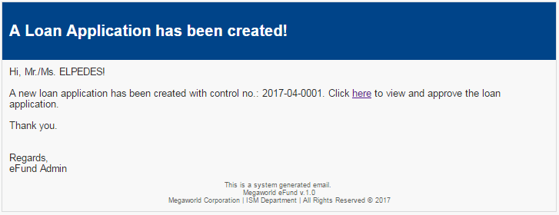
Guarantor/Endorser/Payroll

Slide 2
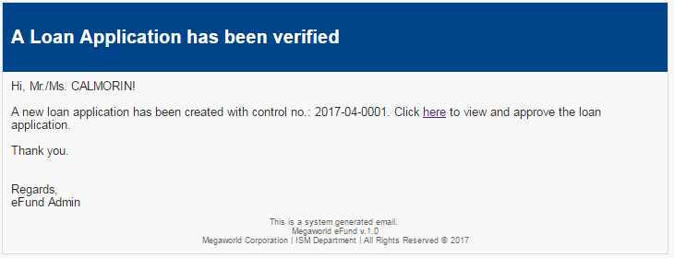
Officer

Slide 3
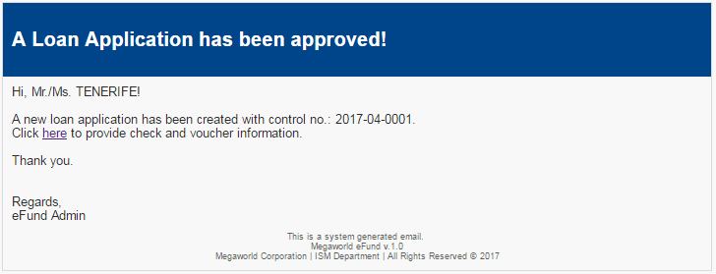
Treasury

Slide 4
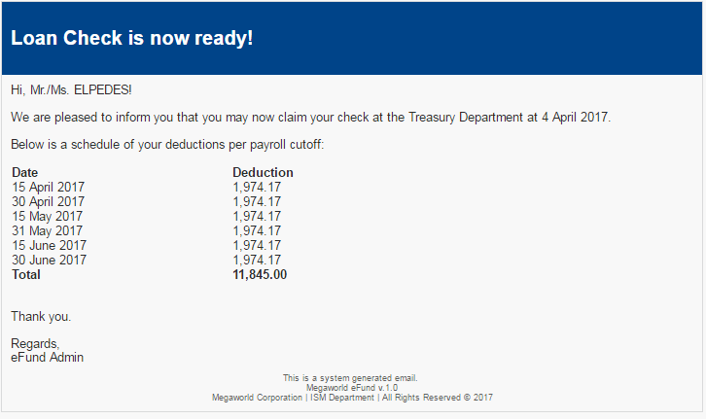
Check To Employee

Slide 5
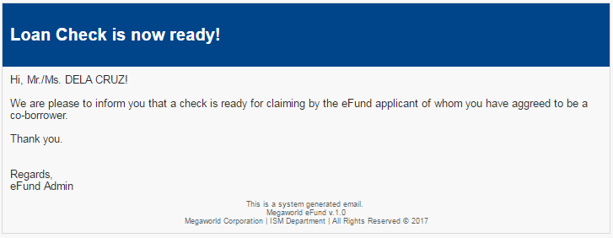
Check To Guarantor

Slide 6
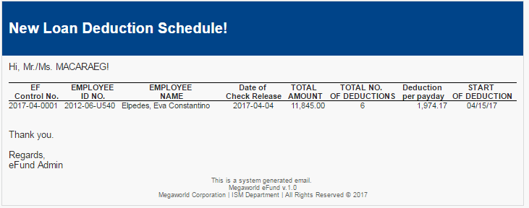
Payroll Notification

Slide 7
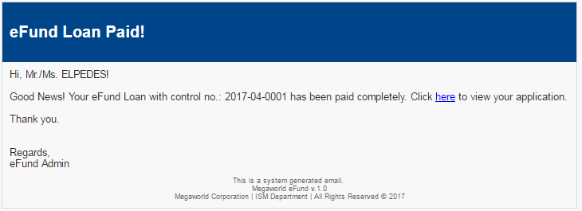
Paid

Slide 8
System Flow
Loan Application
Guarantor
Endorser
Payroll
Officer
Check Prep
Releasing
Custodian

