Slide 1
Analysis of a game- Sueca
Vasco Silva

Slide 2
Game Overview
Name: Sueca
Type: Trick-taking card game
Players: 4 (2 teams of 2)
Duration: 30-45+ minutes
Age Range: 10+

Slide 3
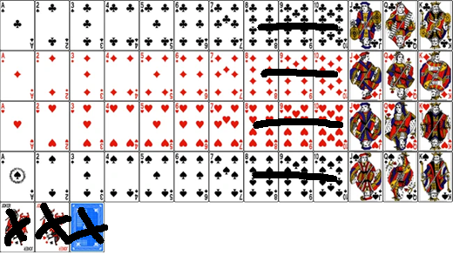
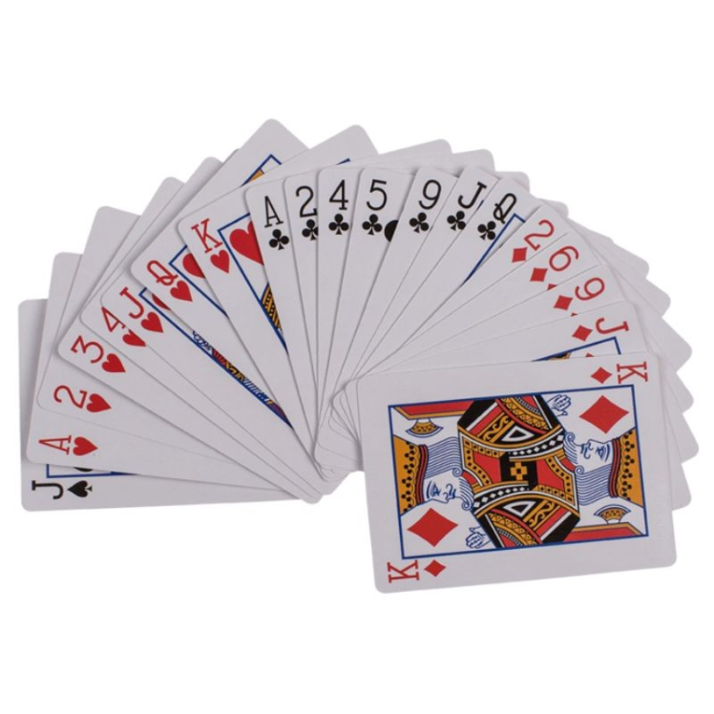
Components and setup

Slide 4
Rules

Slide 5
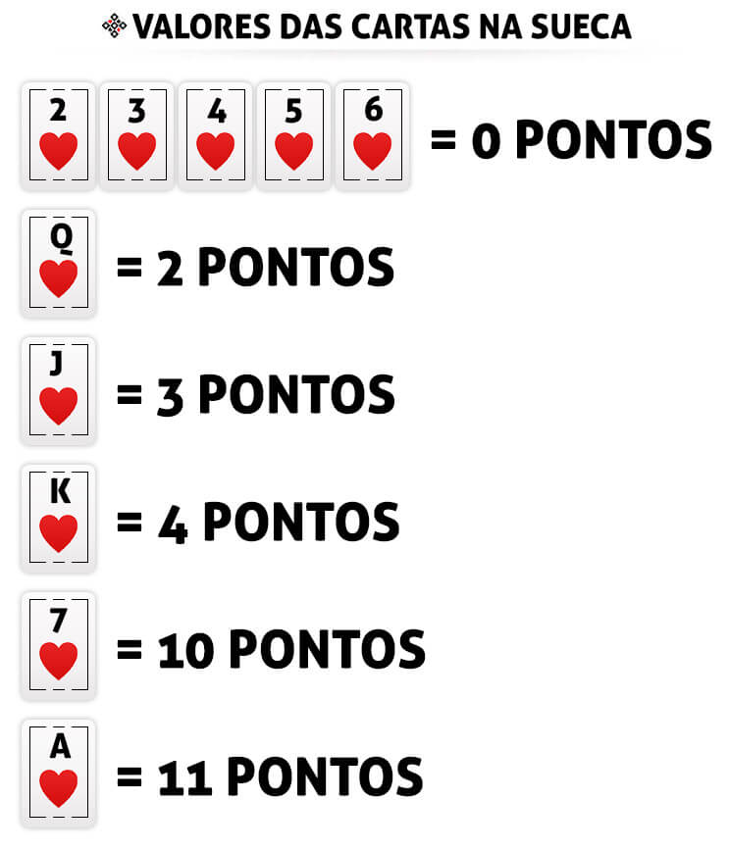

Slide 6
Playing a round

Slide 7

Team play, strategy and mind games
Team Synergy is key
Early Game Strategy
Adapting to the Hand
Mind Games & Psychological
Play Non-Verbal Communication
Pre-Match Planning

Slide 8
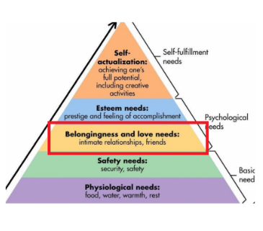

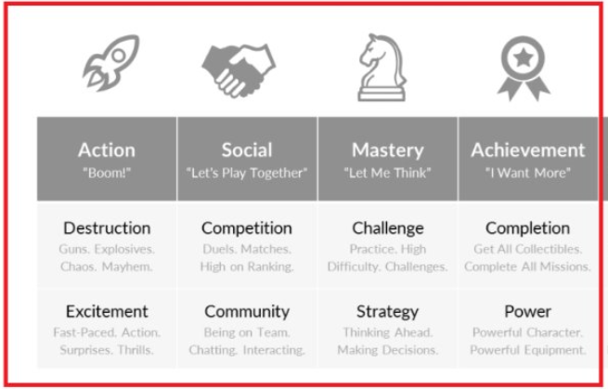
Motivation Profile
Gamer Motivation Model
Maslow's Hierarchy of Needs
16 Basics Desires of Human Nature

Slide 9
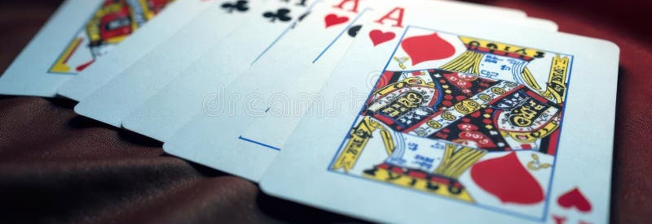
Betting

Slide 10
Thank you

