Slide 1

Economic Impact of Video Games:
A Big Data Approach Using Global Sales Data
Vasco Silva-1240499

Slide 2
Context & Objectives
Video games evolved into a multi-billion dollar global industry
Traditional analysis struggles with scale, heterogeneity, and temporal depth
Objective: design and validate a Big Data pipeline to analyze long-term industry trends

Slide 3
Literature Review
Prior studies focus on:
Console life cycles
Genre dominance
Regional markets
Industry reports (Newzoo, Visual Capitalist) show revenue growth but lack transparent pipelines
Gap: Limited reproducible, scalable analytical pipelines

Slide 4
Dataset Overview
Source: Video Game Sales (1978–2024)
Records: ~70k
Key attributes:
Year, Platform, Genre
Regional sales (NA, PAL, JP, Other)
Global sales
Physical sales bias
No mobile-first revenue

Slide 5


Apache Spark and Colab
Distributed processing
Scales beyond pandas
Built-in aggregation & validation
Reproducible
No local environment issues
Adequate for batch analytics

Slide 6
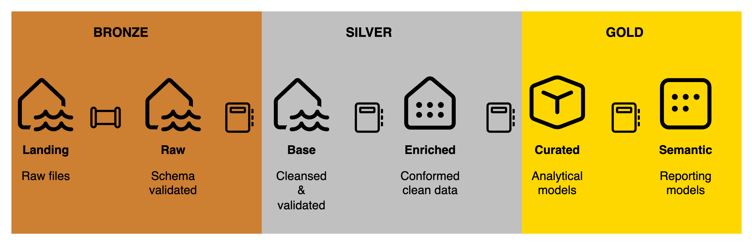
Lakehouse Architecture

Slide 7
Validation Strategy
Incremental validation
Hard Rules
Soft Rules
No over-cleaning
Regional vs global sales consistency
Duplicate Removal
Platform Normalization

Slide 8
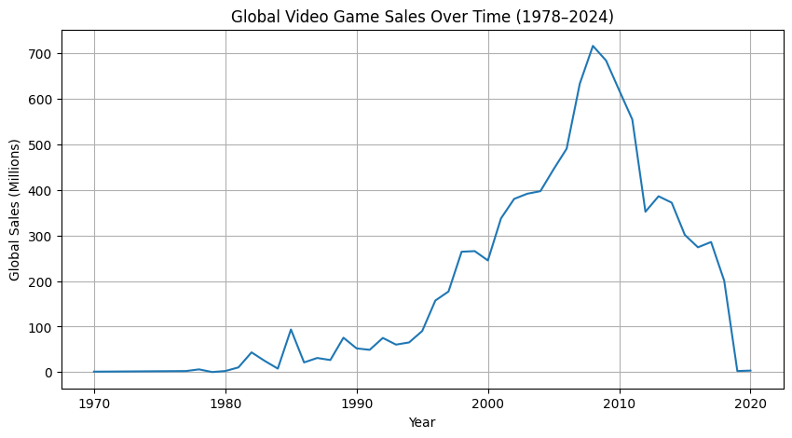
Results: Global Trends

Slide 9
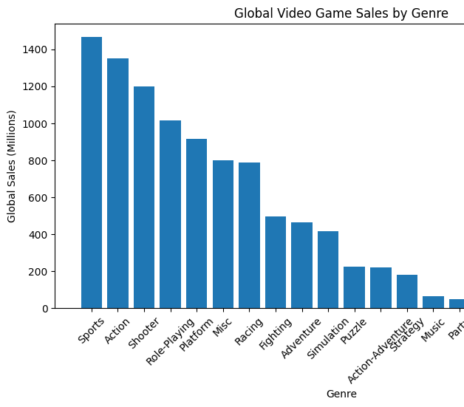
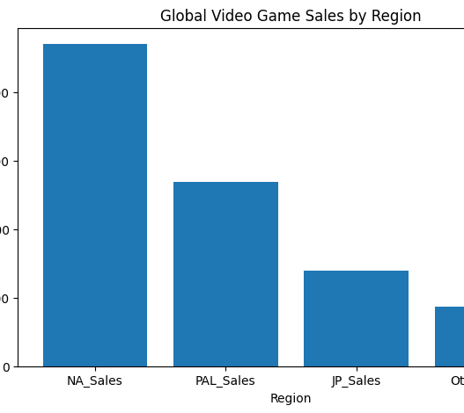
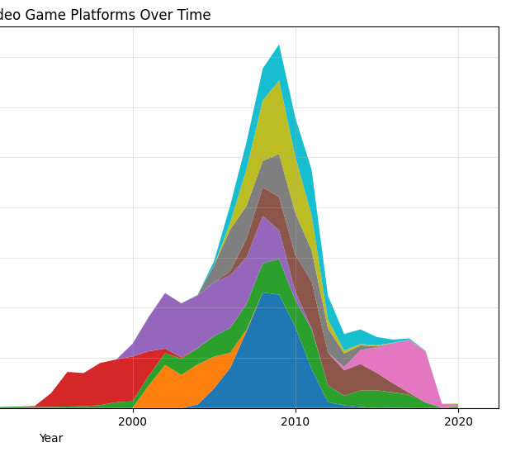
Platform & Genre Dynamics

Slide 10
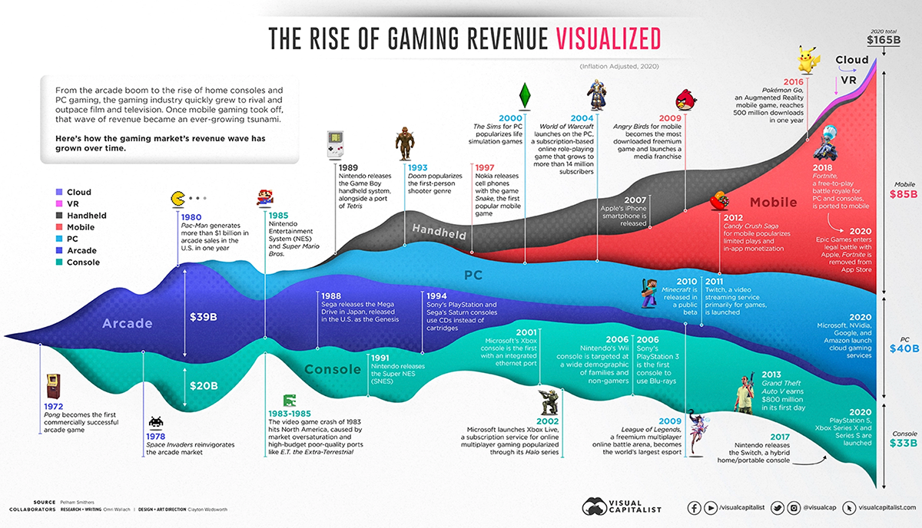
Comparison with External Industry Graph

Slide 11
Limitations & Trade-offs
No inflation adjustment
Physical sales bias
Platform metadata inconsistency

Slide 12
Thank you

