Slide 1

Economic Impact of Video Games:
A Big Data Approach Using Global Sales Data
Vasco Silva-1240499

Slide 2
Introduction

Slide 3
Literature Review
Digital Entertainment
Socio-Cultural impact
Consumer trends
Impact on GDP

Slide 4
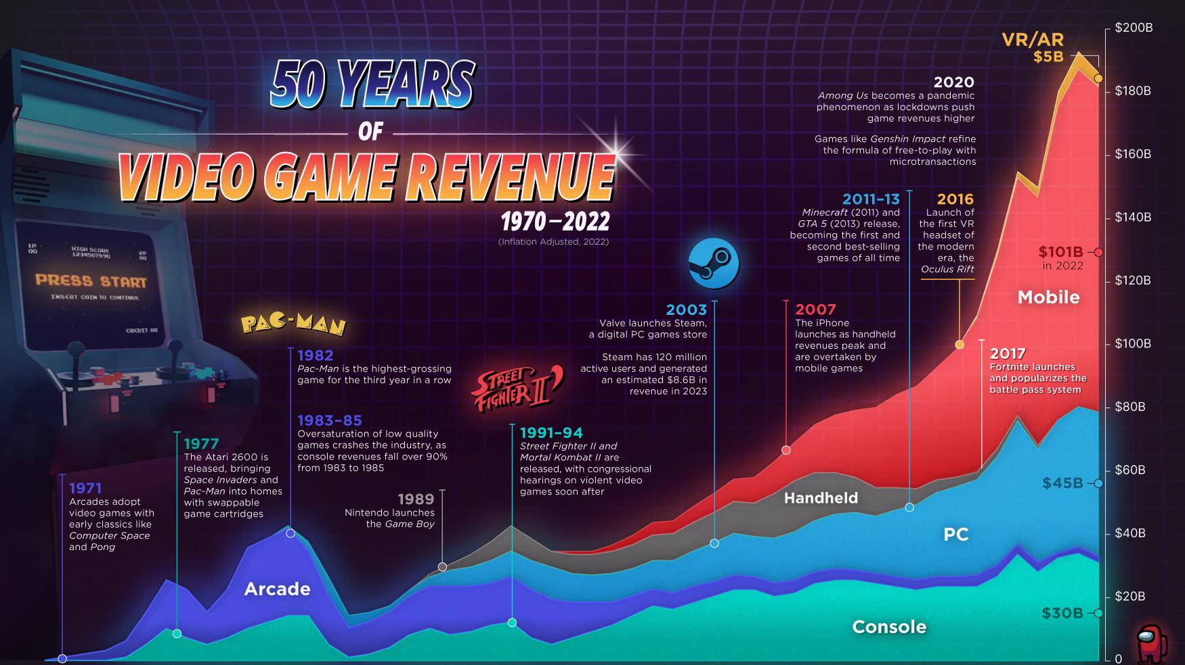

Slide 5
Dataset Description
Video Game Sales 1978-2024
​Name
Genre
​NASales
EUSales
JPSales
OtherSales
GlobalSales

Slide 6
TECHNOLOGY & FRAMEWORK SELECTION
Programming Language
Data Processing Frameworks
Data Visualization Tools
Version Control and Collaboration
Optional and Supportive Tools

Slide 7
DATA INTEGRATION & ENRICHMENT STRATEGY
Primary Dataset
Supplementary Data Sources
Data Linking and Enrichment Process
Analytical Objectives

Slide 8
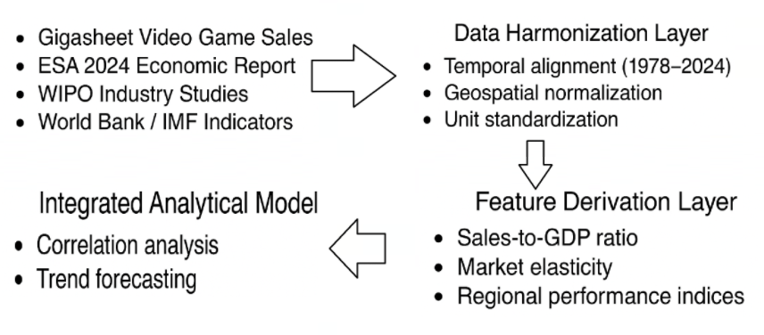
PROPOSED BIG DATA ARCHITECTURE
Data Ingestion Layer

Slide 9
Methodology
Data Acquisition
Data Preprocessing
Feature Engineering and Aggregation
Analytical Modelling
Visualization and Reporting
Validation and Reproducibility

Slide 10

RESULTS & DISCUSSION
Regional Market Dynamics
Platform Evolution
Genre and Publisher Trends
Analytical Modelling
Economic Influence
Limitations

Slide 11
Thank you

