Slide 1
Disaster Recovery & Backups

Slide 2
Disaster Recovery (DR)
Plan to get your applications running again after following a natural or human-induced disaster.
Types of Disasters:
1. Natural Disasters
Earthquakes, floods, hurricanes
Power outages
Fires
2. Technical Failures
Hardware failures (server, disk, network)
Entire AWS region goes down
Internet backbone issues
DNS provider failures
Data center cooling/power system failures
3. Human-Caused
Cyberattacks (ransomware, DDoS)
Human error (accidental deletion, misconfigurations)
Malicious insiders
Software bugs causing outages
DR Process Flow:
1. Normal Operations
2. Disaster Occurs (fire, earthquake, cyberattack, hardware failure)
3. Detection & Assessment (monitoring alerts trigger)
4. Failover Activation (switch to backup site/region)
5. Recovery Operations (restore data, restart services)
6. Verification (test that everything works)
7. Return to Normal (failback to primary site when ready)

Slide 3
Always Remember - Multi-AZ is not Multi-Region
Multi-AZ is for achieving High Availability
What: Deploy across multiple data centers within same region
Use case: High availability, protect against data center failures
Characteristics:
Same region (e.g., all in us-east-1)
Low latency between AZs (<2ms)
Synchronous replication possible
Helps in achieving high availability in case of zonal failures
Multi-Region is for achieving Disaster Recovery
What: Deploy across multiple geographic regions
Use case: Disaster recovery, compliance, performance (geo-proximity)
Characteristics:
Different regions (e.g., us-east-1 and eu-west-1)
Higher latency between regions (50-200ms)
True geographic isolation
Helps in continuous serving of traffic in case of regional failures

Slide 4
DR Strategies
Strategy | RTO | RPO | Cost | Availability
Backup & Restore | ~2-10+ hours | Hours | $ | Non-critical apps, dev/test
Pilot Light | ~15-45 min | 5-15 min | $$ | Important business apps
Warm Standby | 5-10 min | <5 min | $$$ | Revenue-generating apps
Active-Active | Near-zero | Near-zero | $$$$ | Mission-critical systems

Slide 5
Selecting Your DR Strategy - RPO & RTO
RPO (Recovery Point Objective): Maximum acceptable data loss (time)
  How much data can we afford to lose?
  Measured in time (e.g., 1 hour)
  Measures: Data loss tolerance
RTO (Recovery Time Objective): Maximum acceptable downtime
  How quickly must we recover?
  Measured in time (e.g., 4 hours)
  Measures: Downtime tolerance
Ask These Questions | Impact on DR Strategy
Revenue loss per hour of downtime? | Higher loss -> Lower RTO needed
Can you recreate lost data? | No -> Lower RPO needed
Compliance requirements? | Strict -> Lower RTO/RPO needed
Available budget? | Higher budget -> Better RTO/RPO

Slide 6
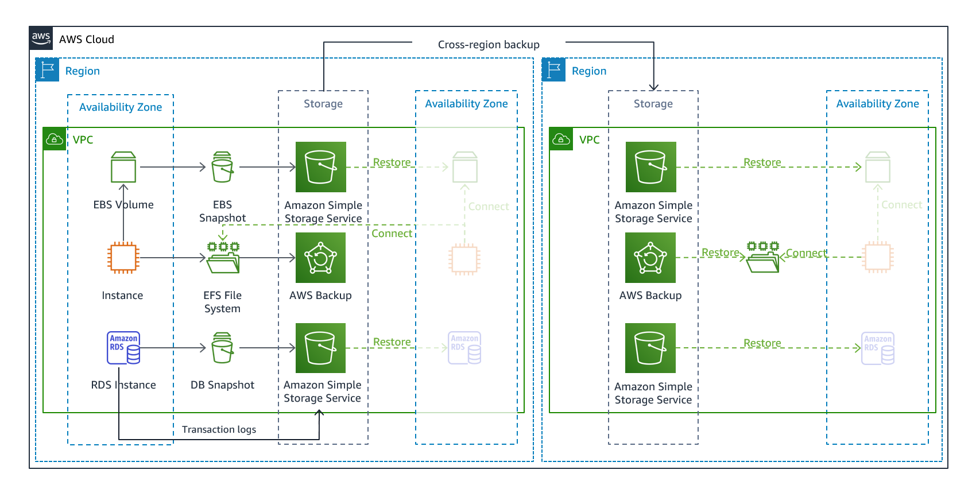
Backup & Restore
Concept: Regular backups to secondary region, restore infrastructure when disaster strikes
RPO: 5 minutes to 24 hours (depending on restore method)
RTO: 2-10 hours (time to restore infrastructure + data + reconfigure)
Cost: Lowest (storage + data transfer only, no running infrastructure in DR region)
Example:
Primary Region (us-east-1):
RDS database with automated daily snapshot created and copied to DR Region
EC2 servers with automated daily AMI created and copied to DR Region
DR Region (us-west-2):
Cross-region snapshot and AMI copies exist
Retain last 7 days of snapshots and AMIs
No running infrastructure (cost savings)
On Disaster:
Detect and assess disaster
Restore RDS from latest snapshot in us-west-2
Launch EC2 instances from pre-synced AMI in us-west-2
Configure application to connect to restored database
Update Route 53 DNS to point to us-west-2
Verify and test application
Total RTO: ~6 hours

Slide 7
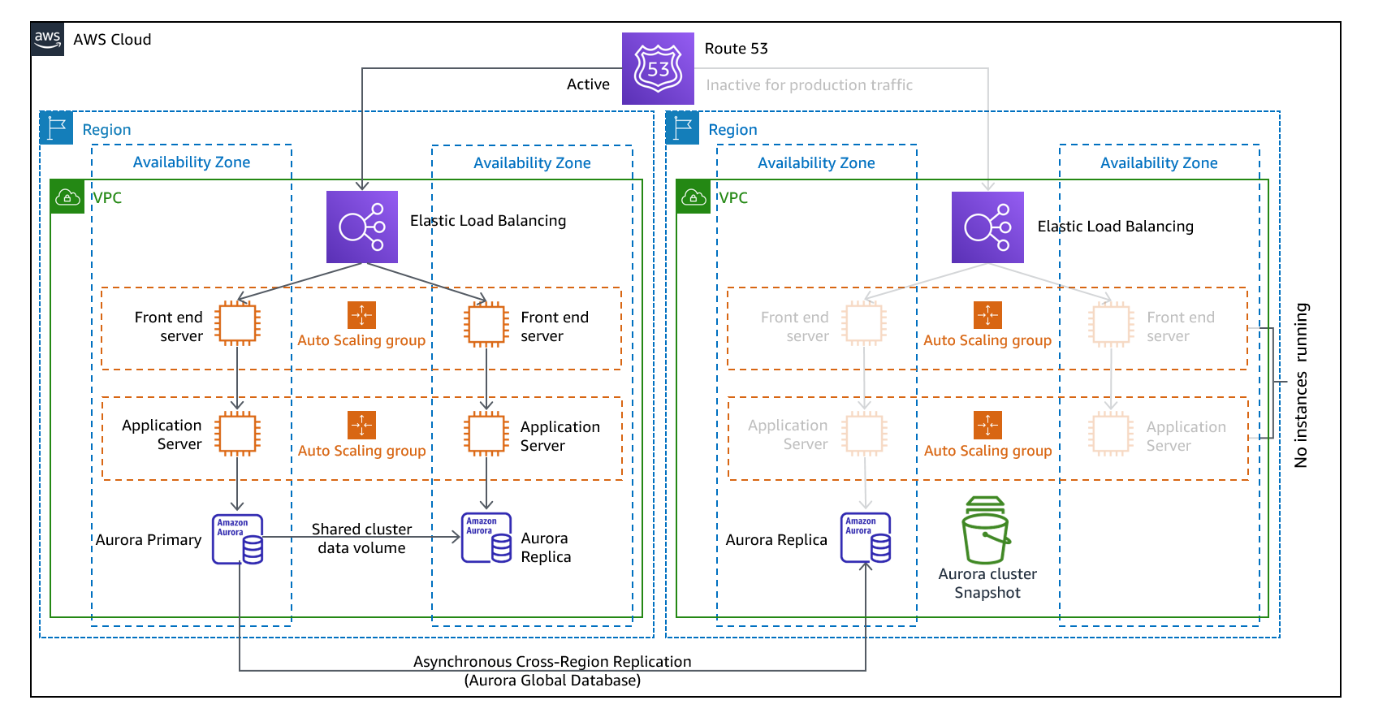
Pilot Light
Concept: Minimal version running in DR region, scale up on disaster
RPO: 5-15 minutes (continuous database replication)
RTO: 15-45 minutes (time to promote, launch, and route traffic)
Cost: Medium (minimal infrastructure + replication costs)
Example:
Primary Region (us-east-1):
ALB -> 10 Application servers (full production load)
RDS MySQL primary (production database)
DR Region (us-west-2):
RDS Read Replica (continuously syncing data)
AMIs stored and ready
Auto Scaling Group configured (target count = 0, no servers running)
ALB pre-configured (ready, no targets registered)
On Disaster:
Promote Read Replica to primary
Update Auto Scaling Group target count from 0 -> 10
Application servers start and auto-register with ALB
Update Route 53 DNS to point to us-west-2 ALB
Verify application health via ALB health checks
Total RTO: ~30 minutes

Slide 8
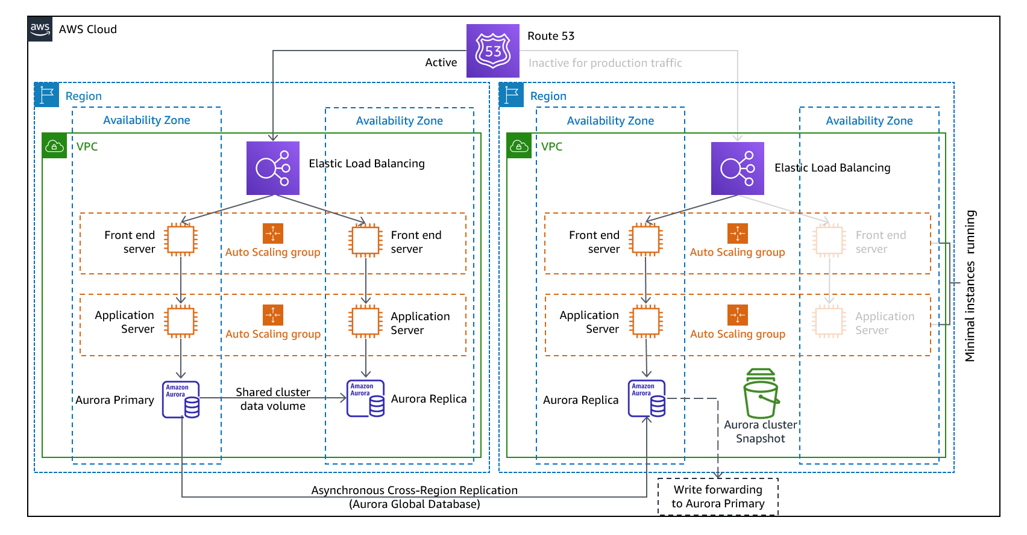
Warm Standby
Concept: Scaled-down but fully functional version running in DR region, scale up on disaster
RPO: <1 minute (continuous replication with minimal lag)
RTO: ~5 minutes (scale existing infrastructure to full capacity)
Cost: Medium-High (~30% of production infrastructure always running)
Example:
Primary Region (us-east-1):
ALB -> 10 × m5.large EC2 instances
Aurora Global Database (primary/writer)
Handling 1000 req/sec (100% production traffic)
DR Region (us-west-2):
ALB -> 2 × m5.large EC2 instances (20% capacity, running, warm)
Aurora Global Database (secondary region, live replication)
Processing health checks, pre-warmed and tested
On Disaster:
Promote Aurora secondary region to primary (~1 min)
Route 53 failover to us-west-2
The application is running and gradually increase the capacity:
  Auto Scaling increases capacity 2 -> 10 instances
  New instances join pre-warmed cluster and register with ALB
Verify application at full capacity
Total RTO: ~5-10 minutes

Slide 9
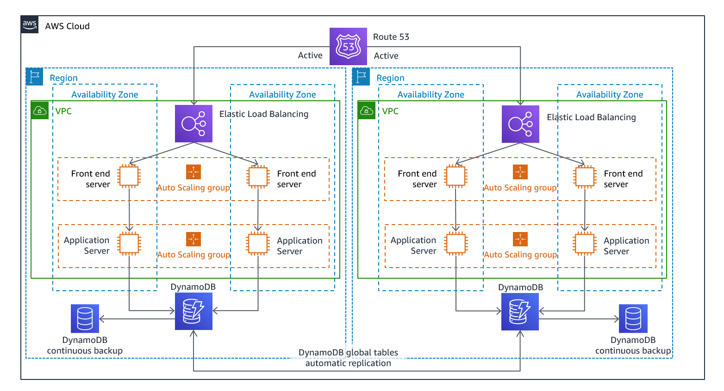
Multi-site active/active
Concept: Full production capacity in multiple regions, both actively serving traffic
RPO: <1 second
RTO: <1 minutes (automatic failover with Route 53 health check)
Cost: Highest (double infrastructure running at full capacity in both regions)
Example: Active-Active Architecture with DynamoDB Global Tables
Region 1 (us-east-1) - 50% traffic:
ALB -> 10 × m5.large EC2 instances (actively serving)
DynamoDB Global Tables (accepts reads and writes locally)
Serving US users via Route 53 geolocation routing
Region 2 (eu-west-1) - 50% traffic:
ALB -> 10 × m5.large EC2 instances (actively serving)
DynamoDB Global Tables (accepts reads and writes locally)
Serving EU users via Route 53 geolocation routing
How it works:
Both regions serve production traffic simultaneously
DynamoDB Global Tables replicate data across regions in <1 second
Each region handles read-local/write-local pattern (writes accepted in both regions)
Route 53 uses geolocation routing to direct users to nearest region
On Disaster:
Route 53 health check detects primary region failure (~30 sec)
Route 53 automatically reroutes US traffic to secondary region (~seconds)
Secondary region begins handling 100% traffic
DynamoDB Global Tables continue replicating (unaffected)
Verify application handling increased load (~30 sec)
Total RTO: 1-2 minutes

Slide 10
AWS Backup Services – Overview
1. Centralized Backup Management
Unified backup across multiple services
AWS Backup: Multi-service backup from one console
DLM: Automated EBS snapshot lifecycle management and AMI Management
Pros: Centralized control, consistent policies, compliance reporting, Cons: Additional cost, requires planning
2. Automated Service Backups: Built-in backup features of individual AWS services
RDS: Automated daily snapshots + transaction logs
S3: Versioning and replication etc.
Pros: Easy, service-specific, often included in cost, Cons: Fragmented management, limited cross-service policies
3. Manual Backups
On-demand and user-initiated backups
Manual snapshots: EBS, RDS, AMIs
Pros: Full control, flexibility, specific use cases, Cons: Manual effort, human error risk

Slide 11
1.) AWS Backup Service (Centralized)
Unified backup service across multiple AWS services
Supports: EC2 instances, EBS volumes, RDS databases, EFS, S3 bucket, DynamoDB tables etc.
Configuration Methods:
Backup Plans: Define schedule, retention, lifecycle
Tag-based: Automatically backup resources with specific tags
Cross-region copy: Replicate backups to other regions
Cross-account copy: Copy backups to different AWS accounts
Example:
Backup Plan: “Backup entire Production landscape Daily”
Schedule: Daily at 2 AM
Retention: 7 daily, 4 weekly, 12 monthly
Lifecycle: Move to cold storage after 30 days
Tags: Env=Prod (will backup all the EC2, RDS, EFS, EBS, DynamoDB, S3 with tag Env-Prod daily)
Copy to: us-west-2 (DR region)

Slide 12
2.) DLM - Data Lifecycle Manager (Centralized)
EC2 AMI and EBS Snapshot management
Supports: EC2 instances (snapshots all attached volumes), EBS Volumes
Configuration:
Target: Tag-based resource selection
Schedule: Hourly, daily, weekly, monthly
Retention: Count-based (keep X snapshots) or age-based (keep Y days)
Cross-region copy: Yes
Fast snapshot restore: Pre-warm snapshots for faster recovery
Examples:
1.) Volume Snapshots
DLM Policy: "Volume Backup“
Target: Volumes tagged “Backup=True”
Schedule: Every 12 hours
Retention: Keep 14 snapshots (7 days worth)
Cross-region: Copy to us-west-2
2.) AMI Creation
DLM Policy: “Golden AMI”
Target: Instance tagged "AMI-Source=True“
Schedule: Weekly on Sunday
Retention: Keep 4 AMIs (1 month)
Action: Create AMI + reboot instance

Slide 13
3.) RDS Automated Backups (Service Level)
Built-in RDS backup feature
Supports: RDS (all engines: MySQL, PostgreSQL, MariaDB, Oracle, SQL Server), Aurora
Features:
Daily snapshots: Full backup at specified time
Transaction logs: Continuous backup (every 5 minutes)
Point-in-time recovery (PITR): Restore to any second within retention window
Retention: 0-35 days (7 days default)
Cross-region copy: Manual or automated
Configuration:
RDS Instance Settings:
Backup retention period: 7 days
Backup window: 02:00-04:00 UTC (preferred time)
Copy tags to snapshots: Yes
Enable deletion protection: Yes (prevents accidental deletion)

Slide 14
4.) S3 Versioning (Service Level)
Keep multiple versions of objects stored in S3 to track changes and revert to older changes when required
Configuration:
S3 Bucket Settings:
Versioning: Enabled
MFA Delete: Optional (require MFA to delete versions)
Result:
Every PUT creates new version
DELETE adds delete marker (versions preserved)
Can restore any previous version
Lifecycle Policy (should be applied to save cost):
S3 Lifecycle Rule:
Non-current versions after 30 days: S3 Glacier
Non-current versions after 90 days: Delete

Slide 15
5.) S3 Replication (Service Level)
Automatic replication of objects to bucket in same region or different region
Types:
CRR (Cross-Region Replication): us-east-1 -> us-west-2
SRR (Same-Region Replication): Different bucket in same region
Configuration:
Replication Rule:
Source: s3://prod-data-us-east-1
Destination: s3://prod-data-backup-us-west-2
Replicate: All objects (or prefix/tag filtered)
Storage class: S3 Glacier (for cost savings)
Replication time: Real-time (seconds to minutes)
Use Case:
Disaster recovery (cross-region backup)
Compliance (data redundancy)

Slide 16
6.) RDS Manual Snapshots (Manual)
User-initiated snapshots (on-demand)
Differences from Automated:
Manual trigger (not scheduled)
Never expire (retained indefinitely until manually deleted)
Survive DB instance deletion
Can share across accounts
Can copy to other regions
Use Cases:
Before major changes (schema updates, version upgrades)
Long-term archival (beyond 35-day automated retention)
Compliance requirements (keep snapshot for years)

Slide 17
7.) EBS Snapshots (Manual)
On-demand EBS volume snapshots
Methods:
Console: EC2 -> Volumes -> Create Snapshot
Features:
Incremental (only changed blocks stored)
Stored in S3 (managed by AWS)
Can copy to other regions
Can share with other accounts
Use Case:
Only need data backup (single volume)
Backup data volumes (not root)
Granular restore (specific volume only)
Don't need instance configuration

Slide 18
8.) EC2 AMI - Amazon Machine Image (Manual)
On-demand full instance image (snapshot of entire EC2 instance)
Methods:
Console: EC2 -> Instances -> Select instance -> Actions -> Image and templates -> Create image
Features:
Incremental storage: Only changed blocks stored (like EBS snapshots)
Stored in S3: Managed by AWS (invisible to you)
Cross-region copy: Can copy AMI to other regions for DR
Use Cases:
Golden images: Pre-configured application servers
Disaster recovery: Launch replacement instances quickly
Scaling: Auto Scaling Groups use AMIs to launch instances
Environment cloning: Copy prod to staging
Version control: Snapshot application state at specific points

