Slide 1
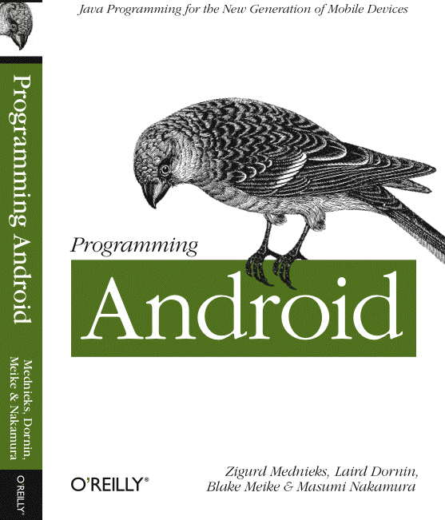
G. Blake Meike
blake.meike@gmail.com
http://portabledroid.wordpress.com/
Slides and code are available:
git://github.com/bmeike/TestingAndroid.git

Slide 2
Testing Android
Part I
  Unit Testing and JUnit (30 min)
  Exercise (20 min)
Break (10 min)
Part 2
  Review Exercise (5 min)
  Unit Testing Android (30 min)
  Exercise (20 min)
Review (10 min)

Slide 3
Exercise I: A solution
Yes: this example is a little trumped up. The solution is pretty complex for the problem
Assert used to enforce expected values
Note use of fail() to handle unexpected normal completion

Slide 4
Part II: Android Test Framework
Based on JUnit 3 (no annotations)
Custom TestCase types
Custom Asserts
Custom Mocks
Event Injection
Other tools
Eclipse JUnit
Exercise

Slide 5
Framework Basics
Separate project, separate .apk
Don't use the same Package Name!!
Ok (good idea) to put the code in the same Java package
It is actually pretty rough... :(

Slide 6
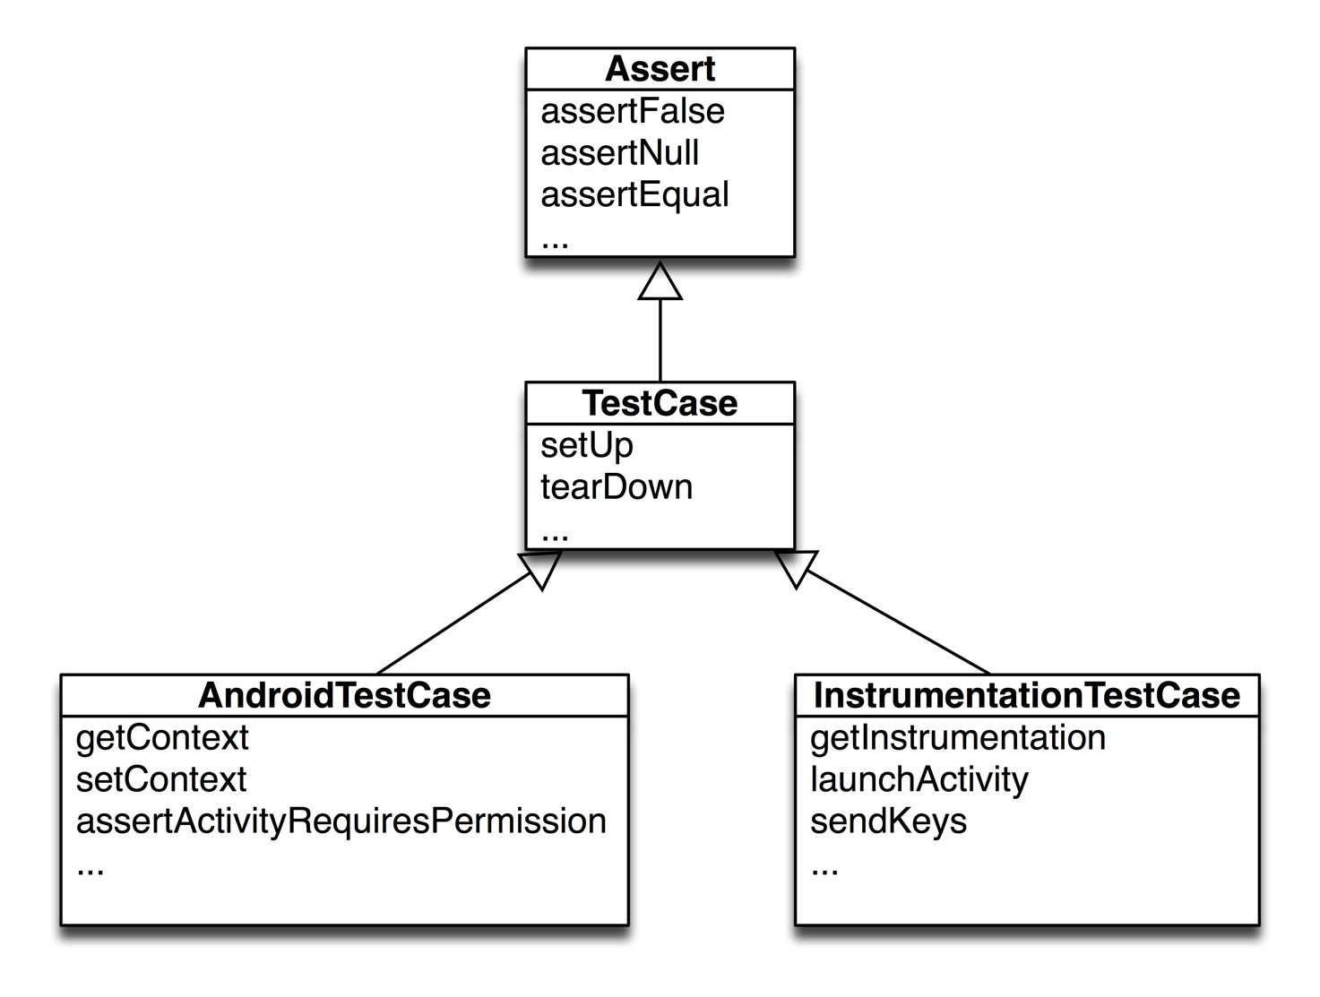
JUnit TestClass Hierarchy

Slide 7
Basic TestCase Features
AndroidTestCase
  Knows about Context
  Knows about permissions
  Can “scrub” a class (???)
InstrumentationTestCase
  Knows about Activities
  @UiThreadTest and runOnUiThread
  sendKeys (don't run on UI Thread!)

Slide 8
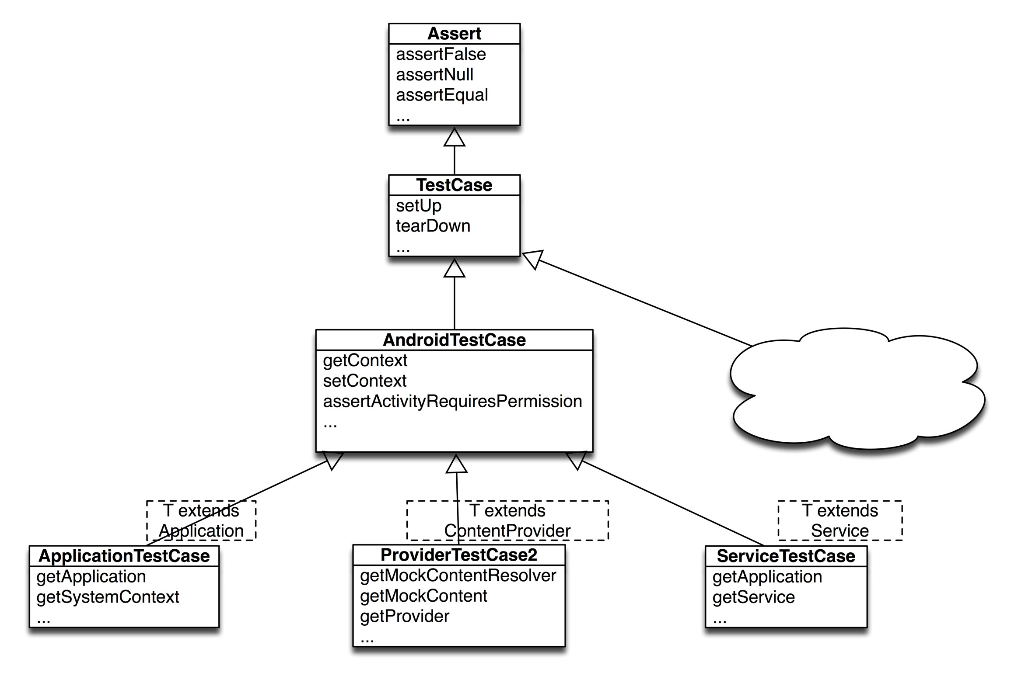
AndroidTestCase Subclasses

Slide 9
AndroidTestCase Subclasses
ApplicationTestCase
  Allows mocking Context
ProviderTestCase2
  Allows replacing the system map of content provider authorities
  Will not affect the real system data
ServiceTestCase
  Allows mocking Context and Application

Slide 10
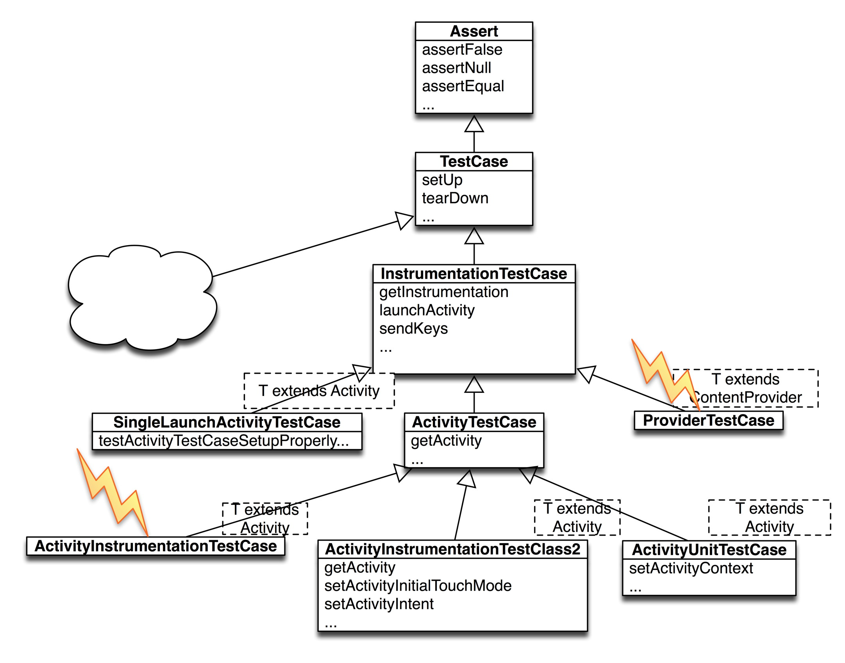
InstrumentationTest Subclasses

Slide 11
InstrumentationTest Subclasses
Several deprecated classes
  ActivityInstrumentationTestCase
  ProviderTestCase
Several less-useful classes
  SingleLaunchActivityTestCase, etc.
Useful stuff:
  ActivityUnitTestCase
    isolated
  ActivityInstrumentationTestCase2
    lifecycle

Slide 12
Tests on the UI Thread
@UiThreadTest
public void testUnderflow() {
// …
}
public void testNonNumericInput() {
try {
runTestOnUiThread(new Runnable() {
public void run() { textfield.requestFocus(); }
});
}
catch (Throwable e) { fail(e.getMessage()); }
sendKeys(KeyEvent.KEYCODE_H, KeyEvent.KEYCODE_1);
AssertEquals(“H1”, textfield.getText().toString());
}

Slide 13
Assertions
MoreAsserts
  assert[Not]Empty(container)
  assert[Not]ContainsRegex(regex, thing)
  assert[Not]MatchesRegex(regex, thing)
ViewAsserts (???)
  assertGroupIntegrity(viewgroup)
  assertGroup[Not]Contains(viewgroup, view)
  AssertBaselineAligned (???)

Slide 14
Mocks :(
Application
ContentProvider
ContentResolver
Context
Cursor
PackageManager
Others...
None of these are mocks by our definition. They are dummies. All methods throw UnsupportedOperationException

Slide 15
Event Injection: TouchUtils
A collection to touch, click and drag methods, useful with subclasses of InstrumentationTestCase
  clickView(testcase, view)
  drag(testcase, view)
  scrollToTop(testcase, activity, viewgroup)

Slide 16
Other Tools
hierarchyviewer
adb shell am instrument -w
monkey/monkeyrunner
ADK/eclipse heap profiler
ADK/eclipse CPU profiler
ADK/eclipse debugger (Debug As...)

Slide 17
Android Testing with Eclipse
Team > Switch To > example1
New > Android Test Project
Choose the Target Project
Fix the package
Create a new TestCase, subclassing ActivityInstrumentationTestCase2
Implement test... methods
Run As Android JUnit Test

Slide 18
Exercise
Verify that getAndClear gets the contents of its EditText, and leaves it empty
Use sendKeys to verify that the input EditText does not accept non-numeric characters
Hard: verify that TestTargetApplication will not run as root (uid = 0)
  Use an ApplicationTestCase
  Use ContextWrapper
http://developer.android.com/reference/android/content/ContextWrapper.html

Slide 19
Testing Android
Part I
  Unit Testing and JUnit (30 min)
  Exercise (20 min)
Break (10 min)
Part 2
  Review Exercise (5 min)
  Unit Testing Android (30 min)
  Exercise (20 min)
Review (10 min)

Slide 20
Review
Design for Testing: DI
Mocking
JUnit 3 and 4
Eclipse support for JUnit
Android Framework provides JUnit extensions
  Mostly good ideas
  Mostly hard to use
Additional tools: profilers, debuggers, etc.

Slide 21
Exercise II: A solution
Remember @UiTestThread
Remember runTestOnUiThread
Remember that sendKeys can't be used from the UI thread
Context injection is witchcraft.

Slide 22
Thanks!
G. Blake Meike
blake.meike@gmail.com
http://portabledroid.wordpress.com/
Slides and code are available:
git://github.com/bmeike/TestingAndroid.git

