Slide 1
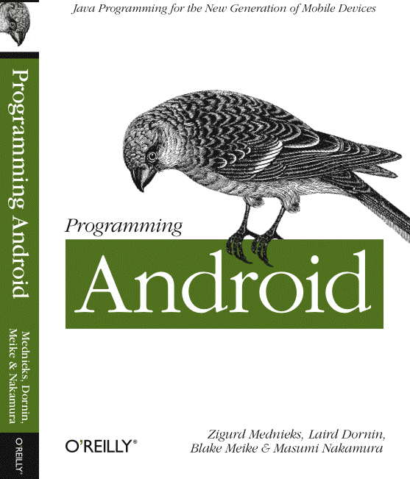
G. Blake Meike
blake.meike@gmail.com
http://portabledroid.wordpress.com/
Slides and code are available:
git://github.com/bmeike/TestingAndroid.git

Slide 2
Testing Android
Part I
  Unit Testing and JUnit (30 min)
  Exercise (20 min)
Break (10 min)
Part 2
  Review Exercise (5 min)
  Unit Testing Android (30 min)
  Exercise (20 min)
Review (10 min)

Slide 3
Part I: Unit Testing and JUnit
Design for Testing (DI/IoC)
Mocking
JUnit
JUnit and Eclipse
Exercise

Slide 4
What is Unit Testing?
It's not QA!
Because your compiler isn't enough
Enables refactoring
Feedback that you are done
Feedback about progress to stakeholders

Slide 5
Design for Test
Your first attempt at testing is likely to convince you that it is just too much trouble
… But you can design programs that
are easy to test

Slide 6
IOC/DI
Inversion of Control
Dependency Injection
Championed by Martin Fowler
The original idea behind Spring
Consider an app that sends email to all
of the attendees of tonight's lecture:

Slide 7
Dependency Injection (not)
// Might work, but difficult to test
public void emailAttendees(
Event event, EmailMessage msg)
{
AttendeeMgr mgr = new AttendeeMgr(event);
for (Attendee attendee: mgr.getAttendees()) {
sentTo(attendee, msg;
}
}

Slide 8
Dependency Injection (not quite)
public interface AttendeeMgr {
List<Attendee> getAttendees(Event evt);
}
public void emailAttendees(
Event event, EmailMessage msg)
{
AttendeeMgr mgr =
AttendeeMgrFactory.getAttendeeMgr();
for (Attendee attendee: mgr.getAttendees()) {
sentTo(attendee, msg;
}
}

Slide 9
Dependency Injection!
private final AttendeeMgr mgr;
public AttendeeEmailer(AttendeeMgr mgr) {
this.mgr = mgr;
}
public void emailAttendees(EmailMessage msg) {
for (Attendee attendee: mgr.getAttendees()) {
sentTo(attendee, msg;
}
}

Slide 10
Mocking
Dummy: unimplemented and never used
public int getCount(int key) { throw new UnsupportedOperationException(); }
Stub: limited static responses
public int getCount(int key) { return 3; }
Fake: implemented but not suitable for prod.
public int getCount(int key) { return resps.get(key).intValue(); }
Mock: preprogrammed for specific call seq.
  EasyMock, PowerMock

Slide 11
Mocking (EasyMock)
HttpClient mockClient =
EasyMock.createMock(HttpClient.class); //!!
EasyMock
.expect(
mockClient.execute(EasyMock.anyObject()))
.andReturn(new BasicHttpResponse(
new BasicStatusLine(
HttpVersion.HTTP_1_1,
200,
"OK")))
mockClient.submit(
new HttpGet(
"http://callmeike.net/test?woot"),
new TestResponseHandler());

Slide 12
JUnit
A simple idea: fixtures and test cases
Generally 1-1 class under test – test class
Test classes extend TestCase
Individual tests are methods
Unordered! If you think you need order, your doing it wrong.

Slide 13
JUnit
public class AndroidTestCase extends TestCase {
MyTestTarget target;
@Override
protected void setUp() throws Exception {
super.setUp();
target = MyTestTarget.createNewTarget();
}
@Override
protected void tearDown() throws Exception {
super.tearDown();
target = null'
}
public void testTargetNull() {
assertNotNull("Target is null", target);
}
public void testTargetRun() {
try { target.run(); }
catch (Exception e) {
fail("Run failed: " + e.getMessage();
}
}
}

Slide 14
JUnit
V3: override/introspection
  Create fixtures in setUp()
  Delete fixtures in tearDown()
  Testcases: methods with name prefix “test...
V4: annotations
  Create fixtures in method annotated @Before
  Delete fixtures in method annotated @After
  Testcases annotated @Test

Slide 15
JUnit
Assertions:
  assertTrue([reason,]expected, actual)
  assertEqual([reason,]expected, actual)
  assertNotNull([reason,]thingie)
  fail(reason)

Slide 16
Testing Android with JUnit
It is possible to test components of your Android app with Java JUnit tests!
Java JUnit tests don't require starting the emulator!
Enforces good separation of concerns

Slide 17
JUnit in Eclipse
Create a new project
Add the target project as a dependency
Putting the test in the same package as the target allows use of “default” access
Add a new TestCase
Accept “add JUnit 4 to build path”
Create fixtures
Create tests
“Run As” JUnit test

Slide 18
Exercise
File > Import > Projects from Git
URI: git://github.com/bmeike/TestingAndroid.git
Branch: master
Import Existing projects
TestTarget and JavaTest
Select JavaTest and Run As Junit
Open TestCalc and finish implementation

Slide 19
MockChangeListener
Calculator calls a Listener when the stack changes
Create a MockChangeListener as a fixture
Use expect() to set what the listener should see when it is called next: stack size and top value.
GO!

Slide 20
Testing Android
Part I
  Unit Testing and JUnit (30 min)
  Exercise (20 min)
Break (10 min)
Part 2
  Review Exercise (5 min)
  Unit Testing Android (30 min)
  Exercise (20 min)
Review (10 min)

