Slide 1
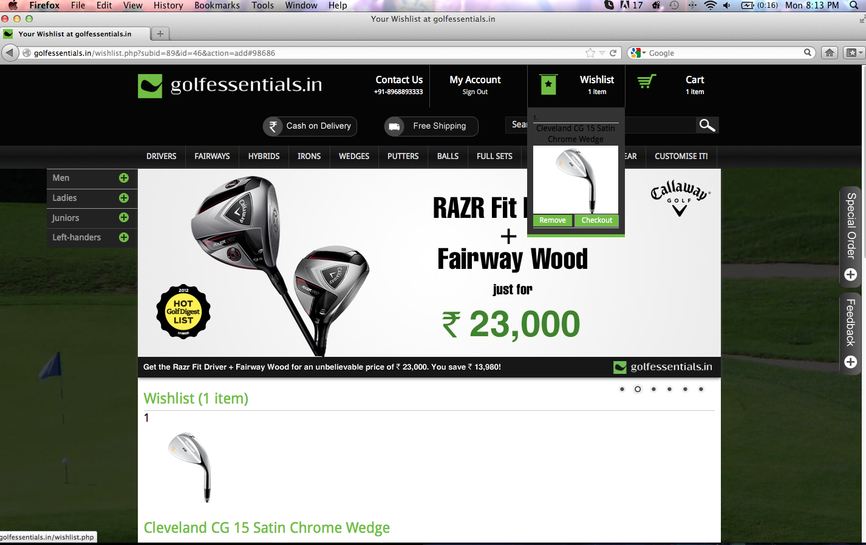
Add to cart (a user cannot checkout from here)

Slide 2
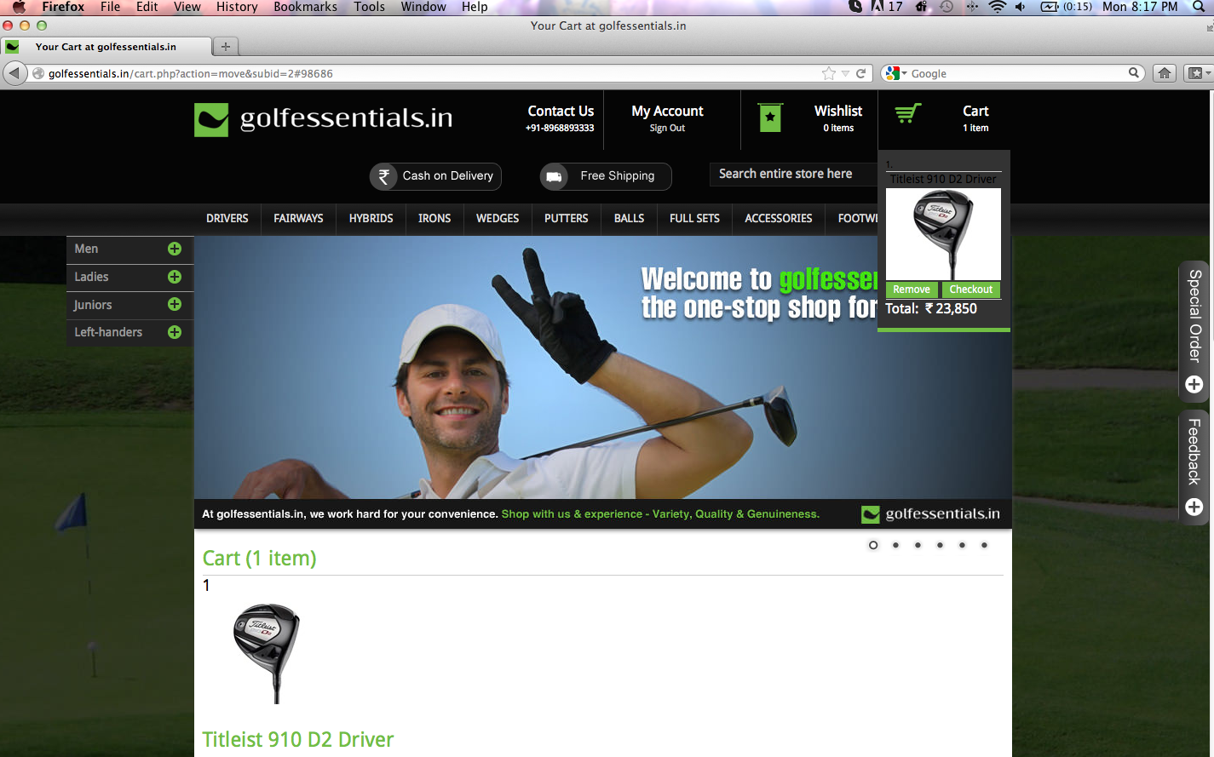
Checkout button is not working

Slide 3
Registration form corrections
An error message does not pop up in case “State” is not selected and also if “I have read & agree to the Terms of Service.” is not checked. This needs to be corrected.
On going forward without these two, I reach the registration form again where Gender and Age (that had been entered) have been erased along with the Password (password being erased is ok). Moreover, “I have read & agree to the Terms of Service.” appeared checked automatically (which needs to be checked by the user)…the next slide carries a screenshot of the same.
The better alternative to the ToS checkbox is that we can mention, “By registering, you agree to the terms of service ”

Slide 4
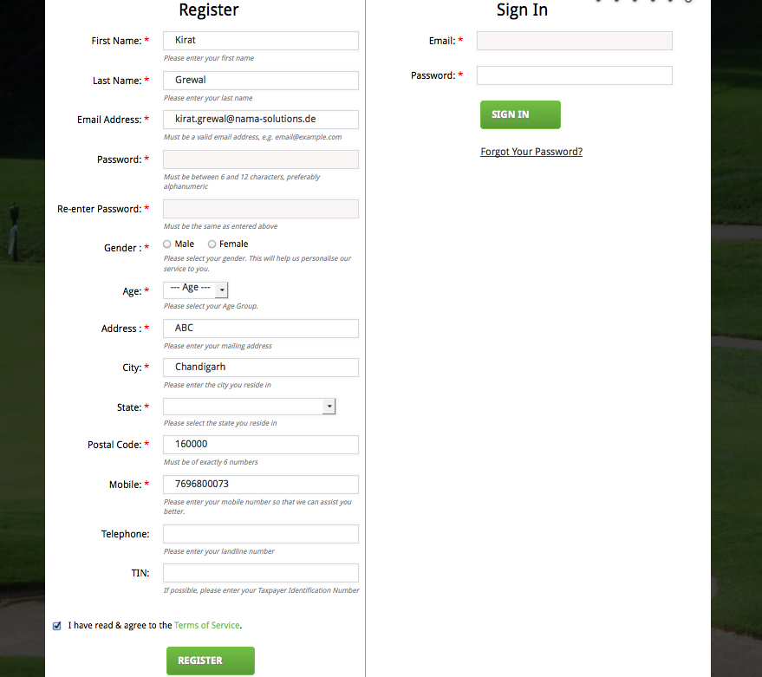

Slide 5
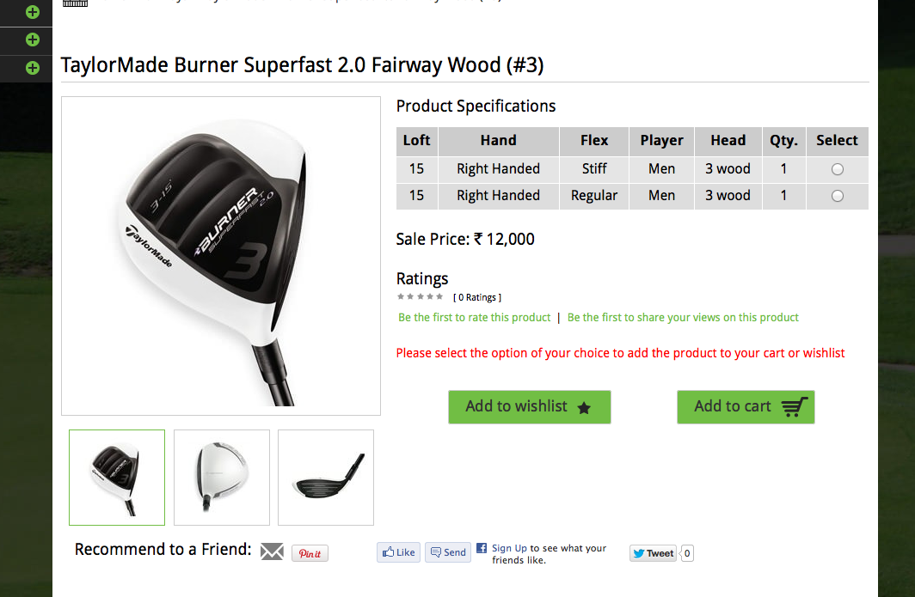
Please make this bold

Slide 6
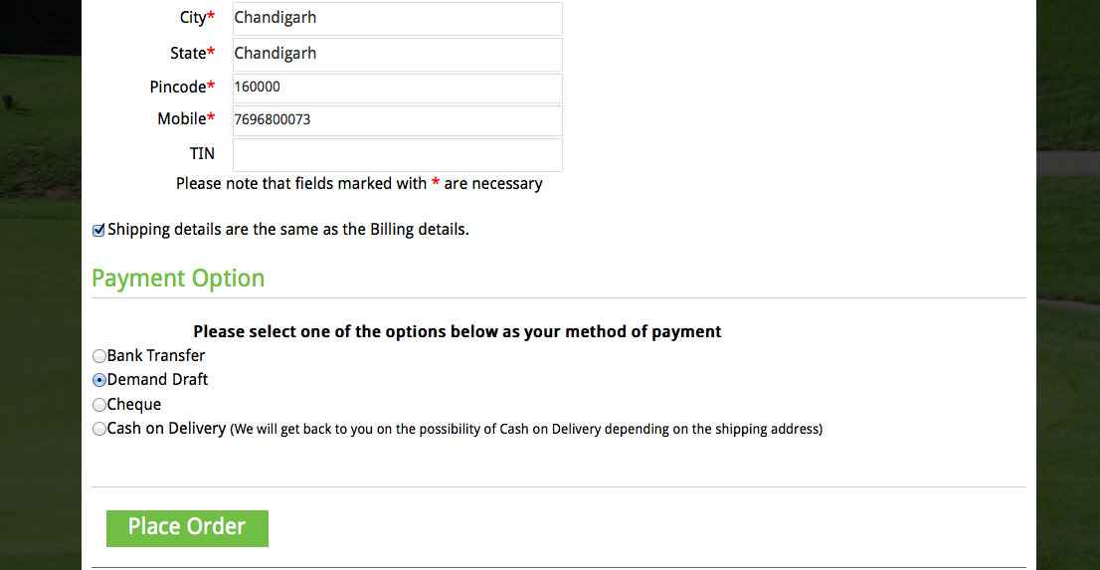
Left align

Slide 7
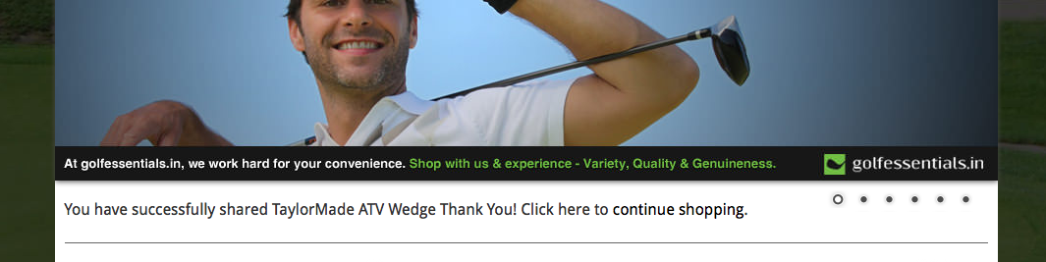
‘Continue Shopping’ in green
Add (.) after product name

Slide 8
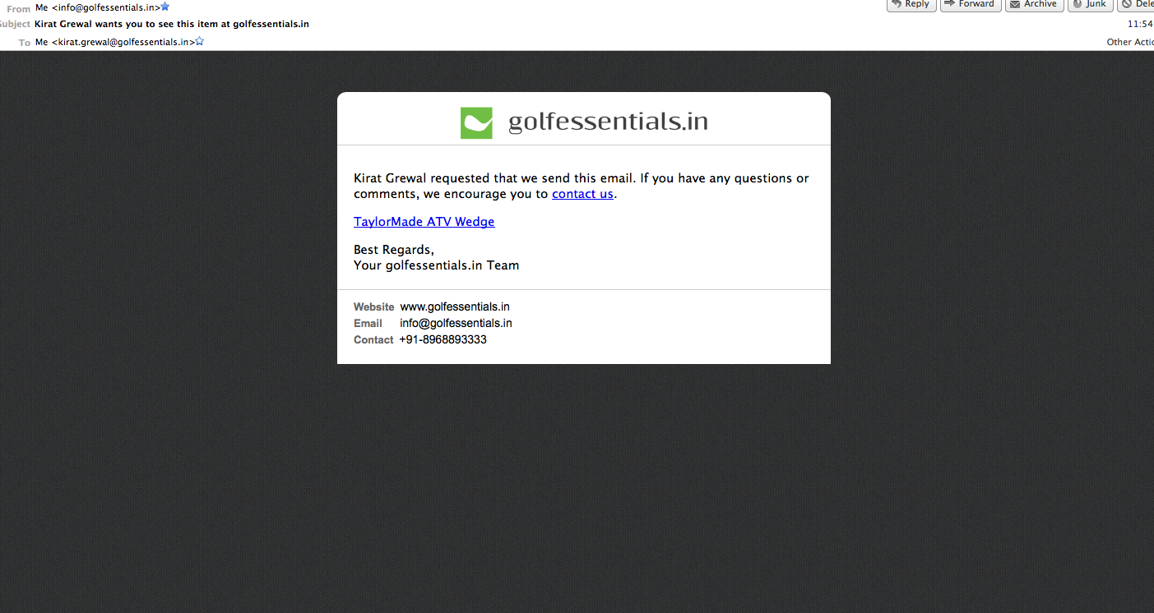
Please follow the link below to check out the product Kirat Grewal thought you would like:

Slide 9
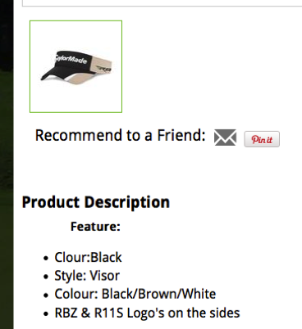
As already mentioned by Kevin
Logos

