Slide 1
Comparison of algorithms for the classification of coronary artery disease using protein multiplex panel
Frank Lin, John-Krill Burger, Prateek Tandon, Vineet Joshi

Slide 2
Introduction
Coronary Artery Disease (CAD) is the number one cause of death globally.
Causes over 800,000 deaths per year in the US.

Slide 3
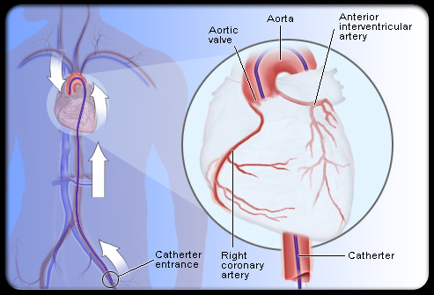
Coronary Angiography
Gold standard for assessment of anatomic coronary disease

Slide 4
Angiography Disadvantages
Mean cost of $10,880
Invasive
Risk of using contrast media and ionizing radiation

Slide 5
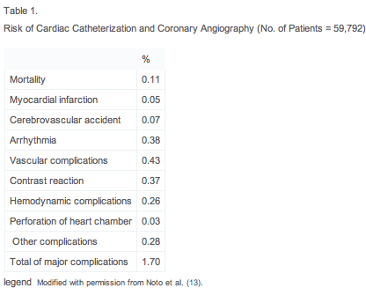

Slide 6
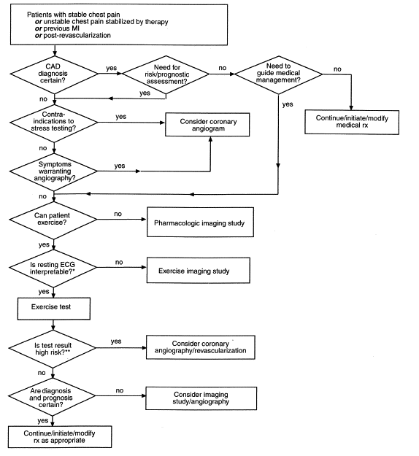

Slide 7
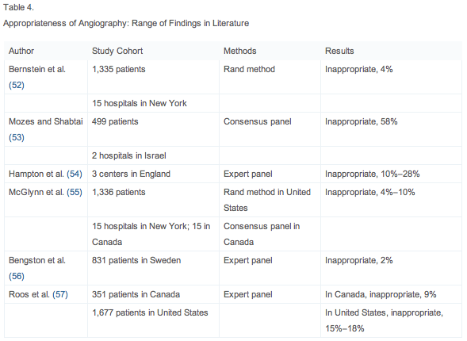

Slide 8
Alternatives
Gene expression classifier
Rosenberg et al. developed a 23 gene blood-based expression test
Protein markers
Troponin T for myocardial infarction
NT-pBNP for acute coronary syndrome
CRP for future cardiovascular events
Protein multiplex panels
LaFramboise et al. measured concentration of 24 proteins

Slide 9

Algorithm to beat
Scoring function:
M_{i}(p) is concentration of ith marker for patient p
Optimization of parameters using MCMC sampling
58.5% specificity at 95% sensitivity (AUC = .84)

Slide 10
Sample Collection
University of Pittsburgh, Division of Cardiology, Department of Medicine
Blood samples from 226 patients with CAD symptoms.
125 with significant arterial obstructions
101 patients normal
Blood samples were interrogated for the concentration of 24 different proteins using the Searchlight Protein Array System.

Slide 11
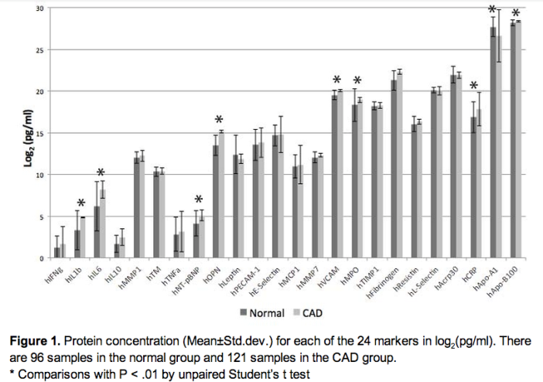
SearchLight Proteomics Assay

Slide 12
Methods/Results
We transformed the data into a matrix with normalized values for each marker concentration as attributes (columns) while rows represented patients.
Created label vector representing each patient.
Shuffled the data randomly and divided into two equal training and test sets.

Slide 13
Methods/Results
We used 3 classifiers to make initial predictions
Logistic Regression (Coded in Matlab)
Voted Perceptron (Coded in Matlab)
Support Vector Machines (built in function)
Compared the precision, recall, and accuracy for the 3 classifiers. Logistic Regression and Voted Perceptron were ideal.
SVM: P:0.740, R:0.712, A:0.720
Logistic Regression: P:0.754, R:0.754, A:0.720
Voted Perceptron: P:0.810, R:0.770, A:0.750

Slide 14
Methods/Results
Tested for different values of training parameters until a consistent recall of over 90% was obtained, while keeping the precision and accuracy around 65-70% for both the classifiers.
Perceptron: Changed parameters so that learning algorithm penalized False Negatives more strongly than False Positives
LR: Changed the classification threshold for testing so classifier only make negative when it is more certain.
Logistic Regression: P:0.646, R:0.927, A:0.680
Voted Perceptron: P:0.653, R:0.925, A:0.700

Slide 15
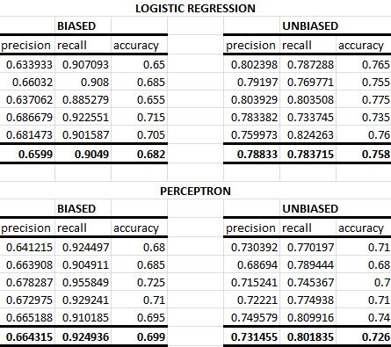
Methods/Results
Performed 5-fold cross validation for each classifier (both biased and unbiased) using both biased and naive algorithms. We repeated this step 5 times and reported the results.

Slide 16
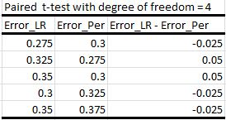
Methods/Results
Comparing the performance of the Logistic Regression and Voted Perceptron Classifier
We performed a paired two-tailed t-test for difference in errors by the two classifiers over same sets of data to quantify and derive a statistical significance
Used 5-fold cross-validation and calculating the error in classification for each held-out set by both the classifiers.
p-value = 0.846537 (doesn’t tell much)

Slide 17
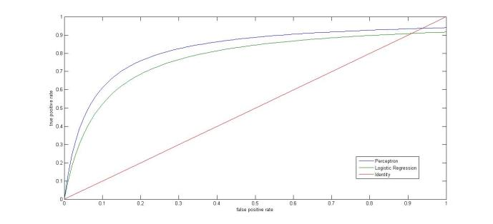
Methods/Results
Next we compared performance between the two classifiers using area under their “Receiver Operating Characteristic” ROC curves.
AUC for LR < Perceptron and the curve also demonstrates that for the same sensitivity Perceptron gives a better specificity

Slide 18
Methods/Results
Have been using 24 attributes/proteins for classification.
We wanted to find the best and smallest set of attributes that would be enough to classify for the disease.
Selected attributes based on p value of t-test between normal and CAD groups.
Groups
A-24 = All 24 attributes
MS-9 = 9 attributes with best p-values
MS-5 = 5 attributes with best p-values
MS-2 = 2 attributes with best p-values
MIT-2 = 2 attributes from a previous study at MIT

Slide 19
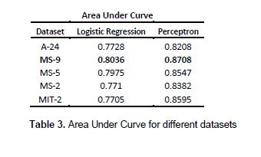
Methods/Results
Analyzed ROC plots of all groups using the Logistic Regression and Perceptron Classifier.

Slide 20
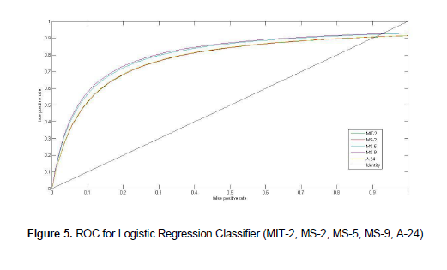
Methods/Results

Slide 21
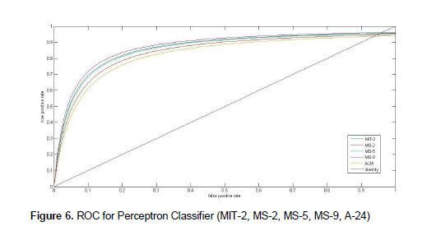
Methods/Results

Slide 22
Methods/Results
To establish significance, we repeated the process 100 times for MS-9.
As a control, we repeated a similar process but used 9 randomly sampled attributes for each iteration.
Performed a paired t-test between the MS-9 and Random 9.
P-value = 5.413E-32
Ms-9 group

Slide 23
Methods/Results
5-fold cross validations using MS-9 for both biased classifiers.
Repeated 5 times and found average Precision, Recall, Accuracy.
Increase in Recall (95%) while Precision and Accuracy remained between 65%-70%.

Slide 24
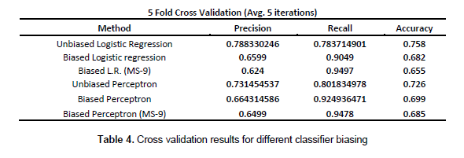
Methods/Results

Slide 25
Discussion
The best overall classification method we identified was using the perceptron classifier with the 9 proteins selected in the MS-9 panel.
Our MS-9 perceptron classifier outperformed the 23 gene classifier of Rosenberg in terms of overall AUC (.871 vs. .72) and specificity at 95% sensitivity (66.4% vs. ~20%).
Since the ultimate goal is to create a blood test for patients entering the ER with chest pain, using fewer markers could substantially reduce the cost of the test and impact its potential for widespread use.

Slide 26
Discussion
The best sensitivity achieved, 95% by the perceptron MS-9 classifier, would still create too many false negatives to be used as a substitute for all other clinical tests.
The test would be used as an initial filtering method to prioritize patients being referred for angiography and false negatives would be avoided by augmenting the test with the routine methods of investigation of family and medical history, Electrocardiograms (EKG), Stress testing, Echocardiography (ECHO), other blood tests, and Electron-Beam Computed Tomography.

Slide 27
Discussion
The best sensitivity achieved, 95% by the perceptron MS-9 classifier, would still create too many false negatives to be used as a substitute for all other clinical tests.
The test would be used as an initial filtering method to prioritize patients being referred for angiography and false negatives would be avoided by augmenting the test with the routine methods of investigation of family and medical history, Electrocardiograms (EKG), Stress testing, Echocardiography (ECHO), other blood tests, and Electron-Beam Computed Tomography.

Slide 28
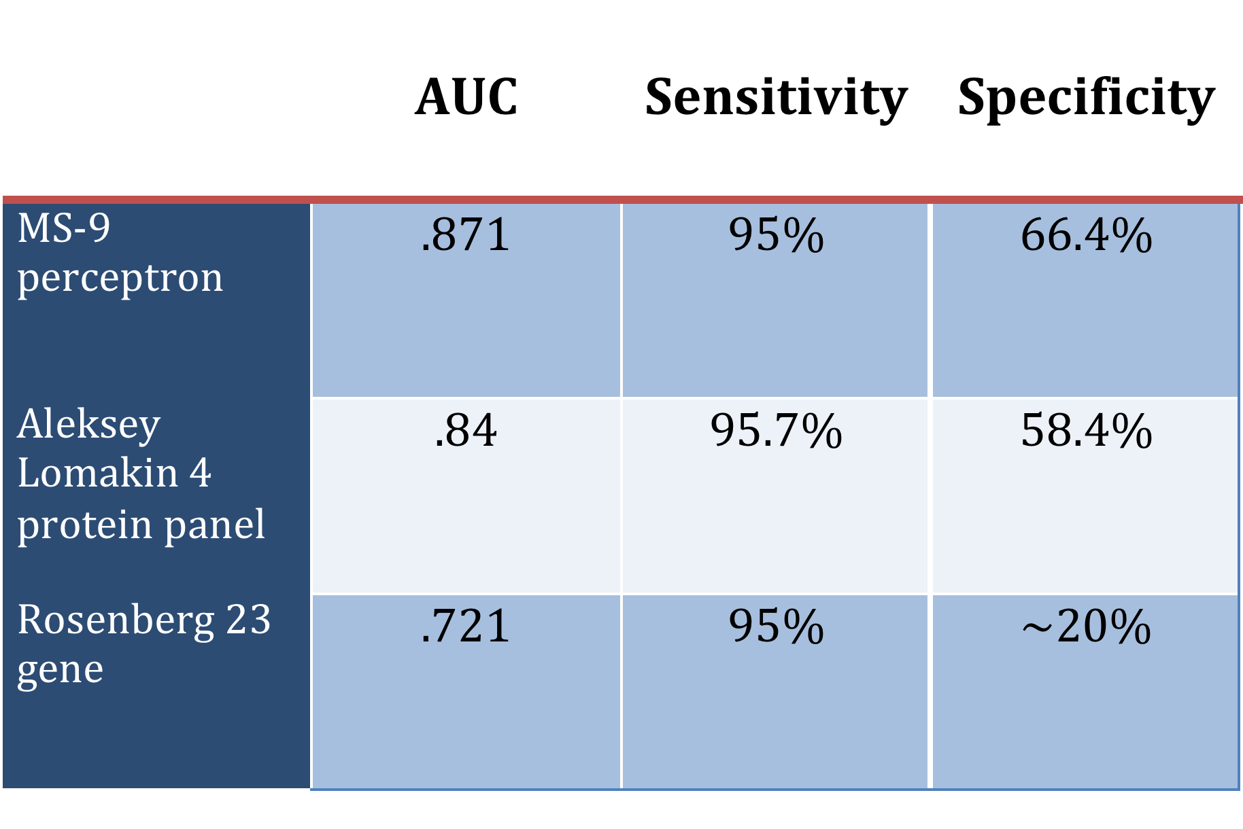
Conclusions

Slide 29
Conclusion
To our knowledge, our 9 protein perceptron classifier is the only protein CAD classifier capable of achieving 65% specificity while maintaining 95% sensitivity.
This supports the idea that a low cost, low risk blood test for CAD could be implemented as a clinically useful tool in the near future.

