Slide 1


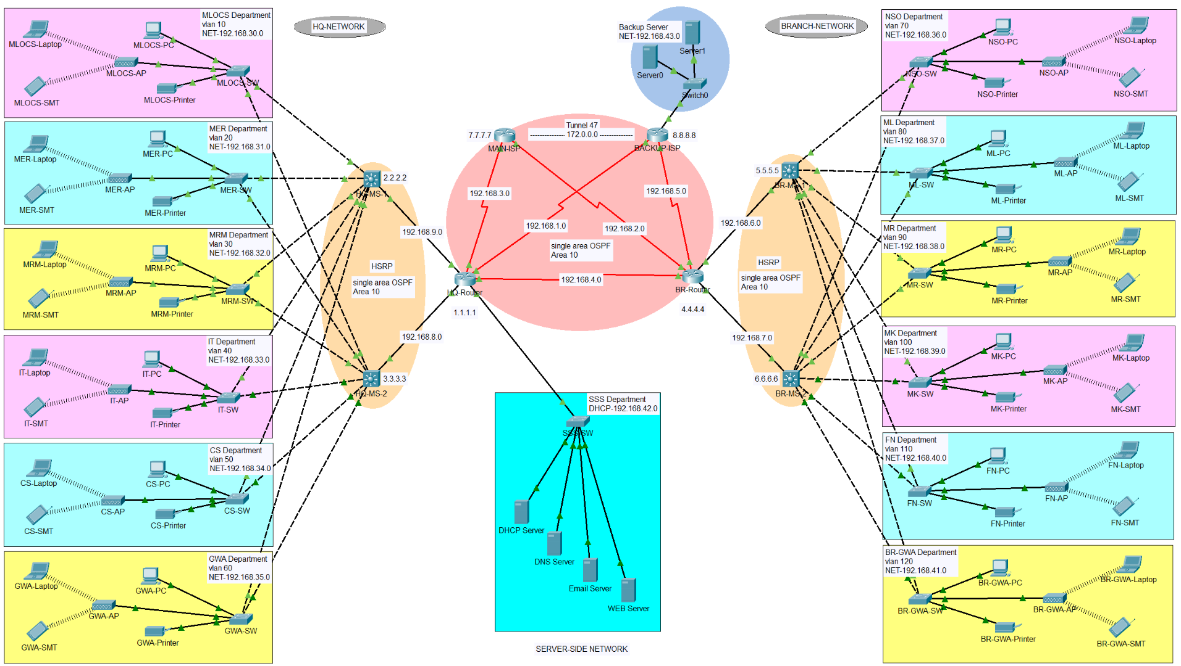
Hospital System Network Design
Guided by
Presented by
Submitted for the partial fulfillment
of
BACHELOR OF TECHNOLOGY
in
(Electronics and Computer Engineering)
MS.Tamandeep Kaur
Lecturer
(SOLITAIRE INFOSYS)
Preetam Kumar
(12205038)
ELECTRONICS AND COMMUNICATION ENGINEERING
2022-26

Slide 2
Content
Abstract
Objectives
Introduction
Networking Devices
IP Address (IPv4)
Cisco Packet Tracer
Interface of Hospital System Network Design
Backup Server
Server-Side Network
Network Area
Tunnel Area
HQ-Network
Branch-Network
Departmental Details
Hospital System Network Design
July- 2024
‹#›

Slide 3
1. Abstract
HOSPITAL SYSTEM NETWORK DESIGN
Login Security to Ensure only admin manipulates data.
The Purpose of this network design is to provide all the information of network configuration of the particular area.
This design provides all information like backup system,data center ,and network area .
This project recognizes the need for a more cohesive and interconnected network, where seamless data exchange and collaboration among various departments and medical personnel can occur in real-time.
Hospital System Network Design
July- 2024
‹#›

Slide 4
2. Objectives
The primary objectives of the project include :
Creating a secure and scalable network that enables rapid data sharing, optimizing network performance to minimize latency and downtime, and implementing stringent security measures to safeguard patient data from cyber threats.
The proposed network design also focuses on incorporating redundancy and disaster recovery mechanisms to ensure uninterrupted access to critical systems, even during unforeseen events.
The "Hospital System Network Design" project represents a strategic initiative aimed at revolutionizing the hospital's information infrastructure to meet the growing demands of modern healthcare.
Hospital System Network Design
July- 2024
‹#›

Slide 5
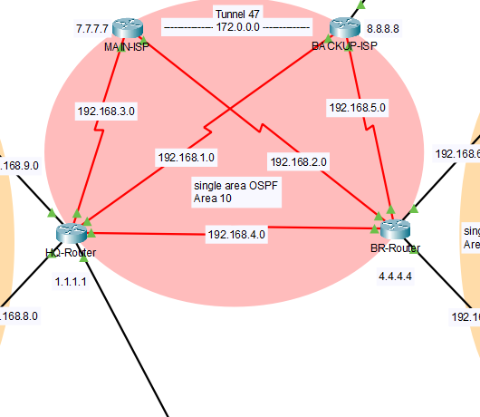
3. Introduction
In my project , I have made a network design for Hospital System using different protocols on cisco packet tracer.
So, What is networking ? Let’s discuss about it.
NETWORKING :
Computer networking refers to interconnected computing devices that can exchange data and share resources with each other. These networked devices use a system of rules, called communications protocols, to transmit information over physical or wireless technologies.
Hospital System Network Design
July- 2024
‹#›

Slide 6
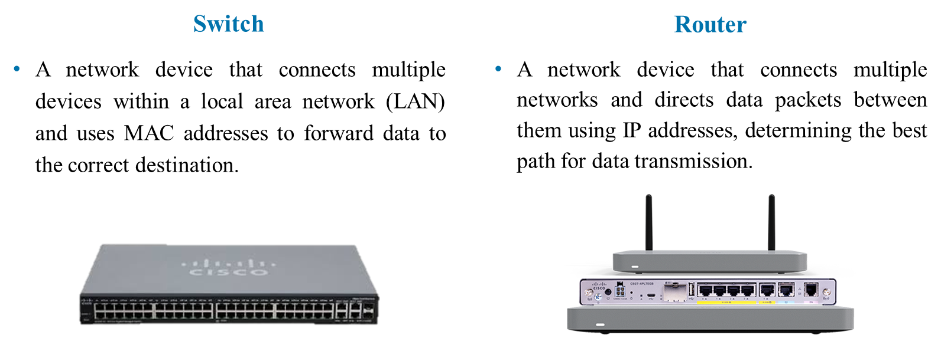
4. Networking Devices
Hospital System Network Design
July- 2024
‹#›

Slide 7
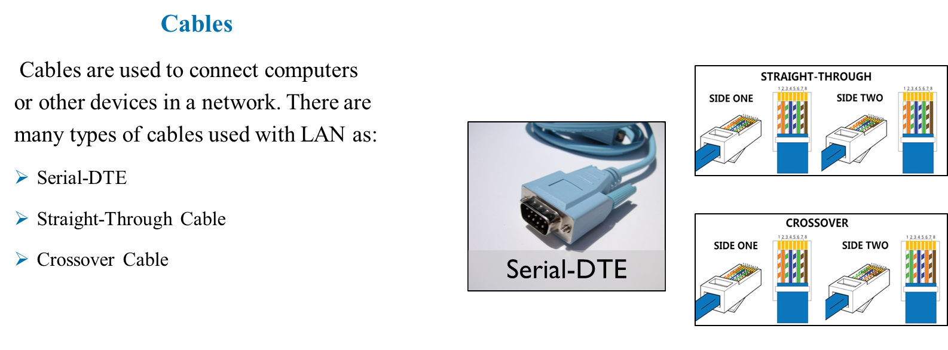
4. Networking Devices
Hospital System Network Design
July- 2024
‹#›

Slide 8
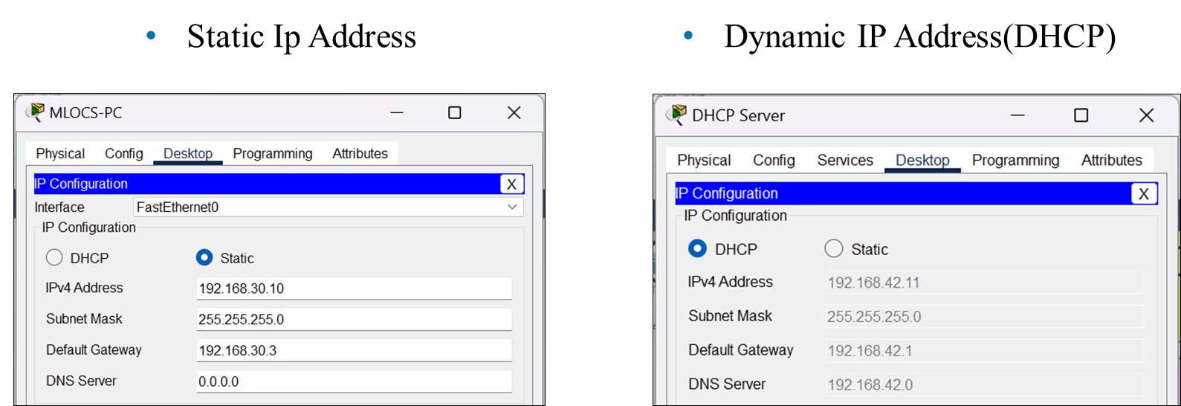
5. IP Address (IPv4)
Hospital System Network Design
July- 2024
‹#›

Slide 9
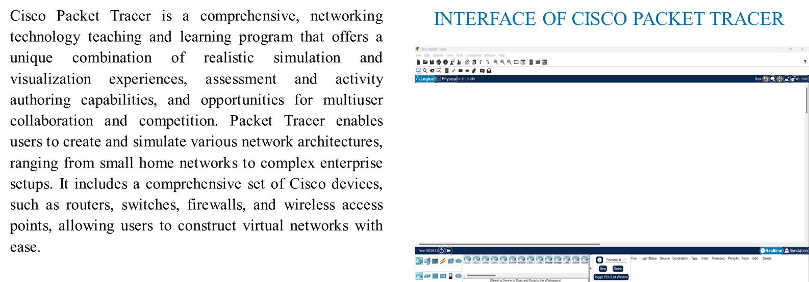
6. Cisco Packet Tracer
Hospital System Network Design
July- 2024
‹#›

Slide 10
7. Interface of Hospital System Network Design
Hospital System Network Design
July- 2024
‹#›

Slide 11
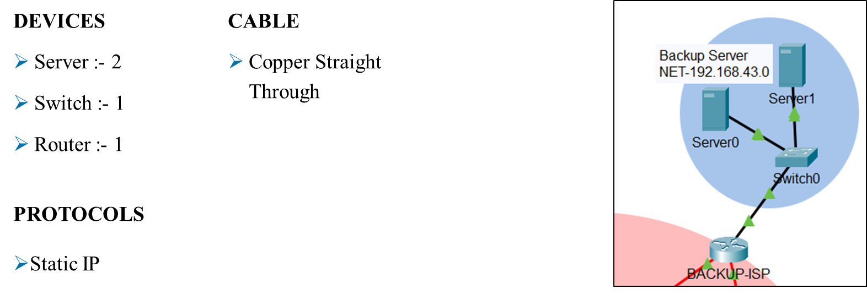
8. Backup Server
Hospital System Network Design
July- 2024
‹#›

Slide 12
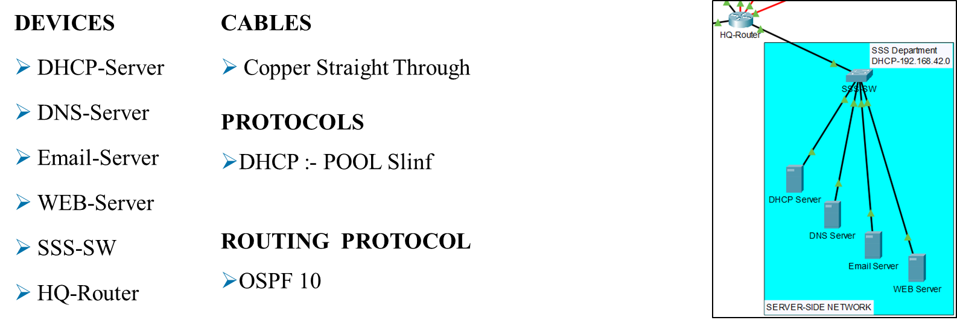
9. Server-Side Network
Hospital System Network Design
July- 2024
‹#›

Slide 13
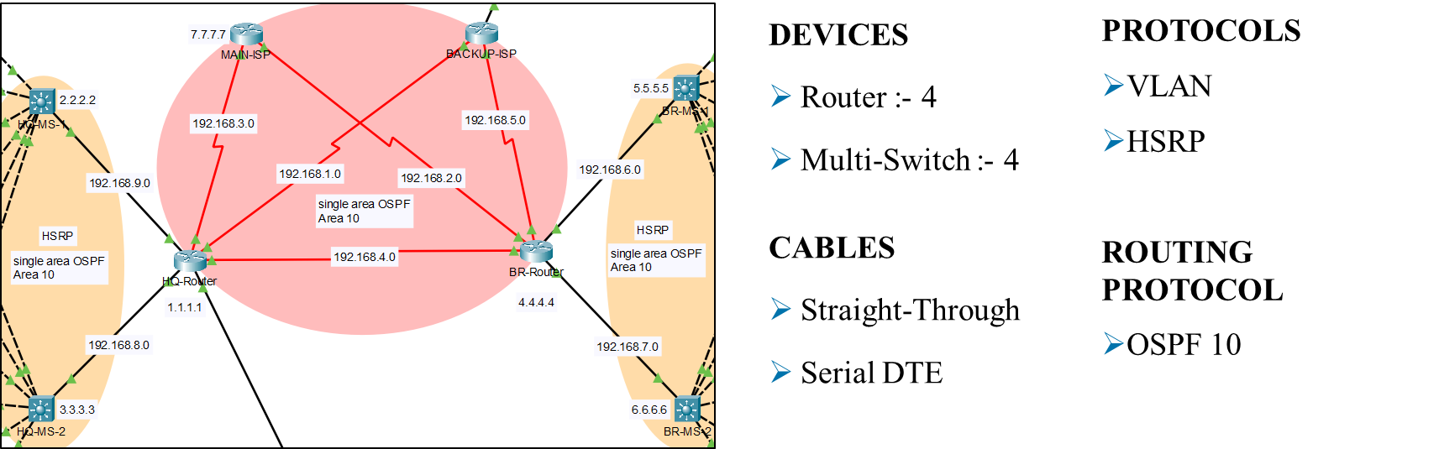
10. Network Area
Hospital System Network Design
July- 2024
‹#›

Slide 14
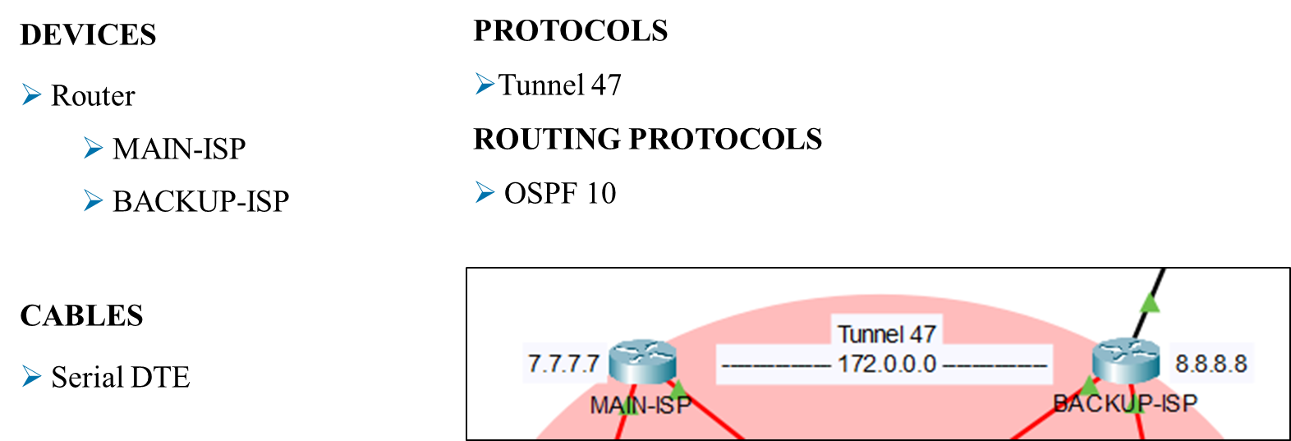
11. Tunnel Area
Hospital System Network Design
July- 2024
‹#›

Slide 15
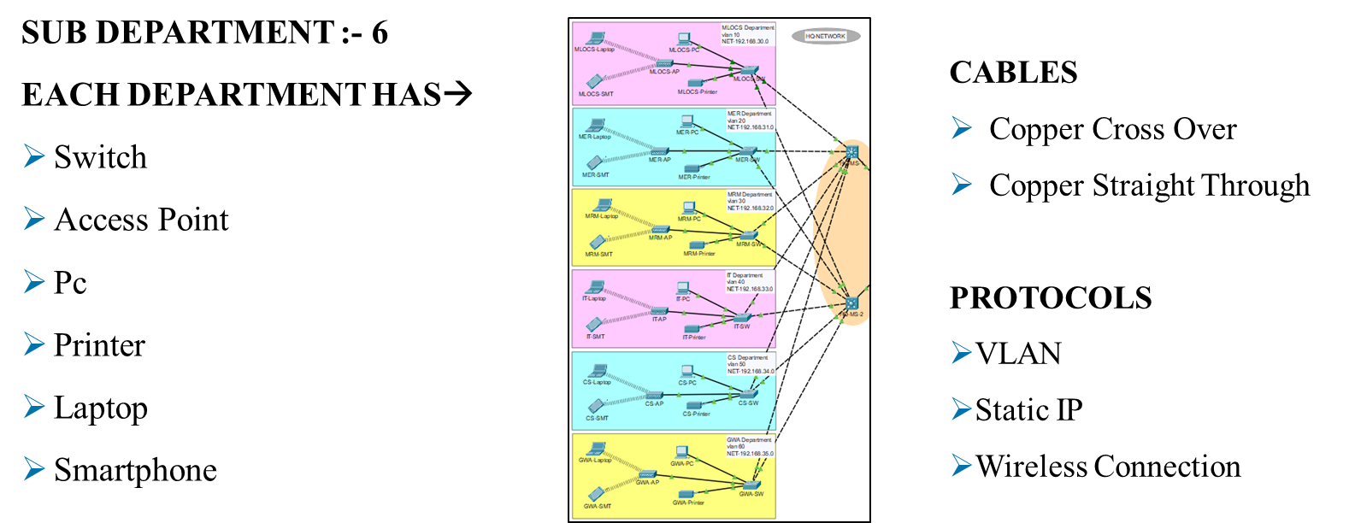
12. HQ-Network
Hospital System Network Design
July- 2024
‹#›

Slide 16
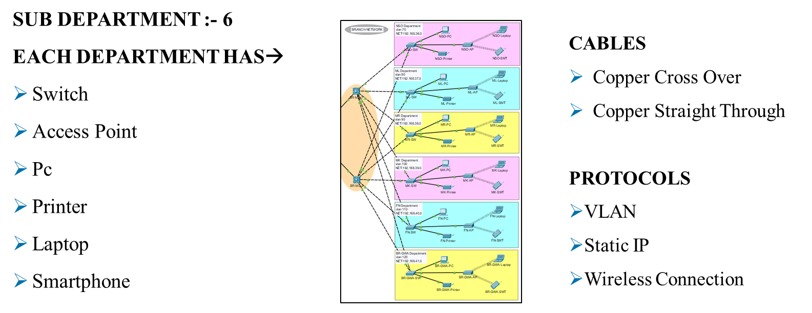
13. Branch-Network
Hospital System Network Design
July- 2024
‹#›

Slide 17
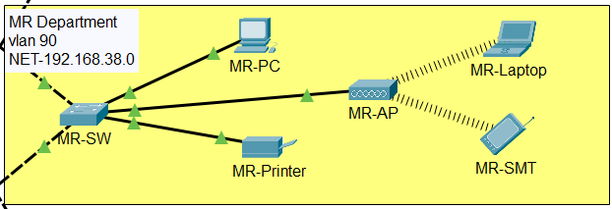
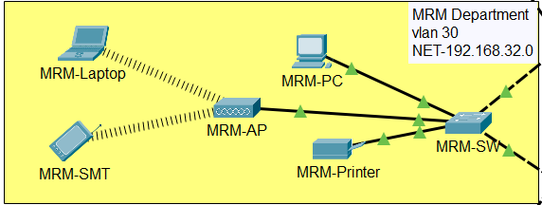
14. Departmental Details
HQ Network |  |  | Branch Network
Department | VLAN | NET | Department | VLAN | NET
MLOCS | 10 | 192.168.30.0 | NSO | 70 | 192.168.36.0
MER | 20 | 192.168.31.0 | ML | 80 | 192.168.37.0
MRM | 30 | 192.168.32.0 | MR | 90 | 192.168.38.0
IT | 40 | 192.168.33.0 | MK | 100 | 192.168.39.0
CS | 50 | 192.168.34.0 | FN | 110 | 192.168.40.0
GWA | 60 | 192.168.35.0 | BR-GWA | 120 | 192.168.41.0
Hospital System Network Design
July- 2024
‹#›

Slide 18


