Slide 1

Social Touch (App)
By: WeiBin Yang

Slide 2
Library Use
Firebase‘s real time database
recycle View with Card View

Slide 3
Challenging
First time use firebase, stuck many time. (Add, Delete, Update, Get)
When first time deep use Recycle View and Card, don’t know how to.
Navigation to the different link, and pass the argument then use them

Slide 4
What you Learn?
Firebase, it is a helpful that can help me to store the data in network
App UI design, now I pretty understand how to design with the view

Slide 5
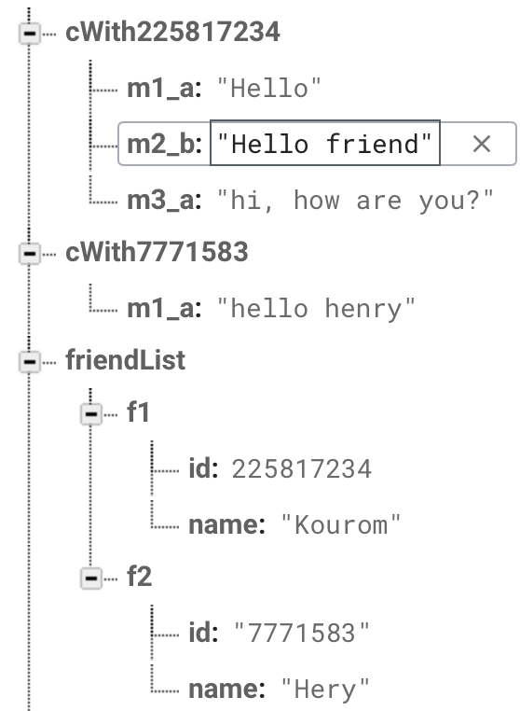
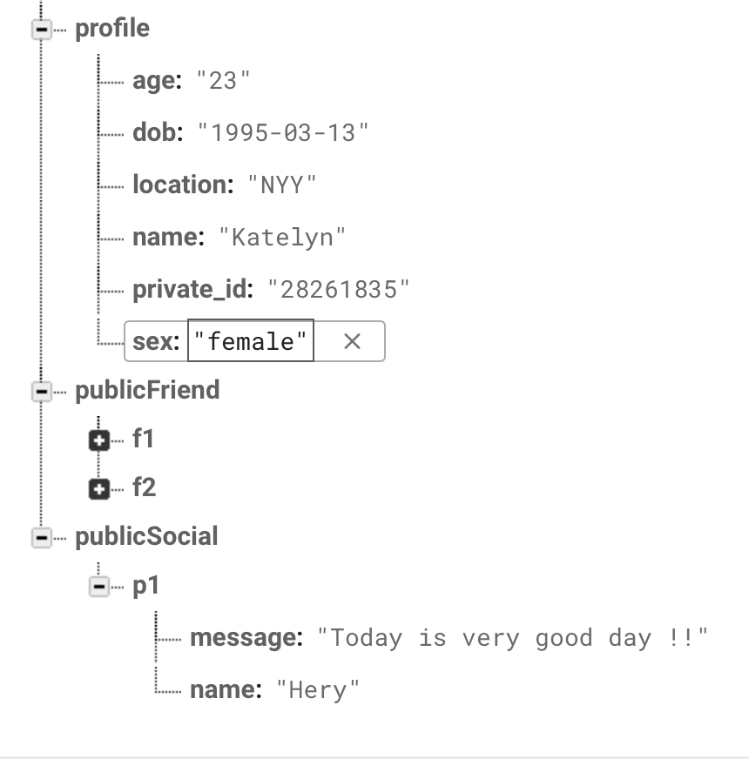
Nice thing to share
Firebase is good library; it is real time database to store your data. You can be easier to save data and use data.

Slide 6
Nice thing to share
Because My app need two people to communicate, but there is only one. So, I will show what will look like if your friend communicate with you.

Slide 7
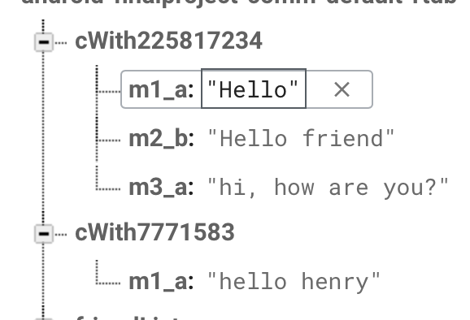
Nice thing to share
My database is look like this, cWith(ID); the m1_a and m2_b means m(message) 1,2,3… a(self/user), b(friend).

Slide 8
Nice thing to share
Reason why I do this way is because Firebase‘s data store is sequence, is will follow by abcdefg, so… no idea

Slide 9
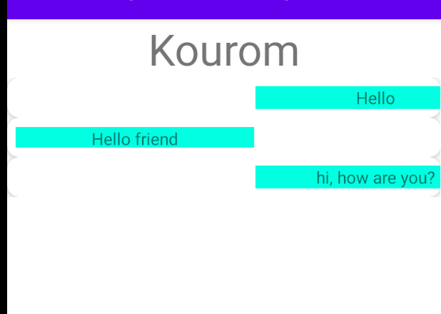
Nice thing to share
So currently will look like this.

Slide 10
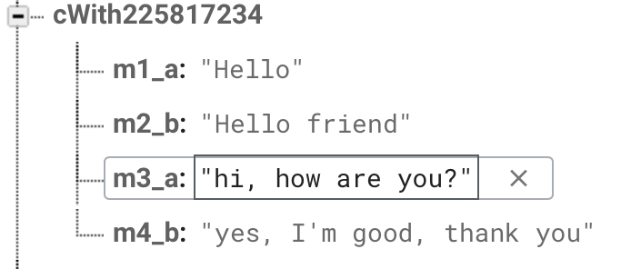
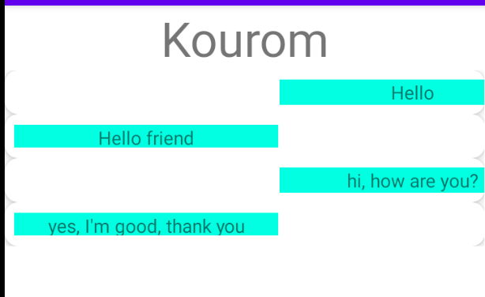
Nice thing to share
Then if I add some thing, like m4_b : yes, I’m good, thank you
Then the app will update the message from friend.

Slide 11
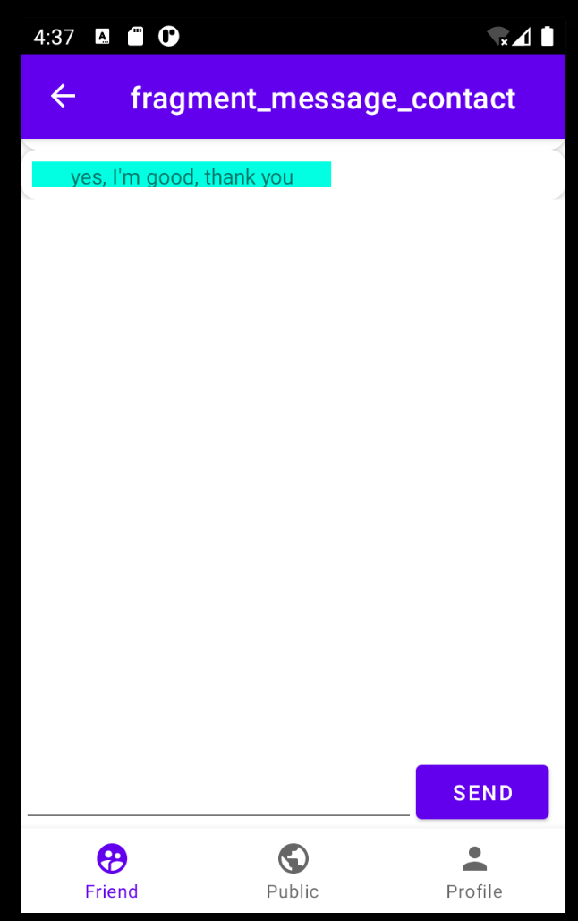
Nice thing to share
Don’t forgot to slide down, because the send button is at bottom, I didn’t do UI good at this.

Slide 12
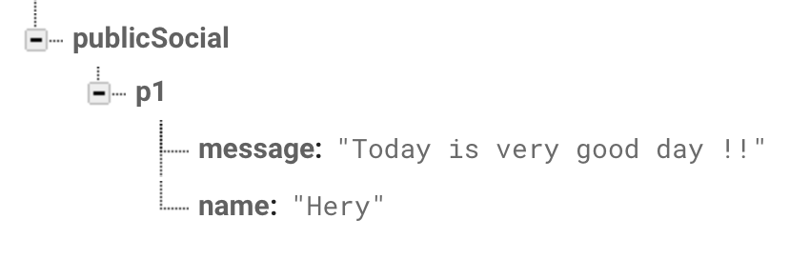

Nice thing to share
So this is how my app work. Also same as the public social

Slide 13
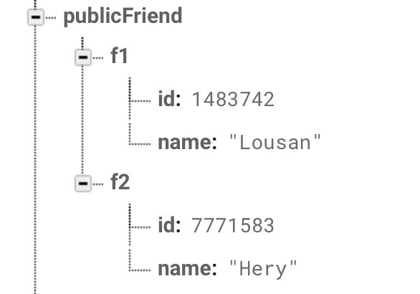
Nice thing to share
AND!! When you add the friend, the id will search in database “publicFriend”, if there is match, friend will add to your list.

Slide 14
Nice thing to share
If you are interest my Firebase, I can invite you, so you have permission to view it.

Slide 15
Poor on this App
App’s UI is not pretty
The Icon that I used is from system, so didn’t specific
The proposal design and current project‘s UI is a lot different (ugly)
No app icon
No animation
If this app with no internet connection, totally no functionality available.

