Slide 1

Domains
Edu.org (not sure avail)
Padlo.in
Ole.org (online education)
Educato.org
Stutu.org(student tutor)
Oes.com (online education system)
Oldbook.com
Rte.org (right to education)
Base color code: #ffbf80
1 . . . 4 . . . 8
9 10
11 12
Classes
Classes
Classes
UG
PG
PHD
Competitive
Medical
Engineering
Kitchen
Treatment

Slide 2








Edu India
Category
KG
1.4.8
9-10
11-12
UG
PG
Competitive
Medical
Engineering
Treatment
Kitchen

Slide 3

Edu India
Category
KG
1.4.8
9-10
11-12
UG
PG
Competitive
Medical
Engineering
Treatment
Kitchen

Slide 4

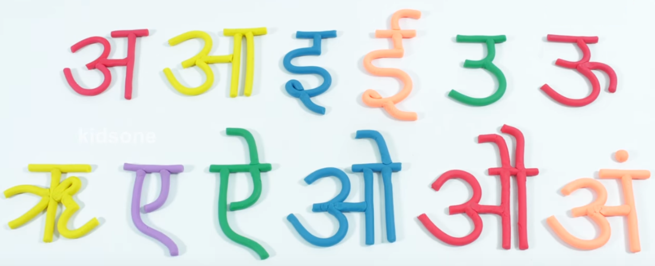
SEARCH RESULT PAGE
INSTITUTION TUTOR STUDENT
CREATE
Time based random QUIZES
LKG
ALL
LKG ALL
LKG –
QUIZ
S
Q
Z
B
CURSIVE WRITING
COLORING
PAINTING COMPETION
ABC
learning alphabets for kids | Phonetics for kids
1. LETTER AFTER A
LKG -
क
ख
ग
LKG – 123
LKG – PHONIC
LKG – RHYMES
LKG – COLORS
More…
More…
LKG – BASICS

Slide 5
Supported Devices and Platform
Mobile
Tablet
PC
App(ios/android) and desktop application

Slide 6
Advertisement
We can add our app/site link into the youtube video
Hire some people on incentive basis to advertise in villages and small towns
In quora review will advertise free app.

Slide 7
Deployment Model
We will develop our platform so that anyone can use our system in many aspect
General Mode – We will upload video and questions link for anyone.
Tutor Mode – Online tuition for tutor as individual (may extend in future online classes as well). They can create own channel, upload youtube video link, upload questions, set exams.
Institute/School Mode– We can create profile for institution/school and they will upload video and questions.
Will provide Old student/teacher hand written note for each class

Slide 8
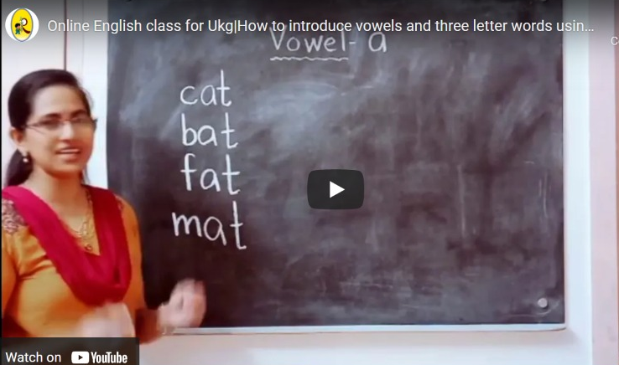
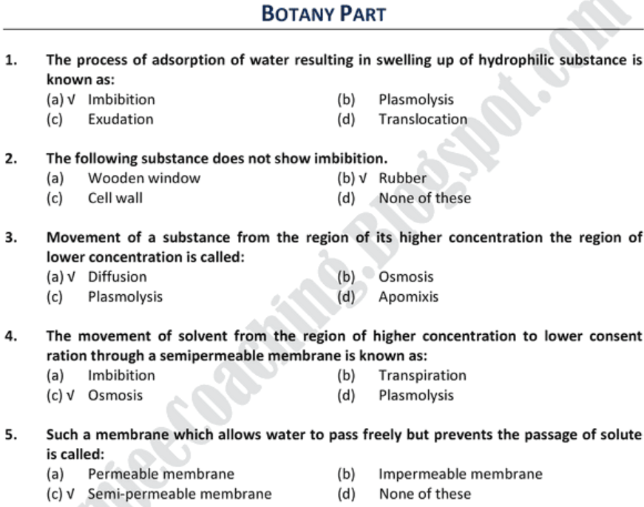
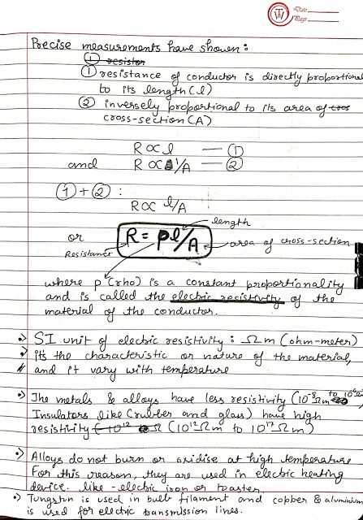
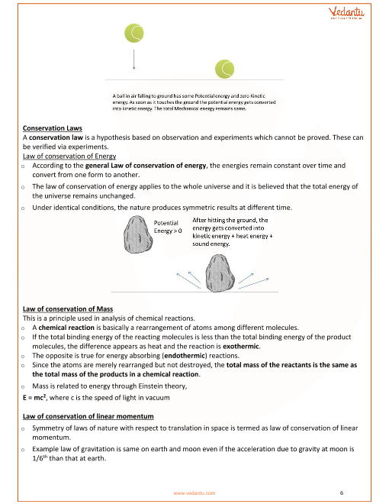
Screen Design
O Multiple Choice
O Hand Note
O Class Note

Slide 9
Quiz Template
Template for LKG-UKG
Template for 1-2-3
Template for 4-5
Template for 6-7-8
Template for 9-10
Template for 11-12 / IIT-JEE

Slide 10
Feature
Translation – (Eng/Hindi)

Slide 11

Domain Selection, Title, Logo
pathshala.org
gurukul.org

Slide 12
Revenue Model
All video lectures would be free.
Test would be paid
Test-Series would be paid
Hand notes would be paid (few pages free)
Class notes would be paid (few pages free)

