Slide 1

Mango Fruit Quality Detection using Optimized VGGNet Model
PAPER ID :90
Rajesh Kumar Singh ,Brijesh Kumar Chaurasia, Man Mohan Shukla, Sunil Vishwakarma, Yogendra Pratap Singh
Tata Consultancy Services, London, UK
Department of Computer Science and Engineering, Pranveer Singh Institute of Technology, Kanpur, UP, India
Presenting Author : Rajesh Kumar Singh

Slide 2
Content:
1. Abstract
2. Introduction
3. Literature Review
4. Research Gaps
5. Proposed Methodology
6. Results & Discussion
7. Comparative Analysis
8. Conclusion & Future Work
9. References

Slide 3
1. ABSTRACT:
▪ Mango fruit quality is largely determined by ripening stage, judged using colour, shape and size.
▪ Artificial Intelligence (AI) is increasingly used to automatically assess the external quality of food and agricultural produce.
▪ VGGNet (Visual Geometry Group Network) is a well-known computer vision model that analyses images and identifies the objects or features they contain. It uses a deep neural network with many layers to learn visual patterns, making it effective for image classification and recognition tasks.
▪ An Optimized VGGNet (OVGGNet) model is proposed for automated mango fruit quality (fresh vs. rotten) detection.
▪ Fully-connected layer replaced with a flattened layer, dense layer uses ReLU activation, sigmoid output performs binary classification, and average pooling is replaced with max pooling.
▪ Model trained and validated on multiple dataset split ratios and validation methods.
▪ The proposed OVGGNet model attains an accuracy of up to 99.76%.

Slide 4
2. INTRODUCTION:
▪ Agriculture is central to socioeconomic development; 82% of Indian farmers are small/marginal, and 70% of rural households depend on it for income.
▪ Mango is nutritionally and economically important, but quality assessment via manual/visual inspection is costly, slow, and error-prone (fatigue, poor vision, imprecision).
▪ AI, computer vision (CV), machine learning (ML) and deep learning (DL) enable automated tools that mimic expert visual perception and decision-making.
▪ CNNs are well suited to detecting/classifying fruit diseases and defects across many classes.
▪ This work compares dataset images with real-time images to classify mango fruit as Fresh (F_Mango) or Rotten (R_Mango).
▪ Goal: an intelligent system to help or replace slow, inconsistent human decision-making in fruit quality grading.

Slide 5
3. LITERATURE REVIEW:
Ref. | Method | Result
[1] | 5 CNN models on a 10-class fruit dataset (fresh/rotten) | InceptionV3 best: 97.34% accuracy
[2] | MobileNetV2, InceptionV3, DenseNet121, VGG16 on apples & mangoes | MobileNetV2: 92.50% test acc. (mango); VGG16 lowest, <80%
[3] | Image processing + CNN (thresholding, morphology) | Mango: 89% (IP), 95% (CNN)
[4] | Improved YOLOv4 + deep CNN | 73.5% AP (fruit), 72.6% AP (vegetable)
[5] | CNN, KNN, SVM on Google/Kaggle datasets | CNN best: 95% accuracy
[6] | CNN + Softmax on Kaggle dataset | 97.82% accuracy
[7] | En-UNet vs UNet segmentation | En-UNet: 97.46%/97.54% (train/val), IoU 0.866
[8] | CNN features + Random Forest classifier | 95.11% grading, 93.23% variety recognition
[9] | CNN-based mango quality classification | 98% accuracy

Slide 6
4. RESEARCH GAPS:
▪ Established CNN architectures (VGG16, InceptionV3, DenseNet121, MobileNetV2) reach good accuracy but carry heavy parameter counts.
▪ Baseline VGG16 underperforms in several studies (accuracy below 80%) without architectural optimization.
▪ Segmentation-based methods (UNet / En-UNet) add computational complexity without exceeding lightweight CNN accuracy.
▪ Many prior works rely on small or single-source datasets, limiting generalization to real-world/real-time conditions.
▪ Few studies specifically target a lightweight, deployable model for fresh-vs-rotten mango classification.
▪ A need exists for a simpler, optimized, low-parameter model that retains high accuracy and sensitivity for binary fruit-quality classification.

Slide 7
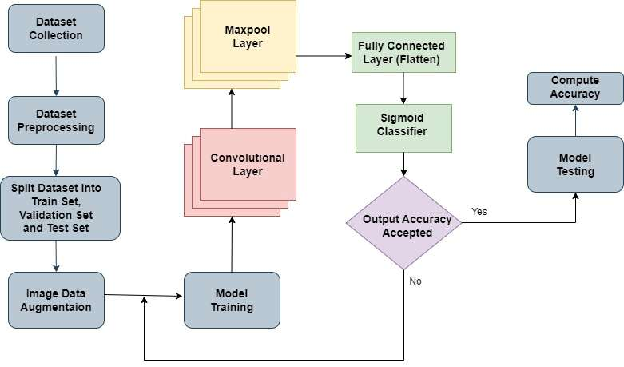
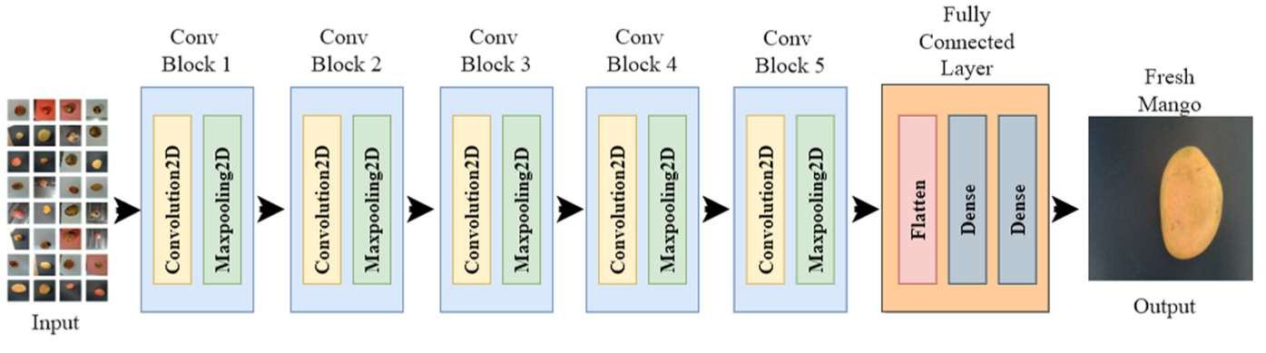
5. PROPOSED METHODOLOGY:
▪ 1. Data Collection - 2000 mango images (1000 Fresh + 1000 Rotten), Mendeley dataset
▪ 2. Data Preprocessing - resize/rescale to 224×224, split into train/val/test
▪ 3. Image Data Augmentation - flipping and rotation (1°-359°)
▪ 4. Model Training - OVGGNet: 5 Conv+Maxpool blocks, Flatten, Dense(ReLU)
▪ 5. Feature Extraction - hierarchical CNN feature learning
▪ 6. Model Testing - accuracy, recall, F1, confusion matrix, fine-tuning
Workflow of the Proposed OVGGNet Model
OVGGNet Architecture: Conv Blocks 1-5 → Flatten → Dense → Sigmoid

Slide 8
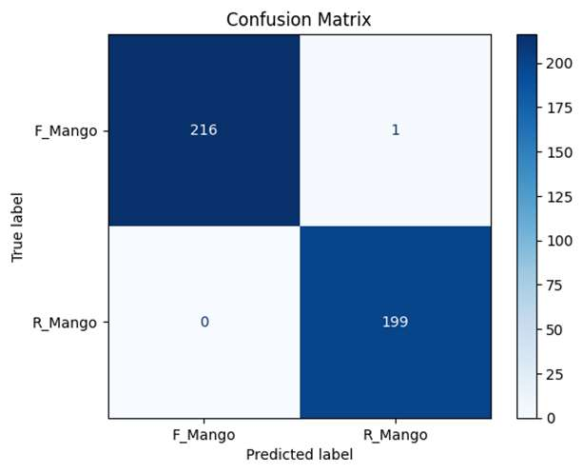
6. RESULTS & DISCUSSION:
Metric (30 epochs) | Case 1 (70:15:15) | Case 2 (80:10:10)
Overall Accuracy | 98.48% | 99.76%
Training Accuracy | 95.91% | 99.55%
Training Loss | 12.22% | 3.07%
Validation Loss | 2.98% | 0.80%
▪ Confusion matrix (Case 2, 80:10:10): 216 Fresh correctly classified, 1 misclassified; 199 Rotten correctly classified, 0 misclassified.
▪ Rotten Mango precision = 1.0, Fresh Mango recall = 1.0; Fresh Mango F1-score = 99.77%.
▪ Decayed mangoes show more distinctive visual characteristics than fresh ones, aiding classification.

Slide 9
7. COMPARATIVE ANALYSIS:
▪ Proposed OVGGNet achieves the highest accuracy (99.76%) among all compared methods.
▪ Existing works trade off lightweight design against accuracy (e.g., VGG16 baseline <80%, YOLOv4 73.5% AP).
▪ OVGGNet's optimized layers (flatten, ReLU dense, sigmoid, max-pooling) reduce parameters while improving sensitivity.

Slide 10
8. CONCLUSION & FUTURE WORK:
Conclusion
▪ Presented mango fruit quality detection using the proposed OVGGNet model.
▪ Model modifies pretrained VGGNet: flattened layer, ReLU dense layer, sigmoid classifier, and max pooling (instead of average pooling).
▪ Evaluated on two dataset splits: 98.48% accuracy (70:15:15) and 99.76% accuracy (80:10:10).
▪ Lightweight, optimized design with fewer parameters and layers reduces computation time while maintaining high accuracy.
Future Work
▪ Extend from binary (fresh/rotten) to multi-class ripening-stage grading.
▪ Validate on larger, more diverse, real-time field datasets across mango varieties and lighting conditions.
▪ Explore deployment on edge/mobile devices for real-time sorting lines.
▪ Benchmark against newer lightweight architectures (e.g., MobileNet, EfficientNet) for further optimization.

Slide 11
9. REFERENCES:
1. Bruinsma, J. (Ed.) (2003). World Agriculture: Towards 2015/2030. Routledge.
2. FAO in India. Online, fao.org/india, Accessed 22 Jan 2025.
3. Sivakumar, D. et al. (2011). Maintaining mango fruit quality during export chain. Food Research Int'l, 44(5), 1254-1263.
4. Zhena, O.P. et al. (2020). Quality evaluation of mango using non-destructive approaches. J. Agri. Food Eng., 1(0003), 1-8.
5. Altaheri, H. et al. (2019). Date fruit classification for robotic harvesting using DL. IEEE Access, 7, 117115-117133.
6. Rizzo, M. et al. (2023). Fruit ripeness classification: A survey. Artificial Intelligence in Agriculture, 7, 44-57.
7. Chaurasia, B.K. et al. (2023). Transfer learning-driven ensemble model for diabetic retinopathy. Med. Bio. Eng. Comput., 61, 2033-2049.
8. Mehl, P.M. et al. (2002). Detection of defects on apple cultivars using hyperspectral imaging. Applied Eng. Agri., 18(2), 219-226.
9. Singh, Y.P., Chaurasia, B.K., Shukla, M.M. (2024). Mango fruit variety classification using lightweight VGGNet. SN Computer Science, 5(1083), 1-15.
10. Kavitha, M., Palani, S. (2020). Comprehensive analysis for retinal image classification. Int'l J. Business Info. Systems, 34(2), 229-252.
11. Miah, M.S. et al. (2021). Identification of fresh/rotten fruits using CNNs. ICCCNT 2021, pp. 1-7.
12. Pacheco, R. et al. (2023). Fruit defect detection using CNN models with real & virtual data. VISIGRAPP (4:VISAPP), 272-279.
13. Akram, M.W. et al. (2023). Machine vision-based automatic fruit quality detection & grading. Front. Agr. Sci. Eng.
14. Mukhiddinov, M. et al. (2022). Improved classification for fruit/vegetable freshness using DL. Sensors, 22(21), 8192.
15. Hamim, M.A. et al. (2023). Bangladeshi fresh-rotten fruit & vegetable detection using DL. CCAI 2023, 233-238.
16. Palakodati, S.S.S. et al. (2020). Fresh & rotten fruits classification using CNN & transfer learning. Rev. Intelligence Artif., 34(5), 617-622.
17. Roy, K., Chaudhuri, S.S., Pramanik, S. (2021). DL-based industrial framework for rotten/fresh fruit via semantic segmentation. Microsyst Technol, 27, 3365-3375.
18. Gururaj, N., Vinod, V., Vijayakumar, K. (2023). Deep grading of mangoes using CNN and CV. Multimed Tools Appl, 82, 39525-39550.
19. Nithya, R. et al. (2022). Computer vision system for mango defect detection using deep CNN. Foods, 11, 3483.
20. Suescun, P. et al. (2020). Spoiled and fresh fruit inspection dataset. Mendeley Data, V1.
21. Dataset. data.mendeley.com/datasets/6ps7gtp2wg/1. Accessed 29 Nov 2025.
22. Maharana, K., Mondal, S., Nemade, B. (2022). Review: Data preprocessing & augmentation techniques. Global Transitions Proceedings, 3(1), 91-99.
23. Shorten, C., Khoshgoftaar, T.M. (2019). A survey on image data augmentation for DL. J. Big Data, 6(60), 1-48.
24. Kingma, D.P., Ba, J. (2017). Adam: A method for stochastic optimization. arXiv:1412.6980.
25. Jogin, M. et al. (2018). Feature extraction using CNNs and DL. IEEE RTEICT 2018, 2319-2323.
26. Maria Navin, J.R., Pankaja, R. (2016). Performance analysis of text classification using confusion matrix. IJETR, 6(4), 75-8.
27. Harris, C.R. et al. (2020). Array programming with NumPy. Nature, 585, 357-362.
28. Pedregosa, F. et al. (2011). Scikit-learn: ML in Python. JMLR, 12, 2825-2830.
29. TensorFlow. tensorflow.org/versions. Accessed 21 Jan 2026.
30. Python 3 (3.9). python.org/downloads/release/python393. Accessed 21 Nov 2025.

