Slide 1






7th International Conference on Data Analytics & Management (ICDAM-2026)
12th to 14th June 2026
DS4Earth: An Integrated Data Science Approach to Climate Change Insights
Using Medallion Architecture, Star Schema Design and Multi-Model Machine Learning
Paper ID: 1210
Rajesh Kumar Singh¹* · Dr Pramod Kumar Yadav² · Dr Lokesh Jain³
¹ Independent Researcher | Tata Consultancy Services, London, UK
² Dept. of Computer Science Engineering, National Institute of Technology Srinagar, India
³ Dept. of AI & Data Science, Vivekananda Institute of Professional Studies – Technical Campus, Delhi, India
* errajeshcs@gmail.com
Presenting Author : Rajesh Kumar Singh

Slide 2
1. INDEX
01
Abstract
06
Star Schema & Data Model
02
Introduction
07
Results & Discussion
03
Literature Review
08
Comparative Analysis
04
Research Gaps
09
Conclusion & Future Work
05
Proposed Methodology
10
References

Slide 3
2. ABSTRACT
DS4Earth is an end-to-end data science framework that turns multi-source climate data into actionable insights. It unifies three pillars — data engineering, machine learning and visual analytics — in a single cloud-native pipeline on Databricks, using the Medallion Architecture and an optimized star schema for scalable, query-efficient climate analytics.
DATA ENGINEERING
Automated Python/PySpark ETL on Databricks
Bronze → Silver → Gold Medallion layers
Star schema with 5 dimensions (Delta Lake, ACID)
MACHINE LEARNING
LSTM temperature forecasting (RMSE 1.85 °C)
Random Forest rainfall (RMSE 0.68 mm)
KMeans climate zones + regression causal analysis
VISUAL ANALYTICS
Interactive Tableau climate dashboards
Country maps, trends, extreme-event views
Auto-refreshed from the Gold layer
1.85 °C
LSTM RMSE — temperature
0.68 mm
Random Forest RMSE — rainfall
0.61
KMeans silhouette score
99.9%
ETL pipeline uptime

Slide 4
3. INTRODUCTION
▸ Climate change is one of the defining challenges of our time — rising temperatures, erratic rainfall and excessive emissions demand data-driven responses.
▸ Climate data is massive but fragmented: satellites, weather stations, simulations and national archives rarely meet in one warehouse.
▸ DS4Earth bridges this gap with a production-ready ETL pipeline, an optimized star schema, multi-model machine learning and interactive dashboards.
▸ Goal: interpretable, decision-ready climate insights for forecasting, zone classification and policy planning — from raw API feeds to dashboards in under 10 minutes.
150+
countries covered
1990–2025
35 years of climate data
< 10 min
ingestion-to-insight latency
4
ML models in one pipeline

Slide 5
4. LITERATURE REVIEW
Study | Focus Area | Key Contribution | Relevance to DS4Earth
Hsieh (2022) | Environmental data science | Framework uniting domain expertise with LSTM, Random Forest and CNN for climate series | Guides our multi-model ML design
Camps-Valls et al. (2019) | Deep learning for Earth sciences | Systematic review of CNNs for satellite imagery, LSTMs for spatiotemporal forecasting | Theoretical basis for LSTM forecasting
Armbrust et al. (2020) | Delta Lake / lakehouse | High-performance ACID table storage over cloud object stores | Foundation of our Medallion layers
Salami (2025) | Hub-Star Modelling 2.0 | Star-schema modelling patterns for Medallion architectures | Informs our star schema design
ESA / NASA / Copernicus (2024) | ML + environmental big data | Joint report on integrating ML with Earth-observation pipelines | Validates the EO-to-ML pipeline approach

Slide 6
5. RESEARCH GAPS
IDENTIFIED GAP
HOW DS4EARTH RESPONDS
Gap 1 — Fragmented climate data
Satellite, sensor and simulation feeds live in silos with no unified, query-ready warehouse.
Medallion lakehouse unifies 5 sources in Bronze → Silver → Gold layers.
Gap 2 — Research-grade ML, not production
Most climate ML studies stop at notebooks — no automated, monitored pipelines.
Scheduled 10-minute ETL jobs, 30-day stress test, 99.9% uptime.
Gap 3 — Weak schema design evidence
Little guidance on warehouse schemas (star vs normalized) for climate OLAP workloads.
Optimized 5-dimension star schema cuts query latency by ~35%.
Gap 4 — Insights locked in models
Few systems deliver interpretable, decision-ready visual analytics to policymakers.
Auto-refreshing Tableau dashboards for forecasts, zones and policy views.

Slide 7
6. PROPOSED METHODOLOGY — END-TO-END PIPELINE
DATA SOURCES
DATABRICKS MEDALLION ARCHITECTURE (DELTA LAKE)
NASA POWER API (satellite EO)
Weather Stack API (real-time sensors)
ETL PIPELINE
Python / PySpark — Databricks Jobs, 10-min cycles
BRONZE
Raw Delta tables — schema drift, raw formats
SILVER
Clean & standardized — MERGE dedup, features
GOLD
Star schema & aggregates — analytics-ready
TABLEAU
Live climate dashboards
IMD Open Data (national met.)
Kaggle / CMIP6 (simulations)
MACHINE LEARNING LAYER
trained on Gold-layer features
KMeans
4 climate zones (k=4)
LSTM
next-day temperature
Random Forest
rainfall (12 features)
Linear Regression
CO₂/PM2.5 causal test

Slide 8
DS4Earth Data Sources - Integrated Climate APIs and Datasets
Source | Type | Format | Parameters | API / Access
NASA(Power) | Historical EO | CSV, JSON | Temp anomalies, CO₂, satellite imagery | NASA Climate API/Earth data REST
IMD (India) | India Meteorological Department (IMD) | CSV, JSON | Rainfall, humidity, monsoon forecasts | IMD Open Data Portal
Weather Stack | Real-time weather | JSON | Temperature, wind, AQI, sunrise/sunset | REST API (subscription)
Kaggle/CMIP6 | Historical /model output | CSV Parquet | Multi-decade climate simulations, sea-level rise | Direct download

Slide 9
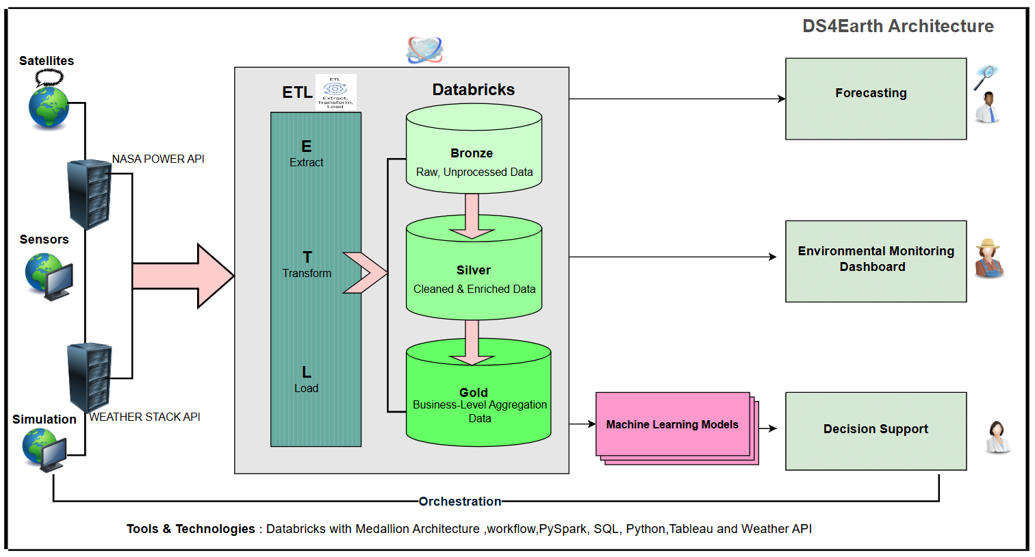

Slide 10
6. PROPOSED METHODOLOGY (CONTD.) — STAR SCHEMA & DATA MODEL
GOLD-LAYER STAR SCHEMA (DELTA LAKE)
WHY THIS DESIGN SCALES
DIM: TIME
date, month, season, year
Fewer joins, simpler queries
Denormalized star beats normalized schemas for analytics workloads.
DIM: LOCATION
country, city, lat/long
DIM: AIR QUALITY
AQI, CO, PM2.5, NO₂
~35% lower query latency
Pre-aggregated Gold views accelerate dashboard and OLAP queries.
FACT: WEATHER OBSERVATION
20+ measures · surrogate keys to all 5 dimensions
OLAP slice & dice
Analyse by time, location, AQI, sky and astronomy simultaneously.
DIM: SKY CONDITION
cloud cover, visibility
DIM: ASTRONOMY
sunrise, sunset, moon phase
ACID + independent scaling
Delta Lake transactions; ingestion, transform and analytics scale separately.

Slide 11
7. RESULTS & DISCUSSION
Model | Task | Metrics | Outcome
LSTM | Temperature forecast | RMSE 1.85 °C · MAE 1.21 °C | Accurate seasonal trend capture; 33.27 °C next-day Delhi, validated vs IMD
Random Forest | Rainfall prediction | RMSE 0.68 mm · MAE 0.42 mm | Reliable low-rain forecasts from 12 weather features
KMeans (k=3) | Climate classification | Silhouette 0.61 | Four well-separated global climate zones across 150+ countries
Linear Regression | CO₂/PM2.5 causal test | R² 0.005 · RMSE 9.25 °C | Local pollution explains ~0.5% of temperature variance — motivates physics-based ML
Deep + ensemble models win
LSTM captures temporal dependencies and Random Forest suppresses precipitation variance — both clearly beat statistical baselines.
Medallion is production-robust
30-day stress test at 10-minute cycles: all scheduled runs succeeded with stable runtimes and 99.9% uptime.
Dashboards close the loop
Tableau views (temperature maps, trends, zones, impact vs vulnerability) auto-refresh from the Gold layer.

Slide 13
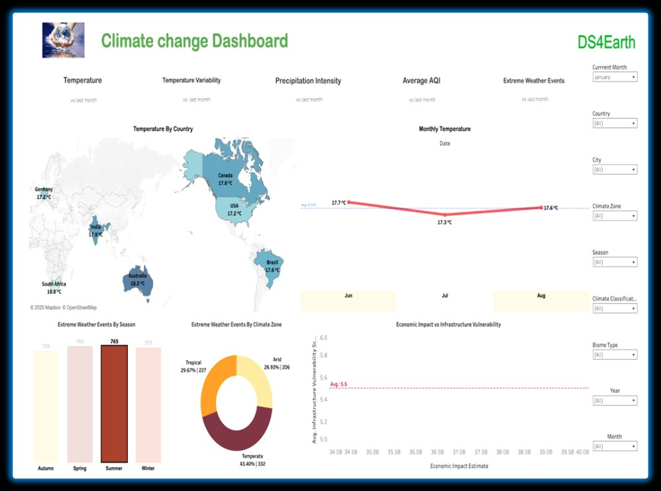

Slide 14
8. COMPARATIVE ANALYSIS
Task | Baseline | DS4Earth Model | Improvement
Temperature forecast | ARIMA | LSTM | 22% lower RMSE
Rainfall prediction | Linear Regression | Random Forest | 40% lower error
Climate classification | Rule-based Köppen | KMeans (k=4) | Flexible, data-driven zones
PREDICTION ERROR vs BASELINE (baseline = 100)
Temperature — ARIMA
100
22%
lower RMSE — LSTM vs ARIMA
Temperature — LSTM
78
Rainfall — Linear Reg.
100
40%
lower error — RF vs Linear Reg.
Rainfall — Random Forest
60

Slide 15
9. CONCLUSION & FUTURE WORK
CONCLUSIONS
▸ DS4Earth shows that cloud-native warehousing (Medallion + star schema), automated ETL, multi-model ML and dashboards can be unified in one production pipeline.
▸ Forecasting works in practice: LSTM (RMSE 1.85 °C) and Random Forest (RMSE 0.68 mm) deliver operationally useful, validated predictions.
▸ Climate zone classification (silhouette 0.61) yields interpretable, policy-relevant regions across 150+ countries.
▸ The pipeline is robust: 30 days of 10-minute cycles with 99.9% uptime and <10-minute data-to-insight latency.
FUTURE WORK
▸ Move beyond weak linear pollution–temperature links (R² 0.005) toward physics-informed, multi-factor ML models.
▸ Add satellite imagery with CNNs and richer Earth-observation sources to deepen spatial insight.
▸ Scale district-level advisories for heatwave preparedness, irrigation and flood-risk planning.
▸ Extend dashboards with real-time alerting and economic impact vs infrastructure-vulnerability analytics.

Slide 16
10. REFERENCES
[1] IPCC (2023). AR6 Synthesis Report: Climate Change 2023. IPCC, Geneva.
[2] Armbrust, M. et al. (2020). Delta Lake: High-performance ACID table storage over cloud object stores. Proc. VLDB, 13(12), 3411–3424.
[3] Hsieh, W. W. (2022). Introduction to Environmental Data Science. Cambridge University Press.
[4] Camps-Valls, G. et al. (2019). Deep Learning for the Earth Sciences. Wiley-Blackwell.
[5] ESA / NASA / Copernicus (2024). Integrating Machine Learning with Environmental Big Data. Joint Technical Report.
[6] Salami, S. (2025). Hub-Star Modelling 2.0 for Medallion Architecture. Technical Paper.
[7] Hochreiter, S. & Schmidhuber, J. (1997). Long short-term memory. Neural Computation, 9(8), 1735–1780.
[8] Menke, W. & Menke, J. (2022). Environmental Data Analysis with MATLAB and Python. Elsevier.
[9] BITS Pilani (2025). Dissertation: A Data Science Approach to AI-Powered Climate Change Insights: DS4Earth. . Pilani Campus, Rajasthan.
[10] Research Paper: Hub-Star Modeling 2.0 for Medallion Architecture, Authors: Shahram
Salami-Sydney, Australia, Published: April , 2025
[11] Breiman, L. (2001). Random forests. Machine Learning, 45(1), 5–33.
[12] MacQueen, J. (1967). Some methods for classification and analysis of multivariate observations. Proc. 5th Berkeley Symposium, 1, 281–297.
[13] World Bank (2022). India Climate and Development Report. World Bank Group, Washington DC.
[14] NASA GISS Surface Temperature Analysis (GISTEMP v4). https://data.giss.nasa.gov/gistemp.
[15] IMD Open Data Portal. https://mausam.imd.gov.in.
[16] Weather Stack Real-Time Weather API. https://weatherstack.com/documentation.
[17] McKinney, W. (2022). Python for Data Analysis (3rd ed.). O'Reilly Media.
[18] IMD Open Data Portal. https://mausam.imd.gov.in. Accessed August 2025.
[19] Open Weather Map API Documentation. https://openweathermap.org/api. Accessed August 2025.
[20] Paper: Predicting Air Pollution Using Hybrid LSTM and CNN Models, Wang(2022),Combines LSTM and CNN to forecast PM2.5 and PM10 levels in urban areas based on weather and industrial data.

