Slide 1


XIV International Conference on
FRONTIERS OF INTELLIGENT COMPUTING:
THEORY AND APPLICATIONS (FICTA-2026)
Paper ID: 226
Forecasting Agricultural Greenhouse Gas Emissions
Using Multivariate Machine Learning
and Medallion Lakehouse Architecture
Authors
Rajesh Kumar Singh¹ | Dr Pramod Kumar Yadav² | Rahul Kumar³
¹ Independent Researcher | Tata Consultancy Services, London, UK ² NIT Srinagar, India ³ Independent Researcher | Accenture, India
⭐ Presenting Author: Rajesh Kumar Singh
Independent Researcher | Tata Consultancy Services, London, UK ✉ errajeshcs@gmail.com
08–09 June 2026 | London Metropolitan University, London, UK
AI and Data Science (AI&DS) Research Group, London Metropolitan University

Slide 2
Agenda
01
The Challenge
05
Modeling Approaches
Climate Change & Agricultural Emissions
4 Strategies: ML, ARIMA, Prophet, LSTM/VAR
02
Project Objectives
06
Results & Model Comparison
Goals, Scope & Research Contributions
Performance Table & Key Findings
03
System Architecture
07
Interactive Dashboards
Medallion Lakehouse (Bronze → Silver → Gold)
3 Web-Based Policy Tools
04
Exploratory Data Analysis
08
Conclusion & Impact
Correlations, Decomposition & Stationarity
Contributions & Future Directions
FICTA-2026 | Paper ID: 226

Slide 3
The Challenge: Climate Change & Agriculture
10–12%
9.7B
25%
Of (Man-made –Pollutions )
radiative forcing
from Agriculture
World population
by 2050 requiring
more food
Agriculture + Land Use
share of total GHG
emissions (IPCC)
The Global Dilemma
Agriculture is the bedrock of global food security, yet also a major contributor to GHGs — releasing Methane (CH₄) and Nitrous Oxide (N₂O) through livestock, manure management, and fertilizer use. The central challenge: how do we feed a growing world without compromising planetary health?
FICTA-2026 | Paper ID: 226

Slide 4
Project Objectives & Contributions
1
Predictive Modelling
Binding ML to forecast agricultural GHG emissions for distinct global regions using historical time-series data.
2
Model Benchmarking
Deeply compare 11 model classes (ARIMA, Prophet, VAR, LSTM, etc.) to identify the most accurate methodologies.
3
Exogenous Drivers
Prove that incorporating GDP & Population as regressors delivers 7.8× lower RMSE vs. best univariate baseline.
4
Interactive Dashboards
Deploy 3 web-based dashboards translating complex model outputs into actionable policy insights for stakeholders.
FICTA-2026 | Paper ID: 226

Slide 5
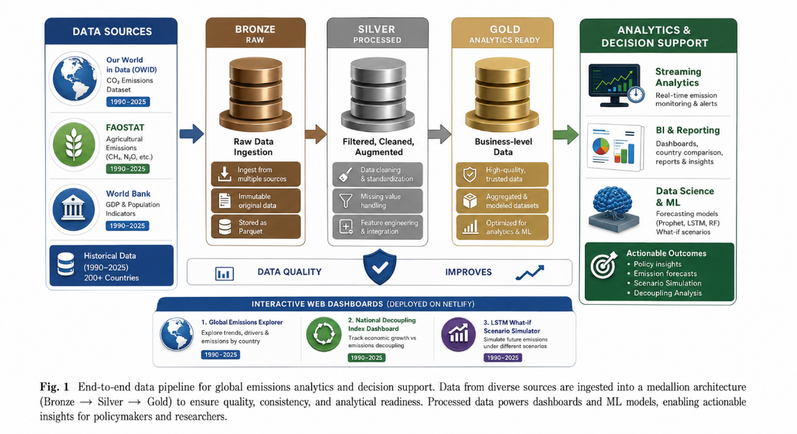
System Architecture: Medallion Lakehouse

Slide 6
System Architecture: Medallion Lakehouse
BRONZE
SILVER
GOLD
Raw Data Ingestion
Cleanse & Transform
Business-Ready Star Schema
• OWID CO₂, FAOSTAT & World Bank CSVs
• Column projection & name standardisation
• Star schema: Fact_Emissions + 5 Dims
▶
▶
• Loaded via PySpark, stored as Parquet
• Dataset integration (country + year keys)
• Dim: Area, Item, Element, Year, Flag
• Immutable historical archive
• Unit conversion → tCO₂eq (IPCC AR6)
• Optimised for high-speed ML queries
• 4–8× compression vs CSV
• Forward-fill imputation & IQR outliers
• Direct feed to modelling pipeline
DATA QUALITY ─────────────────────────────────────────────────────────►
FICTA-2026 | Paper ID: 226

Slide 7
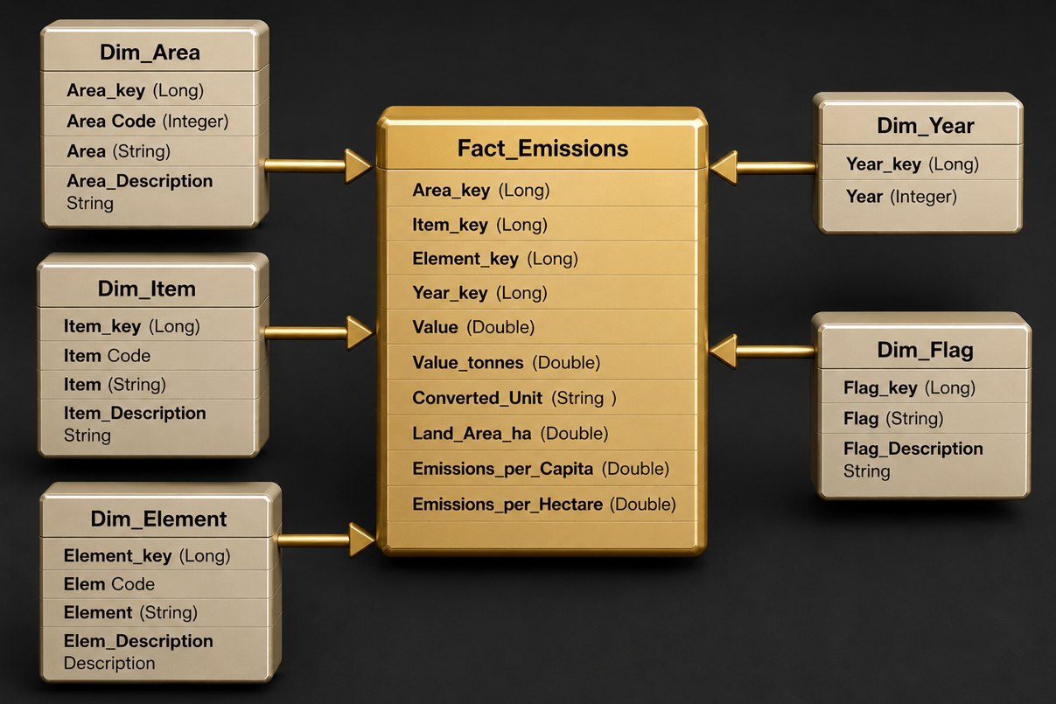
A Star Schema Design
Gold layer is structured as a star schema, which clearly defines relationships and
improves query performance.

Slide 8
Exploratory Data Analysis (EDA)
r = 0.97
GDP & CO₂ are almost perfectly correlated — economic activity drives emissions.
r = 0.91
Population & CO₂ show very strong correlation — demographic growth is a key driver.
r < 0.1
Year alone barely correlates — time alone predicts nothing without context.
Stationarity: Raw series → non-stationary (ADF p>0.05). After 1st-order differencing → stationary (ADF p<0.01). ACF/PACF of differenced series ≈ white noise → simple ARIMA models will produce flat forecasts.
FICTA-2026 | Paper ID: 226

Slide 9
Modeling Approaches: 4-Strategy Framework
Approach 1: General ML Regressors
Approach 2: Univariate Time Series
Time series → supervised regression
Lag features: lag1, lag2, lag3 + Rolling_Mean_3Y
Models: Linear Regression, Random Forest, GBT
Best: Random Forest (R²=0.040)
AR(1), MA(1), ARMA(7,7), ARIMA(1,1,1)
Train: 1990–2017 | Test: 2018–2025
All produce near-flat forecasts
ARIMA RMSE best: ~530 (still poor)
Approach 3: Prophet Framework
Approach 4: Multivariate: VAR & LSTM
Y(t)=g(t)+s(t)+h(t)+ε(t)
Without regressors: RMSE=362.23 (plateau)
+ GDP & Population via add_regressor()
With regressors: RMSE=46.72 ✓ 7.8× better
VAR: bidirectional Granger causality
LSTM: 2-layer (64+32 units), 10yr windows
Both model Population + GDP + GHG together
LSTM: best for non-linear trend capture
FICTA-2026 | Paper ID: 226

Slide 10
Model Performance Comparison
Model | Category | RMSE | R² | Forecast Behaviour
Linear Regression | General ML | 0.086 | -1.245 | Unrealistic values
Random Forest | General ML | 0.056 | 0.040 | Realistic, non-negative
AR(1) | Univariate | 689.15 | N/A | Flat mean-revert
GBT Regressor | General ML | High | -1.792 | ✗ Poor fit
MA(1) | Univariate | 637.69 | N/A | Slightly better
ARMA(7,7) | Univariate | 533.11 | N/A | Volatile
ARIMA(1,1,1) | Univariate | ~530 | N/A | Flat (white noise)
Prophet (no regressors) | Univariate | 362.23 | N/A | Plateau forecast
Prophet + GDP + Pop ★ | Multivariate | 46.72 | N/A | Trend-following ✓
VAR | Multivariate | N/A | N/A | Dynamic system ✓
LSTM | Multivariate | N/A | N/A | Non-linear trend ✓
★ Key Finding: Prophet + GDP + Population delivers RMSE = 46.72 — 7.8× lower than best univariate baseline (362.23)
FICTA-2026 | Paper ID: 226

Slide 11
Key Findings & Insights
✗
Univariate Models Are Insufficient
✓
Exogenous Regressors Deliver 7.8× Improvement
ARIMA and Prophet (without regressors) all fail to track future emission trajectories. Year-on-year changes behave as near-white-noise after differencing — no meaningful autocorrelation to exploit.
The GDP–CO₂ link (r=0.97) is the critical signal. Emissions don't follow past emissions — they follow economic activity. Models ignoring GDP/Population will get the future wrong.
↕
LSTM vs VAR Trade-Off
✓
Random Forest as Best Regression Baseline
VAR offers interpretable Granger causality coefficients — best for policy work. LSTM handles non-linear saturation effects. Use LSTM for data-rich economies; VAR for thinner records.
Random Forest (R²=0.040) clearly outperforms OLS and GBT. Ensemble averaging reduces variance; non-parametric structure handles mild non-linearities in the lag-feature space.
FICTA-2026 | Paper ID: 226

Slide 12
Interactive Dashboard System
Dashboard 1
Dashboard 2
Dashboard 3
Global Emissions Explorer
National Decoupling Index
'What-If' Scenario Tool
ghgemission.netlify.app/global_emission.html
ghgemission.netlify.app/decoupling_index.html
ghgemission.netlify.app/what_if
• Interactive world choropleth map
• Ranks countries by economic decoupling
• Slider-adjustable GDP & population growth
• Historical + AI-powered country forecasts
• Score = Avg GDP Growth% − Avg GHG Growth%
• Country-level LSTM scenario forecasting
• Emission breakdowns: CO₂, CH₄, N₂O
• High positive score = successful decoupling
• Baseline vs What-If comparison view
• Select any country & metric
• Decade-selectable analysis window
• Powered by trained multivariate LSTM
All dashboards deployed on Netlify | Built with Plotly Dash (Python)
FICTA-2026 | Paper ID: 226

Slide 13
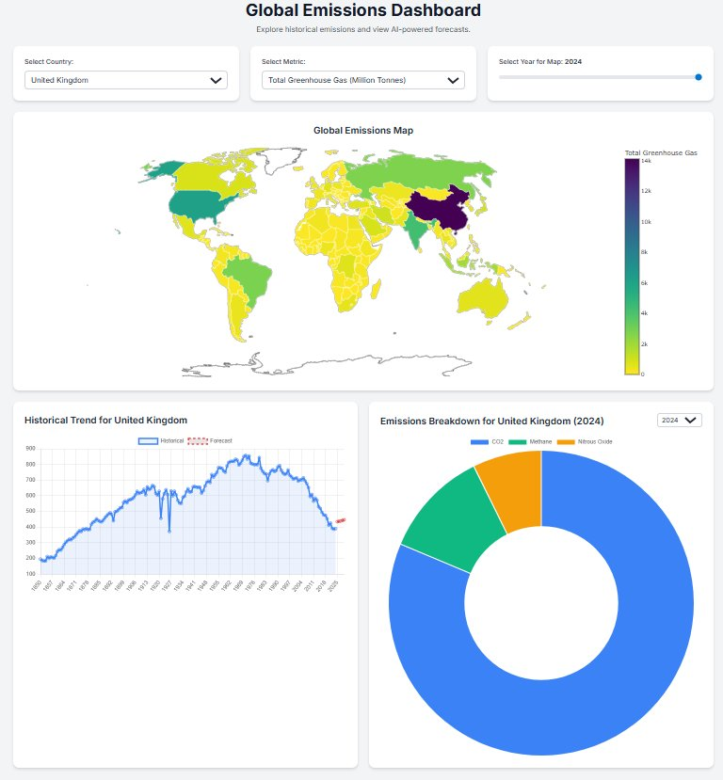

Slide 14
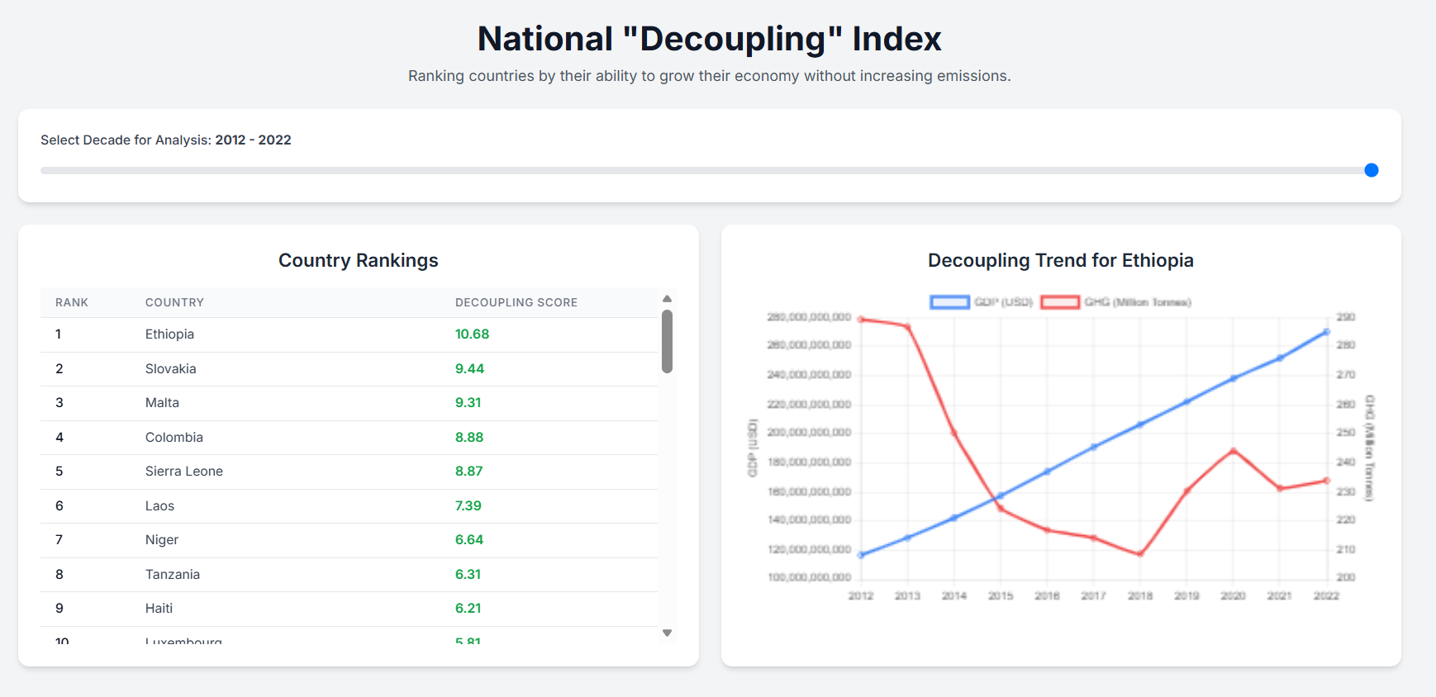

Slide 15
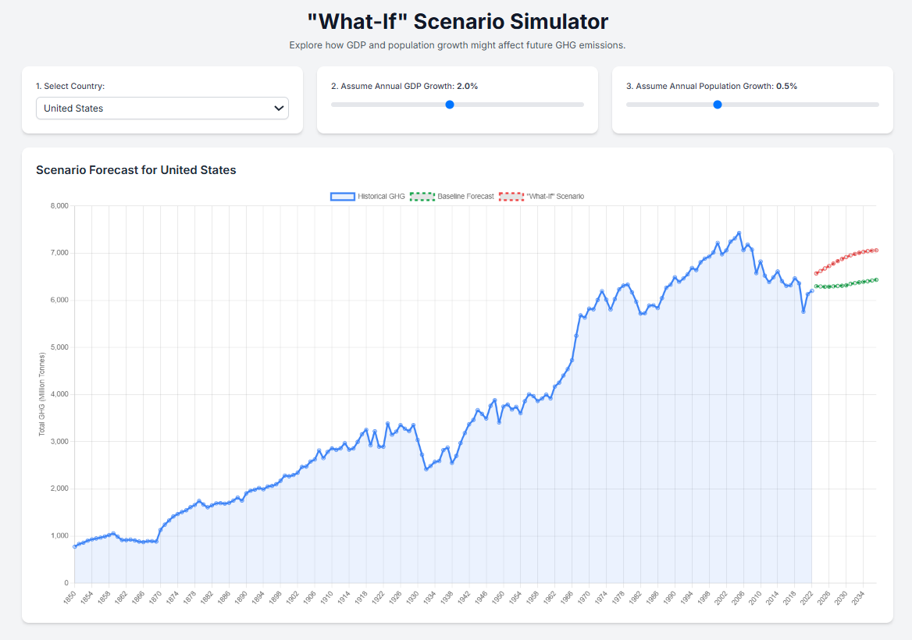

Slide 16
Conclusion & Impact
Core Finding: Multivariate models incorporating GDP and Population outperform all univariate baselines. Prophet + exogenous regressors achieves RMSE = 46.72 — a 7.8× improvement.
Real-World Impact
Policy Making
Climate Science
Industry Planning
Investment
Assess effectiveness of climate policies and set reduction targets.
Build & refine models for predicting change scenarios.
Help agriculture businesses anticipate regulations.
Guide sustainable agriculture & emission reduction projects.
Future Directions
▸ Integrate real-time satellite imagery data
▸ Policy interventions as model features
▸ Granular crop-type & soil data inclusion
▸ Advanced non-linear model architectures
Thank You | Questions Welcome
Rajesh Kumar Singh| errajeshcs@gmail.com | FICTA-2026 Paper ID: 226

