Slide 1
AI-Based Smart Learning Management System
Presented by: E. Prathyusha | Class: AIML - B

Slide 2


Introduction
AI in Education
Smart LMS
Artificial Intelligence (AI) is changing the way education is delivered.
A Smart Learning Management System (LMS) uses AI to make learning more effective.
Personalized Experiences
Teacher Support
It provides personalized learning experiences for students.
It helps teachers manage courses, assessments, and student performance.

Slide 3

What is an AI-Based Smart LMS?
An LMS is a platform used to manage educational content and activities.
AI adds intelligence and automation to the LMS.
It analyzes student learning patterns and performance.
It recommends suitable study materials and activities.
It provides personalized support to each learner.

Slide 4





Objectives
Personalized Learning
Engagement & Performance
Automated Grading
Provide personalized learning to students.
Improve student engagement and performance.
Automate grading and assessment.
Strengths & Weaknesses
Data-Driven Decisions
Identify students' strengths and weaknesses.
Help teachers make better decisions using learning data.

Slide 5

Key Features
Personalized Learning
AI Chatbot
Adapts content according to student needs.
Provides instant answers to student queries.
Automated Assessment
Performance Analytics
Helps evaluate tests and assignments.
Tracks student progress in real time.
Smart Recommendations
Adaptive Learning
Suggests relevant courses and resources.
Adjusts difficulty level based on performance.

Slide 6
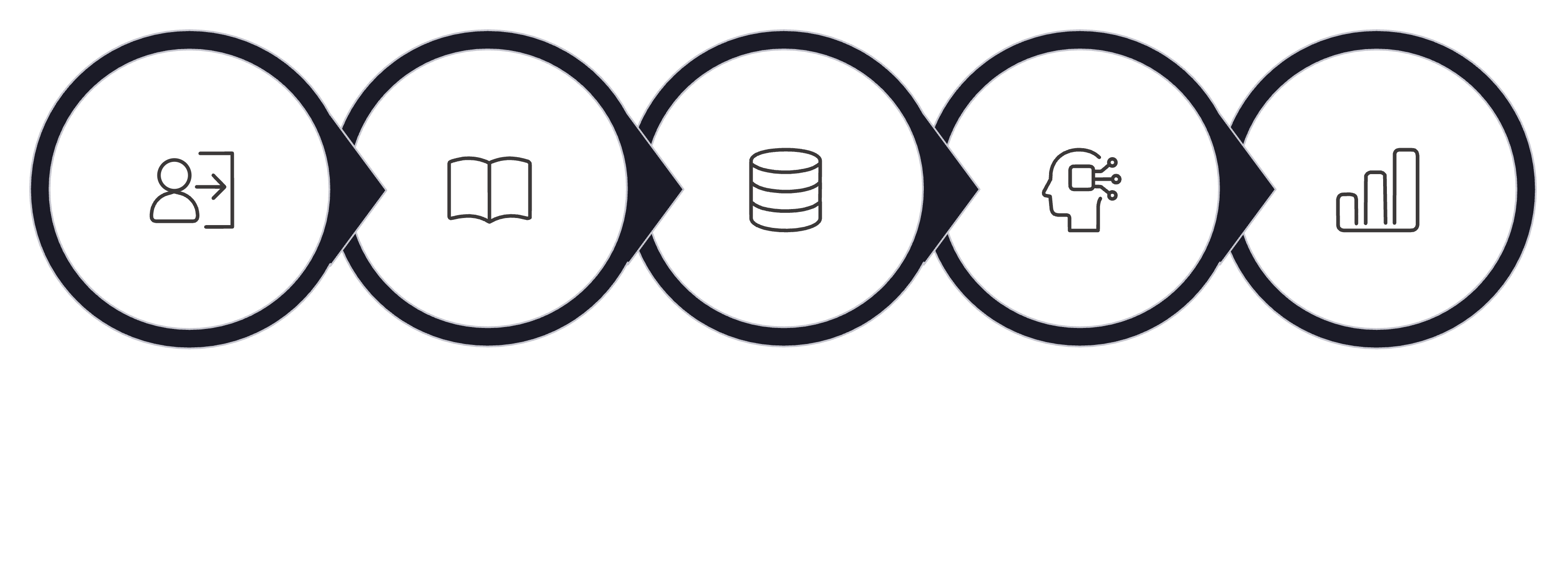
How It Works
Study & Complete
Identify Strengths
Log In
Collect Data
AI Analysis
The AI-based Smart LMS continuously monitors and adapts to each student's unique learning journey, creating a feedback loop that improves over time.

Slide 7
Benefits
For Students
For Teachers
Personalized learning experience
Instant feedback
Learn at their own pace
Better understanding of difficult topics
Improved academic performance
Saves time through automation
Easy student performance tracking
Automated grading
Helps identify weak areas
Supports data-driven teaching

Slide 8

Applications & Challenges
Applications
Online education & virtual classrooms
Online examinations
Skill development
Intelligent tutoring
Exam preparation
Challenges
Data privacy and security
High implementation cost
Dependence on accurate data
Technical requirements
Need for human supervision

Slide 9
Conclusion
Personalized, Adaptive & Efficient
Right Content at the Right Time
AI-based Smart LMS makes education personalized, adaptive, and efficient.
AI helps students receive the right content at the right time.
Reduced Teacher Workload
Future of Education
It reduces teachers' workload through automation and smart tools.
AI-based LMS has great potential to transform the future of education.

Slide 10
Thank You
Presented by: E. Prathyusha | Class: AIML - B

