Slide 1



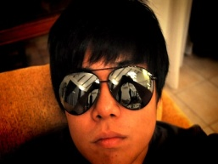

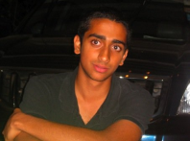

CEO
Tomas Isman
VP Operations
Joon Ho Choi
VP Marketing
Tomas Isman
VP Finance
Sidharth Shanker
Advertising Head
Tomas Isman
Accounting Head
Sidharth Shanker
Delivery Head
Joon Ho Choi
Cooking Head
Tomas Isman
Intitial Setup:

Slide 2








CEO
Tomas Isman
VP Operations
Joon Ho Choi
VP Marketing
Tomas Isman
VP Finance
Sidharth Shanker
Advertising Head
Tomas Isman
Accounting Head
Sidharth Shanker
Delivery Head
Joon Ho Choi
Cooking Head
Tomas Isman
Delivery Man
Joseph Kwan
Cooking Assistant
Elena Tan
7 months into Operation:

