Slide 1
tradeclaw
EasyA Concensus HK Hackathon 2026
Eric Chan

Slide 2
OpenClaw for
Crypto Trading Intellegence using Coingecko

Slide 3
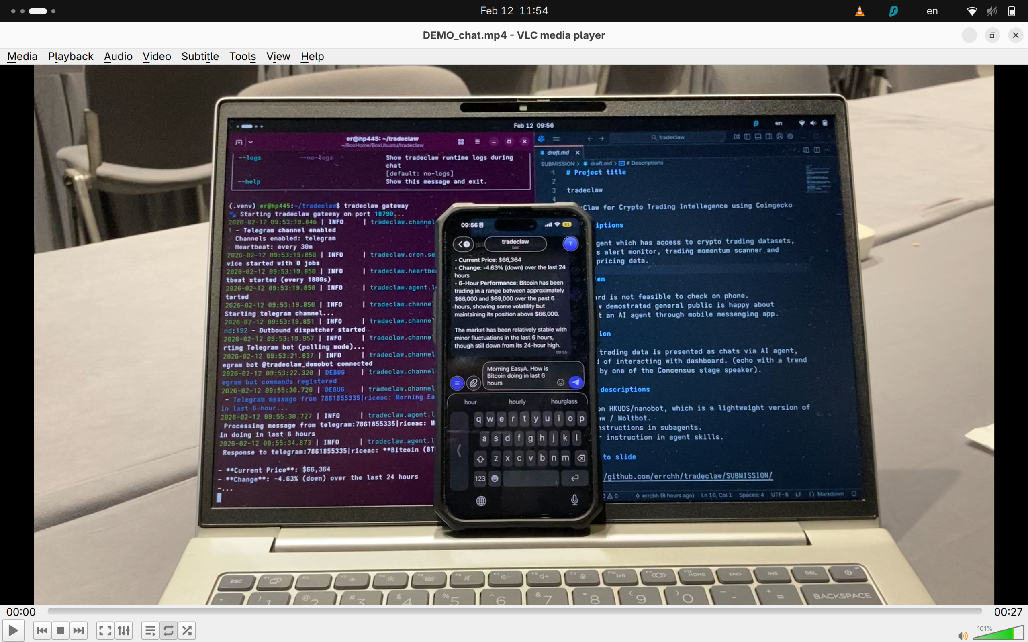

Slide 4
An AI agent which has access to crypto trading datasets provides alert monitor, trading momentum scanner and answer pricing data
Description

Slide 5
Dashboard is not feasible to check on phone.
OpenClaw demostrated general public is happy about interact an AI agent through mobile messenger app.
Problem

Slide 6
Crypto trading data is presented as chats via AI agent, instead of interacting with dashboard.
(echo with a trend talked by one of the Concensus stage speaker).
Solution

Slide 7
Based on HKUDS/nanobot, which is a lightweight version of OpenClaw / Moltbot.
Wrapped functionalities in subagents, methodologies in agent skills.
Tech descriptions

Slide 8
GitHub | https://github.com/errchh/tradeclaw/
Linkedin | https://www.linkedin.com/in/ericchanwork
X | @riceandcha
Mastodon | @riceandcha@fosstodon.org
Links

